Slide 1



Sitecore Experience Analytics Reports
For Developers

Slide 2



Speaker Rosen Petrov
About me:
Microsoft .NET technologies inspire me, however, my real passion is Sitecore Experience Platform. I am one of the creators of Sitecore User Group Bulgaria and co-organizer of all Sitecore Community events in Sofia.
I’ve been working with Sitecore since version 7.2.
Certified Developer: - Sitecore 7.2, Sitecore 8 and Sitecore 9. - MCSD for Web Applications.
Check #RosenDevBlog for my blog posts.
rosen.petrov@hotmail.com
@RossenPettrov
Sitecore Developer at FFW Agency

Slide 3

Table of content
What are Sitecore Experience Analytics reports and how they work?
What Experience Analytics reports does Sitecore provide OOB?
How to create custom Sitecore Experience Analytics reports?
How to bridge the gap between marketers and developer when working on Sitecore Experience Analytics reports?
Demos and examples

Slide 4

What are Sitecore Experience Analytics reports?
“
Sitecore Experience Analytics provides dashboards and reports for marketers and marketing analysts to identify patterns and trends in experience data.
Sitecore Documentation
Notes:
EA reports help us and our clients to analyze how users engage with a website.
This information can help you analyze the amount of traffic on your website, as well as the quality of that traffic.
You can use experience data to analyze the performance, optimization, and the level of commitment of your website visitors and contacts by comparing
metrics such as page views, conversion rates, and engagement value.

Slide 5





Default categories of
Sitecore Experience Analytics reports
Dashboard
Audience
Acquisition
Behavior
Conversions
Overview of key analytics by displaying a selection of charts
Understanding of who your visitors are
What is driving traffic to your website
Analyze the behavior of your visitors
Percentage of visitors that achieve a particular goal
Notes:
When you open Experience Analytics for the first time, you see a dashboard page, which provides an overview of your experience data.
There are several categories of reports, each containing different charts and graphs.
Marketers can view a dashboard, and multiple reports. They can also filter report data by date range or by website.
Experience Analytics contains the following categories of reports:
Dashboard – provides an overview of key analytics by displaying a selection of charts and performance indicators.
Audience – helps you gain an understanding of who your visitors are.
Acquisition – shows you what is driving traffic to your website. For example, from campaigns and other marketing channels.
Behavior – helps you to analyze the behavior of your visitors. For example, by analyzing the effectiveness of your profiling and personalization strategy.
Conversions – the percentage of visitors that achieve a particular goal. This helps you understand how well your marketing efforts are working.

Slide 6

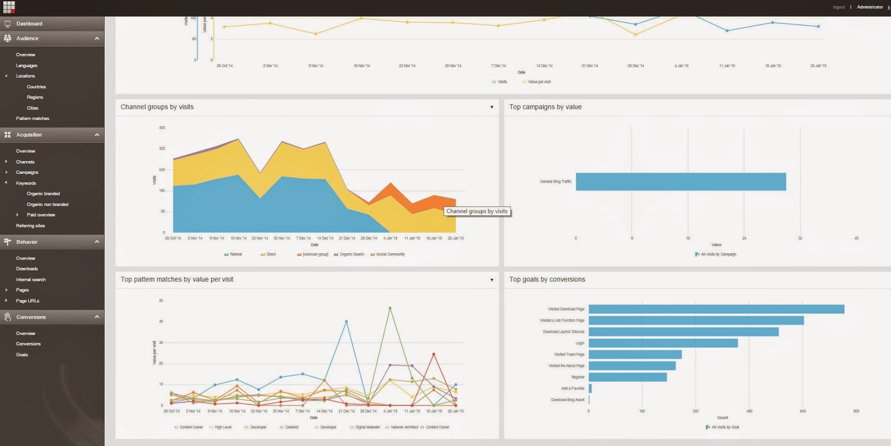
Let’s see what are we talking about…
Notes:
When you open Experience Analytics for the first time, you see a dashboard page, which provides an overview of your experience data.
There are several categories of reports, each containing different charts and graphs.
Marketers can view a dashboard, and multiple reports. They can also filter report data by date range or by website.
Experience Analytics contains the following categories of reports:
Dashboard – provides an overview of key analytics by displaying a selection of charts and performance indicators.
Audience – helps you gain an understanding of who your visitors are.
Acquisition – shows you what is driving traffic to your website. For example, from campaigns and other marketing channels.
Behavior – helps you to analyze the behavior of your visitors. For example, by analyzing the effectiveness of your profiling and personalization strategy.
Conversions – the percentage of visitors that achieve a particular goal. This helps you understand how well your marketing efforts are working.

Slide 7




How to create custom
Sitecore Experience Analytics reports?
My journey
1
2
3
4
Start with an example
Learn the terms
Code it
Share the knowledge

Slide 8

Custom Experience Analytics reports: How Sitecore does it?
Key points:
Create a new report page in the Core database under /sitecore/client/Applications/ExperienceAnalytics/Dashboard based on the Speak-DashboardPage template
Add a chart component to the report page
Create a parameters item under the PageSettings item of the report page. Use a corresponding template depending on chart component type
Set the Metrics and Segments fields on the parameters item in order to adjust what data to be displayed in the chart component
Set the parameters item as a data source of the chart component
Sitecore documentation reference

Slide 9
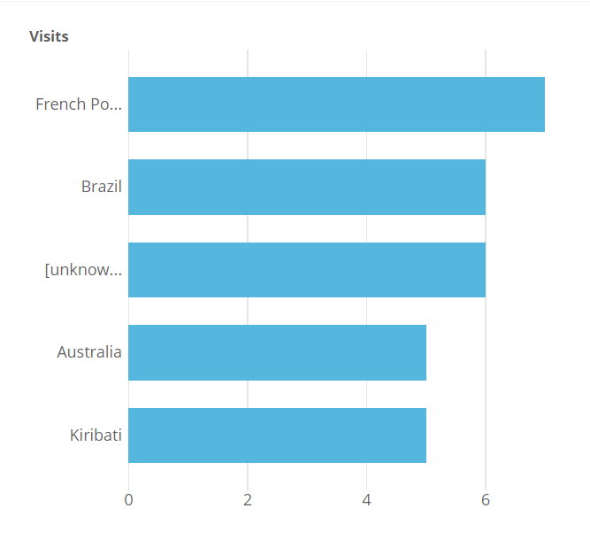
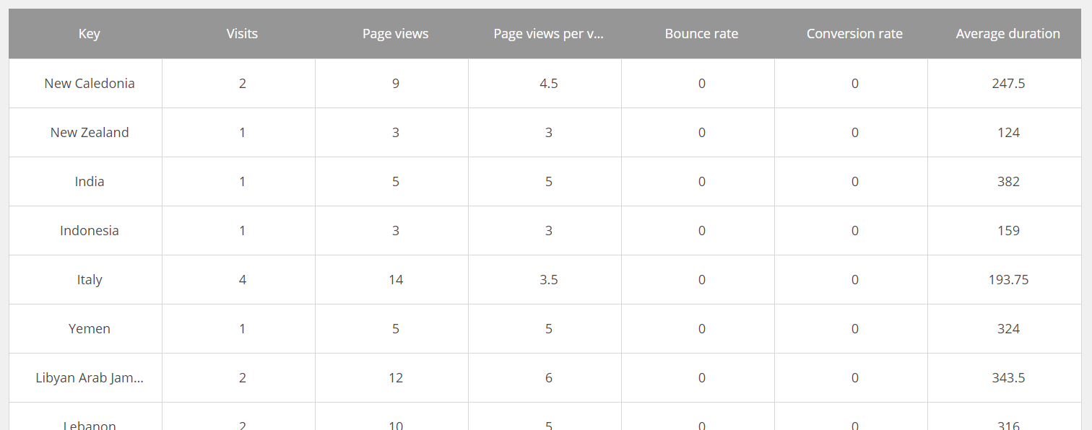
Sitecore charts components
ExperienceAnalyticsBarChart
ExperienceAnalyticsListControl

Slide 10
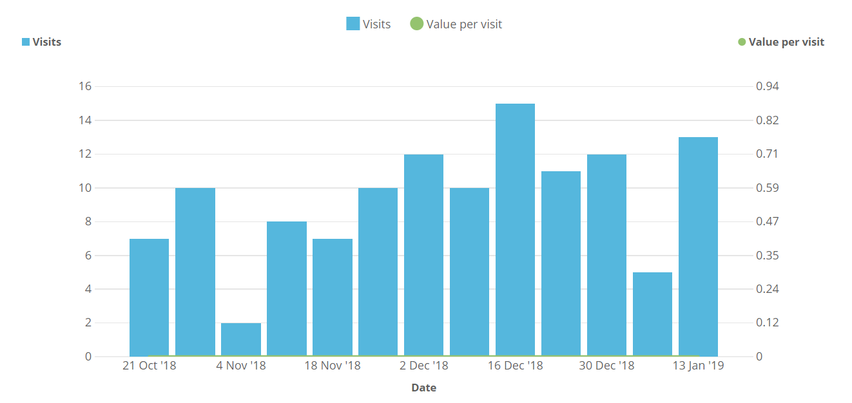
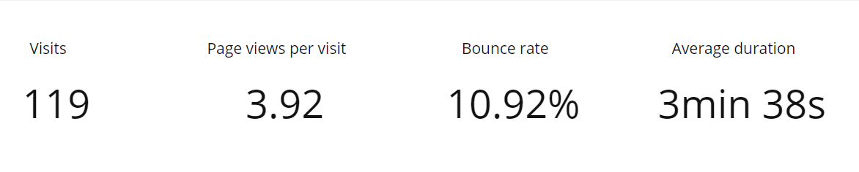
Sitecore charts components
ExperienceAnalyticsKpiChart
ExperienceAnalyticsLineChart

Slide 11
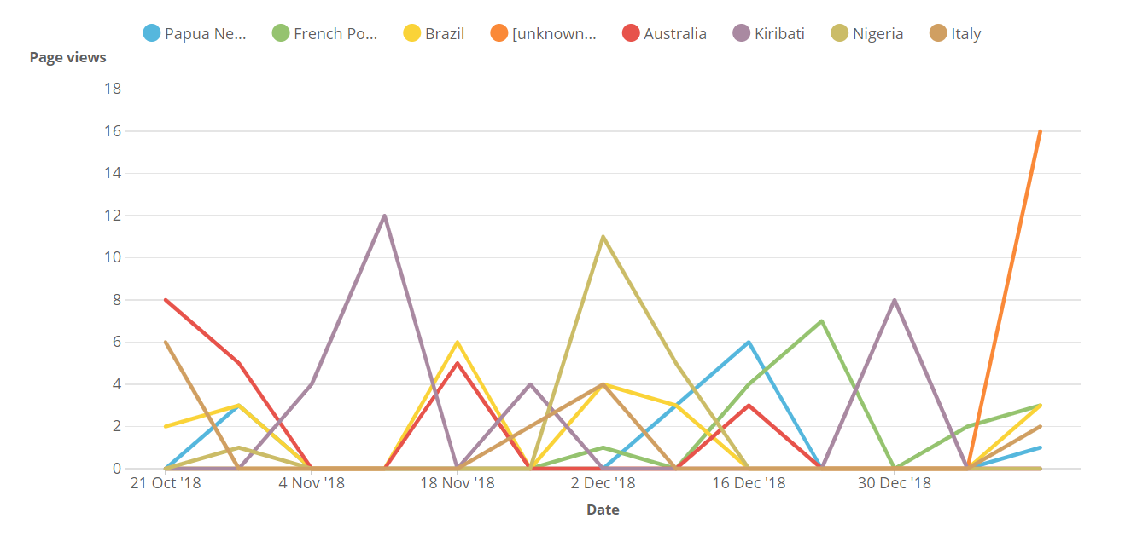
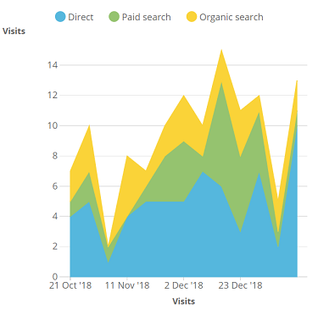
Sitecore charts components
ExperienceAnalyticsLineChart
ExperienceAnalyticsAreaChart

Slide 12
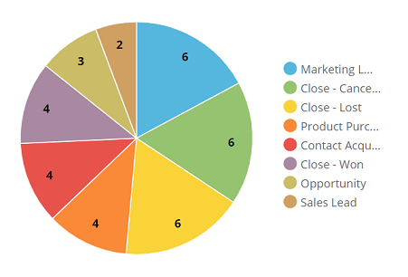
Sitecore charts components
ExperienceAnalyticsPieChart

Slide 13
Custom Experience Analytics reports: Terms we should know
Key points:
Dimensions
Metrics
Segments
Filters and Rules
Good know: Experience Analytics glossary

Slide 14
Sitecore Dimension definition
“
Dimensions describe the data. Think of a dimension as describing the “what” as in “what city is the visitor from” or “what pages were viewed”. From a development perspective we think about the dimension as a grouping of the data - group by city, group by page, etc.
Notes:
EA reports help us and our clients to analyze how users engage with a website.
This information can help you analyze the amount of traffic on your website, as well as the quality of that traffic.
You can use experience data to analyze the performance, optimization, and the level of commitment of your website visitors and contacts by comparing
metrics such as page views, conversion rates, and engagement value.

Slide 15
Sitecore Metric definition
“
Metrics measure the data. Think of a metric as answering “how many” or “how long” as in “how many visits” or “how long a visitor was on the site”. In Sitecore, there are seven standard metrics that measure the different attributes of each dimension: Visit, Value, Page Views, Time On Site, Bounces, Conversions and Count.
Notes:
EA reports help us and our clients to analyze how users engage with a website.
This information can help you analyze the amount of traffic on your website, as well as the quality of that traffic.
You can use experience data to analyze the performance, optimization, and the level of commitment of your website visitors and contacts by comparing
metrics such as page views, conversion rates, and engagement value.

Slide 16
Sitecore Segment definition
“
Segments control which data is analyzed. By default they contain all the data of their parent dimension, but can apply filters that will only display a subset of these based on an assortment of conditions. You can think about a segment like an instance of a dimension with an optional filter.
Notes:
EA reports help us and our clients to analyze how users engage with a website.
This information can help you analyze the amount of traffic on your website, as well as the quality of that traffic.
You can use experience data to analyze the performance, optimization, and the level of commitment of your website visitors and contacts by comparing
metrics such as page views, conversion rates, and engagement value.

Slide 17
Sitecore Filter and Rule definitions
“
Filters are used in Sitecore segments to filter the analyzed data if needed. Rules are the building blocks of the Sitecore Rules Set Editor. They are used for setting up the filters.
Notes:
EA reports help us and our clients to analyze how users engage with a website.
This information can help you analyze the amount of traffic on your website, as well as the quality of that traffic.
You can use experience data to analyze the performance, optimization, and the level of commitment of your website visitors and contacts by comparing
metrics such as page views, conversion rates, and engagement value.

Slide 18




Custom Experience Analytics reports: Development flow
upcoming demo
best practice
Can’t find what you need
Create a custom Sitecore dimension
Duplicate an existing Sitecore report depending on your needs and configure it
docs link
docs link
Check if Sitecore provides such kind of dimension/segment/report
Found a dimension that fits your needs but does not have the proper segment
Create a custom report filter + segment and use it for your report
Rock it!
docs link
Found a report that is based on the segment you need but which renders other metrics
Duplicate that report and change the displayed metrics to what you need

Slide 19
Custom Experience Analytics reports: Create a custom dimension
Create a report which displays
All Visits by Operating System
Dev tools: Sitecore xGenerator module, Sitecore Rocks
Bye Sitecore dimension, welcome Sitecore flexible dimension

Slide 20
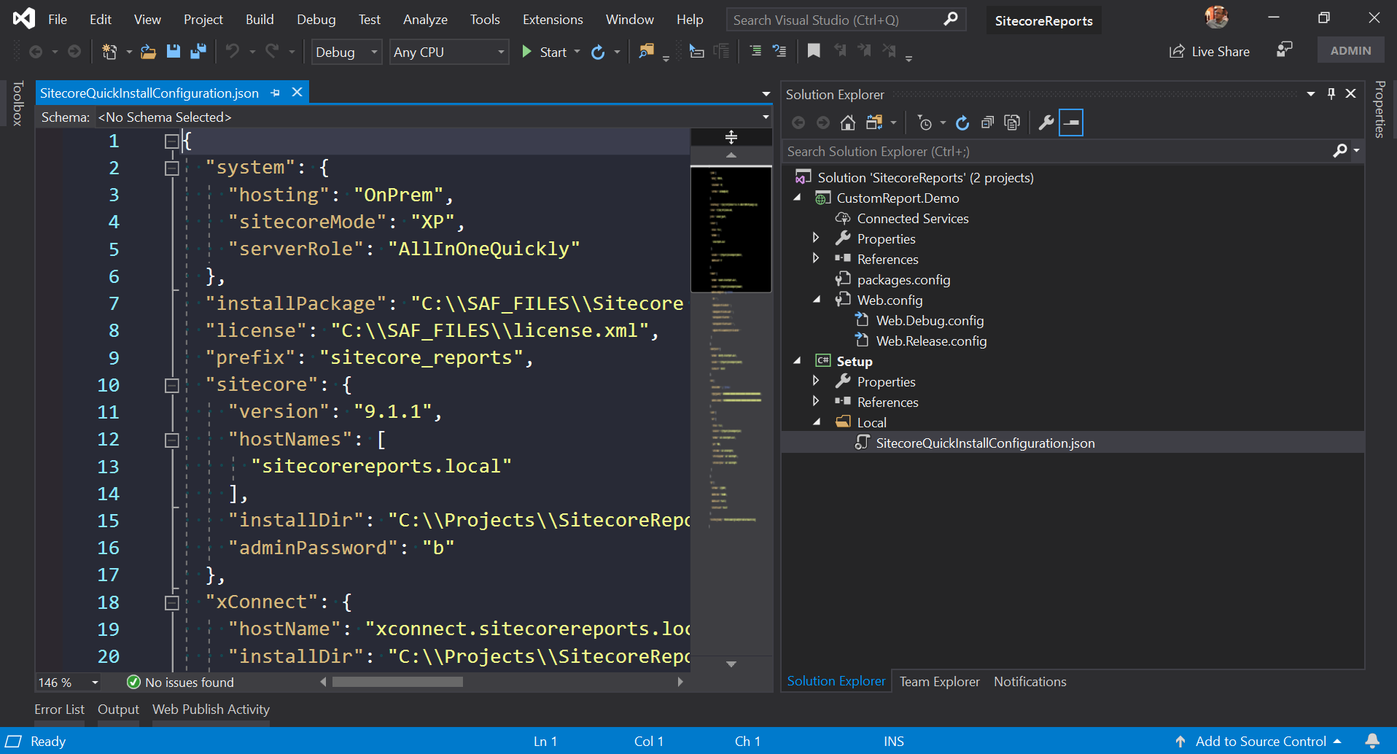
Demo
Notes:
When you open Experience Analytics for the first time, you see a dashboard page, which provides an overview of your experience data.
There are several categories of reports, each containing different charts and graphs.
Marketers can view a dashboard, and multiple reports. They can also filter report data by date range or by website.
Experience Analytics contains the following categories of reports:
Dashboard – provides an overview of key analytics by displaying a selection of charts and performance indicators.
Audience – helps you gain an understanding of who your visitors are.
Acquisition – shows you what is driving traffic to your website. For example, from campaigns and other marketing channels.
Behavior – helps you to analyze the behavior of your visitors. For example, by analyzing the effectiveness of your profiling and personalization strategy.
Conversions – the percentage of visitors that achieve a particular goal. This helps you understand how well your marketing efforts are working.

Slide 21

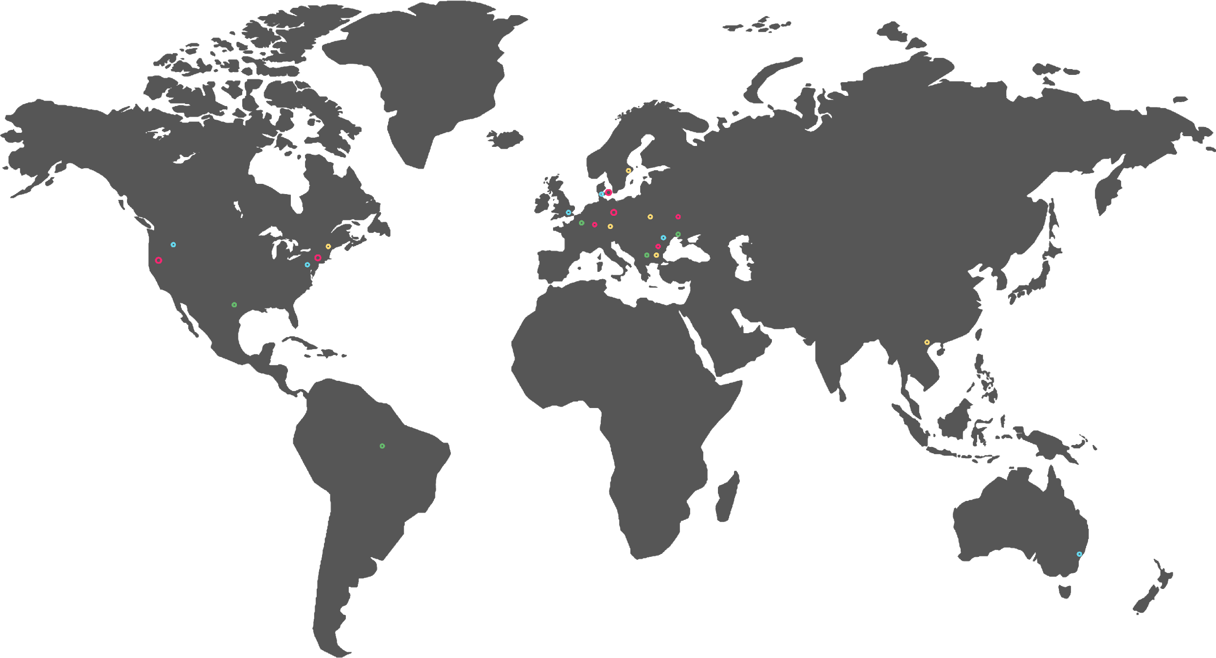
We’re everywhere you need us.
Thank you!
FFW’s team is based out of more than 10 countries around the world. Contact us to learn how you can benefit from our global expertise.
CONNECT WITH US

