Slide 1

Introduction to Web Apps with React

Slide 2

Table of Contents
What is React?
Architecture
Create React App
React with ASP.NET
Next Steps

Slide 3

What is React?

Slide 4
What is React?
React is a JavaScript library for building dynamic user interfaces
Renders your UI and responds to events
Flexible from adding little interactivity to a page to building complex apps
Scalable component-based architecture
Virtual DOM

Slide 5
Architecture

Slide 6

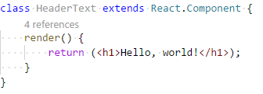
Components
Main building blocks of a React Application
Encapsulated custom elements that extend HTML itself
Can be functional or class component
A component should ideally do one thing
Use components to separate your concerns

Slide 7
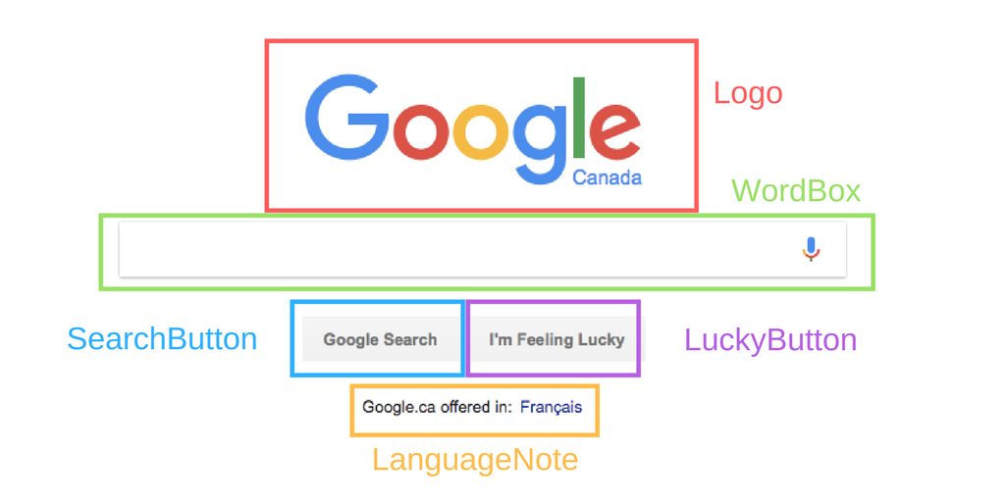

Slide 8
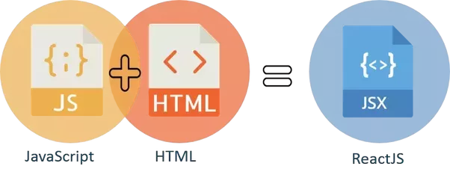
JSX
JSX lets you create JavaScript objects using HTML-like syntax
Optional
Combines the easy-of-use of templates with the power of JavaScript
Needs to be “transpiled”

Slide 9
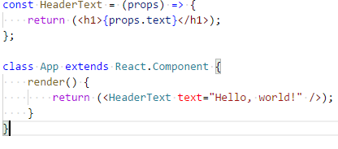
Props
Props are selected pieces of data that are passed to child component from parent and are immutable by the child
The main way to create reusable components

Slide 10
State
States are component data unique to class components that should only be set in the constructor and further only modified by inherited setState() method
Changing the state is the main way for creating component functionality
State should be used on as few components as possible to reduce bugs
Always place the common state between several components in their mutual parent component

Slide 11
Create React App

Slide 12

Setup
Setup manually React application with Babel and JSX
Setup with “create-react-app” tool
Setup with Webpack

Slide 13
Setup manually with Babel and JSX
Installation
npm install -g npx
npm init -y
npm install react react-dom babel-cli babel-preset-react-app --save
Add package.json scripts
"start": "npx babel --watch src --out-dir build --presets react-app/prod"
Create “src” folder and add HTML file in there
Refer the “react” and “react-dom” libraries in the HTML
Run “npm start”
Add your scripts in the “src” folder and they will be transpiled to
“build” folder from which you should refer them in the HTML

Slide 14

Setup with “create-react-app” tool
Installation
npm install -g create-react-app
Usage
create-react-app [app-name]
Delete everything in the “src” folder and add “index.js” file as a starting point for your application
Run ”npm start”
Add your scripts in the “src” folder and they will be plugged automatically in the “/public/index.html” after compiling
Import “react” and “react-dom” whenever you need them

Slide 15
React with ASP.NET

Slide 16

React with ASP.NET
Using client side React along with server side ASP.NET Core Web API
Separation of concerns between client and server
Better team management
Speed because of the small chunks of data sended by the server instead of whole views
Reusability on project level
Testability

Slide 17
Next Steps

Slide 18

Next Steps
Learning more about the main concepts of React
Forms
Lifting state up
Learning about advanced parts of React
Lifecycle hooks
PropTypes
Refs
Learning about the React ecosystem
React Router
Redux.js

Slide 19
Useful Tools and Resources
React Documentation
https://reactjs.org/docs/getting-started.html
Pluralsight “React.js Getting Started” course
https://www.pluralsight.com/courses/react-js-getting-started
The Github repository for this presentation
https://github.com/RosenUrkov/React-Demo
React Developer Tools Chrome and Firefox extension
https://chrome.google.com/webstore/detail/react-developer-tools/fmkadmapgofadopljbjfkapdkoienihi
The Github repository for the “create-react-app” tool
https://github.com/facebook/create-react-app

Slide 20

Introduction to Web Apps with React
Questions

