Slide 1
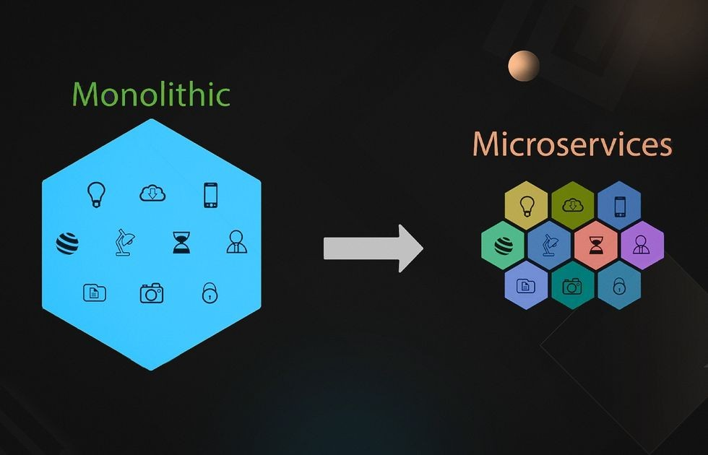
Edwin Jose R
Senior Technical Lead
H & R Block India Pvt. Ltd.
Reference: https://azure.microsoft.com/en-in/solutions/microservice-applications

Slide 2
Agenda
Monolith vs Micro Services
Domain Driven Design
Drone Delivery System
Simple Micro Service implementation

Slide 3
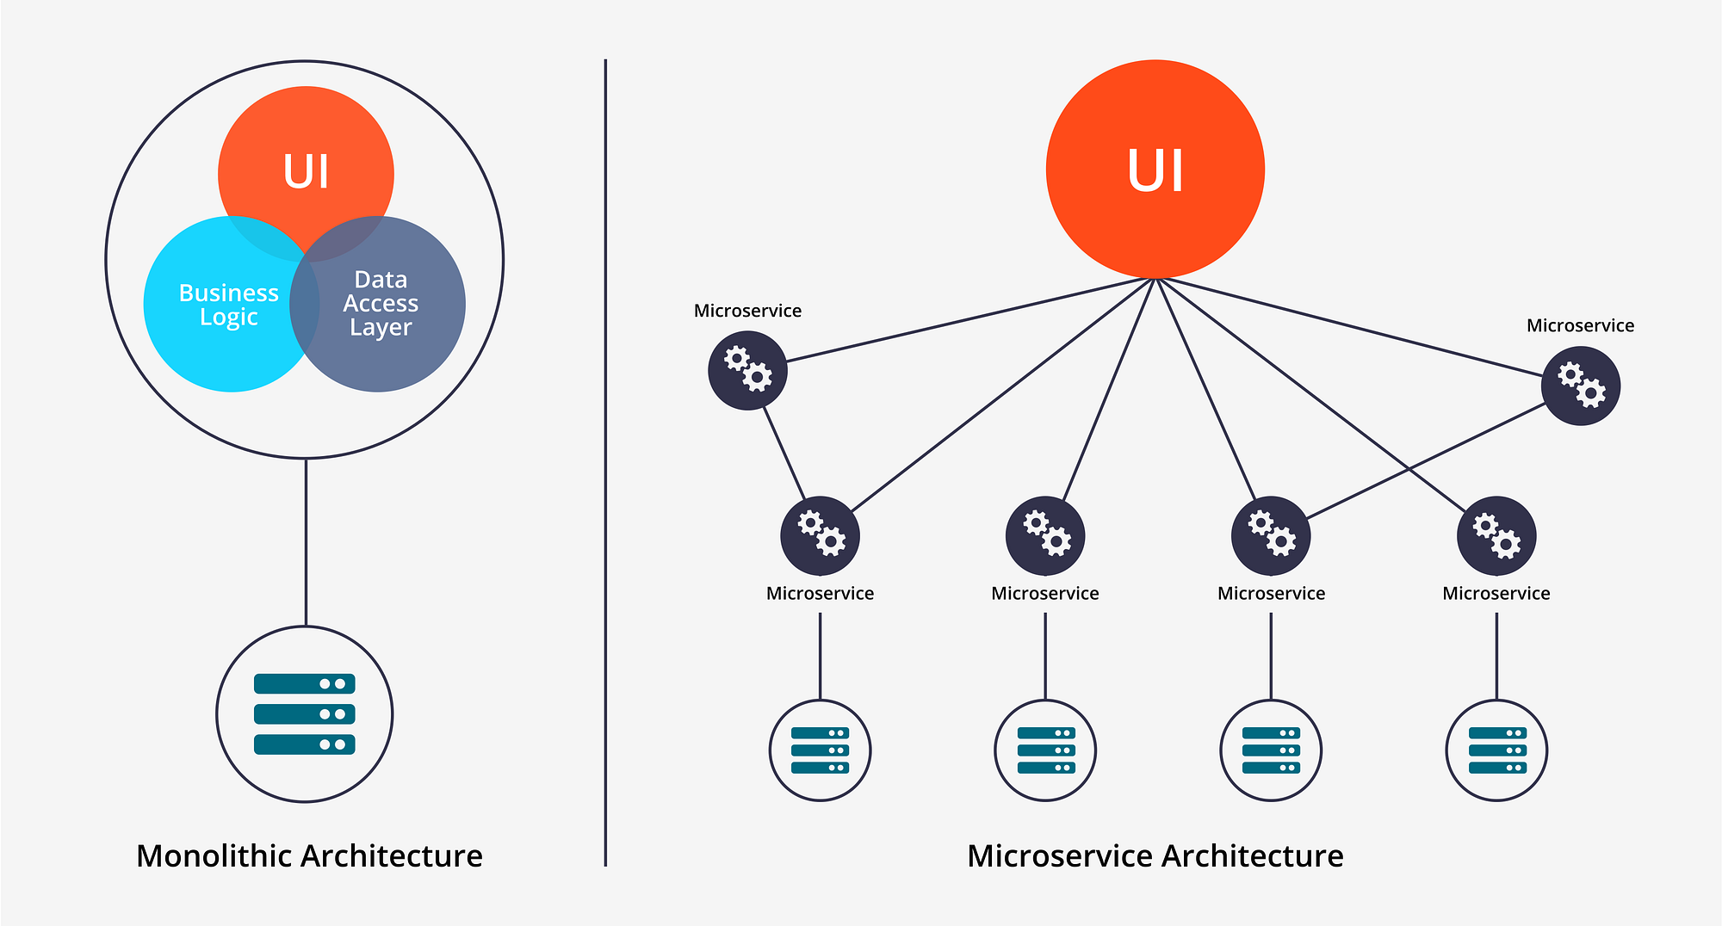
Monolith vs Micro Services

Slide 4
Introduction to Microservices Architecture
Microservices are small, independent components within an application.
Each microservice has its own codebase, which allows for focused development and maintenance.
They are loosely coupled, meaning changes to one service don’t impact others.

Slide 5
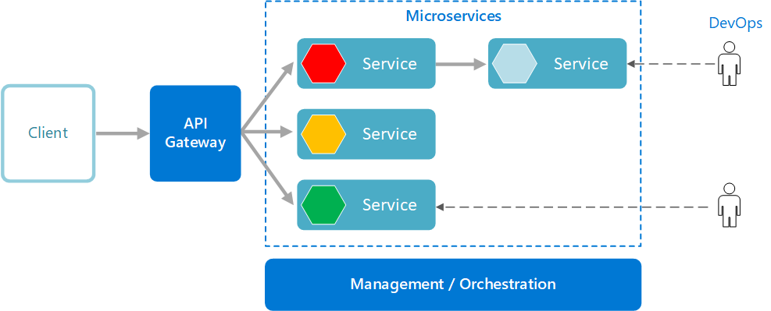

Slide 6
Advantages
Independent Deployment
Data Responsibility
API Communication
Polyglot Programming
Notes:
Independent Deployment:
Microservices can be deployed separately.
Updates to a specific service don’t require rebuilding and redeploying the entire application.
This agility improves development speed and reduces risk.
Data Responsibility:
Each microservice is responsible for its own data persistence.
Unlike the traditional model with a central data layer, microservices manage their own databases or external state.
API Communication:
Microservices communicate via well-defined APIs.
Internal implementation details are hidden, promoting encapsulation and modularity.
Polyglot Programming:
Microservices allow using different technology stacks, libraries, and frameworks.
Teams can choose the best tools for each service’s specific requirements.

Slide 7
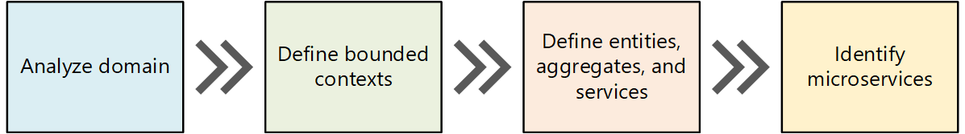
Domain Driven Design (DDD)
Domain-driven design (DDD) is a software design approach that emphasizes modeling software to align with a specific domain, based on input from domain experts
Bounded Contexts
Strategic DDD
Tactical DDD
Strategic DDD
Notes:
Bounded Contexts: Instead of having a single unified model, DDD divides a large system into bounded contexts, each with its own model. These bounded contexts help manage complexity and ensure that different parts of the system can have distinct models.
Ubiquitous Language: DDD promotes the use of a ubiquitous language shared by domain experts, users, and developers. This language is used in the domain model and for describing system requirements. It fosters a common understanding of the domain.
Strategic DDD: In the strategic phase, you define the large-scale structure of the system. It focuses on the core domain and ensures that architecture aligns with business capabilities.
Tactical DDD: Tactical DDD provides design patterns for creating the domain model. These patterns include entities, aggregates, and domain services.

Slide 8
Sample Scenario: Drone Delivery
Fabrikam, Inc. is starting a drone delivery service.
The company manages a fleet of drone aircraft.
Businesses register with the service, and users can request a drone to pick up goods for delivery.
When a customer schedules a pickup, a backend system assigns a drone and notifies the user with an estimated delivery time.
While the delivery is in progress, the customer can track the location of the drone, with a continuously updated ETA.

Slide 9
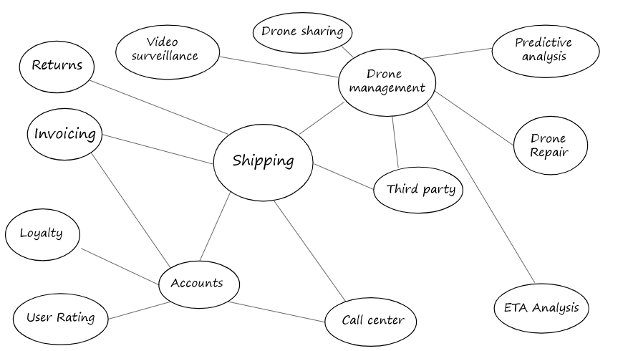
Scenario: Drone delivery

Slide 10
Bounded Context
The domain model will include representations of real things in the world — users, drones, packages, and so forth.
A bounded context is simply the boundary within a domain where a particular domain model applies.

Slide 11
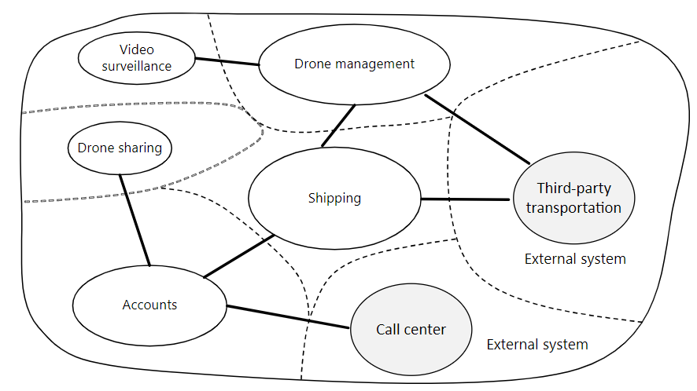
Define bounded contexts

Slide 12
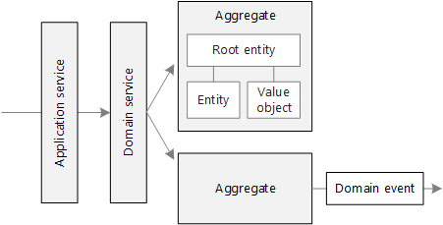
Tactical DDD
Entities. An entity is an object with a unique identity that persists over time.
Value objects. A value object has no identity. It is defined only by the values of its attributes.
Aggregates. An aggregate defines a consistency boundary around one or more entities.

Slide 13
Drone delivery: Applying the patterns
We start with the scenarios that the Shipping bounded context must handle.
A customer can request a drone to pick up goods from a business that is registered with the drone delivery service.
The sender generates a tag (barcode or RFID) to put on the package.
A drone will pick up and deliver a package from the source location to the destination location.
When a customer schedules a delivery, the system provides an ETA based on route information, weather conditions, and historical data.
When the drone is in flight, a user can track the current location and the latest ETA.
Until a drone has picked up the package, the customer can cancel a delivery.
The customer is notified when the delivery is completed.
The sender can request delivery confirmation from the customer, in the form of a signature or finger print.
Users can look up the history of a completed delivery.

Slide 14
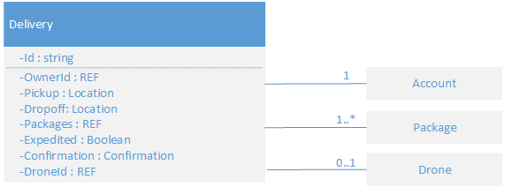
Defining Entities, Aggregates and Value Objects
From these scenarios, the development team identified the following entities.
Delivery
Package
Drone
Account
Confirmation
Notification
Tag
The first four, Delivery, Package, Drone, and Account, are all aggregates that represent transactional consistency boundaries. Confirmations and Notifications are child entities of Deliveries, and Tags are child entities of Packages.
The value objects in this design include Location, ETA, PackageWeight, and PackageSize.

Slide 15
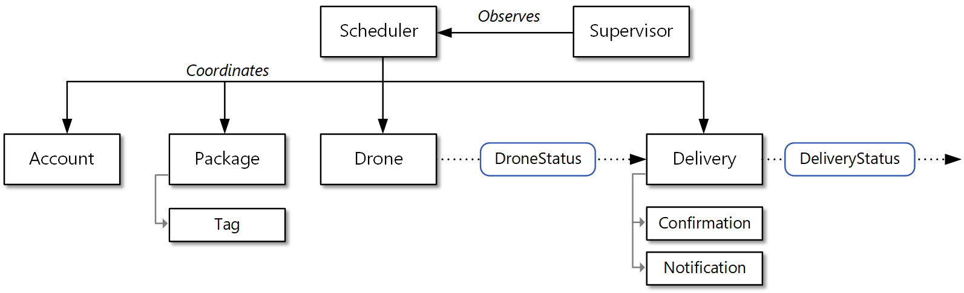
Domain Events
There are two domain events:
While a drone is in flight, the Drone entity sends DroneStatus events that describe the drone's location and status (in-flight, landed).
The Delivery entity sends DeliveryTracking events whenever the stage of a delivery changes. These include DeliveryCreated, DeliveryRescheduled, DeliveryHeadedToDropoff, and DeliveryCompleted.

Slide 16
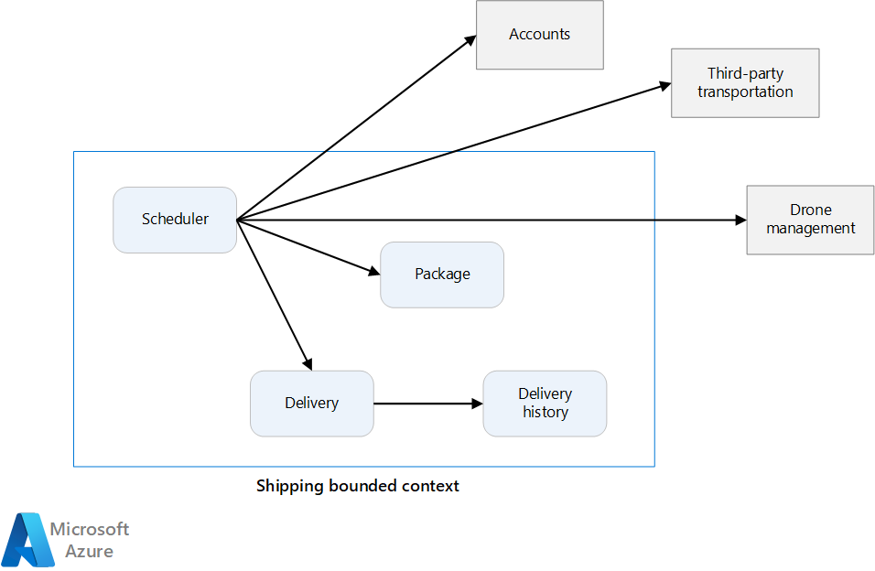
Identify microservice boundaries

Slide 17
From domain model to microservices
Start with a bounded context
Next, look at the aggregates in your domain model. Aggregates are often good candidates for microservices.
Domain services are also good candidates for microservices.

Slide 18
Validation
Each service has a single responsibility.
There are no chatty calls between services
Each service is small enough that it can be built by a small team working independently.
It should always be possible to deploy a service without redeploying any other services.
Services are not tightly coupled, and can evolve independently.
Your service boundaries will not create problems with data consistency or integrity.

Slide 19
Defining microservices for the Drone Delivery application
Development team had identified the four aggregates — Delivery, Package, Drone, and Account — and two domain services, Scheduler and Supervisor.
Delivery and Package are obvious candidates for microservices. The Scheduler and Supervisor coordinate the activities performed by other microservices, so it makes sense to implement these domain services as microservices.

Slide 20
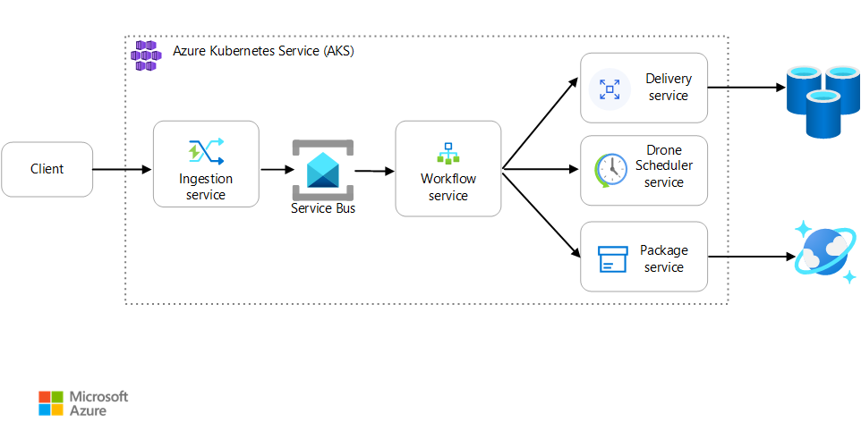
Reference implementation

Slide 21
Your First Microservice
Install .NET 8 SDK
dotnet --version -> 8.x
Create your service
dotnet new webapi -o MyMicroservice --no-https
Run your service
dotnet run
http://localhost:<port number>/weatherforecast.
Install Docker
Check that Docker is ready to use
docker --version

Slide 22
DockerFile
Add a DockerFile
fsutil file createnew Dockerfile 0
FROM mcr.microsoft.com/dotnet/sdk:8.0 AS build WORKDIR /src
COPY MyMicroservice.csproj .
RUN dotnet restore
COPY . .
RUN dotnet publish -c release -o /app
FROM mcr.microsoft.com/dotnet/aspnet:8.0 WORKDIR /app COPY --from=build /app . ENTRYPOINT ["dotnet", "MyMicroservice.dll"]

Slide 23
Docker
Add a .dockerignore file
fsutil file createnew .dockerignore 0
Dockerfile
[b|B]in
[O|o]bj

Slide 24

Docker
Create Docker image
docker build -t mymicroservice .
docker images
Run Docker image
docker run -it --rm -p 3000:8080 --name mymicroservicecontainer mymicroservice
http://localhost:3000/weatherforecast
docker ps

Slide 25

Docker
Prerequisites
https://hub.docker.com/
Sign in to Docker Hub
docker login
Upload image to Docker Hub
docker tag mymicroservice [YOUR DOCKER USERNAME]/mymicroservice
docker push [YOUR DOCKER USERNAME]/mymicroservice

Slide 26
Set up Azure tools
Create an Azure account
Install Azure CLI
Sign in to Azure
az login
Install AKS CLI
az aks install-cli
Create a resource group
az group create --name MyMicroserviceResources --location westus
Create an AKS cluster
az aks create --resource-group MyMicroserviceResources --name MyMicroserviceCluster --node-count 1 --enable-addons http_application_routing --generate-ssh-keys
az aks get-credentials --resource-group MyMicroserviceResources --name MyMicroserviceCluster

Slide 27
Deploy to Azure
---
apiVersion: apps/v1
kind: Deployment
metadata:
name: mymicroservice
spec:
replicas: 1
template:
metadata:
labels:
app: mymicroservice
spec:
containers:
- name: mymicroservice
image: [YOUR DOCKER ID]/mymicroservice:latest
ports:
- containerPort: 80
env:
- name: ASPNETCORE_URLS
value: http://*:80
selector:
matchLabels:
app: mymicroservice
---
apiVersion: v1
kind: Service
metadata:
name: mymicroservice
spec:
type: LoadBalancer
ports:
- port: 80
selector:
app: mymicroservice
Create a deployment file
fsutil file createnew deploy.yaml 0

Slide 28
Deploy to Azure
Run
Run deployment
kubectl apply -f deploy.yaml
Test
Test your deployed service
kubectl get service mymicroservice –watch
http://[YOUR EXTERNAL IP ADDRESS]/weatherforecast
Scale
Scale your service
kubectl scale --replicas=2 deployment/mymicroservice
Clean up
Clean up resources
az group delete -n MyMicroserviceResources

