Slide 1
GPU vs CPU usage

Slide 2
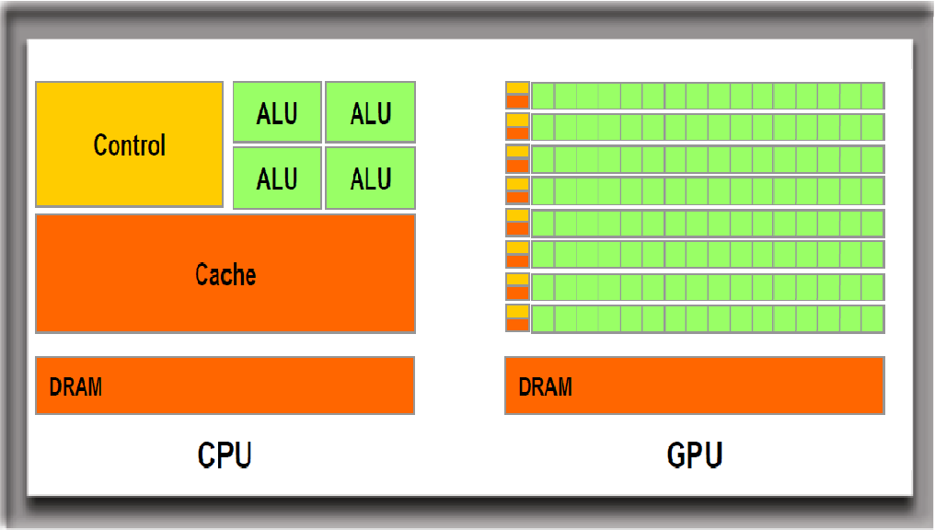
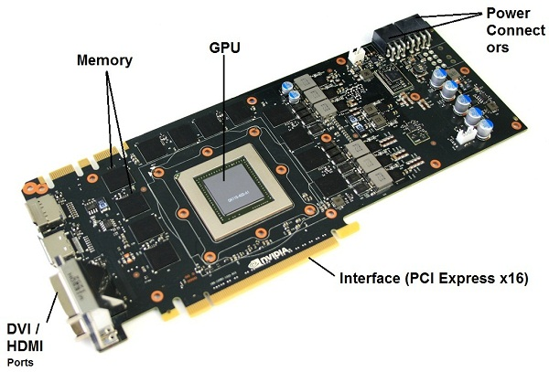
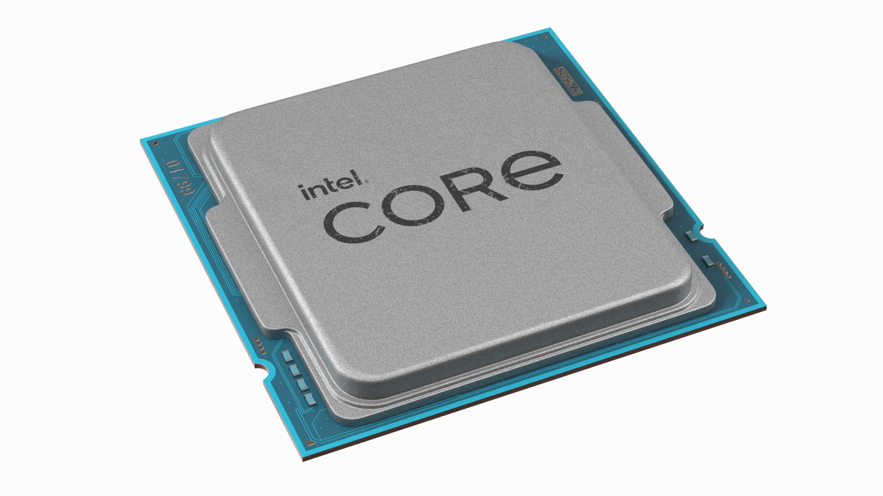
The hardware side of things – microprocessors
CPUs made up of
Arithmetic & Logic Units
Control Units
Memory Units
GPUs have many additional circuit components, such as:
Video Processing Unit
Display Interface
CPU = Central Processing Unit GPU = Graphics Processing Unit

Slide 3
What can we parallelize in code?

Slide 4
What do we use CPUs vs GPUs for?
CPUs:
Can process all main tasks
Run process serially
Are best for processing one large task
GPUs:
Handle graphics-related tasks (such as video rendition)
Run a large number of operations at the same time (in parallel)
Are best for processing many small tasks in parallel

Slide 5
What if we want to train a machine learning model?

Slide 6
Slide Credit
Deniz Akpinaroglu

