Slide 1
Hallucinating protein backbones and sequences
Introducing ColabDesign…

Slide 2
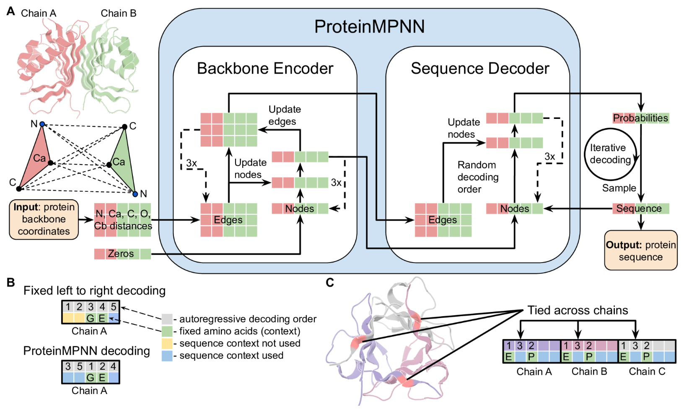
We covered ProteinMPNN

Slide 3
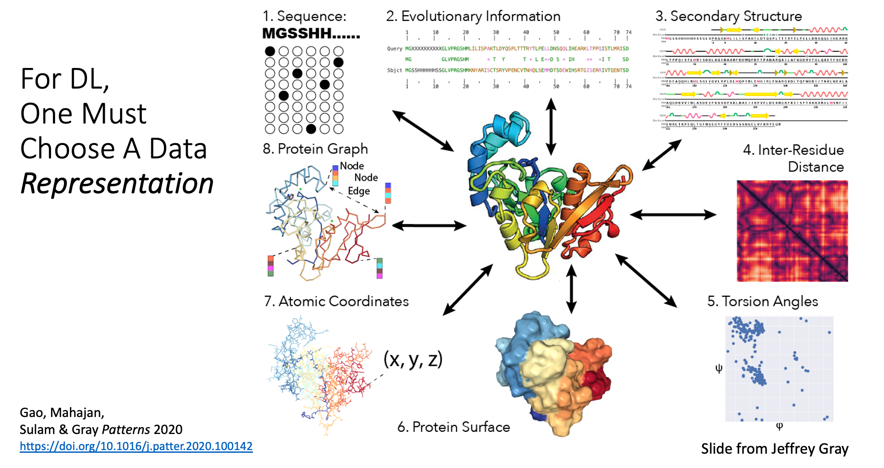
Common data representations for proteins in machine learning
Gao, Mahajan, Sulam & Gray Patterns 2020
https://doi.org/10.1016/j.patter.2020.100142

Slide 4
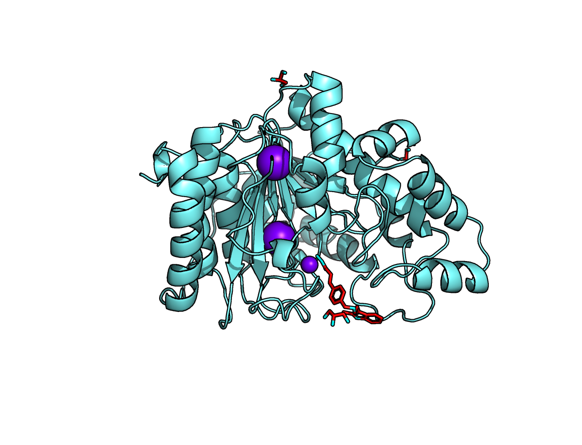
We covered protein structure prediction
ILVEPRTEINS…

Slide 5
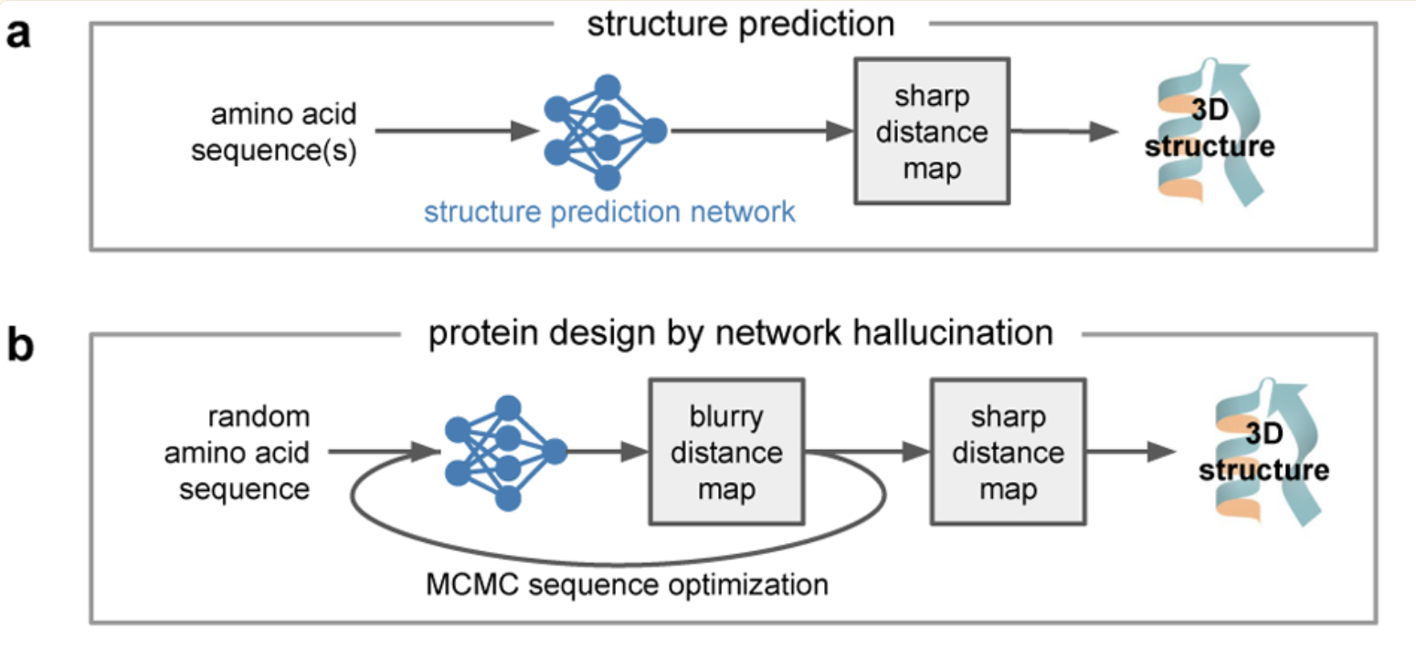
Structure prediction vs hallucination

Slide 6
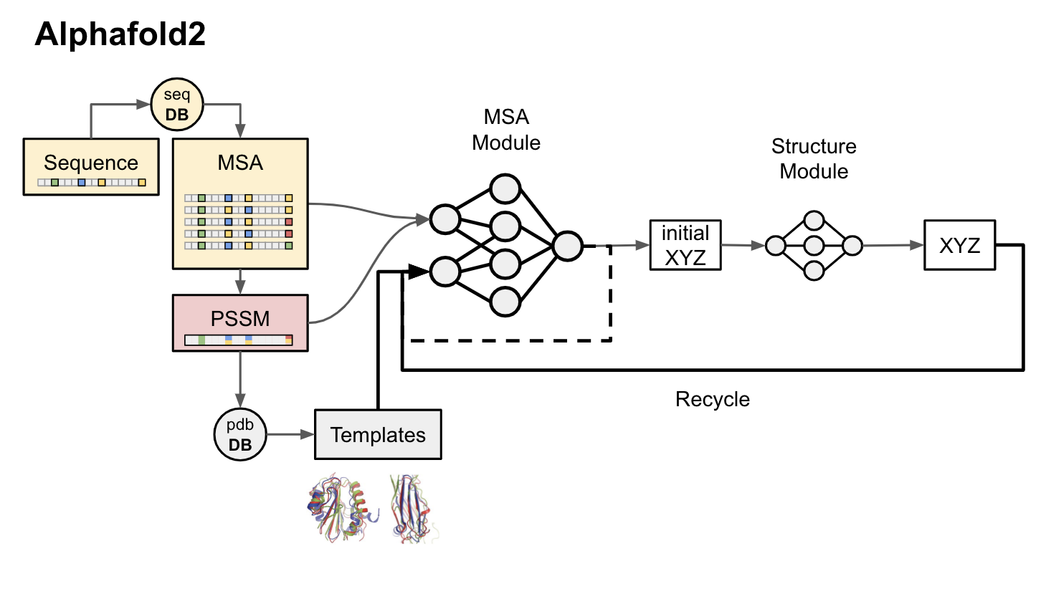
Slide credit: Sergey Ovchinnikov

Slide 7
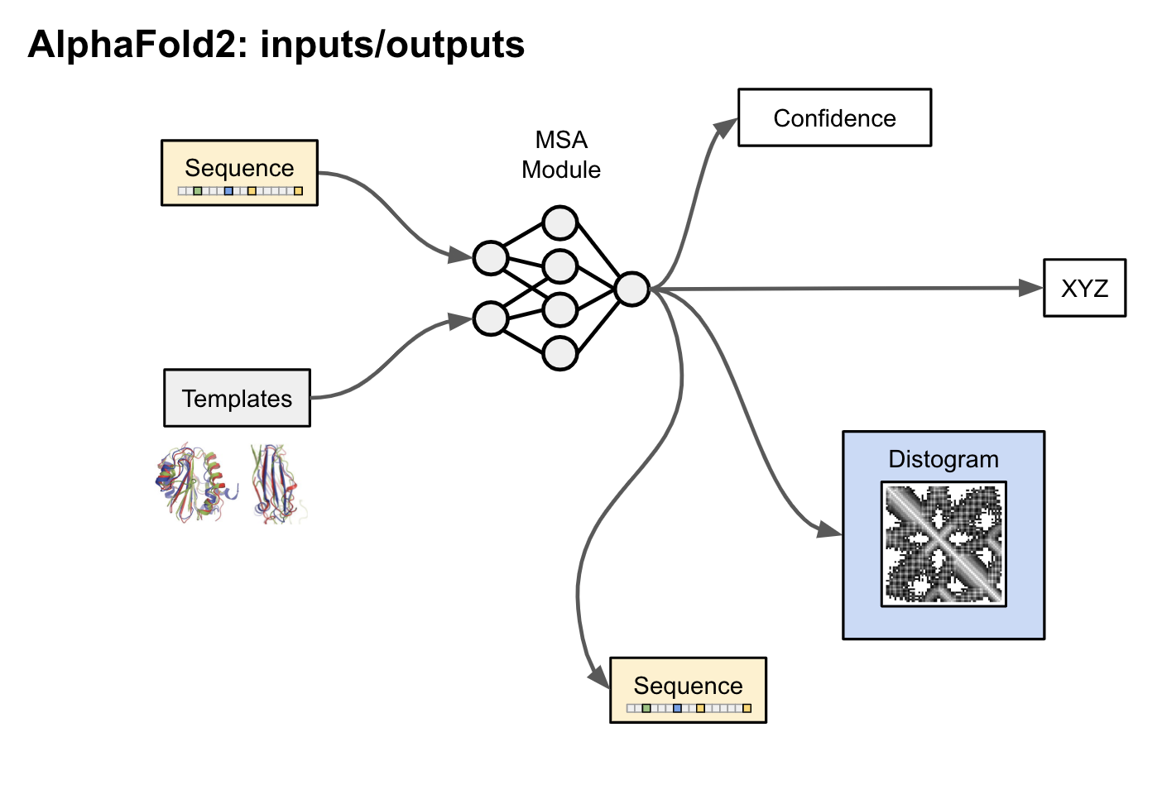
Slide credit: Sergey Ovchinnikov

Slide 8
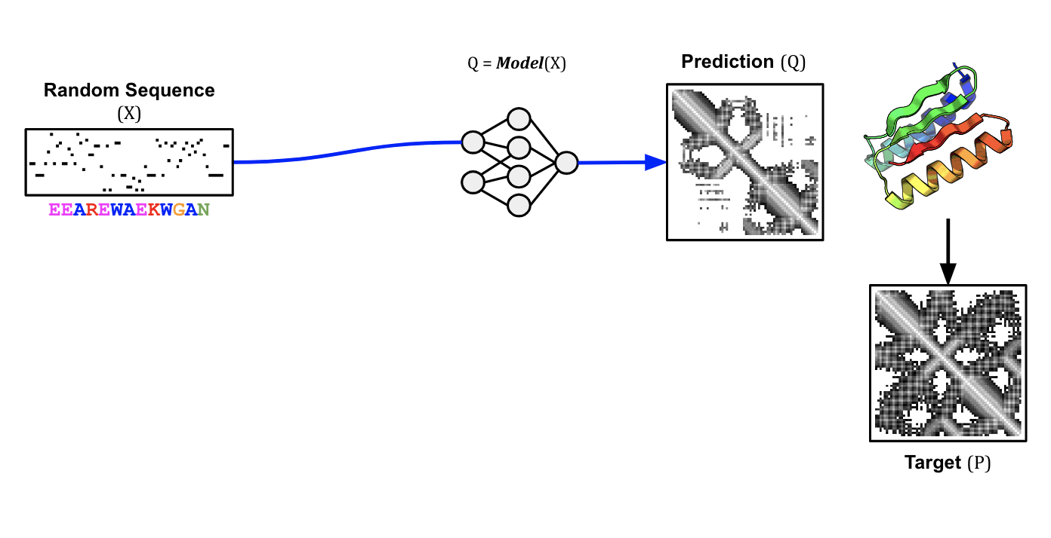
Slide credit: Sergey Ovchinnikov

Slide 9
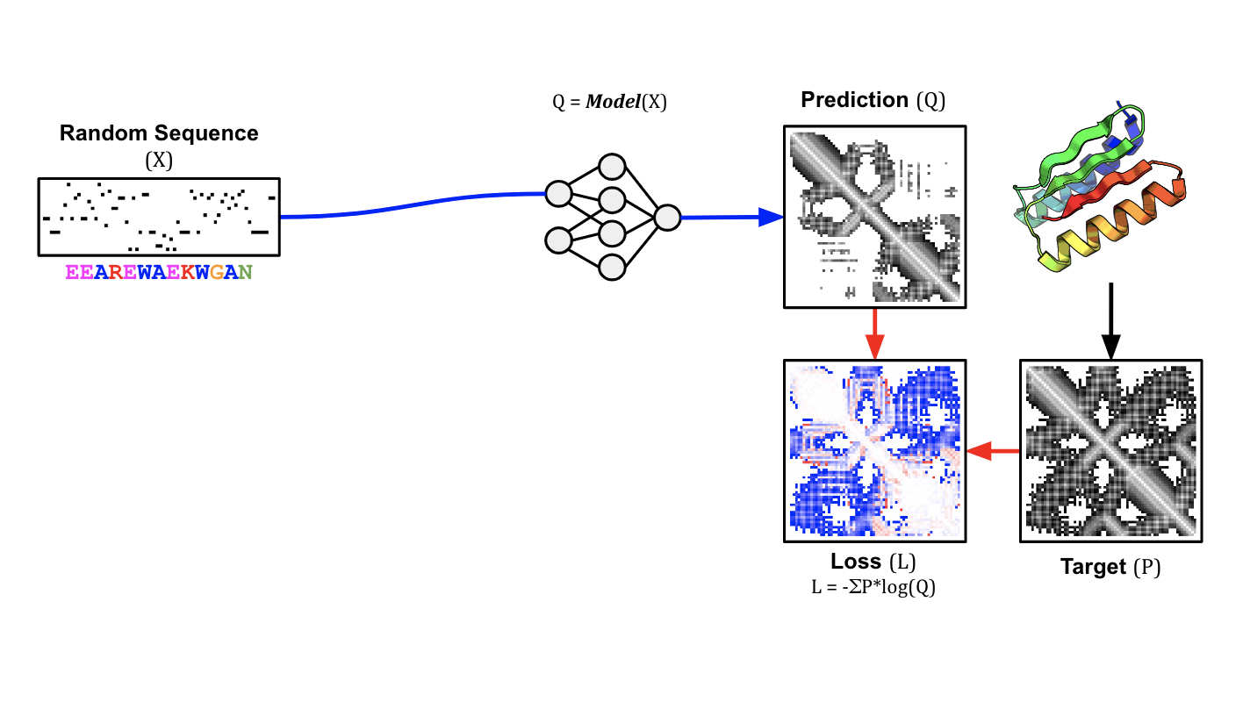
Slide credit: Sergey Ovchinnikov

Slide 10
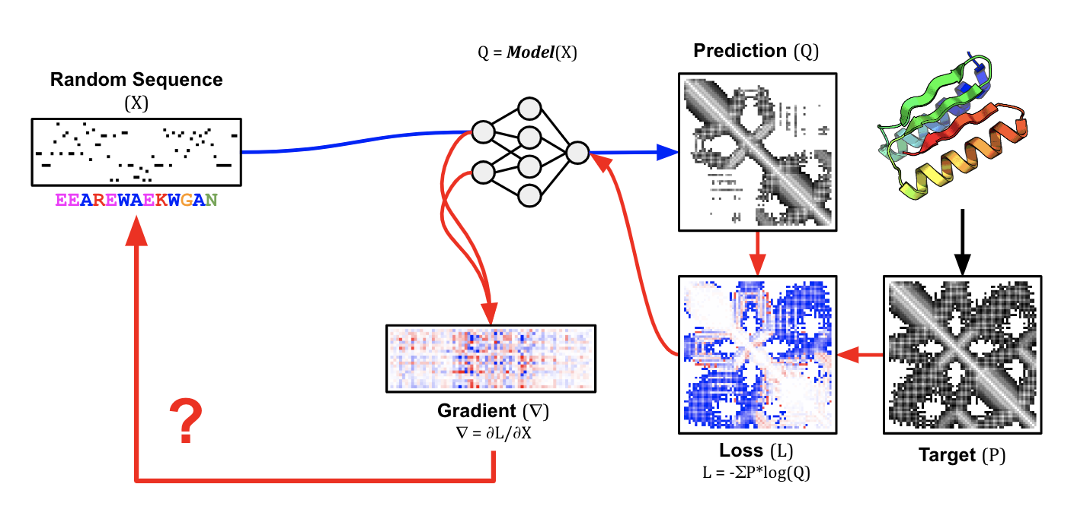
Slide credit: Sergey Ovchinnikov

Slide 11
Can we use AlphaFold to design functional proteins?
There are 4 particularly interesting design cases:
Designing protein sequences onto fixed backbones
Designing new backbone geometries
Designing new binders
Designing new scaffolds

Slide 12
Can we use AlphaFold to design functional proteins?
There are 4 particularly interesting design cases:
Fixed backbone hallucination (design sequence on fixed backbone)
Free backbone hallucination (design a backbone with no constraint)
Binder hallucination (design a protein that binds target)
Constrained hallucination (design a protein that scaffolds a motif)

Slide 13
Hallucination Demonstration via ColabDesign

Slide 14
ColabDesign Demonstration
search “colabdesign” or go to
https://github.com/sokrypton/ColabDesign

Slide 15
Slide Credit
Deniz Akpinaroglu

