Slide 1
Introduction to constraints

Slide 2
When are constraints used?
Encouraging the model to adhere to specific structural restrictions.
Evaluating structural features for which there exists no score term.
Examples:
Dihedral angles are maintained on a protein segment
Distances between residues are maintained

Slide 3
What are constraints?
In Rosetta, constraints are additions to the score function that bias and/or evaluate certain structural properties of the pose.
Constraints do not restrict the sampling of structures that violate the specified properties; they add a score penalty/reward to bias the outcome from the Monte Carlo object.

Slide 4
Constraint format
Constraints have three specifications:
What is being constrained?
What function is being used to introduce the penalty?
What is the weight of all constraints?

Slide 5
Defining constraints

Slide 6
Constraint format
Constraints have three specifications:
What is being constrained?
What function is being used to introduce the penalty?
What is the weight of all constraints? (default = 1.0)
Constraints are formatted as follows:
Constraint_Type1 Constraint_Def1
Constraint_Type2 Constraint_Def2
…

Slide 7
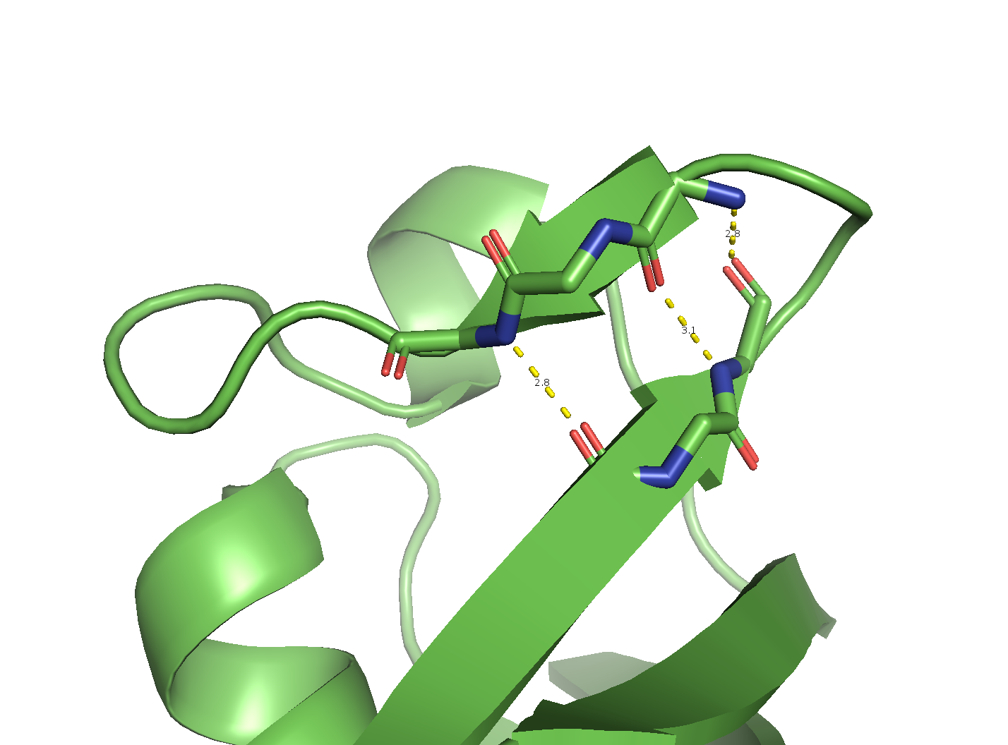
Constraint types
Atom Pair
The most commonly used constraint
Adds a score penalty if two specific atoms deviate from a certain distance
The score term introduced is called atom_pair_constraint
Example,
AtomPair O 43 N 50 Constraint_Def1
AtomPair N 45 O 48 Constraint_Def2
AtomPair O 45 N 48 Constraint_Def3

Slide 8
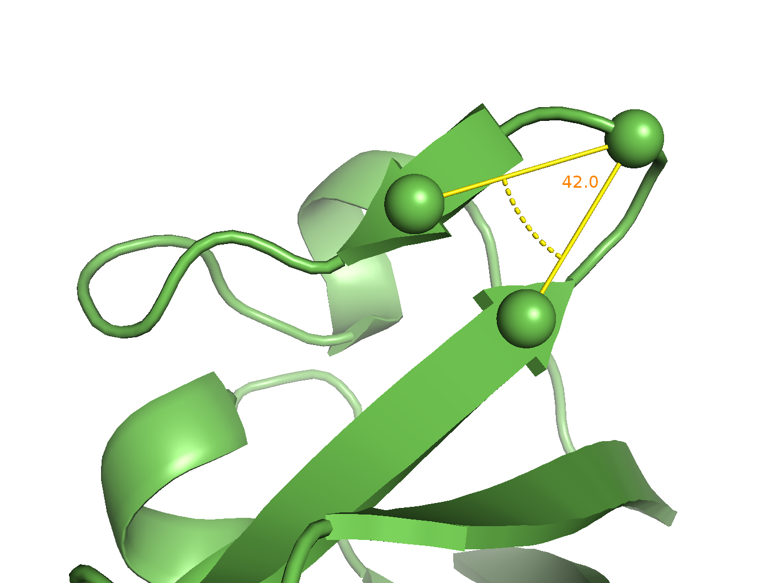
Constraint types
Angle
Can be used to constrain an angle between three atoms; they need not be bonded
Adds a score penalty if the angle is violated
The score term introduced is called angle_constraint
Example,
Angle CA 44 CA 47 CA 49 Constraint_Def

Slide 9
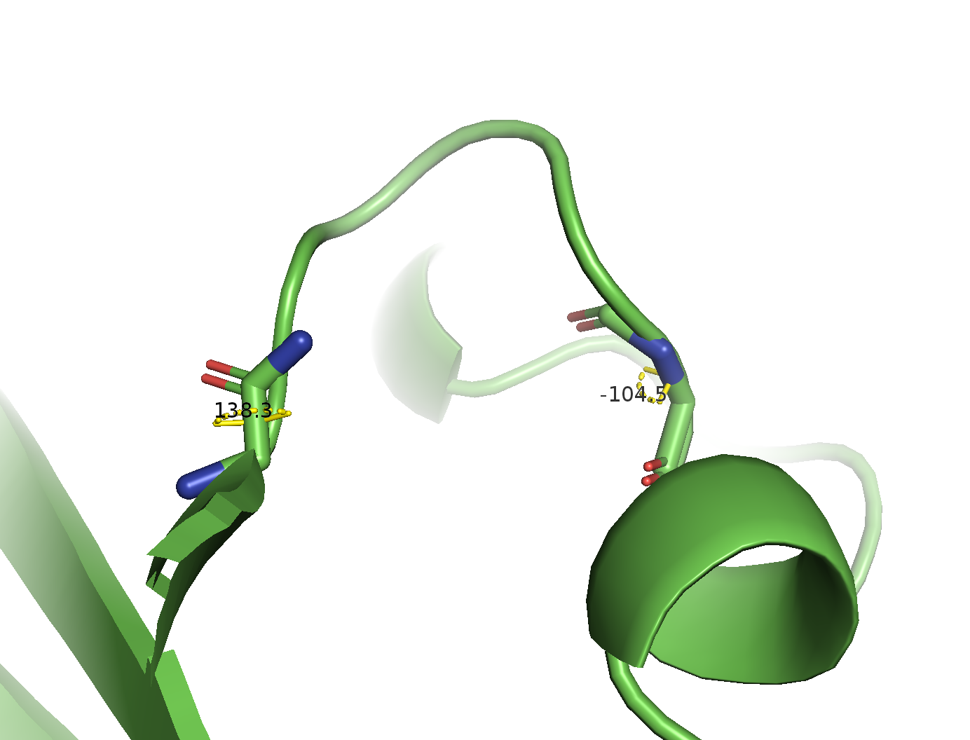
Constraint types
Dihedral
Can be used to constrain a dihedral angle between four atoms; they need not be bonded
Adds a score penalty if the dihedral angle is violated
The score term introduced is called dihedral_constraint
Example,
Dihedral N 50 CA 50 C 50 N 51 Constraint_Def1
Dihedral C 54 N 55 CA 55 C 55 Constraint_Def2

Slide 10
Some other constraint types
NamedAtomPair and NamedAngle
Similar to AtomPair and Angle, but useful if atom numbers change during the protocol; computationally more expensive
CoordinateConstraint
Used to constrain an atom to a specified XYZ constraint
AmbiguousNMRDistance
Similar to AtomPair, but ambiguous hydrogens are automatically detected for select atom types

Slide 11
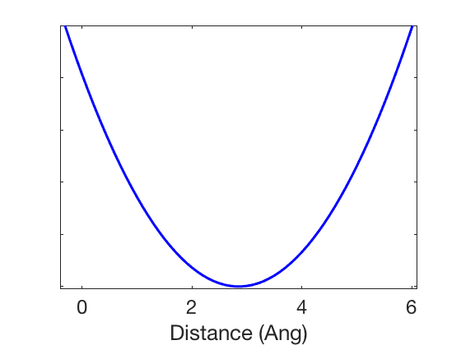
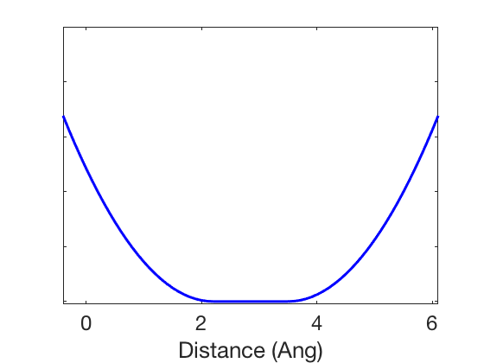
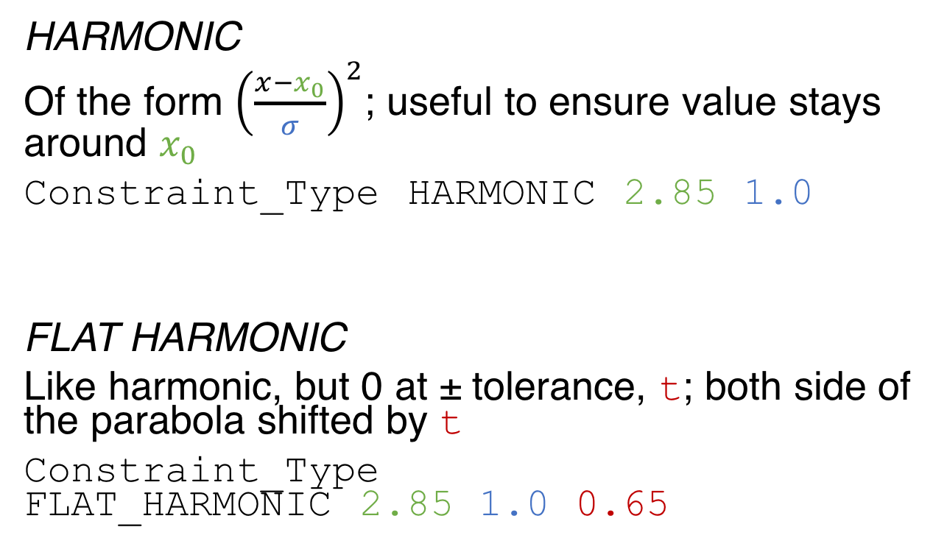
Function types
HARMONIC
Of the form ${\left(\frac{x−x_{0}}{σ}\right)}^{2}$; useful to ensure value stays around $x_{0}$
Constraint_Type HARMONIC 2.85 1.0
FLAT HARMONIC
Like harmonic, but 0 at ± tolerance, t; both side of the parabola shifted by t
Constraint_Type FLAT_HARMONIC 2.85 1.0 0.65

Slide 12
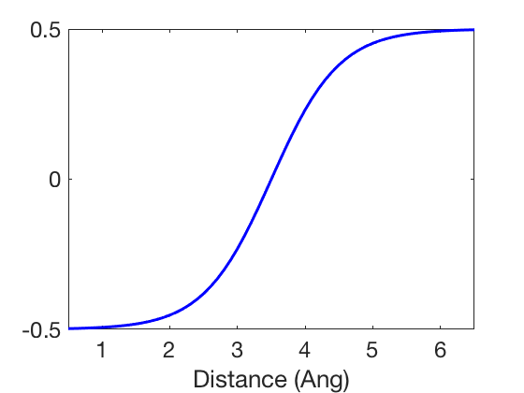
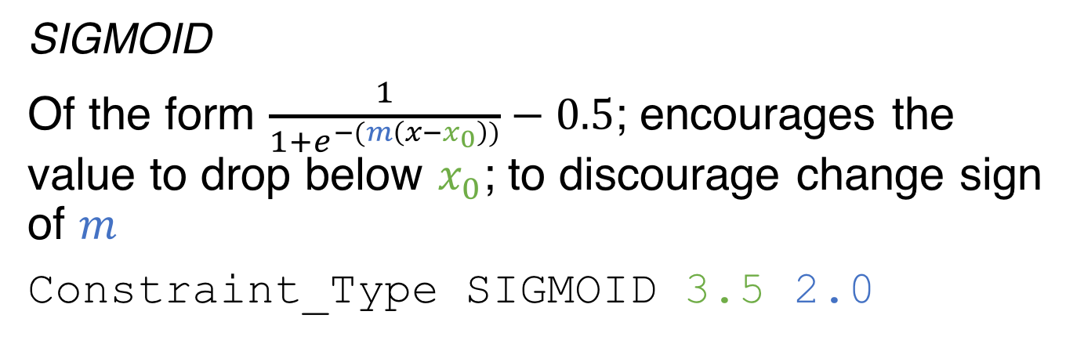
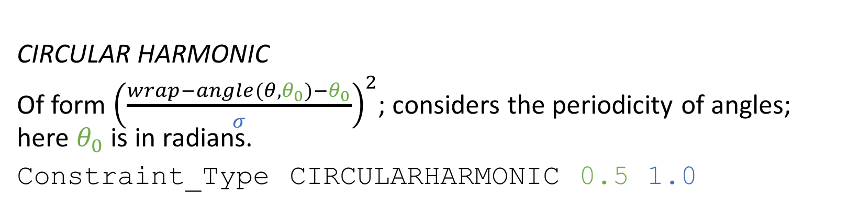
Function types
SIGMOID
Of the form $\frac{1}{1+e^{−(m\left(x−x_{0}\right))}}−0.5$; encourages the value to drop below $x_{0}$; to discourage change sign of $m$
Constraint_Type SIGMOID 3.5 2.0
CIRCULAR HARMONIC
Of form ${\left(\frac{wrap−angle(θ,θ_{0})−θ_{0}}{σ}\right)}^{2}$; considers the periodicity of angles; here $θ_{0}$ is in radians.
Constraint_Type CIRCULARHARMONIC 0.5 1.0

Slide 13
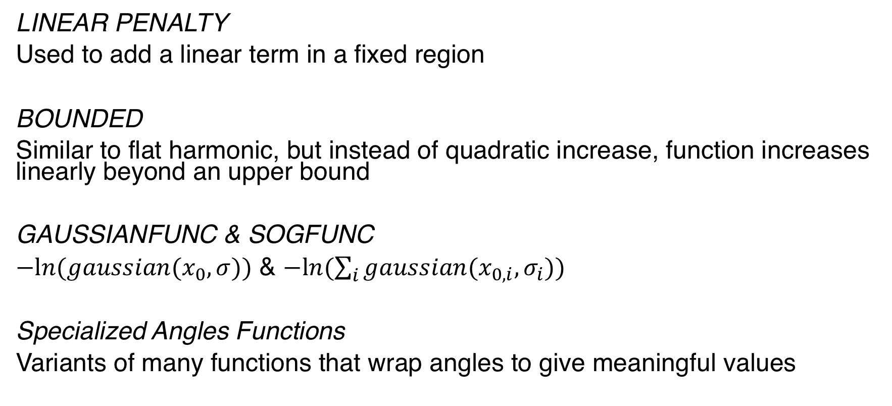
Some other function types
LINEAR PENALTY
Used to add a linear term in a fixed region
BOUNDED
Similar to flat harmonic, but instead of quadratic increase, function increases linearly beyond an upper bound
GAUSSIANFUNC & SOGFUNC
$−ln⁡(gaussian(x_{0},σ))$ & $−ln⁡(\sum_{i}{gaussian(x_{0,i}, σ_{i})})$
Specialized Angles Functions
Variants of many functions that wrap angles to give meaningful values

Slide 14
Putting constraint types and function types together

Slide 15
Which is a better choice?
AtomPair O 43 N 50 FLAT_HARMONIC 2.85 1.0 0.65 AtomPair N 45 O 48 FLAT_HARMONIC 2.85 1.0 0.65 AtomPair O 45 N 48 FLAT_HARMONIC 2.85 1.0 0.65
Or
AtomPair O 43 N 50 SIGMOID 3.5 2.0 AtomPair N 45 O 48 SIGMOID 3.5 2.0 AtomPair O 45 N 48 SIGMOID 3.5 2.0

Slide 16
Boolean-type logic with constraints
Ambiguous Constraint
Behave like the constraints are connected by an OR; output is equal to the lowest value of the individual constraints
AmbiguousConstraint AtomPair O 43 N 50 FLAT_HARMONIC 2.85 1.0 0.65 [AtomPair N 45 O 48 FLAT_HARMONIC 2.85 1.0 0.65 [AtomPair O 45 N 48 FLAT_HARMONIC 2.85 1.0 0.65]] END
Special case: Site Constraint
SiteConstraint CB 43 B SIGMOID 7.0 2.0
This says the C_{β} of residue 43 has to be within 7.0 Å of C_{α} of any residue of chain B.

Slide 17
Other nested constraints
Multi-Constraint
Behave like the constraints are connected by an AND; output is equal to the sum of the individual constraints
K of N Constraint
Output is equal to the sum of the k lowest constraints

Slide 18
Using constraints

Slide 19
Reading in constraints
The simplest way to use constraints is by reading a constraints file.
Say the file h_bonds.cst contained the three constraints that we previously listed, then read them in using the init() function.
from pyrosetta import *;
init("-constraints:cst_fa_file h_bonds.cst")

Slide 20
Modulating constraint weights
Constraints have three specifications:
What is being constrained?
What function is being used to introduce the penalty?
What is the weight of all constraints? (default = 1.0)
The weight multiplied with the constraints can also similarly be read in:
from pyrosetta import *;
init("-constraints:cst_fa_file h_bonds.cst
-constraints:cst_fa_weight 2.0")

Slide 21
Adding constraints onto score functions
Many Rosetta modules will automatically add the constraints to the score function. (Be sure to check them though.)
For custom protocols, the terms will have to be manually added onto the score function.
from pyrosetta.rosetta.core.scoring.constraints import *
sfxn = get_fa_scorefxn()
add_fa_constraints_from_cmdline(pose,sfxn)

Slide 22
Creating constraints within the protocol
To create constraints on the go, we use constraint generators.
from rosetta.protocols.constraint_generator import *
apcg = AtomPairConstraintGenerator()
apcg.set_residue_selector(<residue_selector>)
apcg.set_max_distance(5.0)
add_csts = AddConstraints()
add_csts.add_generator(apcg)
add_csts.apply(pose)

Slide 23
Special cases

Slide 24
Preparing structures from external sources
To prepare structure for Rosetta protocols, relaxing the structure with the native score function is recommended. To avoid disrupting the existing backbone, use:
-relax:constrain_relax_to_start_coords
Adds coordinate constraints to backbone heavy atoms based on starting structure,
or:
-relax:constrain_relax_to_native_coords
Adds coordinate constraints to backbone heavy atoms based on another (native) structure

Slide 25
Automatic constraints for metal ions
When using a PDB with metal ions, use:
-auto_setup_metals
Apart from linkage information, this automatically adds atom pair constraints and angle constraints to immobilize ion

Slide 26
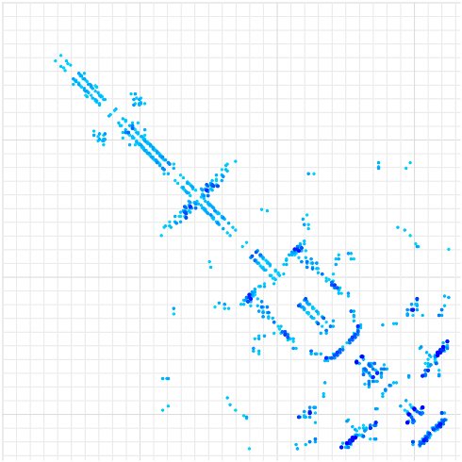
Generating constraints using GREMLIN
GREMLIN predicts residue-residue contacts from statistical analysis of sequence co-evolution.

Slide 27
Constraint file generated from GREMLIN
AtomPair CB 257 CB 317 SCALARWEIGHTEDFUNC 3.833 SUMFUNC 2 SIGMOID 8.077 1.577 CONSTANTFUNC -0.5 AtomPair CB 296 CB 300 SCALARWEIGHTEDFUNC 3.608 SUMFUNC 2 SIGMOID 8.327 1.818 CONSTANTFUNC -0.5 AtomPair CB 251 CB 321 SCALARWEIGHTEDFUNC 3.349 SUMFUNC 2 SIGMOID 8.055 2.646 CONSTANTFUNC -0.5 AtomPair CB 295 CB 306 SCALARWEIGHTEDFUNC 3.139 SUMFUNC 2 SIGMOID 6.587 4.673 CONSTANTFUNC -0.5 AtomPair CB 258 CA 262 SCALARWEIGHTEDFUNC 3.011 SUMFUNC 2 SIGMOID 6.135 5.181 CONSTANTFUNC -0.5 AtomPair CB 255 CB 317 SCALARWEIGHTEDFUNC 2.911 SUMFUNC 2 SIGMOID 8.008 2.786 CONSTANTFUNC -0.5 AtomPair CB 307 CB 319 SCALARWEIGHTEDFUNC 2.788 SUMFUNC 2 SIGMOID 6.971 3.257 CONSTANTFUNC -0.5 AtomPair CB 255 CB 319 SCALARWEIGHTEDFUNC 2.766 SUMFUNC 2 SIGMOID 8.055 2.646 CONSTANTFUNC -0.5 AtomPair CB 224 CB 299 SCALARWEIGHTEDFUNC 2.716 SUMFUNC 2 SIGMOID 6.587 4.673 CONSTANTFUNC -0.5 AtomPair CB 247 CB 324 SCALARWEIGHTEDFUNC 2.707 SUMFUNC 2 SIGMOID 8.302 2.463 CONSTANTFUNC -0.5 AtomPair CB 181 CB 216 SCALARWEIGHTEDFUNC 2.706 SUMFUNC 2 SIGMOID 7.142 2.924 CONSTANTFUNC -0.5 AtomPair CB 180 CB 213 SCALARWEIGHTEDFUNC 2.619 SUMFUNC 2 SIGMOID 9.403 1.953 CONSTANTFUNC -0.5 AtomPair CB 308 CB 318 SCALARWEIGHTEDFUNC 2.598 SUMFUNC 2 SIGMOID 9.057 4.065 CONSTANTFUNC -0.5 AtomPair CB 272 CB 306 SCALARWEIGHTEDFUNC 2.514 SUMFUNC 2 SIGMOID 9.602 2.882 CONSTANTFUNC -0.5 AtomPair CB 253 CB 321 SCALARWEIGHTEDFUNC 2.511 SUMFUNC 2 SIGMOID 8.055 2.646 CONSTANTFUNC -0.5
...

Slide 28
Discussion

Slide 29
How many constraints are too many constraints?
Sampling restraint versus score biasing
How do constraints change the energy landscape?
When do constraints start overpowering the score function?

Slide 30
Resources
Constraint file documentation: https://www.rosettacommons.org/docs/latest/rosetta_basics/file_types/constraint-file
Constraints tutorial: https://www.rosettacommons.org/demos/latest/tutorials/Constraints_Tutorial/Constraints
GREMLIN2 server: https://gremlin2.bakerlab.org/index.php

Slide 31
Slide Credit
Shourya S. Roy Burman

