Slide 1
Pose Lecture

Slide 2
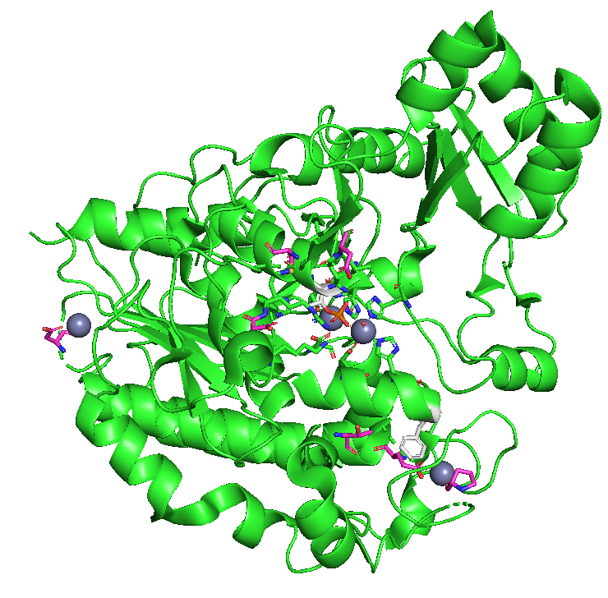
Pose class
A central PyRosetta class
Describes a molecular system. This could be:
A single chain protein
Protein and its ligand
A heterodimer
RNA aptamer
A big RNP like the ribosome
What do you think this class contains?

Slide 3
Pose class
Sequence of residues
Conformation and how conformation changes propagate
Energy terms
Info about the corresponding PDB file

Slide 4
Pose class
Sequence of residues
Conformation and how conformation changes propagate
Energy terms
Info about the corresponding PDB file

Slide 5
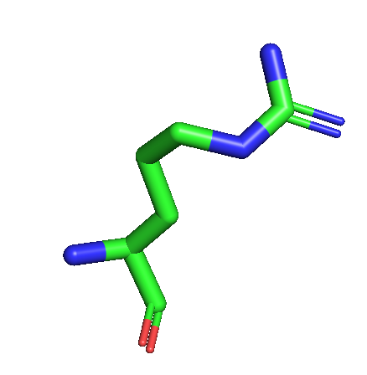
Residues
Pose contains a sequence of residues
Can get residue by number, total residue count
Residue class is information particular to this residue
Atom positions and backbone / side-chain torsions
Sequence position and chain number
Reference to Residue Type: contains info relevant to all residues of this type
What do you think the Residue Type class contains?

Slide 6
Residues
Pose contains a sequence of residues
Can get residue by number, total residue count
Residue class has information particular to this residue
Atom positions and backbone / side-chain torsions
Sequence position and chain number
Reference to Residue Type: contains info relevant to all residues of this type
What do you think the Residue Type class contains?

Slide 7
Residues
Pose contains a sequence of residues
Can get residue by number, total residue count
Residue class has information particular to this residue
Atom positions and backbone / side-chain torsions
Sequence position and chain number
Reference to Residue Type: contains info relevant to all residues of this type
What do you think the Residue Type class contains?

Slide 8
Residue Type class
Contains:
Residue name
Vector of atoms
Properties of a residue: Protein? Charged? Aromatic?
Ideal coordinates for this residue’s atoms
Generated from database files on initialization

Slide 9
Pose class
Sequence of residues
Conformation and how conformation changes propagate
Energy terms
Info about the corresponding PDB file

Slide 10
Conformation class
Defines how coordinate changes propagate through the system
Provides access to some pose geometry
How to access the conformation object: pose.conformation()
Pose is a Python object. Access methods the way you’re used to!
Conformation object can give you some bond lengths, angles, and torsions
Only those needed to propagate coordinate changes

Slide 11
Conformation class
Defines how coordinate changes propagate through the system
Provides access to some pose geometry
How to access the conformation object: pose.conformation()
Pose is a Python object. Access methods the way you’re used to!
Conformation object can give you some bond lengths, angles, and torsions
Only those needed to propagate coordinate changes

Slide 12
Conformation class
Defines how coordinate changes propagate through the system
Provides access to some pose geometry
How to access the conformation object: pose.conformation()
Pose is a Python object. Access methods the way you’re used to!
Conformation object can give you some bond lengths, angles, and torsions
Only those needed to propagate coordinate changes

Slide 13
Pose class
Sequence of residues
Conformation and how conformation changes propagate
Energy terms
Info about the corresponding PDB file

Slide 14
Energies class
A Pose will contain information on its Rosetta score
Stores information from the last time Pose was scored
Cache of residue and residue-pair energies allows for efficient scoring
Keep track of what was changed since last energy evaluation
Energies class stores score term values for the Pose

Slide 15
Pose class
Sequence of residues
Conformation and how conformation changes propagate
Energy terms
Info about the corresponding PDB file

Slide 16
PDB_Info class
Stores information about the PDB file from which the Pose was read, if applicable
Note:
PDB residue numbering and Pose residue numbering are distinct.
The PDB_Info class has methods to go between the two.

Slide 17
Pose Lab
Work on the Pose Lab:
Try to get to the section on manipulating pose geometry.

Slide 18
Manipulating a Pose
Various methods to manipulate a pose.
Set torsions, bond lengths, angles:
pose.set_phi(residue_id, new_angle)
Set atom positions:
residue.set_xyz(atom_index, xyz_vector)
Change residues:
pose.replace_residue(seq_pos, new_residue)

Slide 19
Manipulating a Pose
Can create a pose from scratch with:
pose_from_sequence(‘AAA’)
Initializes pose with ideal coordinates
Can then manipulate geometry to achieve desired pose

Slide 20
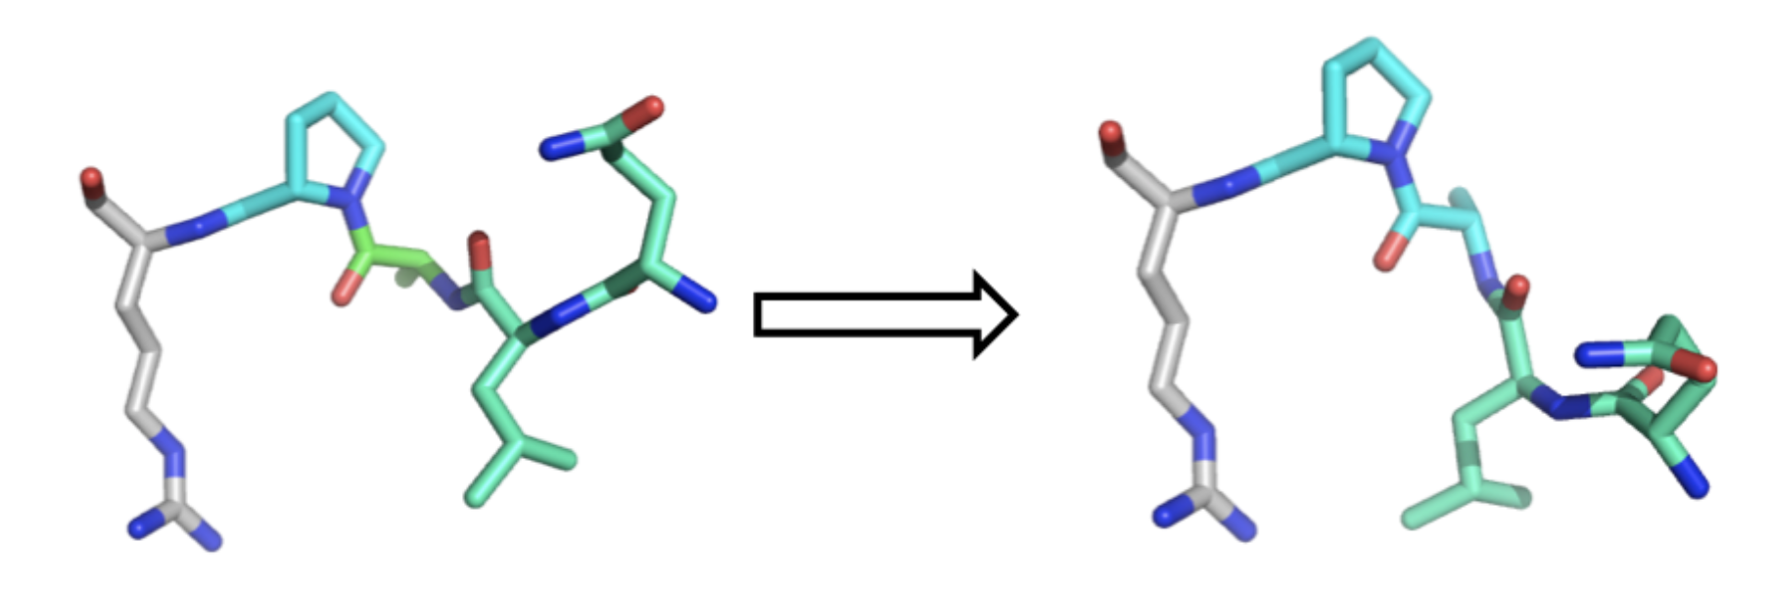
How geometry changes are propagated
Geometry stored in terms of bond distances and angles
Not xyz coordinates

Slide 21
How geometry changes are propagated
Geometry stored in terms of bond distances and angles
Not xyz coordinates

Slide 22
How geometry changes are propagated
Geometry stored in terms of bond distances and angles
Not xyz coordinates
Fold tree:
Indicates the direction in which geometry changes are propagated

Slide 23
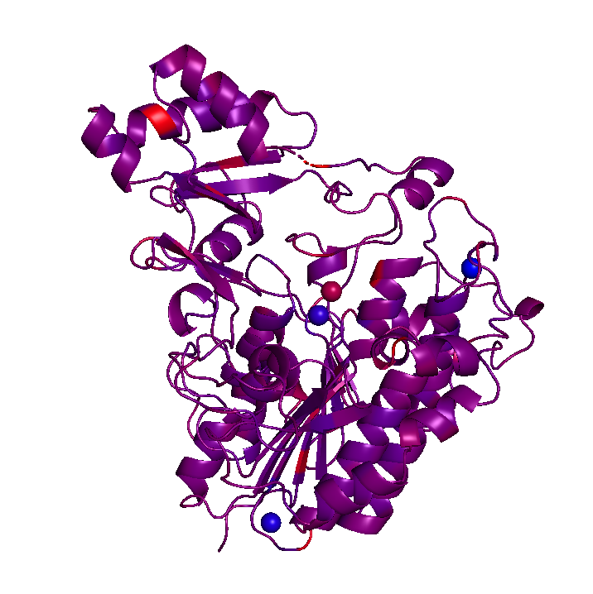
PyMOL
Visualize changes from PyRosetta to a pose with PyMOL
Methods to color pose by convenient information: energy terms

Slide 24
Pose Lab
Continue with Pose Lab

