Slide 1

back2grid
by ROSETTA
Share your battery for win-win!

Slide 2
back2grid is a system that stabilizes power of the electrical grid by enabling parked electric cars to sell their battery energy back to the grid when energy demand is high and help customers earn money from the system.

Slide 3
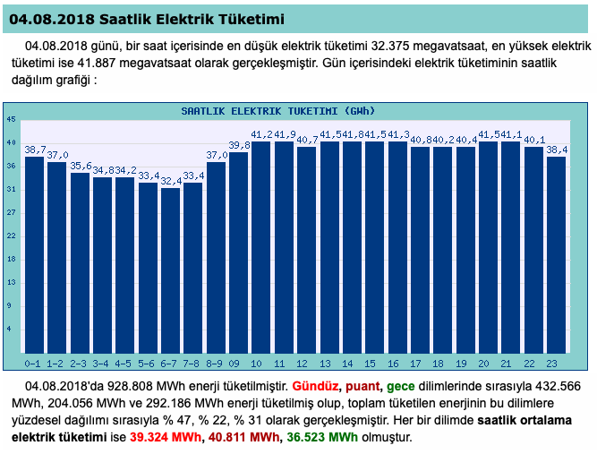
Problem 1
Power grids have the necessity of fulfilling the high energy requirements in peak time periods (from 10am to 22pm). In those cases, they mostly rely on the energy with the high carbon footprint.
Hour (h)
Figure: Hourly Electric Consumption (GWh) *
Electricity Consumption ( Gwh )
*TEİAŞ

Slide 4
Problem 2
In the near future, the number of electric vehicles in Turkey’s traffic are expected to increase 140.000 from 2.500 *
Thus, energy demand will increase.
* Boğaziçi University Energy Policy Research Center (EPAM)

Slide 5
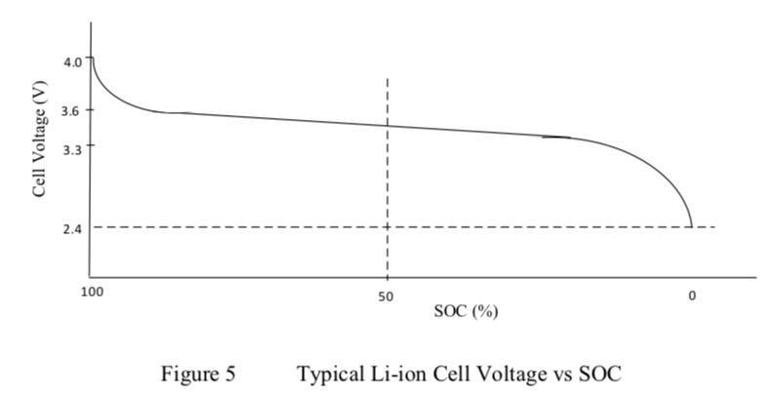
Problem 3
Batteries of the EV’s don’t complete their charging cycles regularly, if they stay inactive most of the time
It’s recommended for Li-ion batteries to work in between 20% and 80% SOC
Long-term unused batteries have shorter lifespan.
Thus batteries must be charged and discharged regularly.
*
* Massey, S. (2016). Modeling, Simulation And Control of Hybrid Electric Vehicle Drive While Minimizing Energy Input Requirements Using Optimized Gear Ratios

Slide 6
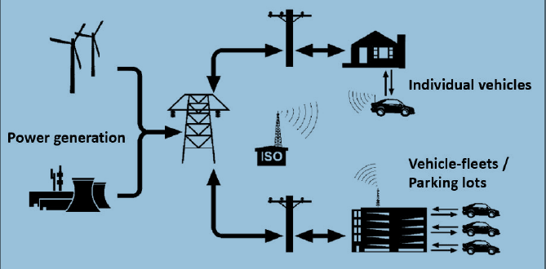
Solution
back2grid provides the services as follows;
Selling stored energy to the grid at the most profitable time periods.
Extending battery lifespan with regular charging.
Also responding to the power demand immediately.
* Deivanayagam, R., Vehicle-to-grid Technology: Concept, Status, and Challenges

Slide 7
Product
back2grid :
Is a communication tool between battery and the grid.
Asks the owner, via mobile application, if they want to charge or discharge the battery of their vehicles.
Notifies the data of SOC to the owner via mobile application
Sells stored energy to the grid
Notifies the bill of running and stored energy to the owner via mobile application
Does not discharge further if the SOC of the battery is lower than %20 to meet customers’ possible needs.

Slide 8

Product
Location Data
SOC
Grid
Power call
back2grid API
Location
Available Power Data
SOC
Location
SOC
BILL
Ch/Disc.
SOC
Vehicle Id
Location
(one time only)
back2grid mobile app

Slide 9

Scenario
Ali is an engineer.
He lives in Maslak.
He works in Ataköy. He owns an electric vehicle.
Every workday Ali drives:
from Maslak to Ataköy between the hours 06:30 - 07:00, travelling 30km, spending 10kWh energy
from Ataköy to Maslak between the hours 17:00 -17:30, travelling 30 km, spending 15kWh of energy
.
Ali’s electric car is used only one hour in a day.

Slide 10
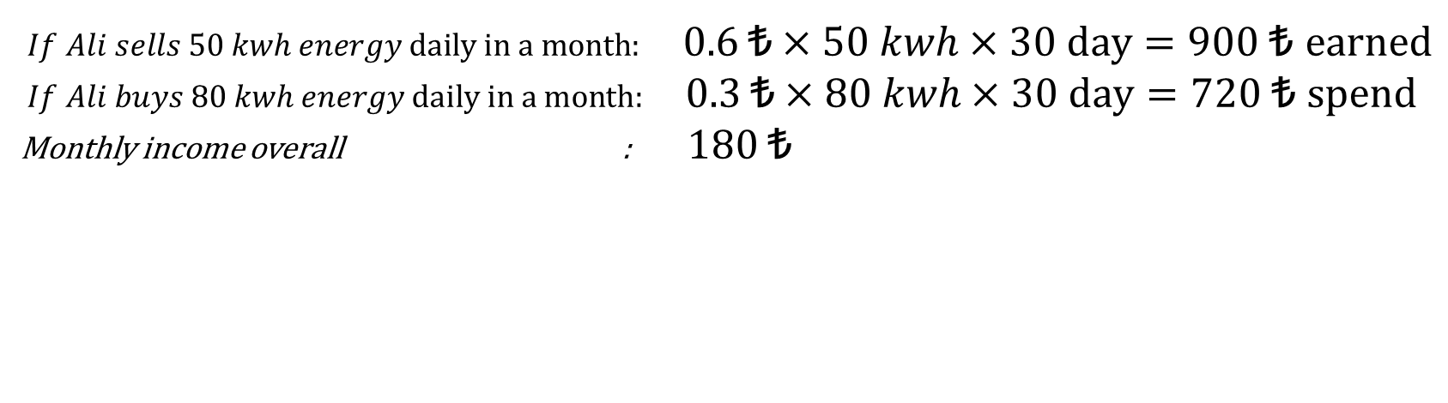
Scenario
Charging Battery
(+80 kWh)
Spend 30min at Driving
(-10 kWh)
Spend 30min driving
(-15 kWh)
Selling to grid
(-50 kWh)
$If Ali sells 50 kwh energy daily in a month:$ 0.6 ₺ $×50 kwh×30 day=900 \text{₺} \text{earned}$
$If Ali buys 80 kwh energy daily in a month:$ 0.3 ₺ $×80 kwh×30 day=720 \text{₺} \text{spend}$
Monthly income overall : 180 ₺

Slide 11
Scenario
If this scenario is applied to trucks or buses, their profit could be higher.

Slide 12
Impact
Customer benefits (Electric vehicle owners, leasing companies)
Extend battery life with regular charge
Create revenue model with selling the stored energy
Mercedes benefits
This product is exclusive for Mercedes customers
Increases the Mercedes brand value
Encourges the use of electric vehicles
Grid benefits
Active power and load regulation
Saving money because establish and manage the backup power plant
EV can be combined with renewable energy systems.

Slide 13
Future of back2grid
With further improvements, back2grid can be integrated with an artificial intelligence that estimates optimum buying and selling prices of energy thus provides the customer with higher profits.

