Slide 1
Docking
Rosetta ML Bootcamp
Ian Anderson
Based on 2024 slides of Nick Randolph

Slide 2
What is docking?

Slide 3
What is docking?
Given two protein subunits, what is the orientation in which they’re binding?

Slide 4
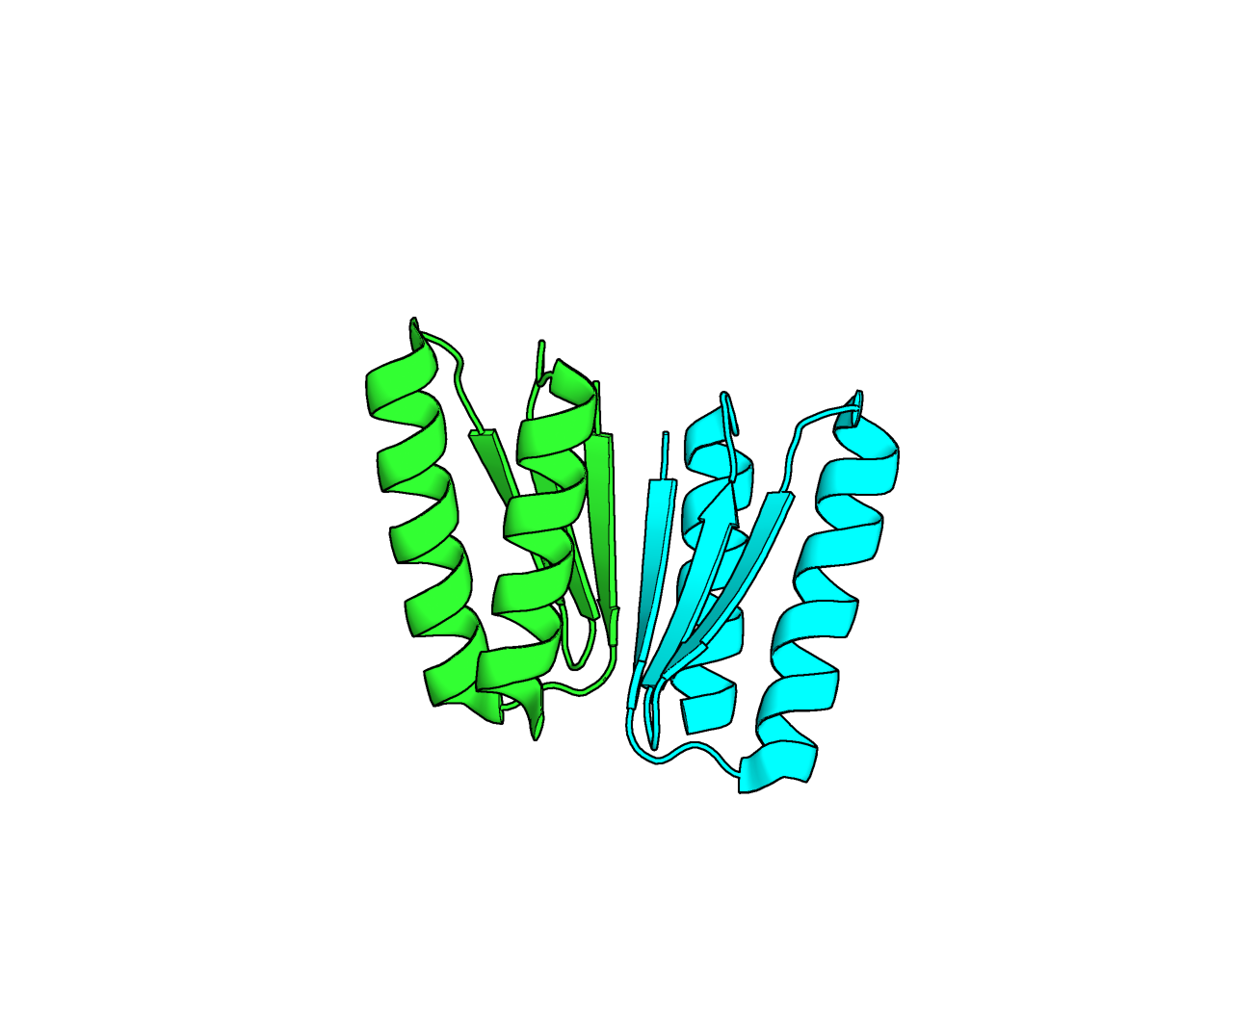
What is docking?
Given two protein subunits, what is the orientation in which they’re binding?
Subunit 1
Subunit 2
Docked Complex
+

Slide 5
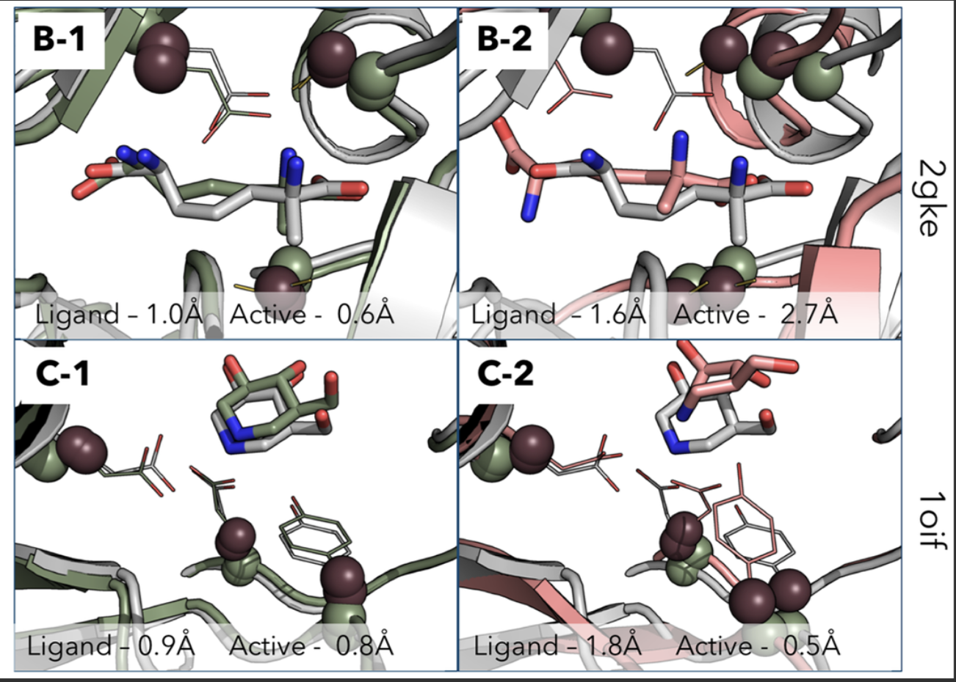
What is docking?
Given a protein and a small molecule, what is the orientation in which they’re binding?
Bertolani et al. (2019)

Slide 6
Rigid body vs flexible docking
Most methods assume rigid body docking which is unrealistic
Flexible docking hard because of lack of data and extra degrees of freedom

Slide 7
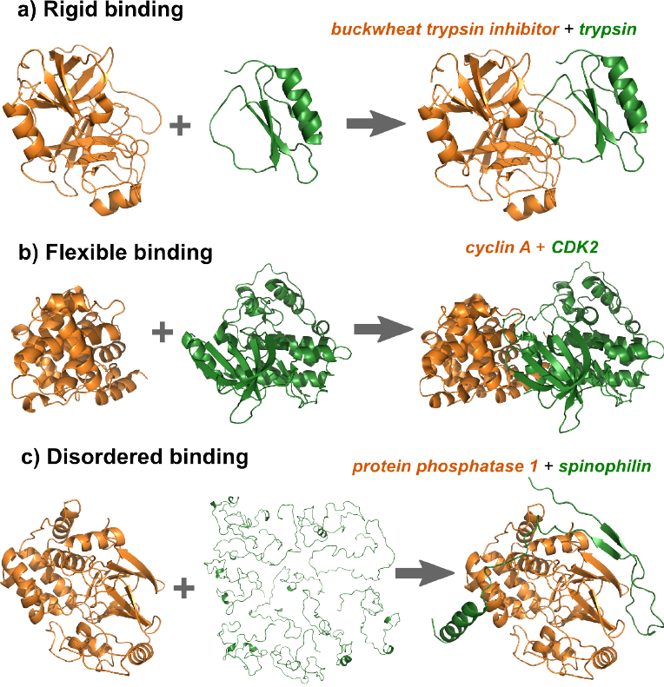
Rigid body vs flexible docking
Most methods assume rigid body docking which is unrealistic
Flexible docking hard because of lack of data and extra degrees of freedom

Slide 8
Different docking protocols
Rigid-body docking: ZDOCK, ClusPro, PatchDock → fast, rough, no flexibility.
Flexible-ligand docking: AutoDock Vina, GOLD, Glide → ligand flexible, protein mostly rigid.
Protein-flexible docking: RosettaDock, HADDOCK → side-chain & limited backbone motion allowed.
Highly flexible docking: Rosetta FlexPepDock → full peptide backbone flexibility.
AI docking (DiffDock): ligand-flexible diffusion model with fixed receptor → fast + high accuracy.

Slide 9
Docking metrics
Metric | i-RMS | L-RMS | fnat | DockQ
Units | Å | Å | -- | --
Range | > 0 | > 0 | [0, 1] | [0, 1]
Description | Measure of interface rmsd | Measure of ligand (smaller protein) rmsd | Fraction of natural/native contacts | Combines iRMS, lRMS, and fnat to make robust measure of docking accuracy

Slide 10
Docking metrics
Metric | i-RMS | L-RMS | fnat | DockQ
Units | Å | Å | -- | --
Range | > 0 | > 0 | [0, 1] | [0, 1]
Description | Measure of interface rmsd | Measure of ligand (smaller protein) rmsd | Fraction of natural/native contacts | Combines iRMS, lRMS, and fnat to make robust measure of docking accuracy

Slide 11
Docking metrics
Metric | i-RMS | L-RMS | fnat | DockQ
Units | Å | Å | -- | --
Range | > 0 | > 0 | [0, 1] | [0, 1]
Description | Measure of interface rmsd | Measure of ligand (smaller protein) rmsd | Fraction of natural/native contacts | Combines iRMS, lRMS, and fnat to make robust measure of docking accuracy

Slide 12
Docking metrics
Metric | i-RMS | L-RMS | fnat | DockQ
Units | Å | Å | -- | --
Range | > 0 | > 0 | [0, 1] | [0, 1]
Description | Measure of interface rmsd | Measure of ligand (smaller protein) rmsd | Fraction of natural/native contacts | Combines iRMS, lRMS, and fnat to make robust measure of docking accuracy

Slide 13
Applications
PPI design
Docking tools can help validate designed PPIs

Slide 14
Applications
PPI design
Docking tools can help validate designed PPIs
Scoring
Docking often has scoring components that rank poses. This can be used to score designs or even guide design

Slide 15
AI Based Docking Tools

Slide 16
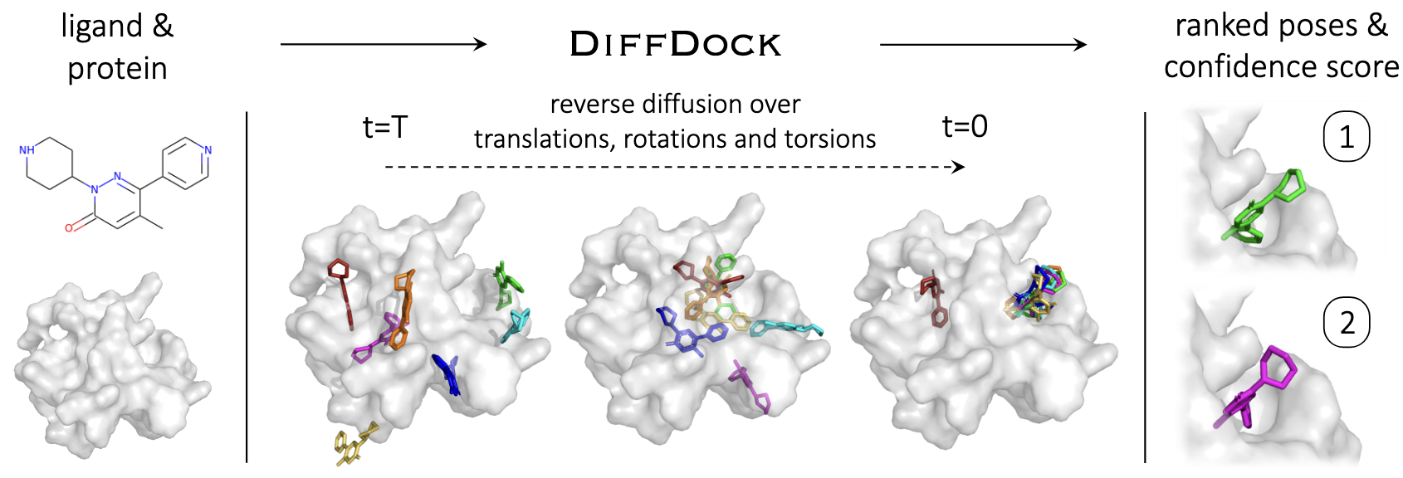
Corso et al. (2023)

Slide 17
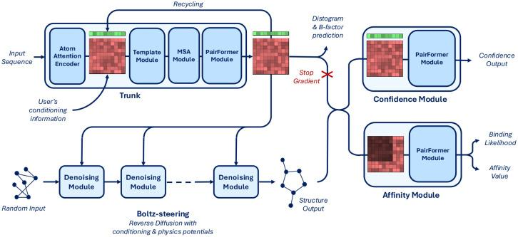
Boltz -2

Slide 18
Multimodal AI Design

Slide 19
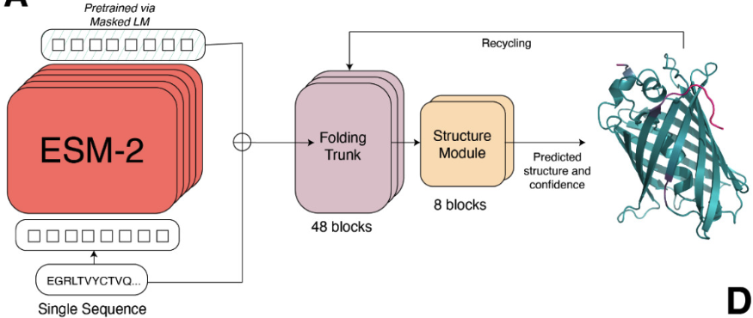
ESMFold – Refresher
Lin et al. (2023)

Slide 20
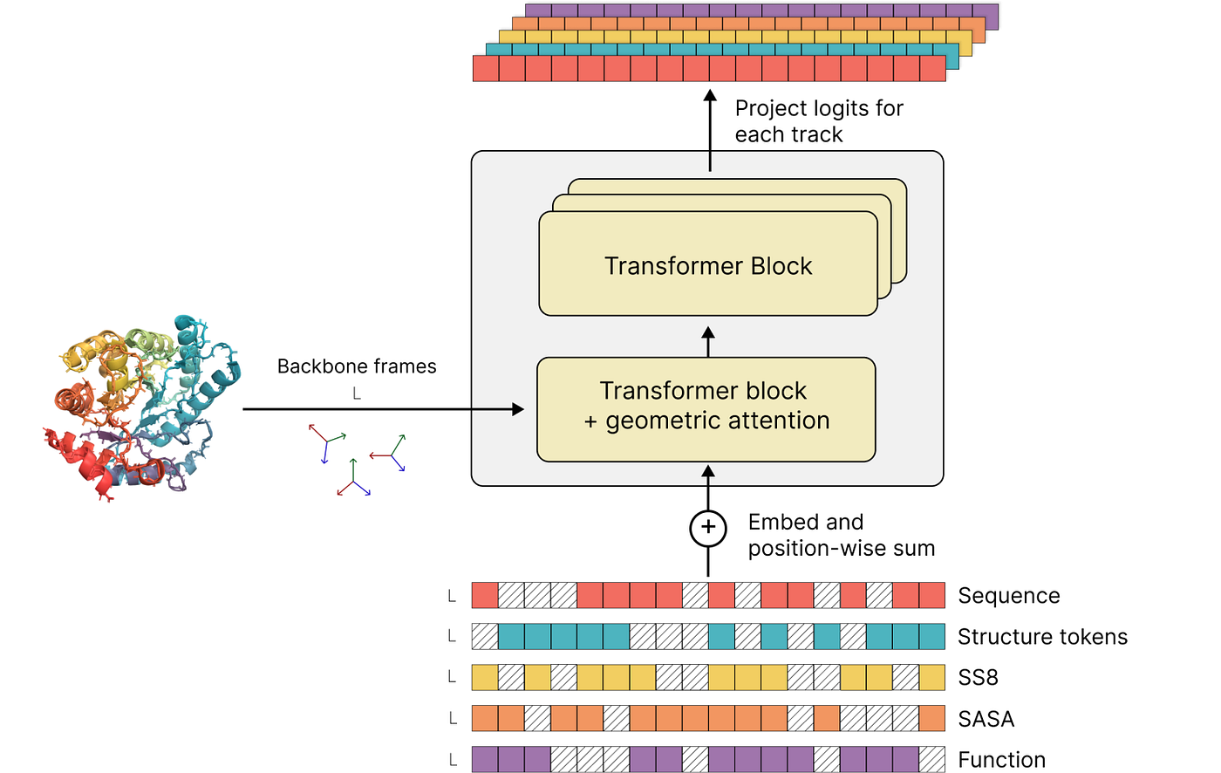
ESM3 Multimodal Design
Hayes et al. (2024)

Slide 21
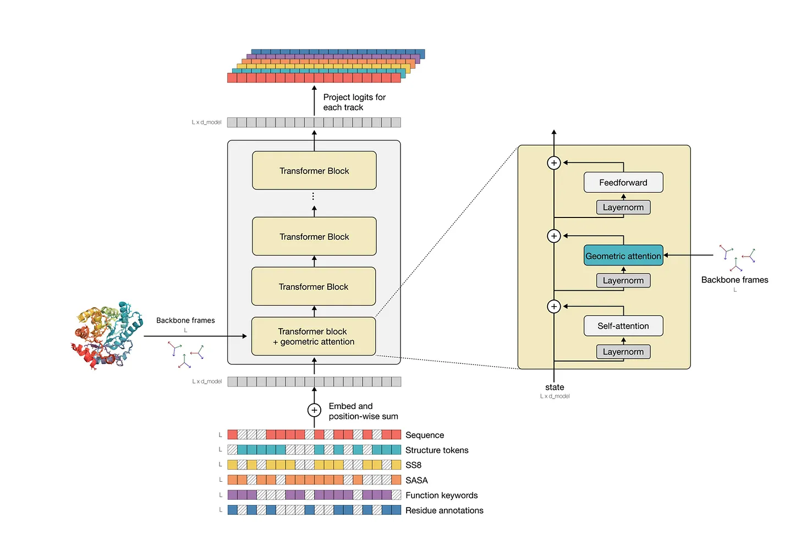
ESM3 Multimodal Design
216 Transformer blocks.
Hayes et al. (2024)

Slide 22
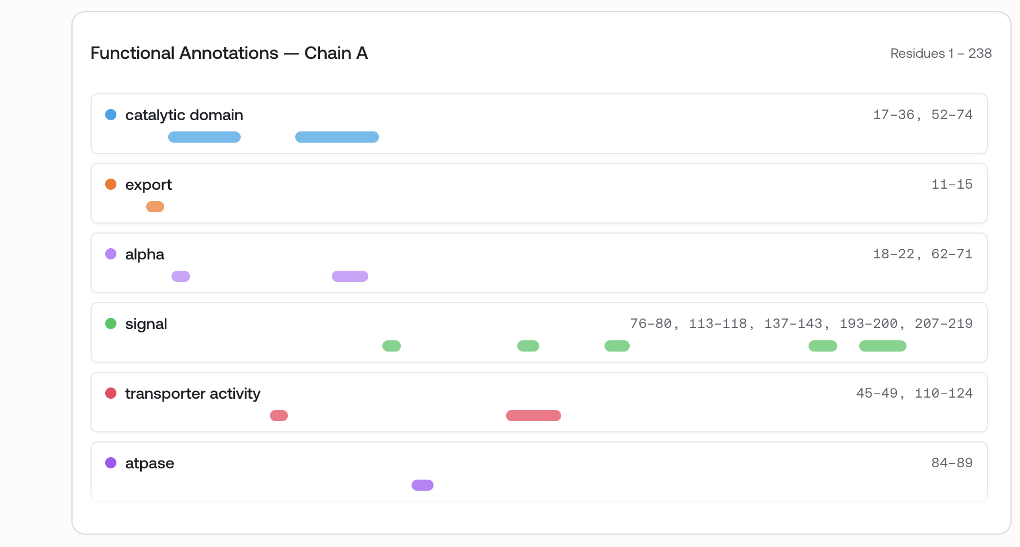
ESM3 Multimodal Design – Function Prediction
Hayes et al. (2024)

Slide 23
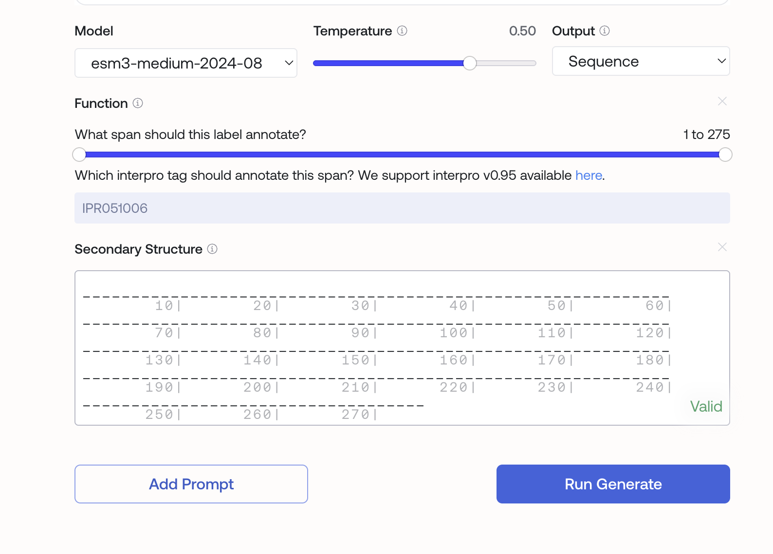
ESM3 Multimodal Design – Design via prompting
Hayes et al. (2024)

