Slide 1

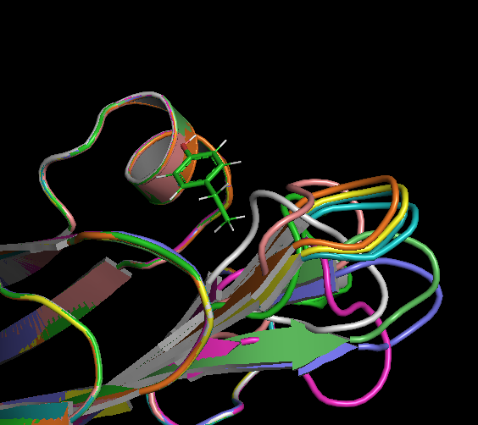
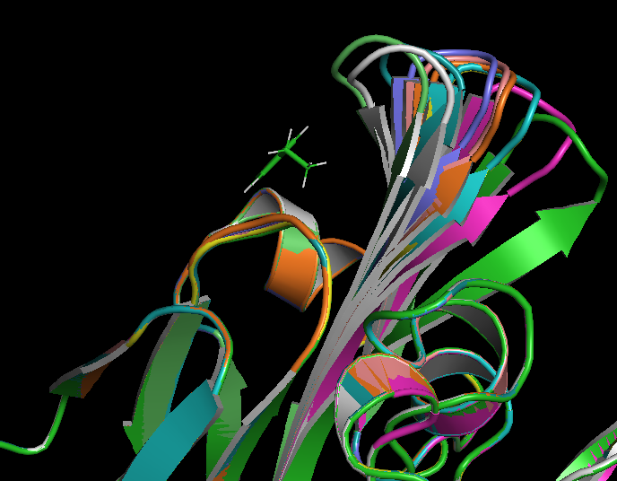
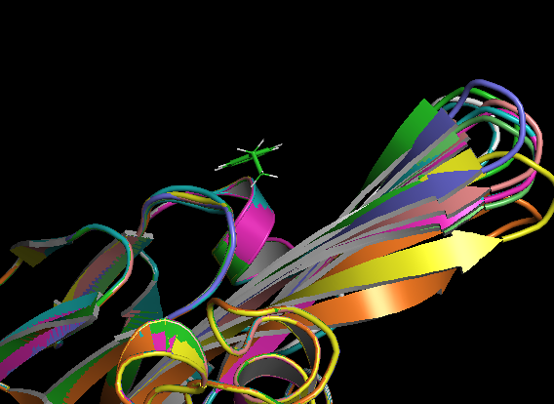
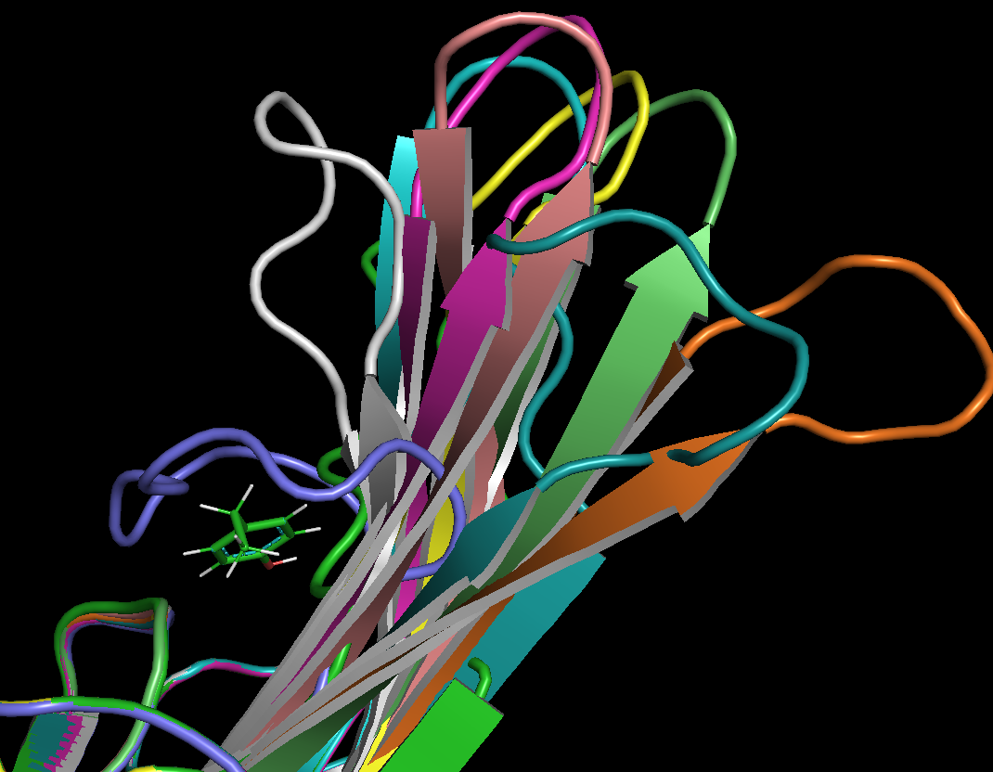
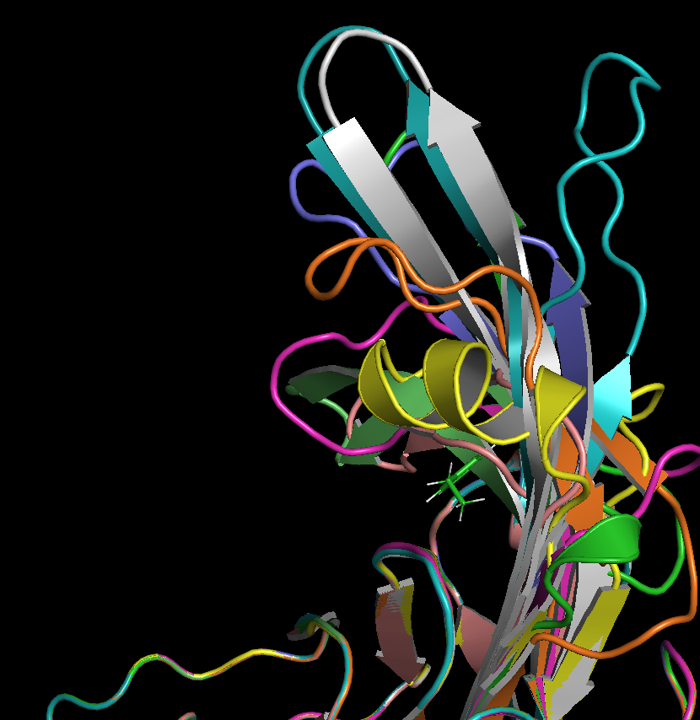
Examples of RFDiffusion outputs - 10 models each
+12
+15
+10
+20
High similarity for inserts 10-15
Starts to show variety around 20-25
+25

Slide 2
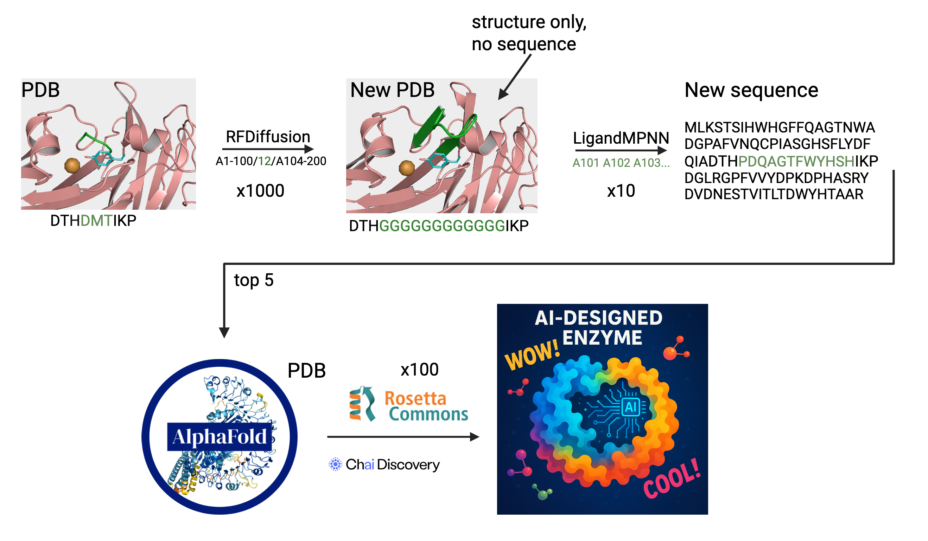
Mary’s AI-driven design workflow
=10,000
models!
(too many!)

Slide 3
Mary’s AI-driven design workflow
=10,000
models!
(too many!)
The question is how to filter?
Needs a filter
Filters on RFDiffusion outputs will reduce the total number of models generated with MPNN

Slide 4
Advice for designing your pipeline
Have a clear goal of what you want to design.
Specifically, what is the goal? What do you want to change or create with the protein?
Go slow and take notes of each input & output
As you make changes and run different things, you will forget what you ran!
Turn one knob at a time
Go slow with designs, choosing the simplest option first before adding more options.
Changing too many things at once can lead to the inability to adjust specific things later.
Keep track of the decisions made for each step and why those decisions were made.

