Slide 1
CMSC 320 HW 5
Aayush Verma

Slide 2
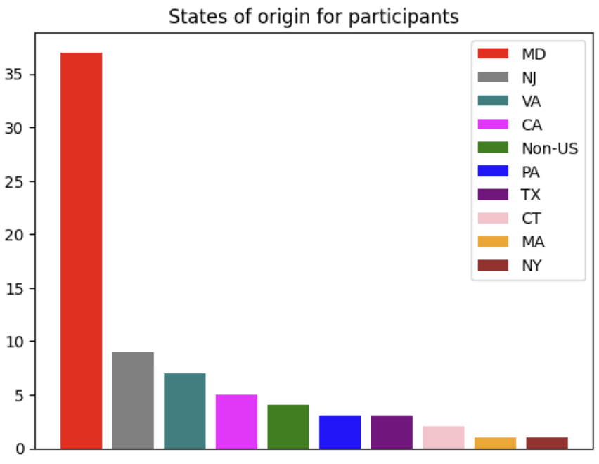
Demographic info pt.1
To the right is a bar plot showing which state the participants of the survey come from.
The vast majority of participants were from Maryland

Slide 3
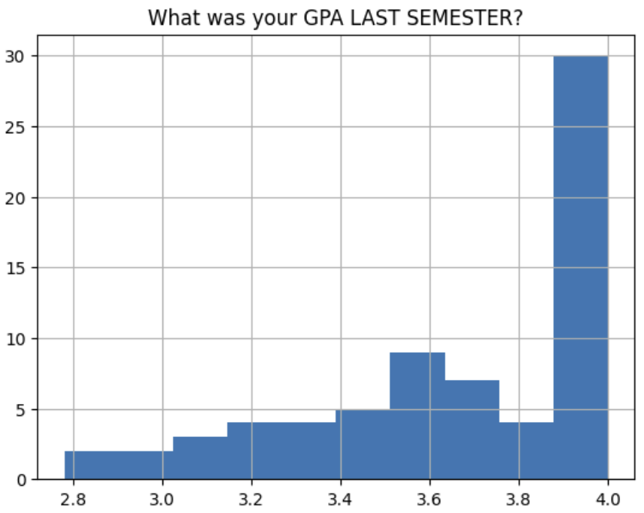
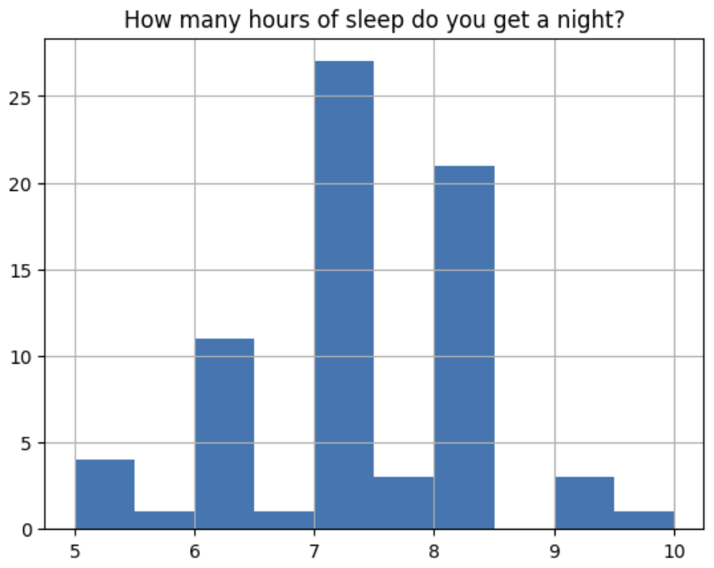
Demographics pt. 2
To the right are histograms showing the GPAs and sleep of survey participants.
As can be seen, the GPAs of students are largely in the 3.8-4.0 range (although students may be inaccurately reporting their grades)
Among all participants, the amount of sleep they get seems to be centered fairly tightly around 7-8 hours

Slide 4
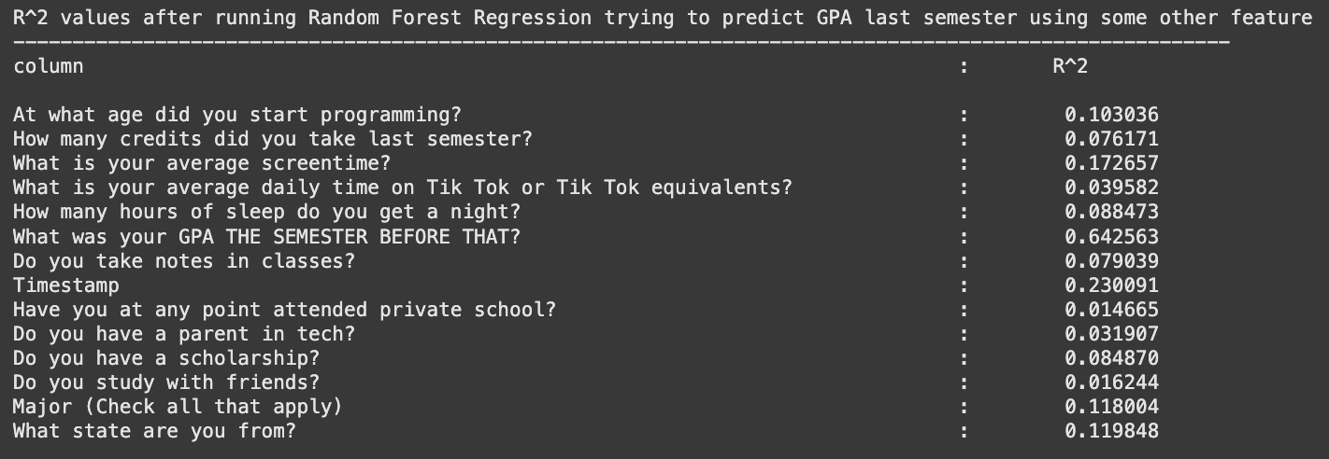
Predictive ability of different factors on grade pt. 1
For each of the factors listed below, I ran a Random Forest Regression to try and predict the GPA and listed the R^2 values.
From the table, it can be seen that the GPA 2 semesters prior had the most power at predicting last semester’s GPA
Intuitively, this makes sense because a student’s performance semester to semester should be fairly consistent.

Slide 5
Predictive ability of different factors on grade pt. 2
Similarly, we can also find that whether the survey participant attended a private school was the worst at predicting the grades of student. This was a little bit surprising, but might be a result of selection bias (students who took the time to fill out this optional survey may simply have a different distribution than the actual population).

Slide 6
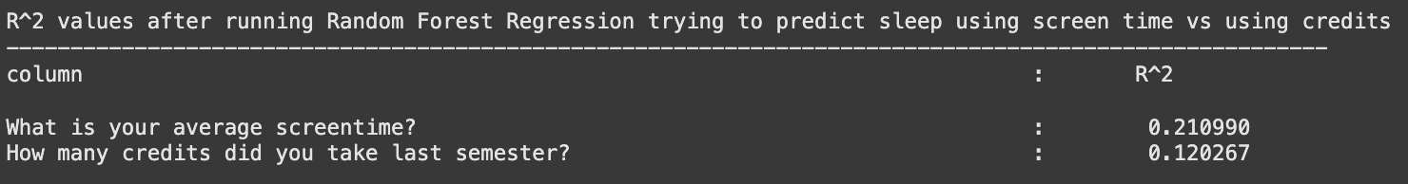
Predicting sleep
I also looked at whether screen time or course load was a better predictor of sleep. I put the features into a random forest regression, trying to predict sleep, and looked at the R^2 values.
It was interesting to see that screen time was a better predictor of sleep (albeit both had fairly low R^2 values). A possible reason for this could be using devices immediately before sleeping.

Slide 7
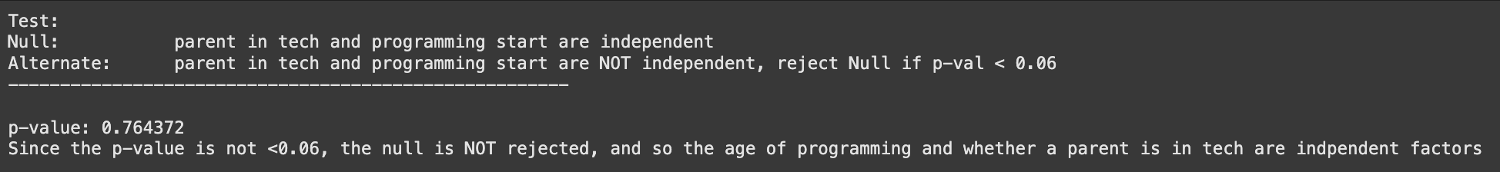
Programming Beginning and Parent in tech
Below is the result of a Chi-Squared test I ran to test if the age at which a survey participant began programming and the number of parents in tech that they had were independent variables.
Interestingly, they did turn out to be independent. This was surprising for me because I would have expected parents to indirectly or directly encourage their kids to go into the same field they did

Slide 8
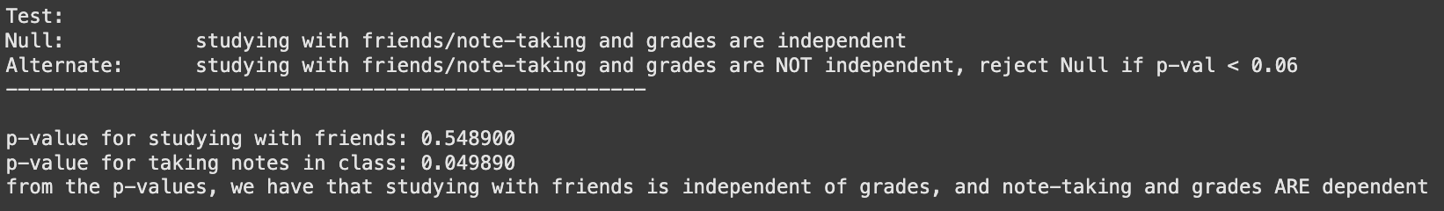
Studying and grades
Below are the results for 2 separate Chi-Squared tests I ran to see:
If studying with friends and grades were independent
If taking notes in class and grades were independent
My results were that, while studying with friends and grades were independent variables, taking notes had a statistically significant effect on grades. This makes sense because, with friends, there’s a fairly high chance of getting distracted rather than studying.

Slide 9
Conclusion
The main takeaways are the following:
None of the factors by themselves were a good indicator of the GPA that a student received. If, in the future, a model needed to be designed to predict a student’s GPA, it would be a good idea to use multiple different features.
There may have been selection bias in the survey, as students who go out of their way to fill out an optional survey may not be a balanced sample of the entire population of students.

