Slide 1
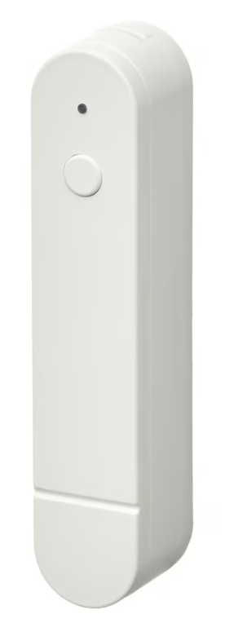

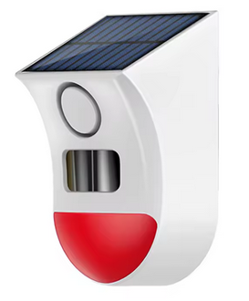





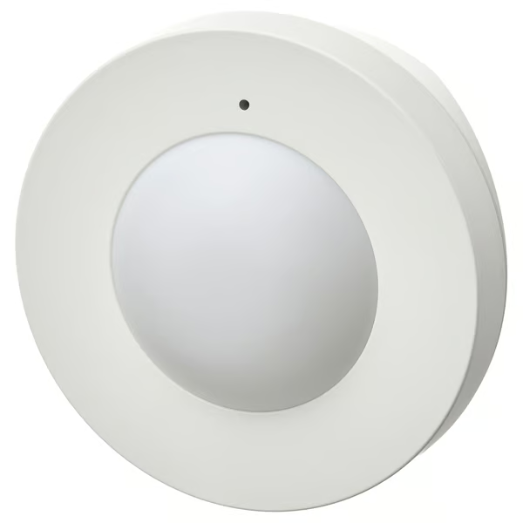
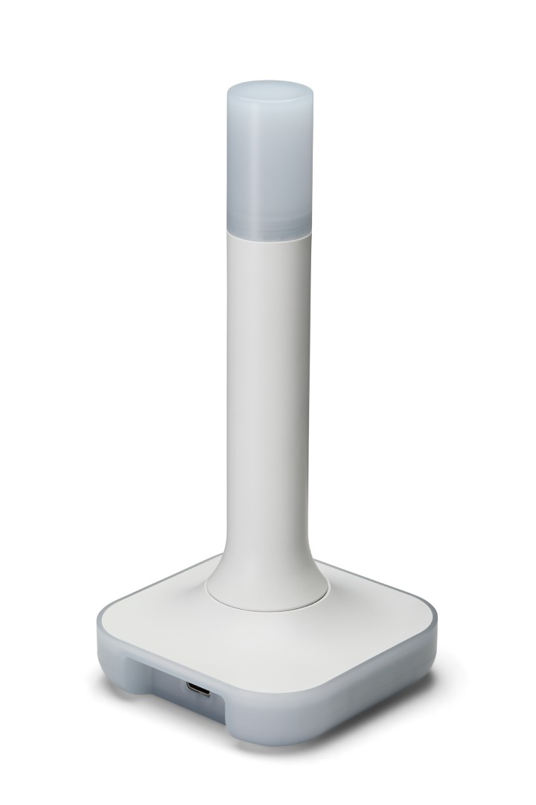
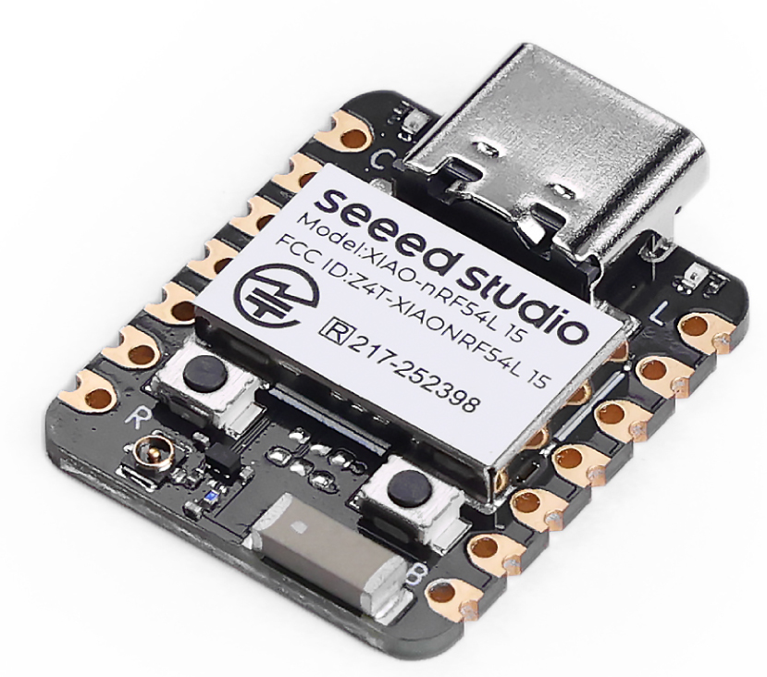

IoT System Architecture: two different stacks using one PHY Layer
CoAP
CoaP Server
using Zephyr CoAP libs
Add-on
Add-on
Stack
Sleepy End Device
CoaP Client
Bridge Add-on
integrate
Seeed nRF54L15
Add-on
ZBT-2
Border Router
Block Legend
Available stack
Home Assistant OS (HAOS)
on old laptop
New code

