Slide 1
DRIVER DROWSINESS DETECTION &
RESPONSE SYSTEM
Guided by:
Mrs. Soumya M
(Asst.Professor,
Dept of CSE, SCTCE)
Members:
Liyana J (238)
Praful George (249)
Rosh Cherian (256)

Slide 2
CONTENTS
Introduction
Literature Review
Problem Statement
Tech Stack
Software Requirements Specification
System Architecture Design
Result
Conclusion
References

Slide 3
INTRODUCTION
The major aim of this project is to develop a Driver Drowsiness Detection and Response System (DDDRS) by monitoring eye movement.
Utilizing computer vision, we continuously track driver eye movements in real-time.
The software immediately identifies signs of drowsiness, providing timely alerts to maintain driver attentiveness and prevent potential accidents.

Slide 4
LITERATURE REVIEW
1. Risk assessment of road traffic accidents related to sleepiness during driving: a systematic review, Shehzad Saleem
The review aims to assess the relationship between sleepiness during driving and road traffic accidents.
A significant proportion of accidents worldwide is caused by driver drowsiness.
Ensuring a minimum of six hours of sleep daily is essential to reduce the risk of drowsiness-related accidents.
Concludes that to address drowsy driving accidents, it is vital to have a system that monitors drivers' sleep patterns and tracks their driving hours.
2. Prevalence of Motor Vehicle Crashes Involving Drowsy Drivers, United States, 2009 – 2013 , Brian C. Tefft
A study conducted by the AAA Foundation for Traffic Safety discovered that in the years 1999-2008,
- 13% of crashes resulting in hospitalization involved a drowsy driver.
- 17% of fatal crashes involved a drowsy driver.
- 7% of all crashes involved a drowsy driver.
According to the National Highway Traffic Safety Administration (NHTSA),
- approximately 228,000 crashes involve a drowsy driver
- resulting in 109,000 injuries and 6,400 fatal crashes annually.

Slide 5
LITERATURE REVIEW (Cont..)
3. Drowsiness Detection and Warning System Using Python, Pratiksha Kolpe, Pratibha Kadam
This paper presents the development of a drowsiness detection and warning system using Python.
The system utilizes OpenCV for eye detection, extracting 68-face-landmarks from live input video captured by a webcam.
The eye blinking ratio is calculated using Euclidean eye aspect ratio, which determines whether the eyes are open or closed.
4. Drowsy or Not? Early Drowsiness Detection utilizing Arduino Based on Electroencephalogram (EEG) Neuro-Signal, Jennalyn N. Mindoro
Integration of a wireless and wearable Electroencephalogram (EEG) tool with an effective prediction model enabled the development of a driver sleepiness prediction system.
The paper introduces a wearable EEG tool designed to automatically assess the driver's mental state.
An experimental setup involving 10 participants incorporated an alarm system activated by brain activity fluctuations, facilitated by an Arduino module. A label of 1 indicates drowsy, while 0 indicates attentive states, achieving an accuracy of 93.33%.

Slide 6
LITERATURE REVIEW (Cont..)
5. Evaluation of Haar Cascade Classifiers Designed for Face Detection, R. Padilla, C. F. F. Costa Filho
Important features within the human face can be utilized by vision-based automated systems for identification and recognition purposes.
Researchers commonly employ the Viola-Jones framework to detect faces and objects within images.
6. Drowsiness detection using heart rate variability analysis based on microcontroller unit”, Muhammad Hendra
The article discusses the use of heart rate variability (HRV) analysis for detecting drowsiness in drivers, employing a microcontroller unit.
HRV, which is derived from electrocardiogram intervals, reflects changes that occur during drowsiness, fatigue, and stress.
The AD8232 module captures the electrocardiogram signal, which is processed within the microcontroller unit. Electrocardiogram data is recorded during simulated driving.
HRV features are extracted, and a radial basis function neural network is used to classify between drowsy and normal states with an accuracy of 79.26%.

Slide 7
PROBLEM STATEMENT
The absence of reliable, real-time systems to detect and prevent driver drowsiness is a major challenge, leading to a high rate of road accidents.There lacks a dependable system for preventing road accidents.
DDDRS employs cutting-edge live eye tracking to detect drowsiness instantly, alerting the driver using LEDs and buzzers. Integrated GPS enables automatic emergency messaging, enhancing road safety by preventing drowsy driving accidents.

Slide 8
TECHNOLOGY STACK
OpenCV
Python Program
Twilio API
Arduino and NEO-6M GPS Module
Git

Slide 9
SOFTWARE REQUIREMENTS SPECIFICATION
Functional Requirements:
Eye Tracking Interface
This interface utilizes computer vision technology to monitor the driver's eye movements consistently. It captures input data through a camera and analyzes it to detect signs of driver drowsiness.
Alert Mechanism
Upon detecting signs of drowsiness, the system activates alerts, comprising LED indicators and audible warnings.
Emergency Message
When the system surpasses the designated time limit threshold, it triggers an emergency message to preassigned emergency contacts.

Slide 10
SOFTWARE REQUIREMENTS SPECIFICATION (Cont..)
Non-Functional Requirements:
Performance: The system shall have low latency in detecting and responding to drowsiness, with a maximum delay of 1 second.
Reliability: The system shall operate reliably under varying lighting conditions and for users wearing glasses or contact lenses.
Scalability: The system architecture shall be designed to accommodate future enhancements or integrations.
Usability: The user interface shall be intuitive and easy to understand for drivers of varying technical expertise.

Slide 11
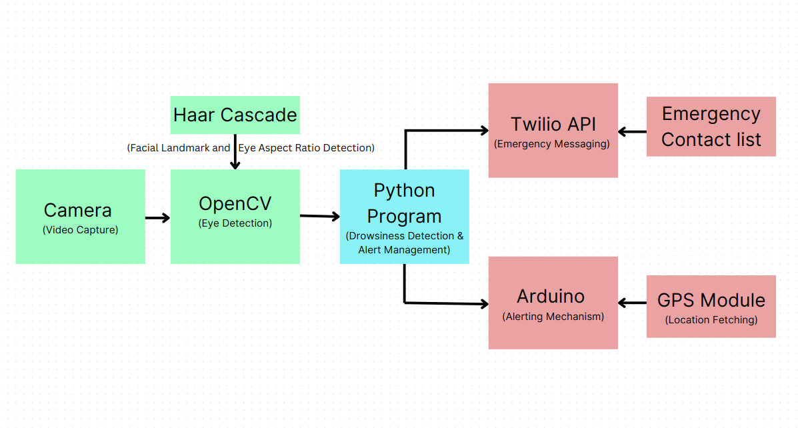
SYSTEM ARCHITECTURE DESIGN
Dataflow Diagram:

Slide 12
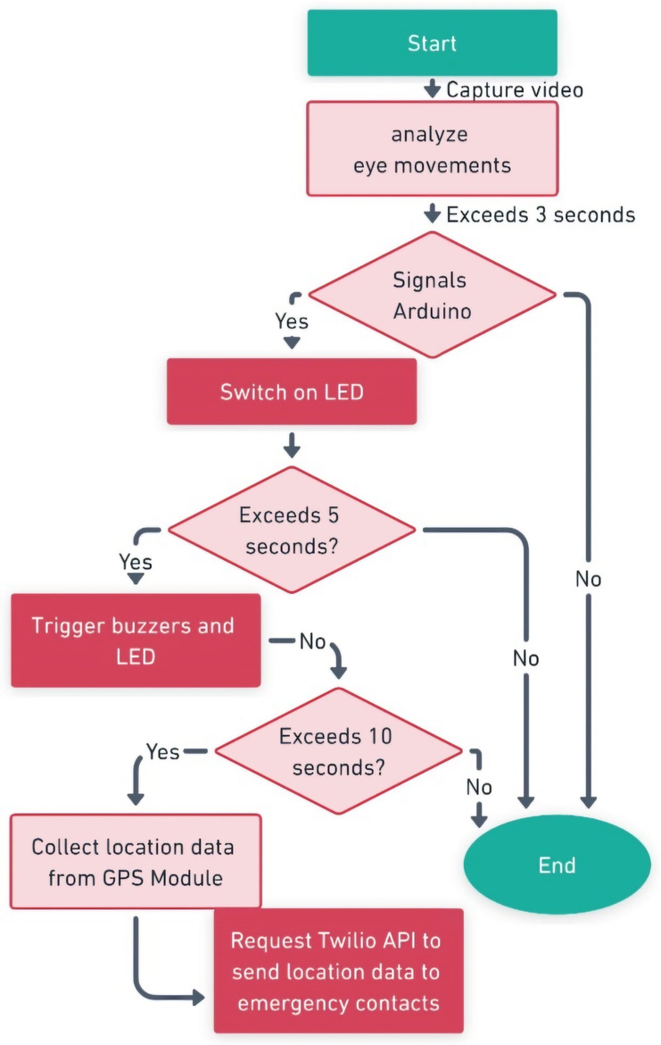
SYSTEM ARCHITECTURE DESIGN (Cont..)
The Eye Tracking Module captures and analyzes video for eye movements.
Signals Arduino if eye closure exceeds 3 seconds.
Arduino triggers buzzer for alerts over 5 seconds.
Arduino requests Twilio API with location if over 10 seconds for alert messages.
Eye Tracking Module and Arduino exchange real-time data.
Arduino integrates with Twilio API for alerts.
GPS module interfaces with Arduino for current location in alerts.

Slide 13
SYSTEM ARCHITECTURE DESIGN (Cont..)
OpenCV captures real-time video from the camera, while the Haar Cascade Algorithm detects eyes using facial landmarks and the eye aspect ratio.
The Python Program analyzes the eye closure duration to detect drowsiness.
If drowsiness is detected, the Python Program initiates the alerting mechanism through the Arduino Module, which triggers physical alerts such as buzzer sounds.
The GPS Module retrieves the current location and transmits the location details to the Python Program.
The Python Program evaluates drowsiness constraints and, if they are met, forwards the location details to the Twilio API to trigger emergency alerts.
The Twilio API processes the location data from the Python Program and sends emergency messages to preassigned contacts.

Slide 14
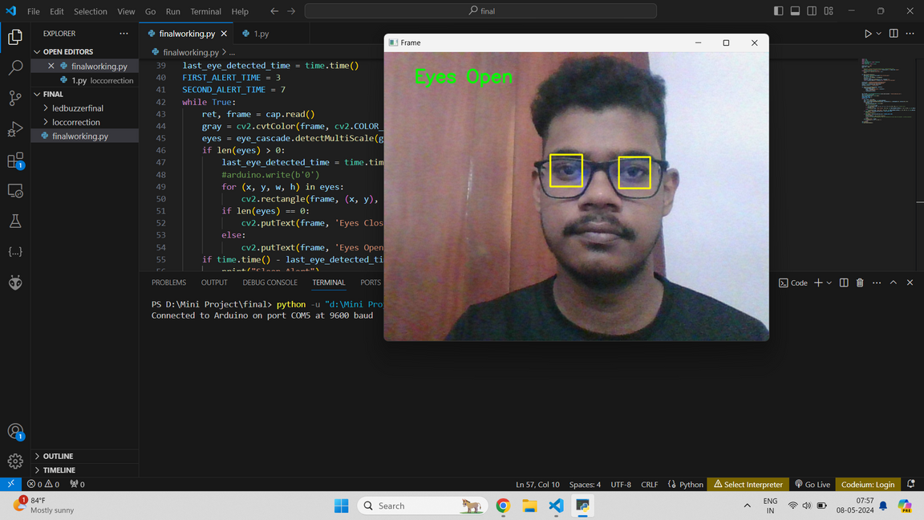
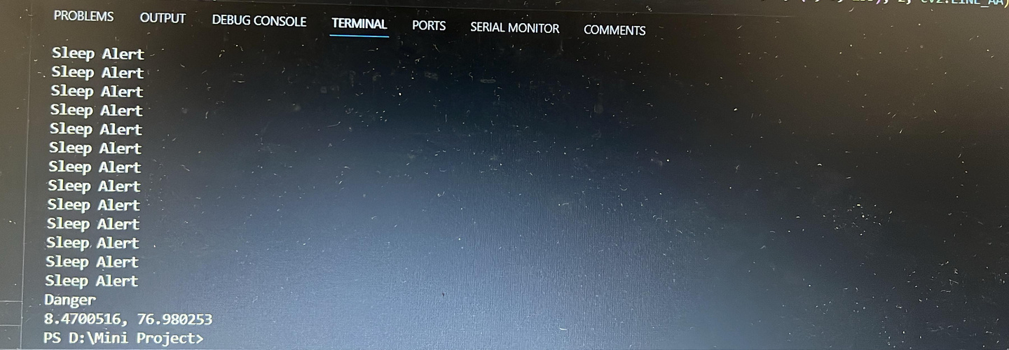
RESULT
Eye detection utilizing
OpenCV.
Detection of closed eyes triggers an alert mechanism upon reaching the specified time limit.

Slide 15
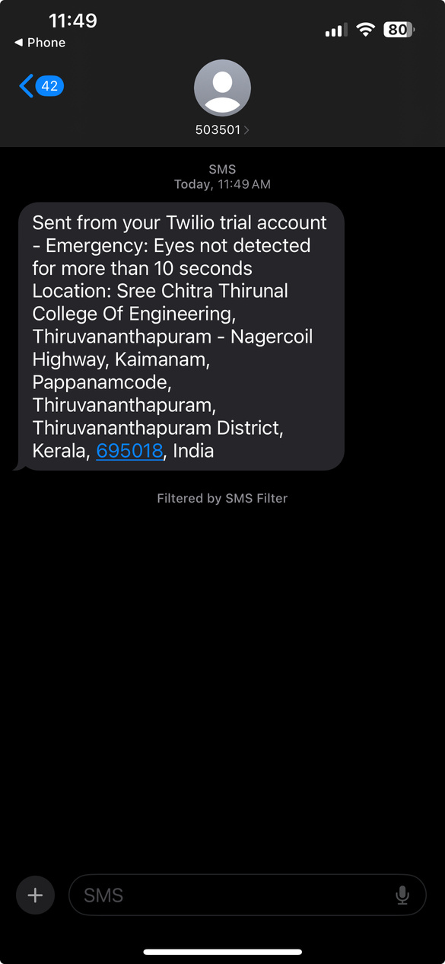
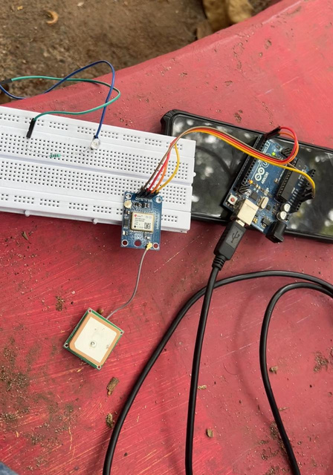
RESULT (Cont..)
Activation of the alert mechanism.
Receipt of alert messages by emergency contacts.
The system successfully detected drowsiness in real-time by analyzing eye closure duration and activated alerts and emergency procedures, including controlled vehicle stopping and alert messages with the vehicle's location.

Slide 16
CONCLUSION
The DDDRS project aimed to enhance road safety by detecting and alerting drowsy drivers in real-time, using technologies like OpenCV, Python, Arduino, and Twilio.
The system accurately detected drowsiness through eye movement analysis, promptly alerting drivers and initiating emergency procedures. It has the potential to reduce accidents caused by drowsy driving significantly.
Future research could focus on reinforcement learning algorithms and hybrid control strategies to enhance the system further.

Slide 17
REFERENCES
1. Shehzad Saleem, “Risk assessment of road traffic accidents related to sleepiness during driving: a systematic review”, Department of Community Medicine, King Edward Medical University, India, 2022
https://doi.org/10.26719/emhj.22.055
2. Brian C. Tefft, “Prevalence of Motor Vehicle Crashes Involving Drowsy Drivers, United States, 2009 – 2013”. AAA Foundation for Traffic Safety, USA,2014
https://tinyurl.com/AAA-DrowsyDriving-Nov2014
3. R. Padilla, C. F. F. Costa Filho and M. G. F. Costa, “Evaluation of Haar Cascade Classifiers Designed for Face Detection”, International Journal of Computer, Electrical, Automation, Control and Information Engineering Vol:6, No:4, 2012
https://bit.ly/Haar_Cascade_Classifiers

Slide 18
REFERENCES (Cont..)
4. Muhammad Hendra, Danang Kurniawan, Riza Vina Chrismiantari, Trio Pambudi Utomo, Nuryani Nuryani, “Drowsiness detection using heart rate variability analysis based on microcontroller unit”, Journal of Physics: Conference Series, Indonesia,2019
https://doi.org/10.1088/1742-6596/1153/1/012047
5. Pratiksha Kolpe, Pratibha Kadam, Usama Mashayak, "Drowsiness Detection and Warning System Using Python", International Conference on Communication and Information Processing, India, 2020
https://doi.org/10.2139/ssrn.3645864
6. Jennalyn N. Mindoro, Cherry D. Casuat, Alvin Sarraga Alon, Mon Arjay F. Malbog, Julie Ann B. Susa, "Drowsy or Not? Early Drowsiness Detection utilizing Arduino Based on Electroencephalogram (EEG) Neuro-Signal", International Journal of Advanced Trends in Computer Science and Engineering, Volume 9 No.2, Philippines,2020
https://doi.org/10.30534/ijatcse/2020/200922020

Slide 19
Thank you

