Slide 1
Data analytics for E-Sports
Roshan Raj Ramesh
209030158

Slide 2
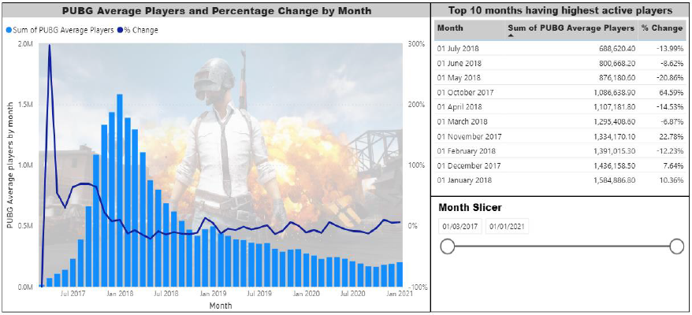
Motivation
PUBG is the most played BR game in 2017, 2018 and first BR game available to the consumers.
The game is struggling to retain the active players.
Reason behind this downfall regards to the gameplay and changes to be done for the Improving the gameplay.

Slide 3
Proposed values
Recommendations and suggestions for game developers to retain the entertainment of the game.
Introductory game guide for new comers to the game and helping them to have a decent gun fight time.

Slide 4
Things to add in the introductory guide
Weapon information
Players position analysis and camping details
Gun top players uses the most

Slide 5
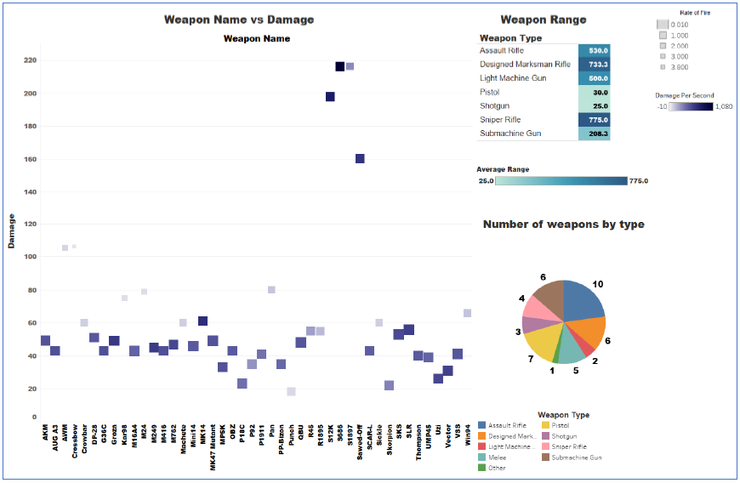
Weapon statistics
Insights from the visualization:
While picking a short-range fight, the player must pick SMGs or a Shotgun.
Assault rifles are very reliable as they can be used in both short-range and mid-range fight. A beginner player must an assault rifle as it is a versatile weapon type and played by top players in the game.
For players who wish to pick a medium and long-range fight is advised to pick designed marksman rifle and sniper rifle are only choice to go.

Slide 6
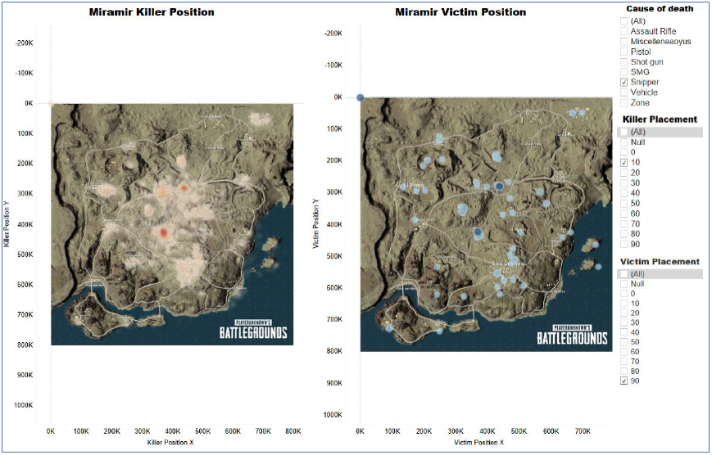
Player camping positions
Camping position of top players.
Sniper prone areas are revealed.
Adjusting the filters can produce number of interesting results

Slide 7
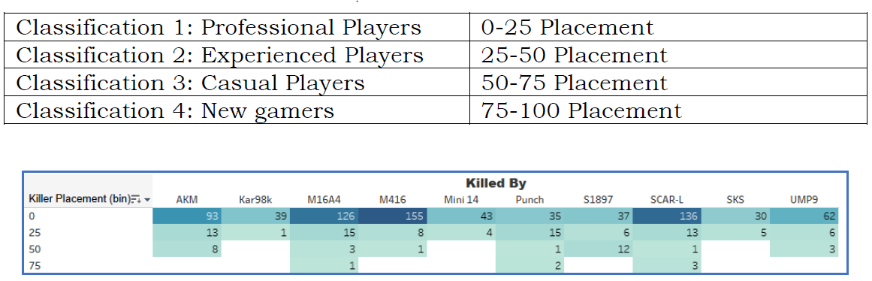
Weapon usage w.r.t to players skill level
Most played gun used by professional players are:
M416
SCAR-L
M16A

Slide 8
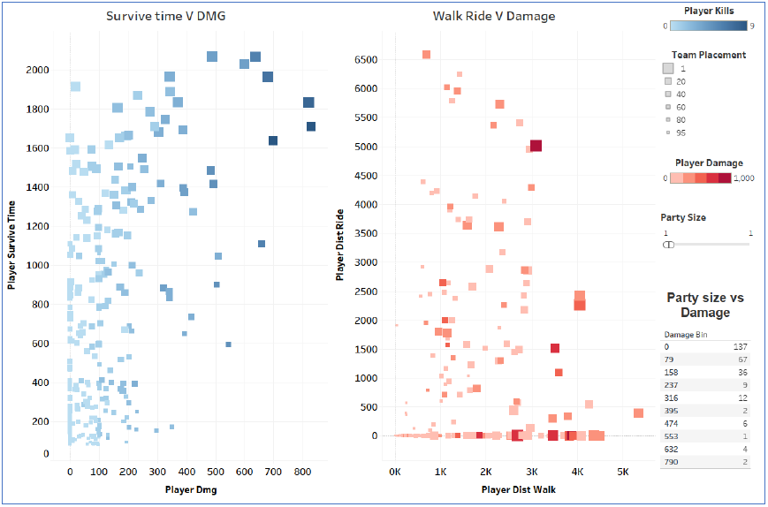
Gameplay choices
Addressing the player’s satisfaction is also a key factor to consider and make them entitled to a particular game.
Players survive time and player damage does not show any correlation which is expected to show some positive correlation.
Suggestions to improve the gun time of a casual player:
Increasing player’s health and Armor’s hit point will encourage players to pick the fight
Better consumables will let players heal faster and continue the fight.

Slide 9
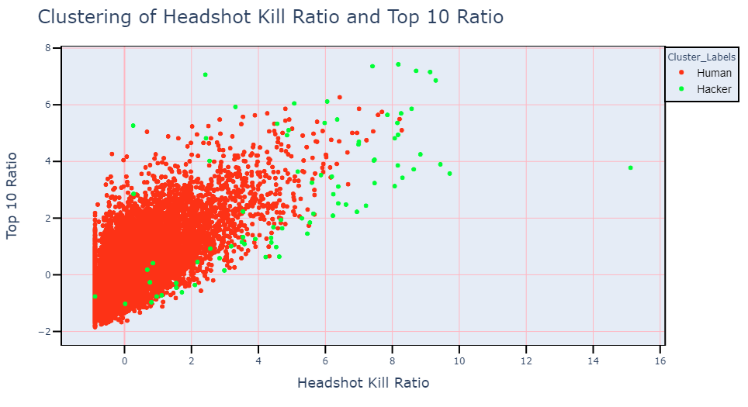
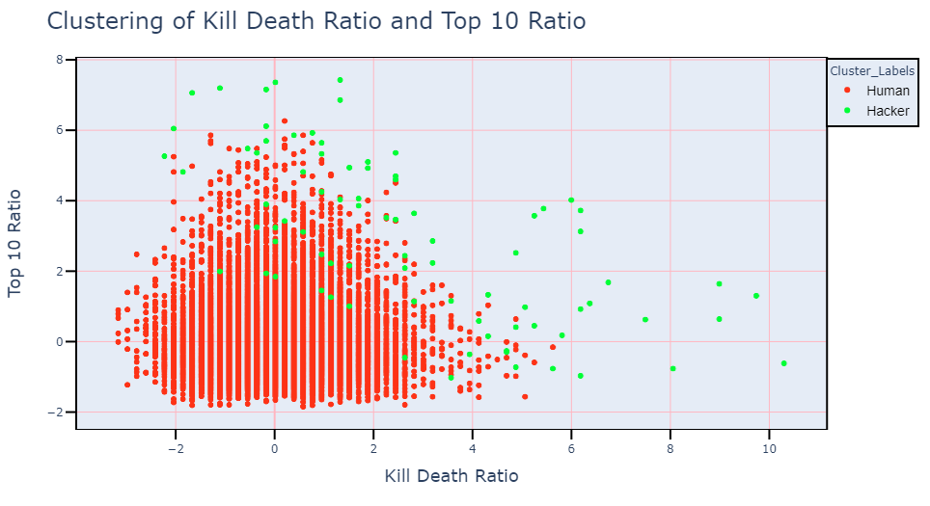
Hacker analysis (Density based clustering)

Slide 10
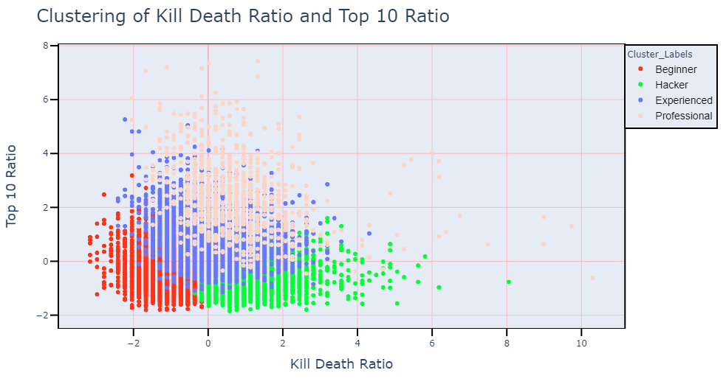
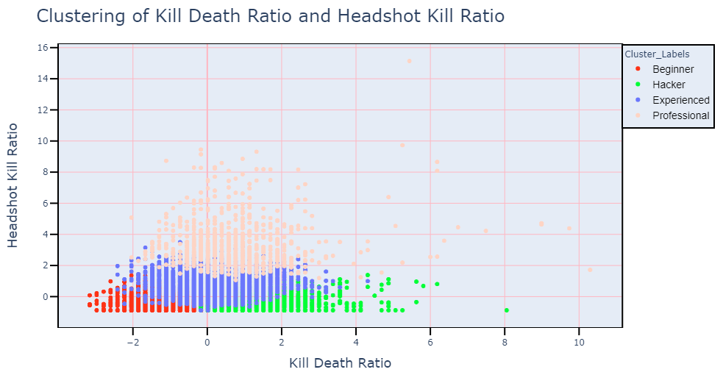
Skill gap analysis (KNN, K=4)

Slide 11
Importance of skill gap analysis
If the skill gap is more between new gamers and the rest of the lobby, it will be difficult for a new gamer to get into the game.
At the same time if the skill gap is less, there is no meaning to play the game in a long run for a professional player.
This should be handled sensibly and should be monitored every season of the game. It creates a welcoming environment for the new gamers and at the same time gives a reason for a professional player to play the game.

Slide 12
Future scope and Conclusion
Comparing the player’s skill gap of a trending game say fortnite, apex legends with PUBG can help us understand the real reason behind PUBG’s downfall.
Analytics can help an E-Sports title retaining the players and also will help to modify some gameplay decision that can make an E-Sports title more welcoming.

