Slide 1
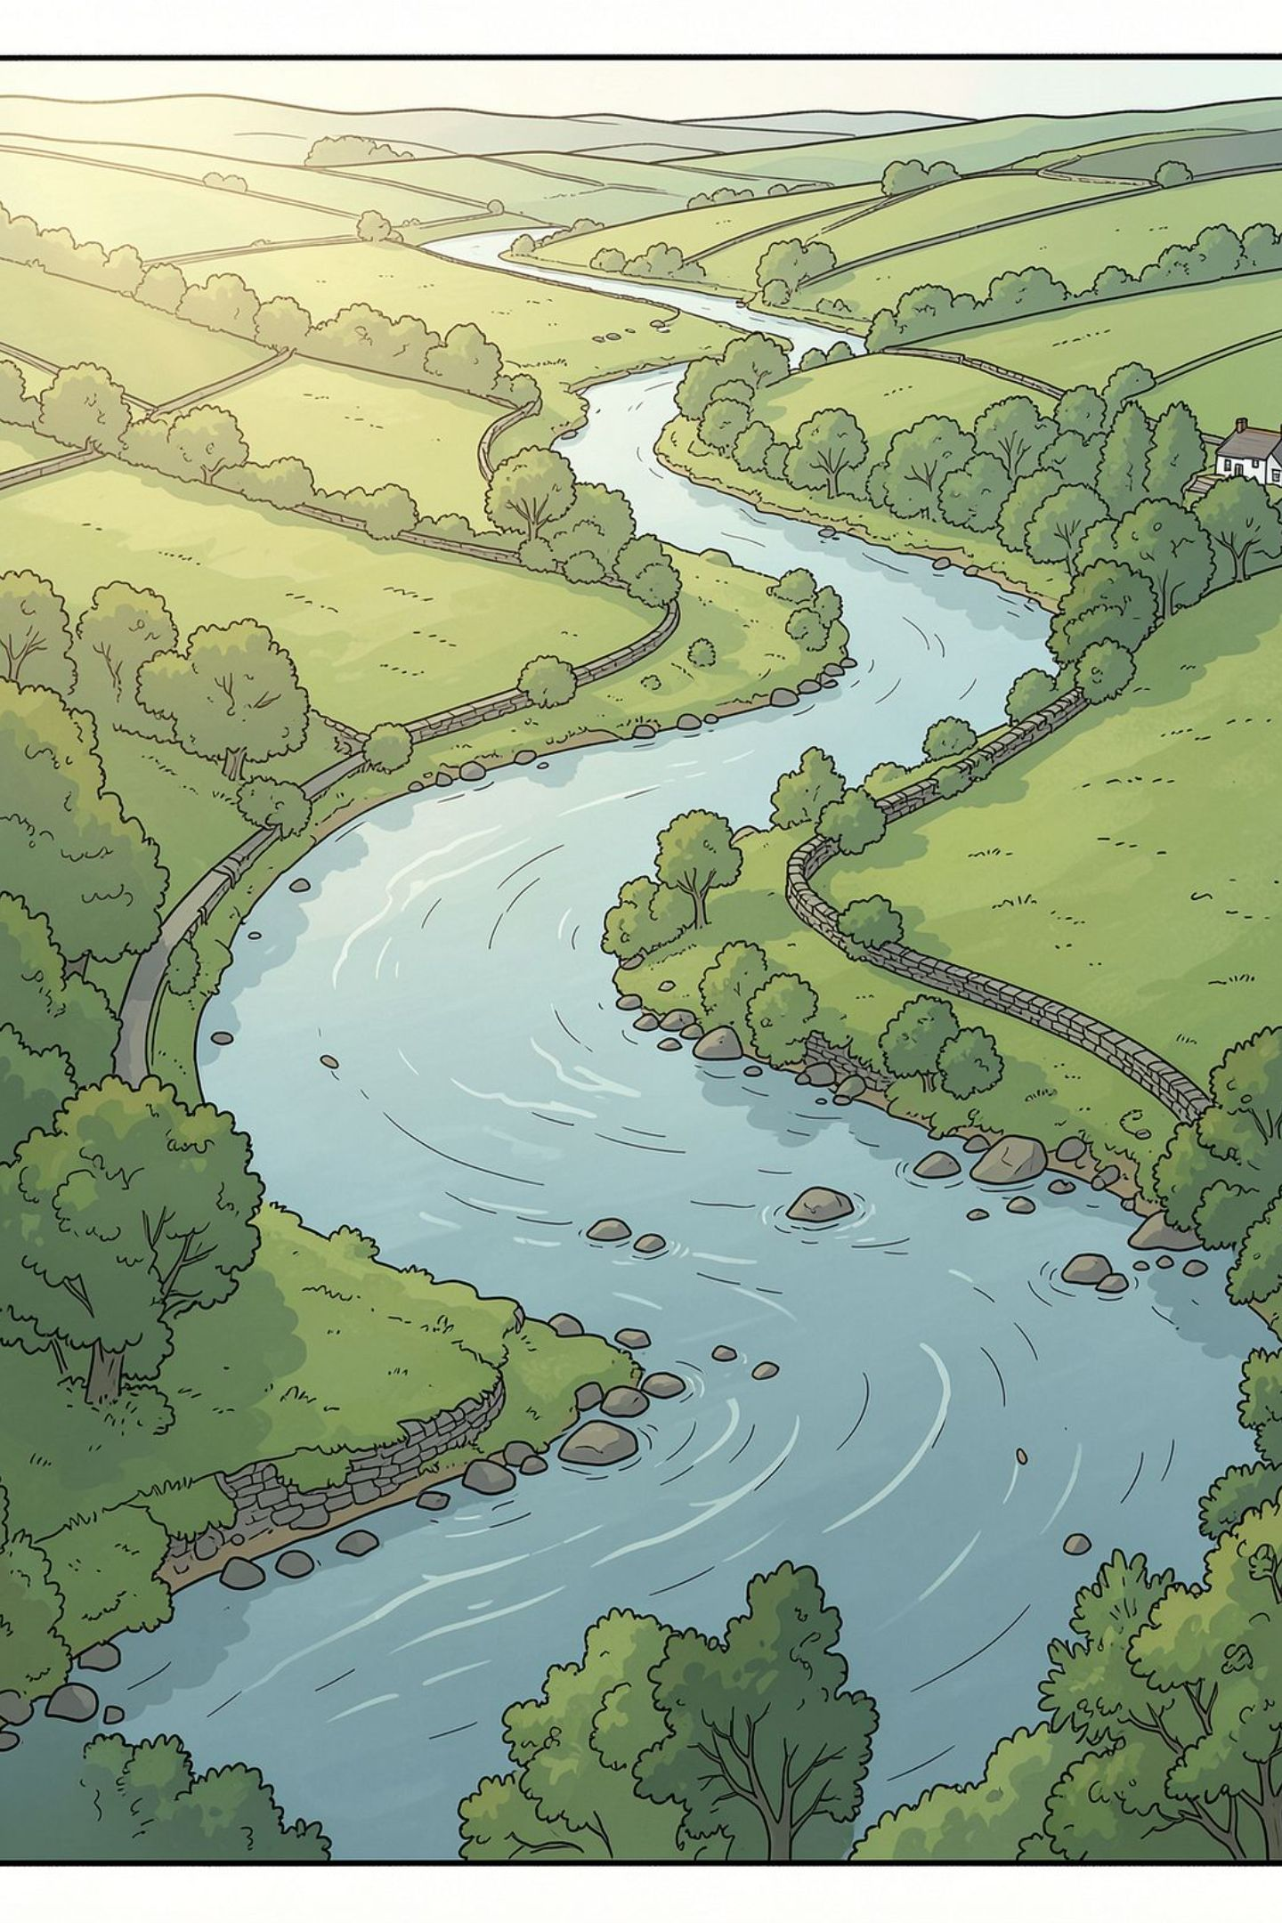
REVIEW 1 — RESEARCH PROGRESS
An Explainable AI-Based Framework for Water Quality Index Prediction and Decision Support Using Machine Learning and TabNet
Submitted by
Student Names:
Chintakayala Karthikeya Ameer Roshan Shaik
Shaik Abdul Samad Desam Pranay Kumar Reddy
Roll Numbers:
23BCE9594 23BCE9533
23BCE7692 23BCE8722
Department of Computer Science & Engineering
VIT-AP University
Under the Guidance of
Prof. Balusa Bhanu Chander
Academic Year: 2026–27

Slide 2
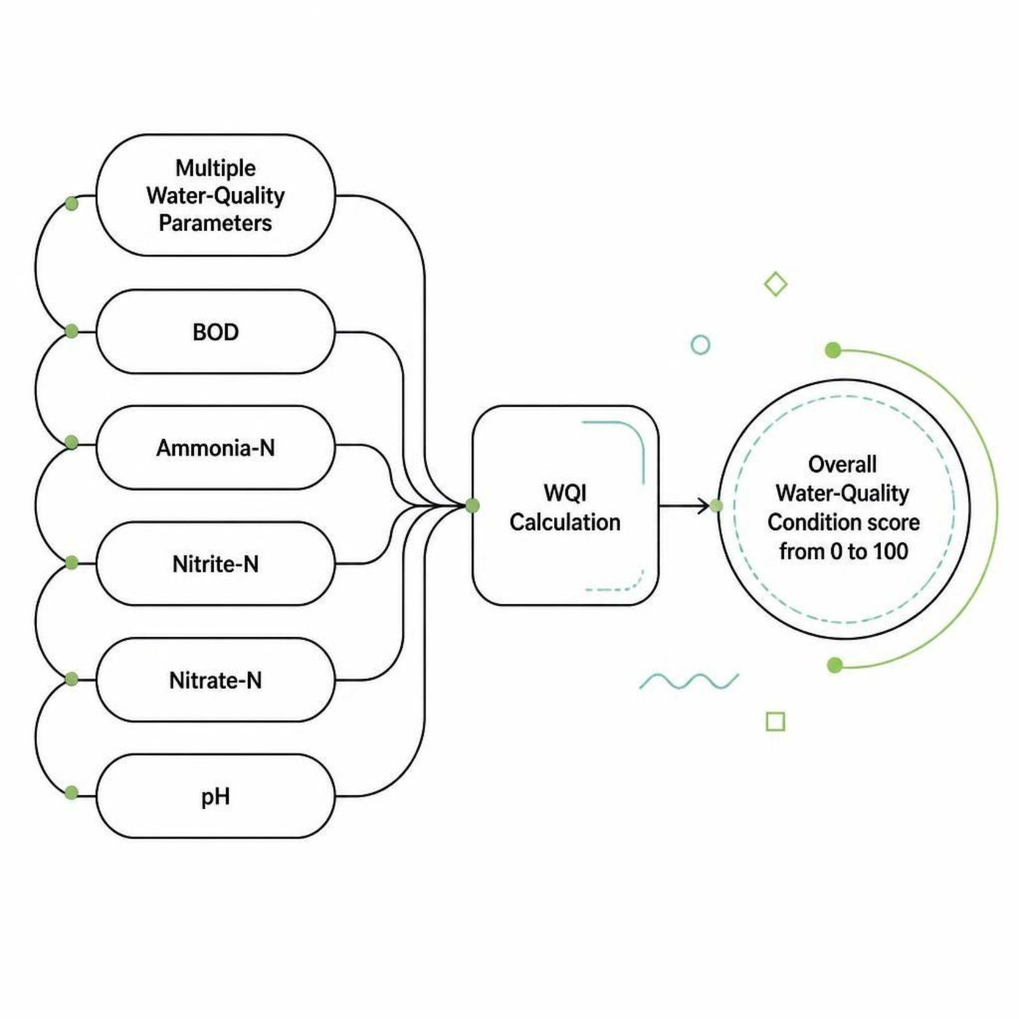
PROBLEM STATEMENT
Why Water Quality Index?
River water quality is governed by multiple physical and chemical parameters. Assessing each parameter individually across hundreds of stations and decades of data makes overall condition difficult to interpret.
A Water Quality Index (WQI) converts multiple measurements into a single interpretable score — providing a summarised condition and a target for machine-learning prediction.

Slide 3
RESEARCH DESIGN
Research Gap and Objectives
Research Gap
Objectives
Long-term datasets contain heterogeneous observations across stations and years
Individual parameters are difficult to interpret as one overall condition
Prediction alone does not explain which parameters influence the result
A link between prediction, explainability, and decision support is needed
Prepare and quality-control the NIEA river water-quality dataset
Construct a CCME-WQI from selected parameters
Develop ML and DL models for WQI prediction
Compare Random Forest, XGBoost, CatBoost, and TabNet
Use SHAP to explain model predictions
Connect prediction and explanation to recommendation-oriented decision support

Slide 4

DATASET
Dataset and Initial Data Understanding
178,680
40
Raw Observations
Raw Variables
1,311
34
Monitoring Stations
Years of Coverage
1990–2024
The raw NIEA dataset contains long-term river water-quality observations collected across multiple monitoring stations in Northern Ireland. Initial inspection examined data types, temporal coverage, parameter availability, missing values, quality indicators, and measurement ranges.
NIEA Raw Dataset
40 Variables
Water-quality parameters
Long-term river observations
178,680 Records
Individual measurement entries
1,311 Stations
Coverage 1990–2024

Slide 5
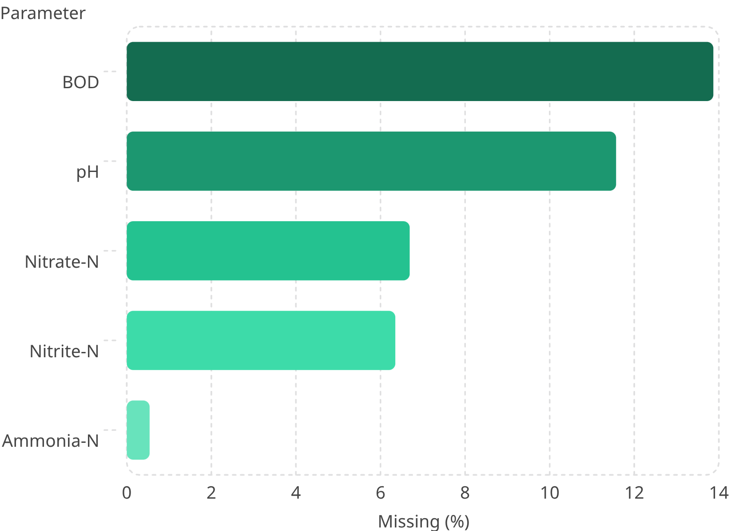

DATA PROCESSING
Data Preprocessing and Quality Control
Completed preprocessing steps:
Missing Value Rates
Selected relevant water-quality parameters
Extracted Year from monitoring dates
Standardised the working dataset structure
Examined missing values, negative values, and extreme observations
Investigated quality flags
Prepared station-year groups
Extreme values were investigated rather than automatically removed — genuine environmental events may produce unusually high measurements.
Raw Dataset
↓ Preprocessing
Core Dataset
178,680 × 40
Data cleaning & selection
175,615 × 13

Slide 6

AGGREGATION
Station-Year Aggregation
The raw dataset contains repeated observations from the same station across different dates. To create a consistent annual assessment unit, observations were grouped by StationCode and Year.
Group by StationCode & Year
Raw Observations
Station-Year Groups
178,680 total records
Create station-year units
15,502 aggregated groups
Each station-year group serves as the unit of annual water-quality assessment for WQI construction.
15,502
11.33
Station-year groups
Mean observations per group
12
1–28
Median observations (typical)
Range of observations per group

Slide 7
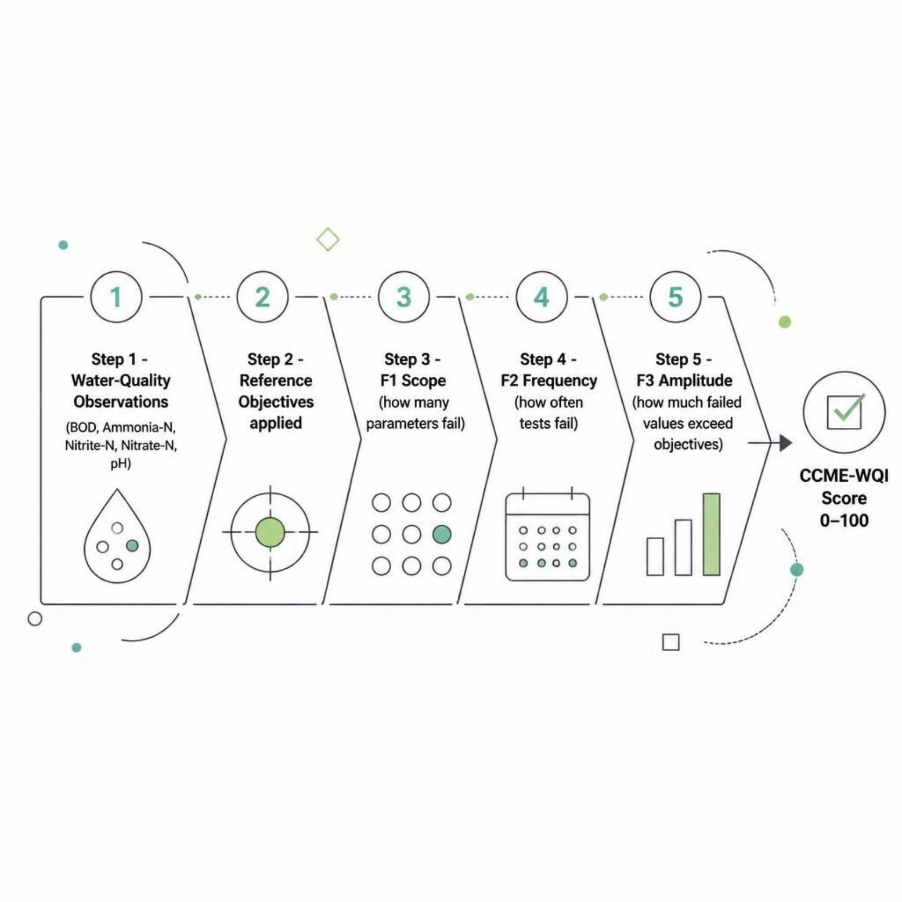
METHODOLOGY
CCME-WQI Construction
Five parameters were selected based on availability in the processed NIEA dataset and compatibility with the CCME-WQI formulation:
BOD (Biochemical Oxygen Demand)
Ammonia-N, Nitrite-N, Nitrate-N
pH
The CCME-WQI combines three components — Scope (F1), Frequency (F2), and Amplitude (F3) — into a single score from 0 to 100.
Formula: CCME-WQI = 100 − √(F1² + F2² + F3²) / 1.732

Slide 8
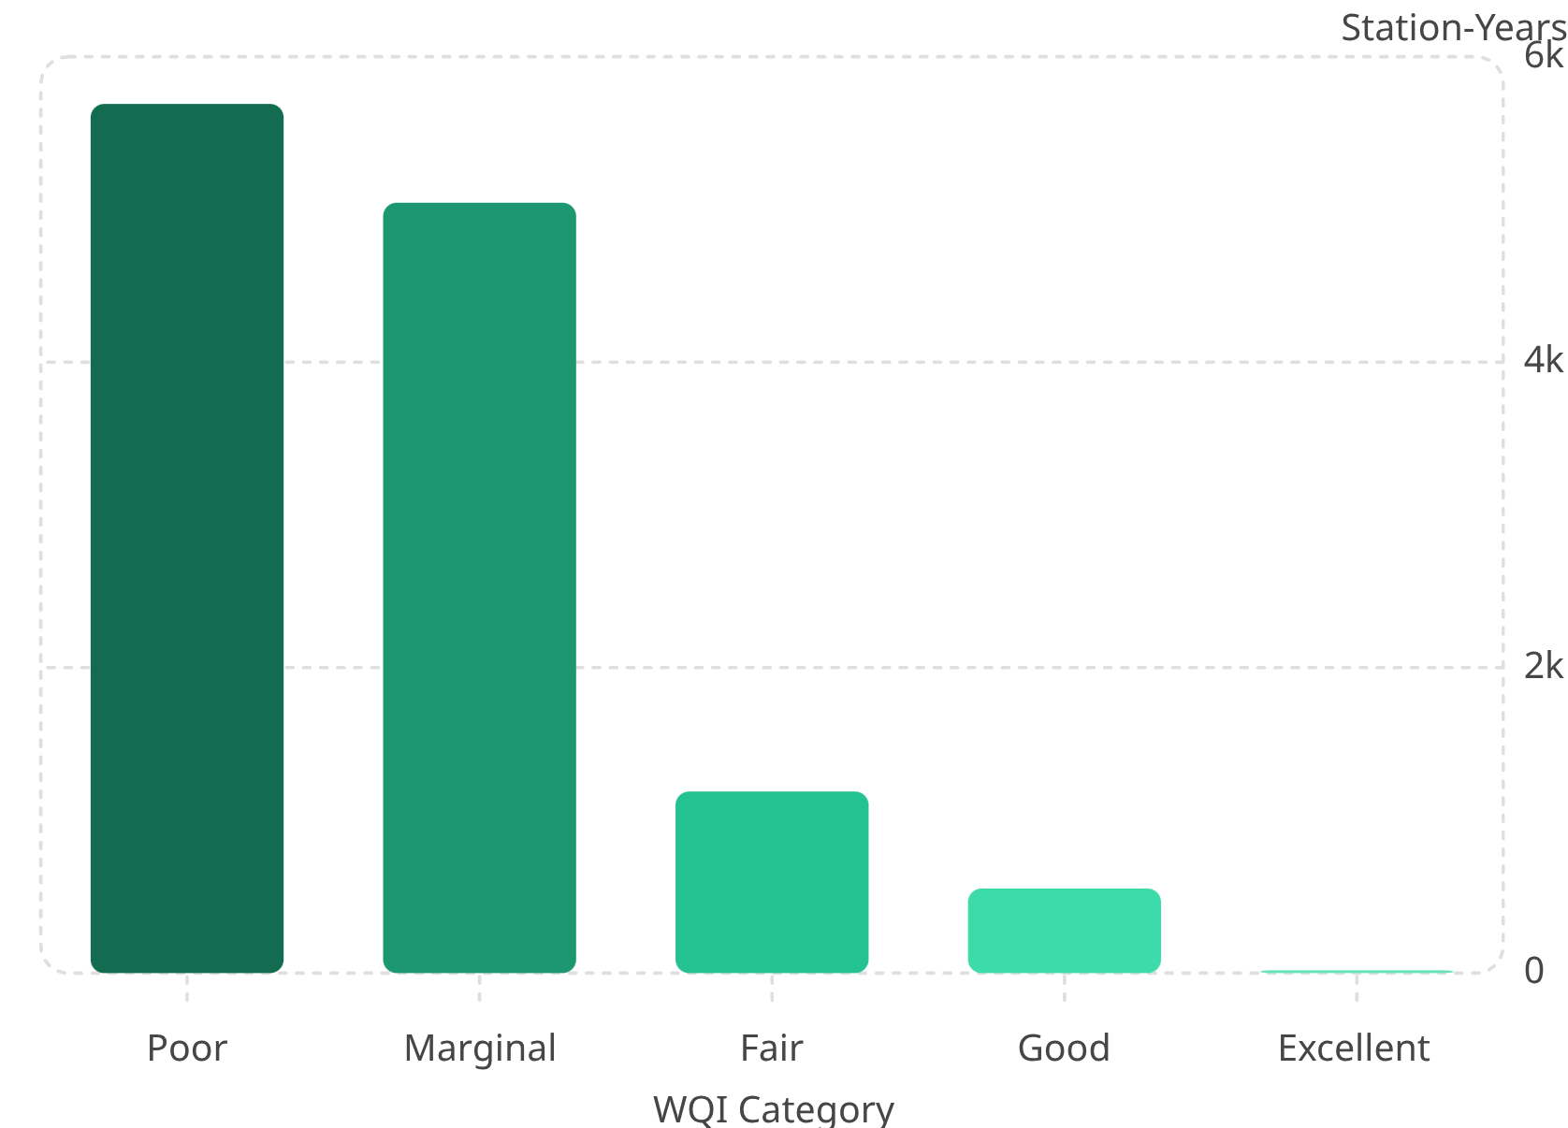
RESULTS
Initial WQI Results and Validation
12,497
49.43
Final WQI Records
Mean WQI
46.66
0
Median WQI
Invalid Values
None outside 0–100
WQI values remained within the valid 0–100 range. The majority of station-year records were classified as Poor (5,691) or Marginal (5,044), while only 19 records were classified as Excellent.
These categories reflect calculated WQI values — not ML predictions. Predictive modelling is the next phase.

Slide 9
FRAMEWORK
Overall Framework and Current Progress
✅ Completed — Review 1
⏭ Next Phase
01
02
01
02
NIEA Raw Dataset
Data Inspection
ML Dataset Preparation
Random Forest · XGBoost · CatBoost · TabNet
03
04
Preprocessing
Quality Control
03
04
Model Evaluation (MAE, MSE, RMSE, R²)
SHAP Explainability
05
06
Station-Year Aggregation
CCME-WQI Construction
05
06
07
08
Water-Quality Interpretation
Recommendation Layer
WQI Validation
Final WQI Dataset
07
Decision Support System

Slide 10

SUMMARY
Conclusion and Next Phase
Completed
Next Phase
Long-term NIEA dataset successfully inspected and processed
175,615 observations prepared; 15,502 station-year groups identified
CCME-WQI successfully constructed and validated
12,497 valid station-year WQI records generated
Dataset and target are ready for predictive modelling
Prepare leakage-free ML dataset
Train and compare Random Forest, XGBoost, CatBoost, and TabNet
Evaluate using MAE, MSE, RMSE, and R²
Apply SHAP for explainability
Develop recommendation-oriented decision support
Current Status: Data processing and WQI construction completed. Predictive modelling and explainability are the next phase.

