Slide 1


Department of Computer Science and Engineering
SKILL GAP VISUALIZER
Mrs. M. Divya M.E.
Supervisor
Assistant Professor
ROSHINI V S
220701229

Slide 2
Problem Statement and Motivation
In today’s fast-changing job market, students and professionals often struggle to identify missing skills for their desired careers. Traditional guidance methods are generic and fail to adapt to evolving industry needs.
Most existing tools suggest roles but lack personalized roadmaps to bridge skill gaps. This project proposes a smart, data-driven system that analyzes user profiles and visualizes gaps while recommending tailored learning paths for career success.
This project addresses that need by offering a user-friendly tool that visualizes skill deficiencies, aligns user profiles with job requirements, and provides structured, goal-oriented career guidance.

Slide 3
Existing System
Rule-Based & Decision Trees: Use fixed rules to match careers based on skills and education; lack adaptability.
Collaborative Filtering: Matches users based on similar profiles; struggles with new users or roles.
Survey-Based & Content Filtering: Often static and less personalized.

Slide 4
Objectives
Identify gaps between users' current skills and target job role requirements.
Use NLP to extract and classify technical and soft skills from resumes and job descriptions.
Visualize matched and missing skills with clear charts and trackers.
Offer an intuitive interface for uploading resumes, selecting roles, and tracking skill progress.

Slide 5
Abstract
Skill-Gap Visualizer is a web-based tool developed using Streamlit that helps users identify gaps between their current skills and job role requirements. Leveraging NLP and ML, it extracts skills from resumes or manual inputs and compares them against parsed job descriptions. The system visualizes matched and missing skills through intuitive charts, aiding users, especially freshers and career switchers—in personalized upskilling and planning. It offers a scalable, cost-effective solution with potential for multi-role and AI-driven enhancements.

Slide 6
Proposed System
Web-based tool using NLP and ML for career development.
Users upload resumes or input skills manually.
Extracts and compares skills with job descriptions.
Visualizes skill gaps and recommends upskilling courses.
Streamlit dashboard for tracking progress and setting goals.

Slide 7
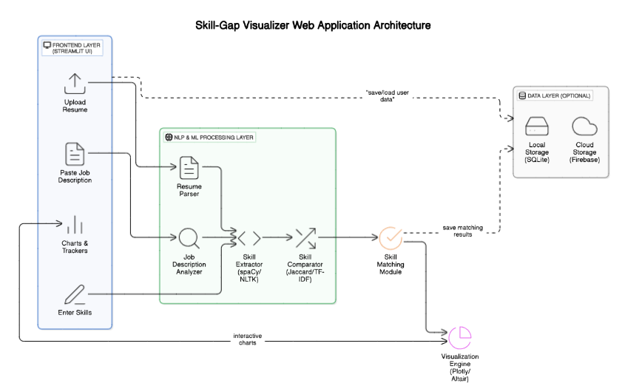
System Architecture

Slide 8
List of Modules
Resume/Input Module: Uploads resumes or inputs skills.
Skill Extraction: Extracts skills using NLP.
Skill Comparison: Compares user skills with job requirements.
Gap Visualization: Displays skill gaps in charts.
Job Role Selection: Selects job roles for comparison.
Progress Tracker: Tracks learning progress.
Recommendation System: Suggests courses for upskilling.
Dashboard: Displays all insights and recommendations.

Slide 9
Functional Description for each modules with DFD and Activity Diagram
1. Resume/Input Module
Function: Allows resume upload or manual skill input.
Output: Extracted skills.
Activity: User uploads input → Skills extracted → Stored for comparison.
2. Skill Extraction Module
Function: Extracts skills using NLP from resumes/job descriptions.
Output: List of extracted skills.
Activity: System processes input → NLP extracts skills → Skills ready for comparison.

Slide 10
Functional Description for each modules with DFD and Activity Diagram
3. Skill Comparison Module
Function: Compares user skills with job role requirements.
Output: Skill gap analysis.
Activity: Extracted skills → Compared with job roles → Skill gaps identified.
4. Gap Visualization Module
Function: Visualizes skill gaps using charts.
Output: Skill gap charts.
Activity: Skill gaps → Visualized in charts → Displayed to the user.

Slide 11
Functional Description for each modules with DFD and Activity Diagram
5. Job Role Selection Module
Function: Allows selection of job roles for comparison.
Output: Selected job role.
Activity: User selects job role → Job data fetched → Comparison initiated.
6. Progress Tracker
Function: Tracks and displays learning progress.
Output: Progress charts.
Activity: User updates progress → System tracks → Progress shown on dashboard.

Slide 12
Functional Description for each modules with DFD and Activity Diagram
7. Recommendation System
Function: Suggests courses and certifications to bridge gaps.
Output: Recommended learning resources.
Activity: System analyzes gaps → Recommends courses → User selects.
8. Dashboard
Function: Displays skill gaps, progress, and recommendations.
Output: Interactive dashboard.
Activity: User logs in → System aggregates data → Dashboard displayed.

Slide 13
Implementation & Results of Module
Implementation Module
Objective: System design and deployment.
Key Points:
Tech Stack: Streamlit (UI), Python (NLP), SQL/NoSQL (Database).
Architecture: Data flow from input to visualization.
Deployment: Hosted on AWS/Heroku.
Testing: Skill extraction accuracy.
Challenges: Handling diverse resume formats.

Slide 14
Implementation & Results of Module
Result Module
Objective: Measure system effectiveness.
Key Points:
Skill Extraction Accuracy: Performance in extracting relevant skills.
Gap Analysis: How well skill gaps are identified.
User Engagement: Interaction rate with recommended courses.
Learning Progress: Completion rates for recommended courses.
Visualization Effectiveness: User feedback on skill gap charts.

Slide 15
Conclusion & Future Work
Conclusion
The Skill-Gap Visualizer uses NLP and ML to assess job readiness by comparing resume skills with job requirements. It provides visual reports, tracks progress, and helps users identify areas for improvement through an intuitive interface, aiding career development and upskilling.
Future Scope
Future improvements include word embeddings for semantic skill matching, multi-role comparisons, AI-based course suggestions, resume feedback, user accounts, and enhanced accessibility.

Slide 16
References
[1] Haq, Mahmood Ul. "CapsNet-FR: Capsule Networks for Improved Recognition of Facial Features." Computers, Materials & Continua, vol. 79, no. 2, 2024.
[2] Keerthana, D., Venugopal, V., Nath, M. K., & Mishra, M. "Hybrid convolutional neural networks with SVM classifier for classification of skin cancer." Biomedical Engineering Advances, vol. 5, 2023, 100069. https://doi.org/10.1016/j.bea.2022.100069
[3] Alhudhaif, A., Almaslukh, B., Aseeri, A. O., Guler, O., & Polat, K. "A novel nonlinear automated multi-class skin lesion detection system using soft-attention based convolutional neural networks." Chaos, Solitons & Fractals, vol. 170, 2023, 113409. https://doi.org/10.1016/j.chaos.2023.113409

Slide 17
Thank You

