Slide 1
IBM University Engagement Project Submission
“Exploring the Power of Agentic AI with IBM Granite and LangFlow”

Slide 2

Project Tile – [College Admission Agent (RAG Based)]
Domain of Project – [ Education ]
Student Name | Recent Passport Photo | Email ID | Mobile number [WhatsApp]
Roshani Ravi Pothare |  | roshanipothare56@gmail.com | 7798546556
Recommended font style and size:
Font Style: Arial
Font Size (Heading): 28
Font Size (Content): 20

Slide 3
Problem Statement -
Problem Statement : College Admission Agent (RAG Based)
The Challenge
A College Admission Agent, powered by RAG (Retrieval-Augmented Generation), streamlines the student admission process. It retrieves and summarizes admission policies, eligibility criteria, and FAQs from institutional databases and official sources. Prospective students can ask natural language questions and receive accurate, up-to-date responses instantly.
The Objective
Build an AI-powered College Admission Agent that streamlines the student admission process and provides accurate, up-to-date responses. The solution should:
Course & Policy Retrieval – Fetch and summarize admission policies, eligibility criteria, and FAQs from institutional databases.
Natural Language Queries – Allow prospective students to ask questions and receive instant answers.
Admission Guidance – Assist with course selection, application guidance, fee structure, and important deadlines.
Enhanced Experience – Reduce manual inquiries, boost transparency, accessibility, and efficiency in college admissions using trusted, real-time data.

Slide 4
Proposed Solution -
Proposed Solution: AI-Powered College Admission Agent
​The proposed solution is a multi-agent AI-powered College Admission Agent built using LangFlow, IBM watsonx.ai, and Granite Models to provide personalized, real-time guidance for prospective students. The system addresses challenges in course selection, policy retrieval, and application tracking through an intelligent, modular architecture.
​At its core, the solution uses a Retrieval-Augmented Generation (RAG) pipeline to fetch accurate admission policies, eligibility criteria, and FAQs from institutional databases and official sources. This data is embedded and stored in a vector database, enabling the system to retrieve and summarize details using Granite models.
​The system consists of four key agents:
​Admission Policy Agent retrieves and summarizes institutional guidelines and requirements using RAG.
​Course Recommendation Agent generates personalized course and program options based on student marks, interests, and eligibility.
​Fee & Deadline Advisory Agent provides structured timelines, fee structures, and critical application schedules.
​Application Tracker & Support Agent allows students to check application statuses and answers admission inquiries with instant feedback.
​The solution includes a user-friendly dashboard (built with Streamlit or React) that tracks application progress and displays relevant university details. Langflow is used to orchestrate agent workflows, while watsonx.ai ensures scalable model deployment, embeddings, and AI governance. Granite models power reasoning, summarization, and personalization.
​Overall, this solution delivers an end-to-end intelligent admission assistant that streamlines the enrollment journey through transparent guidance, real-time feedback, and accurate policy information.

Slide 5
Technology Used
Langflow platform -For designing and orchestrating multi-agent workflows visually
IBM Grainte model - for eg – ibm-granite-3-2-8b – For natural language understanding, reasoning, and personalization
IBM Cloud – It provides the infrastructure to build, deploy, and scale the College Admission Agent efficiently. IBM Cloud enables a reliable, secure, and scalable environment for deploying the College Admission Agent.
RAG– RAG to fetch real data first, then generate intelligent answers, making the College Admission Agent more trustworthy and effective.
IBM Watsonx.ai - For model deployment, embeddings, and AI governance
Vector Database (FAISS/Chroma) – For RAG-based admission policy and FAQ data retrieval.

Slide 6
Langflow component Used –
​Chat Input – Interface where prospective students enter their queries, questions regarding courses, fees, or deadlines.
​IBM watsonx AI Agent – Processes student inputs using Granite models to generate accurate information and recommendations.
​Name of IBM Granite model – Granite-4.0-8B-Instruct → Fast, efficient for real-time admission support.
​Chat output – Displays AI-generated responses such as policy details, course lists, and fee structures.
​File component – Stores and retrieves institutional documents, admission guidelines, and FAQ datasets for analysis.
​Vector Store / Retriever component – For RAG-based document processing and policy retrieval.

Slide 7
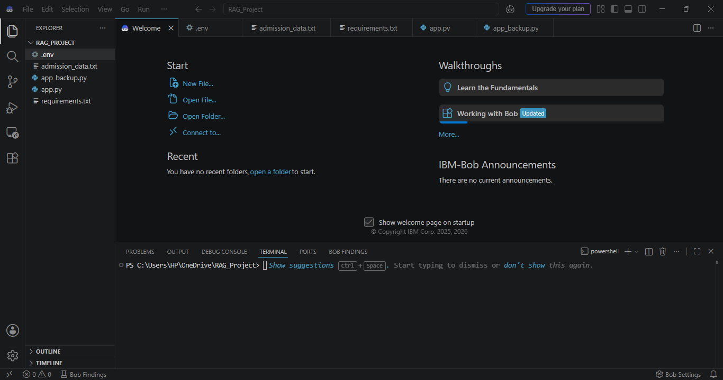

Slide 8
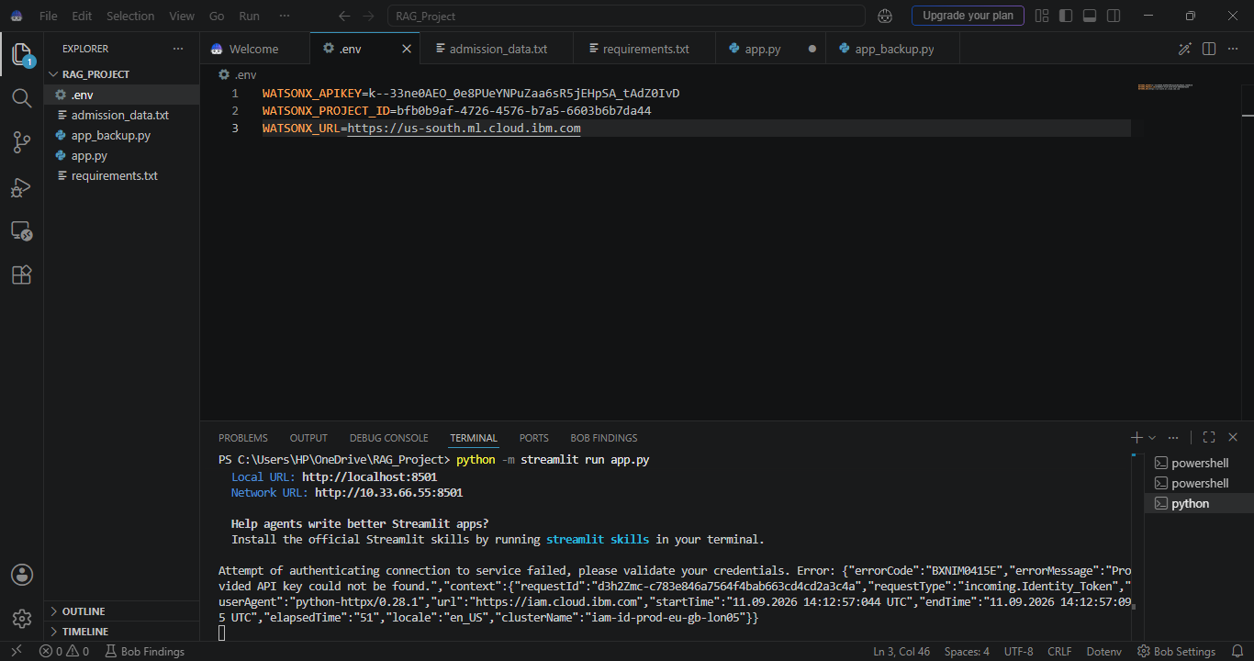

Slide 9
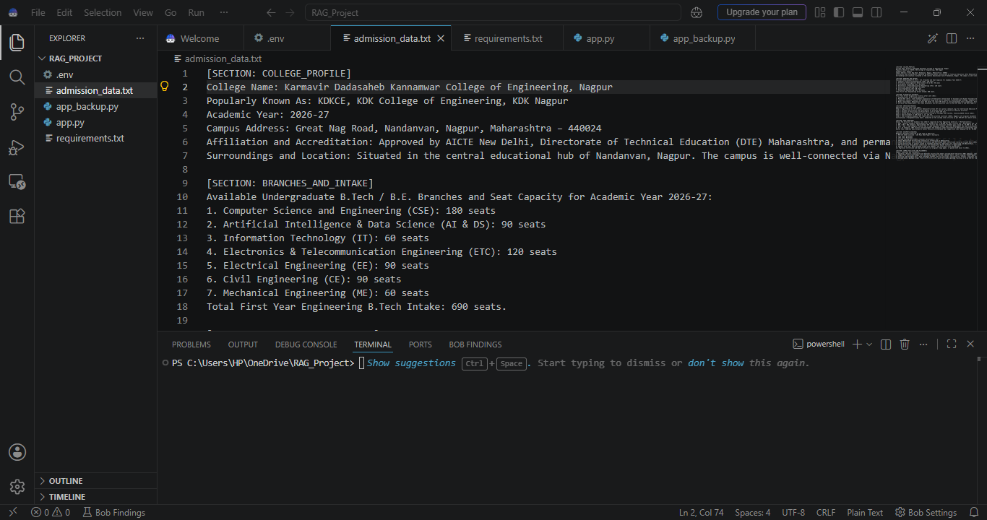

Slide 10
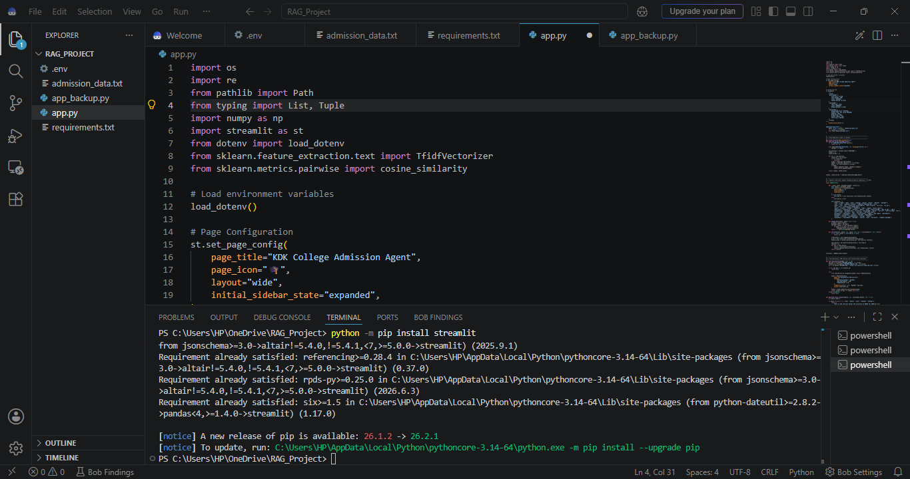

Slide 11
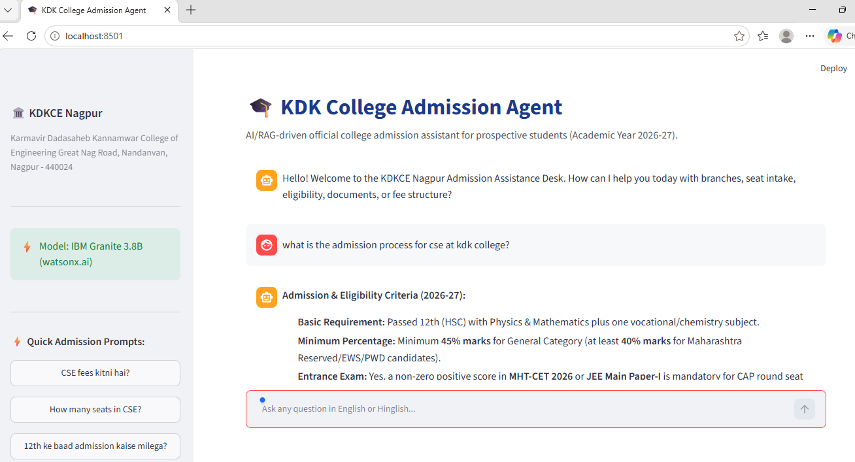

Slide 12

Role of Agentic AI in the solution
Role of IBM watsonx Assitantant in KDK Admission Bot
IBM watsonx Assistant enables the Admission Bot to function as an intelligent, interactive virtual assistant rather than a static webpage. Using natural language intent recognition and structured dialog actions, it automates responses to provide prospective students with instant, accurate information about KDK College of Engineering.
​Each action performs a specific role—such as greeting users by name using session variables, listing engineering branches (Computer Science, AI & DS, Information Technology, and Civil Engineering), detailing fee structures and eligibility criteria, and capturing applicant contact details for enrollment. This modular design ensures efficient conversation flow and accurate data collection.
​The assistant also brings context awareness, tracking user choices across steps to deliver tailored guidance. It supports real-time interaction, responding dynamically to student inputs during the admission inquiry process. Additionally, action variables securely store and pass user data between turns, enabling smooth navigation and a seamless user experience.
​Overall, the solution makes the college admission process proactive, personalized, and accessible, acting like a smart digital counselor that helps students easily explore programs and connect with KDK College.

Slide 13
Novelty and Uniqueness
The proposed College Admission Agent stands out by combining Conversational AI, RAG (Retrieval-Augmented Generation), and rule-based guidance into an intelligent, seamless admission system.
​Context-Aware Dialog Flow – Employs structured intent management to guide prospective students methodically from initial branch exploration to final enrollment.
​RAG-Based Grounded Accuracy – Integrates retrieval against verified college documentation with generative AI, minimizing hallucinations and ensuring reliable fee and eligibility details.
​Personalized Stream Counseling – Tailors academic recommendations dynamically based on applicant qualifications, entrance scores, and specific engineering interests (e.g., CSE, AI & DS, IT, Civil).
​Automated Lead & Profile Capture – Collects applicant contact and academic data interactively without cumbersome static admission forms.
​Round-the-Clock Accessibility – Eliminates manual desk bottlenecks by offering instantaneous, 24/7 counseling support to students and guardians.
​Scalable & Enterprise-Ready – Built on IBM watsonx Assistant with IBM watsonx.ai runtime, ensuring robust compliance, data governance, and rapid deployment.
​This makes the solution a smart, adaptive, and proactive digital admission counselor, far surpassing static FAQ pages or basic chatbots.

Slide 14
Git Hub Link
Please create public github repository (Enable Add README button while creating repository) with format –
Please test and Paste the working Github URL –
https://github.com/Rosha-ai/KDK-College-Admission-Agent
Make sure you have Uploaded following three files into your github repository
1) app.json file , 2) yourproblemstatement.pdf file 3) your projectpresntation.pptx file 4)any other files
·
·
·

Slide 15
Future Scope
1.Integration with College ERP & Student Management Systems –
. The admission assistant can be integrated directly with the college ERP database and applicant portals. This will enable real-time tracking of seat availability across branches, instant application status checks, automated merit list notifications, and secure digital fee verification.
2.AI-Powered Voice Assistant & Multilingual Support –
Enhancing the system with voice interaction and regional language translation (such as Hindi and Marathi alongside English) will significantly improve accessibility. Prospective students and parents can interact naturally via spoken queries or their native language, ensuring a smooth, inclusive admission counseling experience.
·
·
·

Slide 16
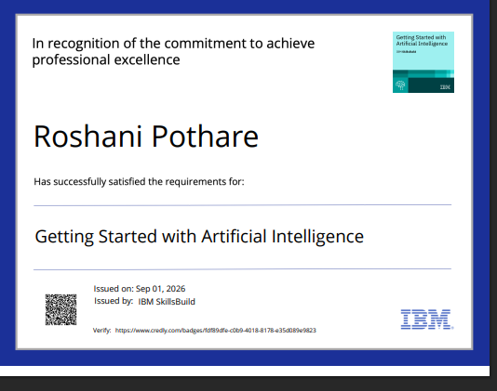
Certificates Earned:
Please add your credly certificate

Slide 17
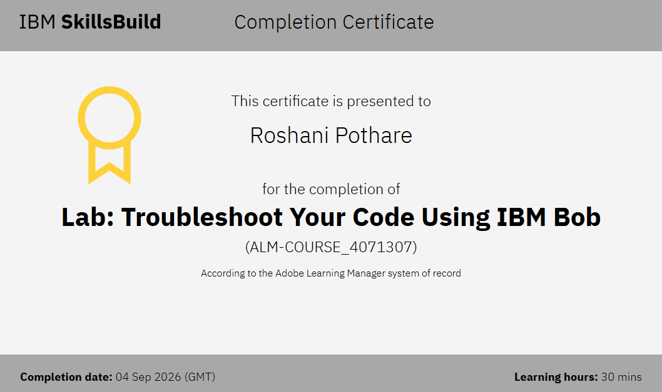
Certificates Earned:​
Add your IBM BOB Certificate

Slide 18


