Slide 1
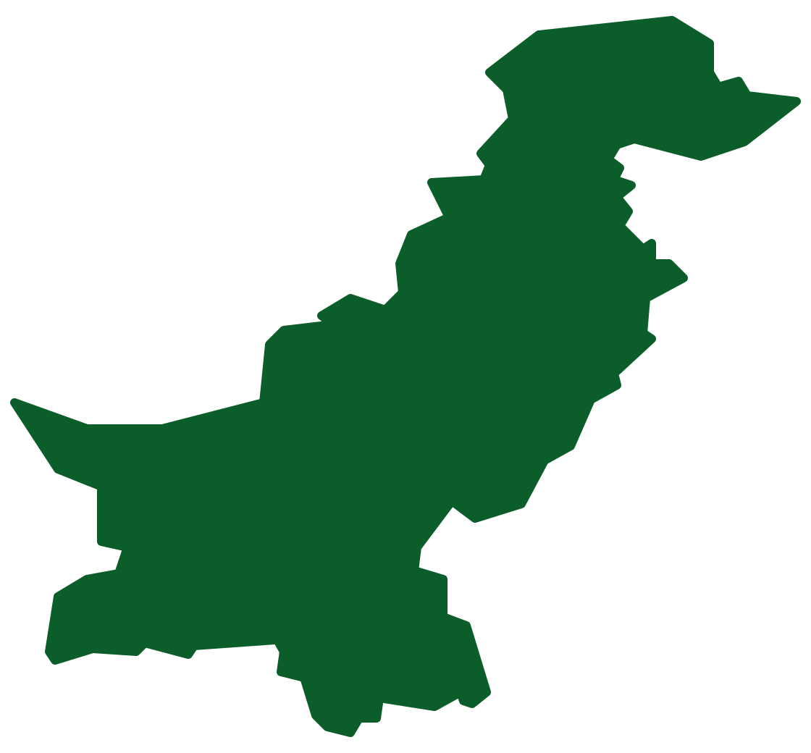
FloodLens Pakistan
HACKINSIGHT 2026
District heavy-rain warnings 1–3 days ahead, with a weekly food-price watch
Team Spark H | Climate & disaster risk · food security
160 districts · scored every hour
huggingface.co/spaces/RoshaanT1/floodlens-pakistan

Slide 2
Problem Statement
THE PROBLEM
1
The decision window
District and PDMA planners need 24–72 h to pre-position Rescue 1122 teams, pumps and relief before roads wash out
Monsoon rain in Pakistan turns deadly within hours. District planners must decide where to send rescue teams, pumps and relief before the rain arrives, but weather models give grid cells, not a per-district answer to “is this unusual for us?”
2
The gap today
Advisories list areas in words; none gives each district a calibrated chance of rain that is unusual for it
1,037
deaths and 1,067 injured in the 2025 monsoon (NDMA final sitrep No. 87)
3
The compound threat
Floods can disrupt supply routes and move staple prices; rain alerts and price data sit in separate places

Slide 3
Dataset Declaration
Dataset name | FloodLens district-day warehouse (5 public sources joined on 160 districts)
Source / link | Open-Meteo Previous Runs (API) · NASA GPM IMERG V07 · OCHA boundaries (HDX) · PBS weekly SPI · NDMA sitreps
Size | 476,640 forecast rows × 25 features · 689,280 satellite rain rows · 146,523 prices · 157 NDMA documents
Time period | Satellite rain 2015–2026 · forecasts Feb 2024–Oct 2026 · prices Jan 2023–Oct 2026
Format & license | 4,856 raw files in manifest.csv (source, query, UTC time, SHA-256, licence) → Parquet / DuckDB · CC BY 4.0, NASA open data, public govt. statistics
Key features / target | Forecast rain, humidity, pressure, cloud, wind (1–3 days ahead), lagged observed rain. Target: rain above the district's own 95th percentile
476K
Rows / records (model table)
25
Columns / features
1.3 GB
Raw data, 4,856 files

Slide 4
Why These Sources: Forecasts vs Satellite Truth
INPUTS (X) · OPEN-METEO ARCHIVED FORECASTS
TRUTH (Y) · NASA GPM IMERG V07 SATELLITE RAIN
Previous Runs API: weather-model forecasts exactly as issued 1, 2 and 3 days ahead
Rain sum, max hourly rain, humidity, pressure, cloud cover, wind speed
Honest lead time: the model only sees forecasts that existed before the target day
0.1° daily satellite rainfall, 2015–2026: labels and each district's 95th-percentile threshold (2015–2023)
Why not gauges? Rain gauges are sparse in many remote districts; satellites cover all 160 evenly
Independent of the weather models, so the model is not graded against its own inputs

Slide 5
Pipeline Used
1
2
3
4
5
Data Collection
Data Cleaning
Analysis / EDA
Modeling
Dashboard / App
APIs, NASA cloud, PBS and NDMA files; every file hashed into a manifest
Quality agent: fix, fill or flag each issue, with the reason logged
District thresholds, monsoon replay, error by province and terrain
Gradient boosting, calibrated; beats climatology on the locked test set
Hourly Prefect flow publishes to a live Hugging Face Space
Raw forecasts and satellite rain in → each district's chance of unusually heavy rain 1–3 days ahead, refreshed every hour

Slide 6
Pipeline Details & Tools
Stage | Tools / Libraries | What we did
Collection | Python, requests, earthaccess (OPeNDAP), pdfplumber | Fetch only what is new; respect API budgets; never overwrite a raw file
Preprocessing | DuckDB, pandas, Shapely, pandera | Grid rain → district values; quality rules fix / fill / flag and log every decision
Analysis / EDA | pandas, bootstrap CIs | 95th-percentile thresholds per district; Aug 2025 replay; skill by province and terrain
Modeling | scikit-learn GBM + Platt calibration, FAISS + e5 | Leakage-tested features; fixed splits; test set run once. Insight Agent cites NDMA text
Dashboard / App | Prefect 3, React + Leaflet, FastAPI, HF Spaces | Hourly flow rebuilds and publishes; map, food prices, live data and Ask (English / Urdu)

Slide 7
Agents & Automation
DATA QUALITY AGENT · runs pandera checks, decides fix / fill / flag, logs why
HOURLY PREFECT FLOW
Rule | Action | Rows | Reason (from quality_log)
spi_price_collected | FLAG | 1,279 | PBS published 0 or nothing: kept NULL, never filled
spi_min_le_avg_le_max | FLAG | 822 | min / avg / max out of order as published: kept as printed
spi_weekly_jump | FLAG | 399 | moved >50% in a week: possible typo, not corrected
cron 5 * * * *
15
runs in the Tue 4 PM – Wed 4 PM window
14
completed
Every decision is stored with a timestamp and replayed on each rebuild; we flag rather than invent prices.
1
failed: NASA server refused us; IMERG step now isolated, switched to NASA cloud
Insight Agent · retrieves NDMA sections (FAISS, multilingual) and gold-table rows; says “I don't know” below threshold.

Slide 8
Optimization: Lean, Fast & Reproducible
143 GB → 182 MB
286 s → 3.6 s
SERVER-SIDE CROPPING
PARSE CACHE
NASA OPeNDAP crops each daily satellite file to Pakistan: 33 MB → ~74 KB per day, same values
PBS price PDFs parsed once and cached by SHA-256; identical tables on every rebuild
Fail-safe runs
1 command
ATOMIC SWAPS
MAKE DATA
Each hourly run builds a scratch DuckDB and swaps it in only on success; a failed run never touches live data
Rebuilds raw → cleaned → gold from the manifest and refuses any file whose hash changed

Slide 9
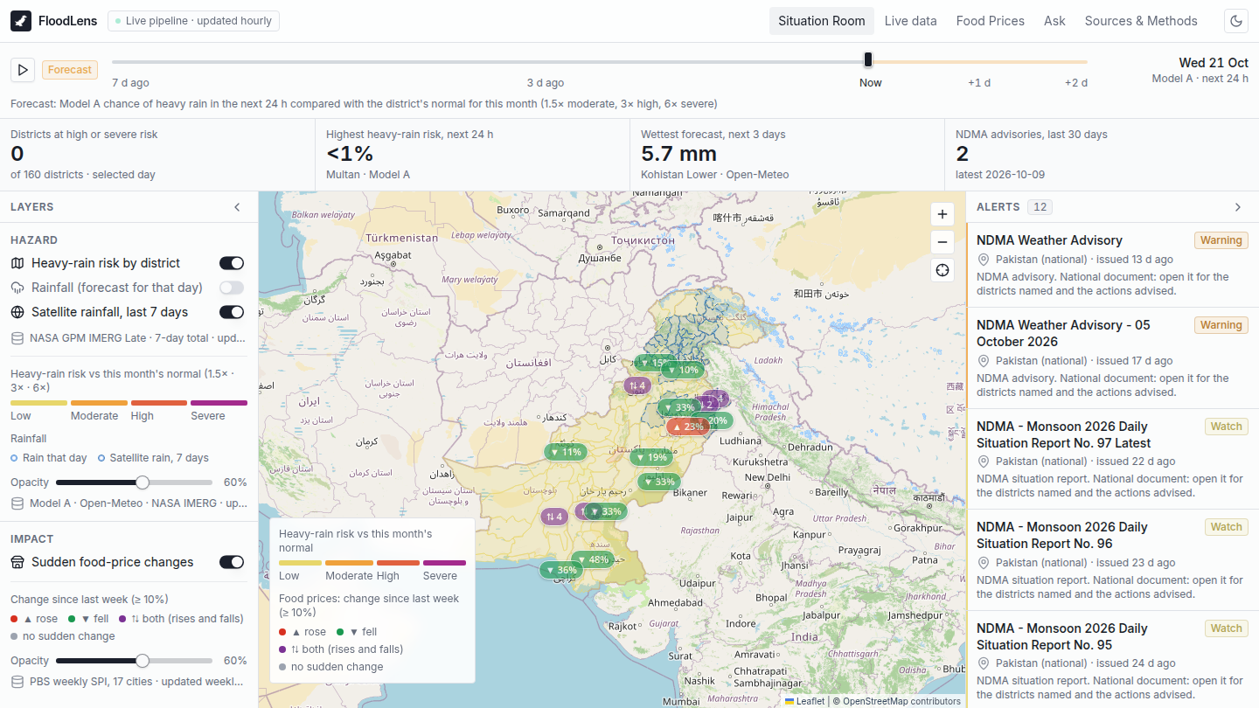
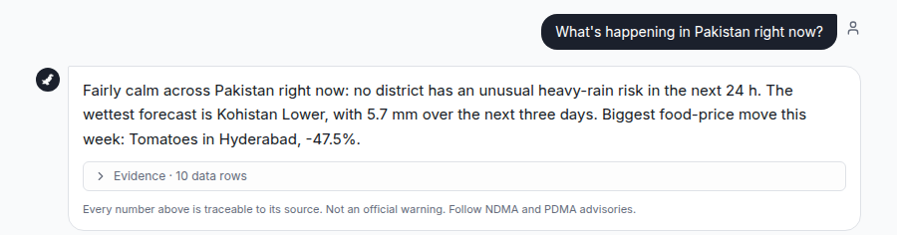
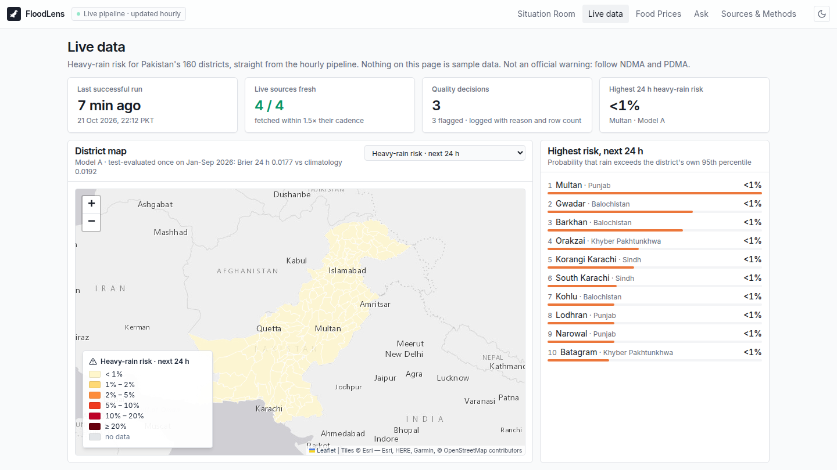
Dashboard / App Views
Page 1 – Situation Room: risk vs each district's normal
Page 2 – Ask (Insight Agent)
Page 3 – Live data
Live demo: huggingface.co/spaces/RoshaanT1/floodlens-pakistan · Repo: github.com/RoshaanT1/floodlens-pakistan

Slide 10
Model A: How It Works
ALGORITHM
CALIBRATION
NO LEAKAGE
Gradient boosting
Probabilities you can trust
Only what was known
scikit-learn HistGradientBoosting: 300 iterations, 15 leaf nodes, ≥100 samples per leaf, L2 = 1. Chosen over logistic regression on validation (Brier 0.0233 vs 0.0238).
Platt scaling fitted on the validation period, never on test, so a 20% warning should mean heavy rain about 1 time in 5.
Forecasts issued 1–3 days before the target day; satellite rain only from days that ended ≥14 h before issue. Automated tests enforce both.
Fixed time splits: train to 30 Jun 2025 · validate Jul–Dec 2025 · test 1 Jan–16 Oct 2026, run once with the frozen model. Baseline declared in advance: district-by-month climatology.

Slide 11
Results vs Baseline
TEST SET 1 Jan–16 Oct 2026, run once · Brier [95% CI], lower is better
 | 24 h | 48 h | 72 h
Model (GBM) | 0.0177 [0.0146, 0.0213] | 0.0178 [0.0147, 0.0214] | 0.0179 [0.0148, 0.0215]
Climatology (declared) | 0.0192 [0.0156, 0.0231] | 0.0192 | 0.0192
Paired difference | −0.0014 [−0.0022, −0.0008] | −0.0013 [−0.0021, −0.0007] | −0.0013 [−0.0019, −0.0007]
Monsoon months: 0.0237 vs 0.0251 · Validation (model choice): GBM 0.0233, logistic 0.0238, climatology 0.0249
Time-based splits (train ≤ Jun 2025, validate Jul–Dec 2025), leakage tests on every feature, test locked in code
Weakest: Azad Kashmir (+1.5%). Model B (prices) did not beat “no change” (MAE 1.667 vs 1.665): rejected and shown as baseline.

Slide 12
Responsible AI & Pakistan Impact
No invented numbers
LOCAL VALIDATION (NDMA)
Every number is inserted by code from a gold table and carries its row id
Replay of Aug 2025: on 14 Aug, 8 of our top-10 districts had heavy rain (34 districts did)
NDMA's 87 sitreps name 125 districts; our fixed 0.5 alert rule flagged only 1, so we rank risk instead
Every claim cited
NDMA quotes carry document, page and section id; no support → “I don't know”
Safe by default
Emergency questions go to Rescue 1122 and NDMA/PDMA first; never an official warning
HONEST LIMITS
Buner, 15 Aug 2025: a flash flood killed 100+, but the satellite's wettest pixel (43 mm) stayed under Buner's 57.5 mm threshold, so the label says “no heavy rain”. Daily satellite rain misses cloudbursts.
Usable in Pakistan
Urdu answers, 160 OCHA districts, PBS prices for 17 cities, NDMA advisories on the map

Slide 13
Why FloodLens: Compared with Today's Alerts
 | Today: advisories & weather apps | FloodLens Pakistan
Timing | Advisories issued as events approach | Probabilities 24–72 h ahead, refreshed hourly
Detail | Areas listed in words | Each of 160 districts, against its own normal
Rigour | No published skill score | Calibrated; beats climatology on a locked test set
Trust | Separate PDFs to read and compare | Row ids for numbers, NDMA section ids for text
Food impact | Not linked to markets | Weekly PBS prices for 17 cities on the same map

Slide 14
Business Model & Sustainability
WHO USES IT
WHO PAYS
WHAT IT COSTS
District disaster-management officers
PDMAs (Punjab, KP, Sindh, Balochistan, GB, AJK) and NDMA
NGOs that pre-position relief
PDMA / NDMA preparedness budgets
Donors funding anticipatory action: money released when a forecast trigger is hit
Public dashboard stays free
One CPU: a small VM (~€4/month) or a free tier
Open data: NASA, OCHA, PBS; Open-Meteo free for non-commercial use
~1.3 GB storage, +10 MB a day
Value: turns reactive relief spending into planned pre-positioning, with evidence that settles where resources go first

Slide 15
Conclusion
1
Beats the baseline on unseen 2026 data
IMPACT
Brier 0.0177 vs climatology 0.0192 (about 7% better); the 95% interval of the gain excludes zero
160 district offices get a free, hourly, per-district signal with reasons and NDMA sources.
Payer: PDMA preparedness budgets or donors' anticipatory-action funds. Runs on 1 CPU, free-tier data.
2
Better everywhere we checked
Ahead of climatology in every province and terrain group and in monsoon months; weakest in Azad Kashmir
FUTURE WORK
Sub-daily rain to catch cloudbursts like Buner
Flood and damage targets, not only rain
A price model that beats “no change”
3
Right when it mattered
Replaying Aug 2025: on 14 Aug, 8 of the 10 districts we ranked highest really had heavy rain

Slide 16
Team & Credits
TEAM SPARK H
RT
HK
MH
Roshaan Tahir · CSDT-13
M Hammad Khan · CSDT-33
M Huzaifa · CSDT-21
Team Lead · Lead Architect
Lead Backend
Lead Data Sources
Open-Meteo forecast pipeline
Model A training and calibration
Insight Agent and live dashboard
NASA IMERG satellite rain fetcher
District rain, 95th-pct thresholds, labels
Data quality checks + 26 tests
Hugging Face Space (Docker server)
Build-and-assemble deploy script
Deploy checklist and AI-use records
Contact: github.com/RoshaanT1/floodlens-pakistan · Data: Open-Meteo, NASA, OCHA, PBS, NDMA
Thank you!

