Slide 1

PrepPilot
AI-Powered Study and Interview Preparation
From knowledge gaps to interview readiness.
Department
of CSE
Team: Santhosh M and Roshan Nur

Slide 2
Abstract
Personalized learning, followed by interview practice
PrepPilot finds the topics a student has not studied or is weak in, builds a personalized study plan, tests knowledge with quizzes, and adapts the plan.
It then prepares the student for interviews with FAQs and an AI mock interview, ending in a readiness score.
One connected preparation journey

Slide 3

Literature survey
Literature Survey: What Exists, What Is Missing
1
2
PlanGlow makes LLM study planning explainable and controllable; a 24-participant study.
3
4
LearnMate2 combines personalized planning with adaptive activities driven by quiz performance.
5
6
AI-driven personalized platform evaluates learning outcomes in a randomized trial with 40 medical students.
7
8
These tools plan or teach but do not link academics to interview readiness.
10
PrepPilot closes the gap through gap detection, an adaptive plan, quizzes, a mock interview, and a readiness score.
9

Slide 4
Technical design
System Architecture
React screens connect preparation modules to backend and AI services.
Frontend
Modules
Backend and AI
React
Gap analyzer
Plan generator
Quiz engine
Revision engine
Interview engine
Readiness scorer
Shared services
Dashboard
Planner
Quiz screens
Interview screens
Database
Authentication
AI service

Slide 5
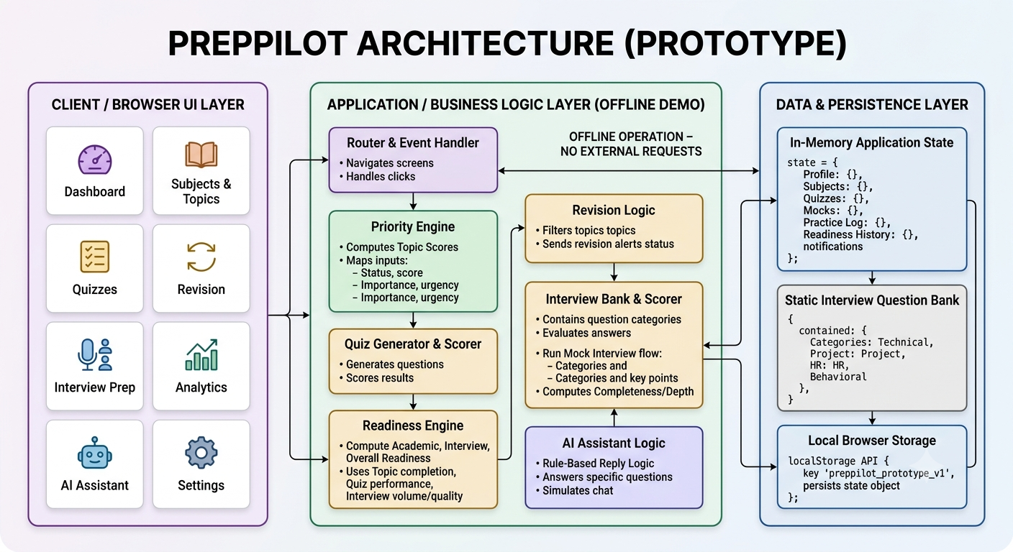

Slide 6




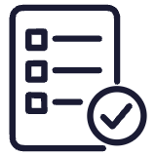



Functional scope
Eight Modules, One Preparation Loop
Subjects and Topics
Knowledge Gap Analyzer
Study Plan Generator
Adaptive Planner
Quiz System
Revision Engine
Interview Prep and Mock Interview
Readiness Score and Analytics

Slide 7



Core behaviors
Key Modules in Detail
Gap analyzer
Mock interview
Explains why a topic is high priority.
Scores responses across six dimensions.
Adaptive planner
Reschedules missed tasks to keep the plan current.
Readiness score
Quizzes
Shows the factors contributing to the result.
Flag weak topics for further study and revision.

Slide 8
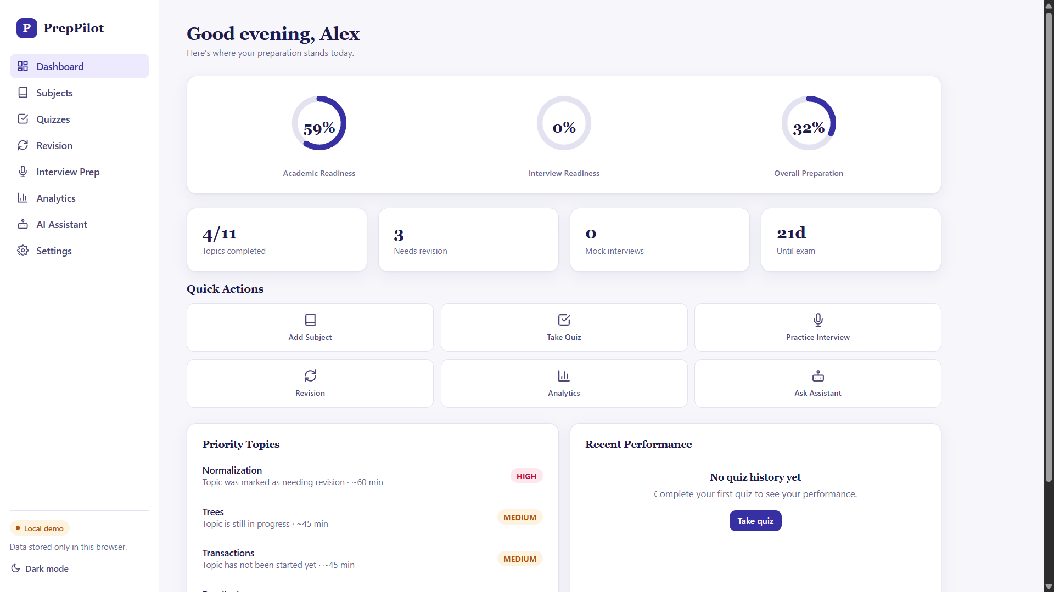

Product output
Output: Dashboard
Dashboard screenshot
User screenshot placeholder · upload here
Readiness scores, today's plan, and weak topics in one view.

Slide 9
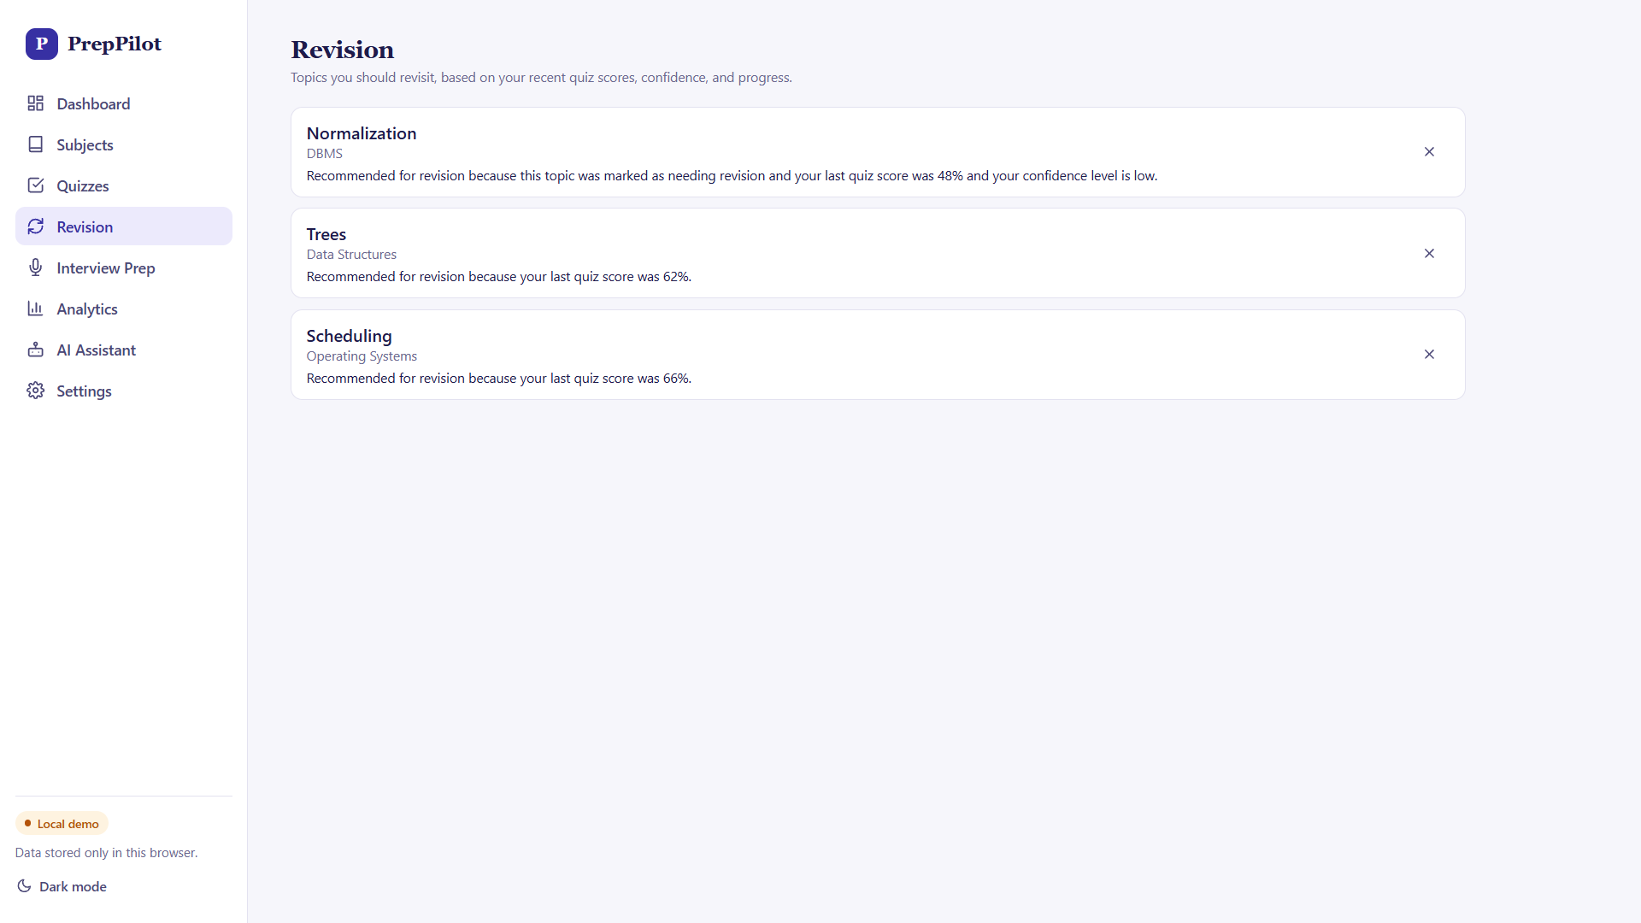
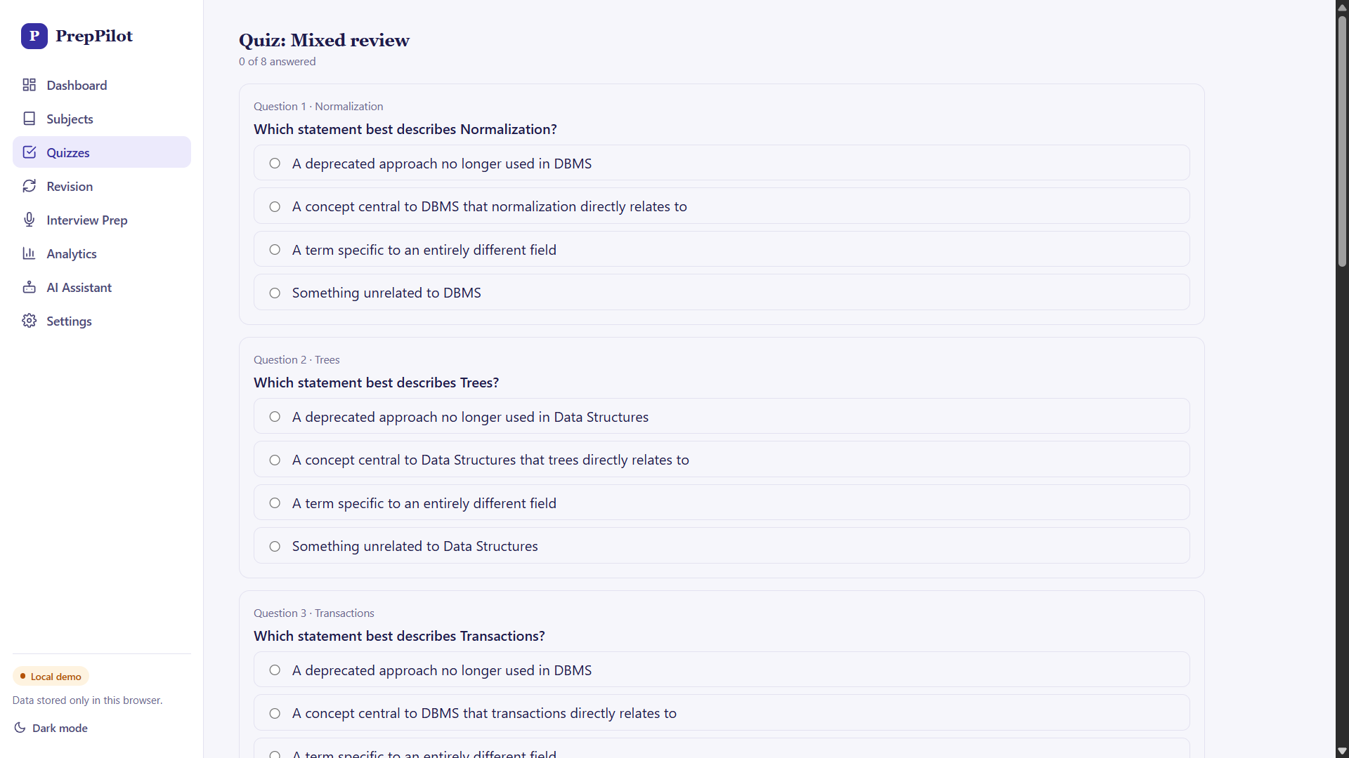
Product output
Output: Planner and Quizzes
Planner screenshot
Quiz screenshot
Upload user screenshot
Upload user screenshot
Personalized study tasks and an adaptive schedule.
Knowledge checks that flag weak topics for revision.

Slide 10
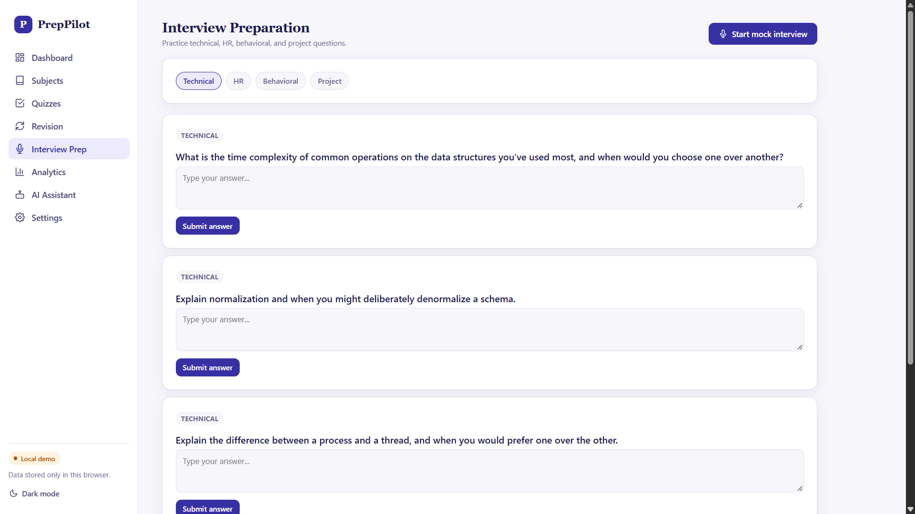
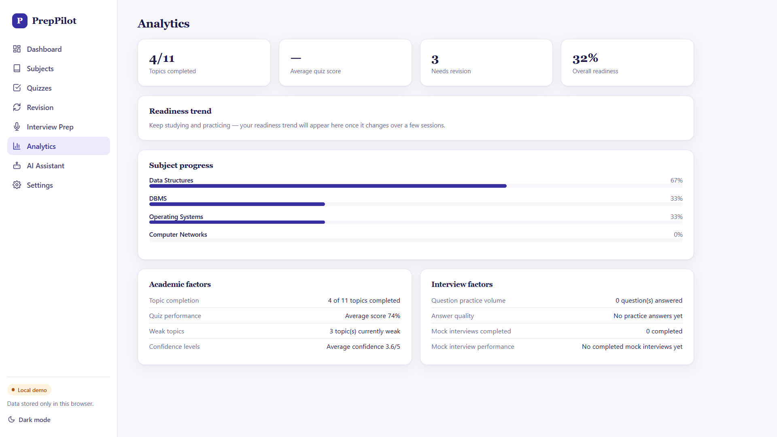
Product output
Output: Interview Prep and Readiness
Mock interview report
Readiness score
Upload user screenshot
Upload user screenshot
Mock interview report with six-dimensional scoring.
Readiness score with visible contributing factors.

Slide 11

References
PlanGlow: Personalized Study Planning with an Explainable and Controllable LLM-Driven System
LearnMate2: LLM-powered Personalized and Adaptive Support System for Online Learning
Evaluation of the impact of AI-driven personalized learning platform on medical students' learning performance
Research supporting the literature survey

