Slide 1
Project Presentation
Building a classifier for Personal attacks
For the course CS5100-Fall 2021: Foundations of AI
Surya Roshan Mugada
12 / 9 / 2021

Slide 2
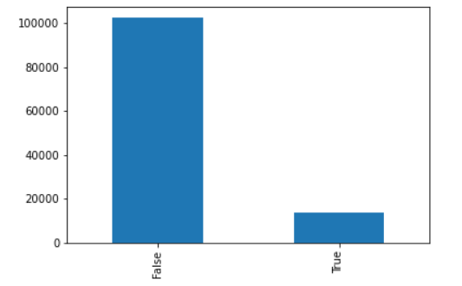
Summary and Answers- First Look
Visualization of the data :
Class imbalance
Text Cleaning
No empty or null values
Text Cleaning performed:
Remove punctuations
Links- urls
Spaces & Numbers
Removal of numbers gave a boost of 0.5% on strawman code
Counts of Attacks and non attacks

Slide 3
Summary and Answers- Features
C. Features chosen: comment, ns, logged_in.
Year not affecting the distribution of data. Attack comments are 2.5 times non attack comments when not logged in.
Used a concept similar to entropy.(seeing the distribution split for each variable).
D. Attack used as majority of the annotations.
E. Performance Optimization: One Hot encoding for fields other than comment before training it. Parallelization (n_jobs=-1) to improve speed.

Slide 4
Models
Model | Parameters - (all tried with train-test) | Best | Macro Avg
Decision Tree | (1,2), (1,1), Bal & ImBal | (1,2) Balanced | 79%
Logistic Regression | (1,1) (1,2) bal & Imbal | (1,1) Imbalanced | 84.3%
Multinomial Naive Bayes | (1,2) Imbalance, Balanced | Imbalance | 81%
Random Forest | (1,2) Imbalance | Imbalance | 81.5%
Linear SVC | (1,2) (1,1) Bal and Imbalance | (1,1) Imbalance | 85.7%
Ridge Classifier | (1,2) Imbalance | (1,2) Imbalance | 79.4%
Passive Aggressive | (1,2) ImBalance | (1,2) Imbalance | 79.4%
Perceptron | (1,2) Imbalance | (1,2) Imbalance | 81.2%
Multilayered PC | (1,2) Balanced, Imbalance | (1,2) Imbalance | 80%

Slide 5
Tuning, Metrics and Best Model
G. For top 2 models:
LinearSVC :
Logistic :
H. I used F1 Macro Average. Helped me to balance Precision & Recall. Cannot prefer one over other. Very easy to increase one and reduce other. Not what we want . Cross validation helped eradicate partiality of train-test split and gave a good potential of model
Class_weight:{1:1,1:2,1:3,1:4,Balanced}, C=[0.1,1,10,100,1000], loss= hinge and square hinge
Macro Avg : 85.7% to 86.8% increase
Class_weight:{1:1,1:2,1:3,1:4,Balanced}, C=[0.1,1,10], solver in [‘newton-cg’, ‘lbfgs’, ‘liblinear’, ‘sag’, ‘saga’]
Macro Avg: 84.4% to 86.1%

Slide 6
Summary :
Cleaned the text data
Data visualization - distribution, plots
Select features, ns, logged_in, comment
Perform one hot encoding
Select attack as majority
Apply train_test split and k cross validation on multiple models
Choose the promising ones and apply different ngrams
Choose the best 2 for hyperparameter tuning
Apply various parameters and choose f1_macro as the scoring metric
Voila! Best performing model.
Best Model: [answer i]
Linear SVC
Metrics:
Class weight | False:1, True:2
C | 1
Loss | Hinge
Macro Avg | 87%
Precision | 88%
Recall | 86%

Slide 7
Thank you!

