Slide 1

Restaurant Ordering & Kitchen Display
Roshan Bright R | 2116240701439 | CSE
Low-Code Application Development

Slide 2









The Problem and Our Goal
Problems with manual ordering
What the system delivers
Paper slips get lost or misread
Orders linked to tables
Kitchen has no live view of orders
Kitchen status tracking
Stock runs out without warning
Automatic stock deduction
Bills and sales totals done by hand
Live sales dashboard
Notes:
Explain the pain points of manual ordering and the four things the system delivers.

Slide 3






Low-Code Features Used
Forms & Lookups
Form Workflows
Deluge Scripting
9 forms linked by lookup fields
10 workflows on add, edit, validate
Stock, totals and validations
Reports
Pivot Charts
Pages
Grouped lists for the kitchen
4 charts for sales analytics
Sales Dashboard with KPI tiles
Notes:
Walk through the six low-code building blocks used in the project.

Slide 4
How the System Works
1
2
3
4
5
6
Place order
Add items
Kitchen
Stock
Payment
Dashboard
Pick a table; table turns Occupied
Price and total calculate automatically
Status moves Placed to Served
Ingredients deducted from recipes
Order Paid; table Free
Charts update from live data
Master-detail design: every order has many Order_Item records linked by a lookup, which works on the free plan where subforms are limited.
Notes:
Follow one order from table selection to the dashboard.

Slide 5
Order Status Flow
Placed
Accepted
Preparing
Ready
Served
Billed
Paid
Accepted
Preparing to Ready
Paid
Stock deducted once from recipes
Kitchen buttons update the card
Payment form closes the order
Table status
Free
Occupied
Free
order created, then payment complete
Notes:
Cancelled is also available as an exit. Table status changes automatically with order and payment workflows.

Slide 6
Workflows and Deluge Code
Form | Workflow
Order | Mark Table Occupied
Order | Go To Items
Order | Deduct Stock
Order_Item | Fetch Price
Order_Item | Update Line Total
Order_Item | Update Order Total
Order_Item | Check Availability
Order_Item | Add Another
Payment | Fetch Amount
Payment | Complete Payment
Deduct Stock (on order edit)
if(input.Status == "Accepted" &&
input.Stock_Deducted == false)
{
items = Order_Item[Order == input.ID];
for each i in items
{
recipe = Recipe[Menu_Item == i.Menu_Item];
for each r in recipe
{
ing = Ingredient[ID == r.Ingredient];
ing.Current_Stock = ing.Current_Stock
- (r.Qty_Required * i.Quantity);
}
}
Order[ID == input.ID].Stock_Deducted = true;
}
Notes:
Ten workflows automate the order lifecycle. The Stock_Deducted flag prevents double deduction.

Slide 7
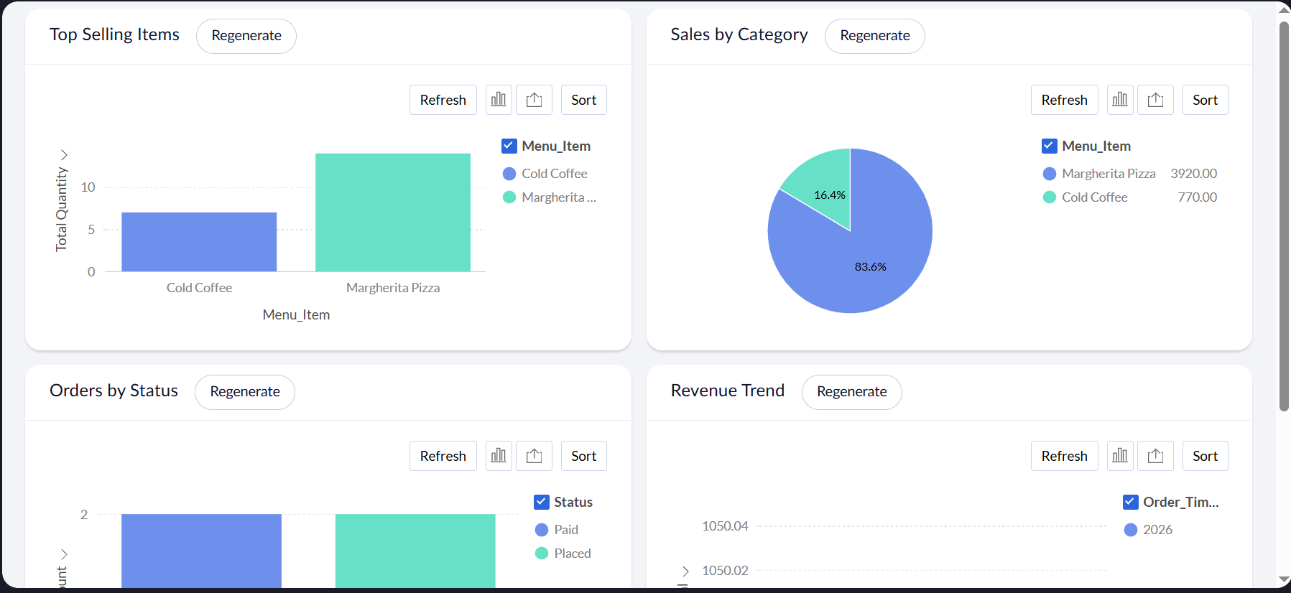
Sales Dashboard
4
Pivot charts
10
Workflows
9
Forms
Top sellers, sales split, orders by status and revenue trend, all from live data
Notes:
Show the live dashboard. Charts read directly from Order and Order_Item.

Slide 8
Challenges and Solutions
Subforms limited on free plan
Separate Order_Item form linked by lookup
CSV lookups imported as invalid
Matched by name instead of ID
Dropdown values rejected on import
Fixed choices (kg, Veg) to match exactly
No public link or scheduled email
In-app forms and dashboard reports
Stock deducted twice on re-edit
Stock_Deducted flag on each order
Notes:
Be honest about the limitations; each had a working low-code answer.

Slide 9




Conclusion and Future Scope
A working order-to-payment system, built without traditional coding
Public QR ordering
Online payments
Daily sales email
Role-based profiles
Notes:
Summarise results, then list future scope. Thank the audience.

