Slide 1


Stack overflow Survey Analysis by Team F
Presented By :
Roshan Yadav
Ashish Yadav
Yuvam Kumar

Slide 2
How we process unstructured Data
25-34
C
Documentation
18-24
Java
YouTube/blogs
35-44
JavaScript
Online forum

Slide 3





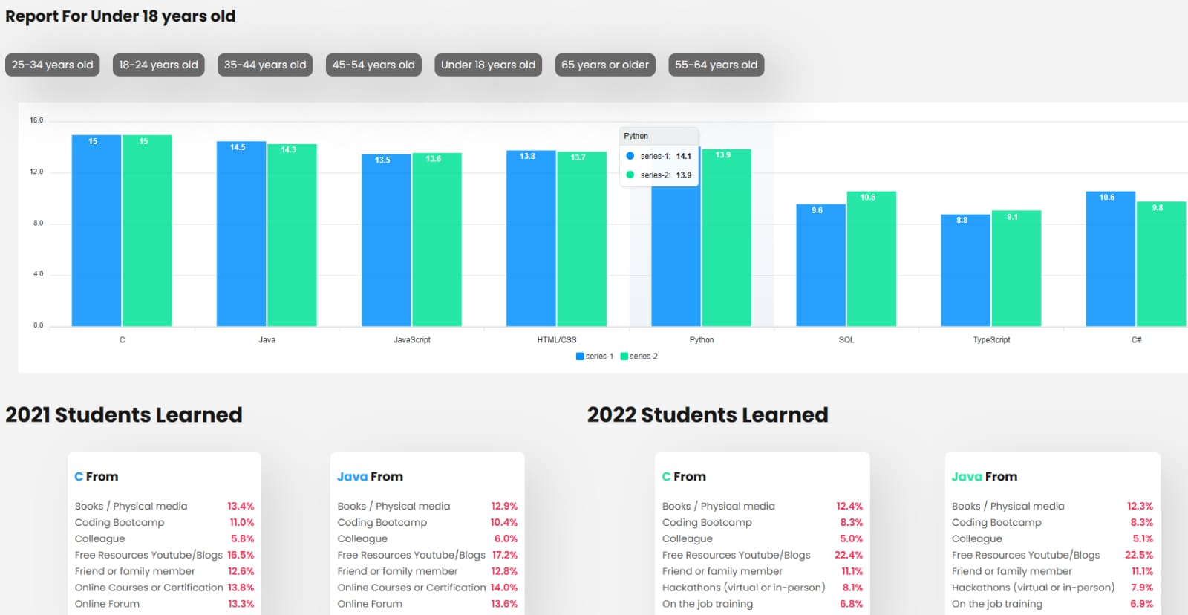
Unstructured data given by faculty
Structured Data
Json
Flask(server)
Use data as Api
Pandas
System flow
Response
Request
Frontend

Slide 4
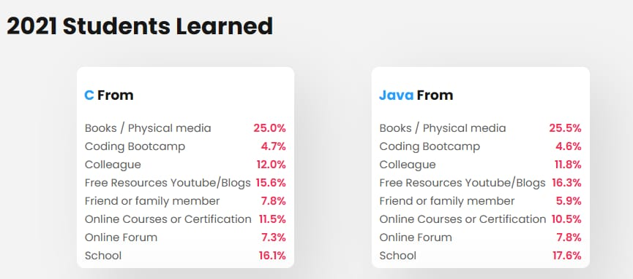
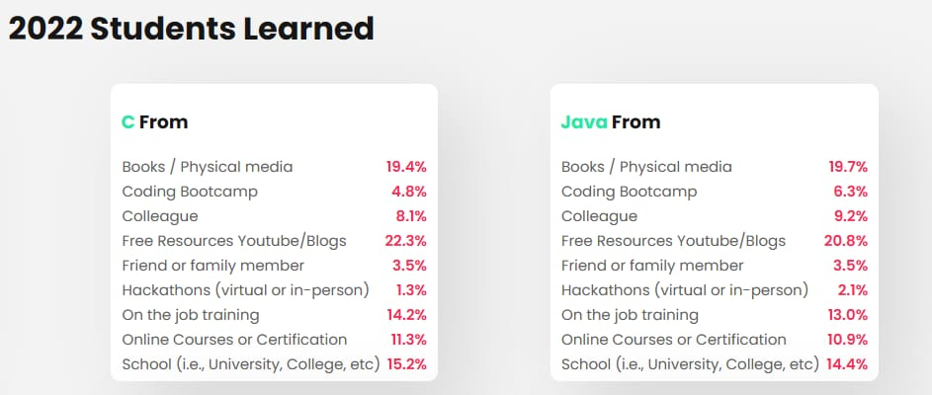
Visualization of Data

Slide 5


