Slide 1
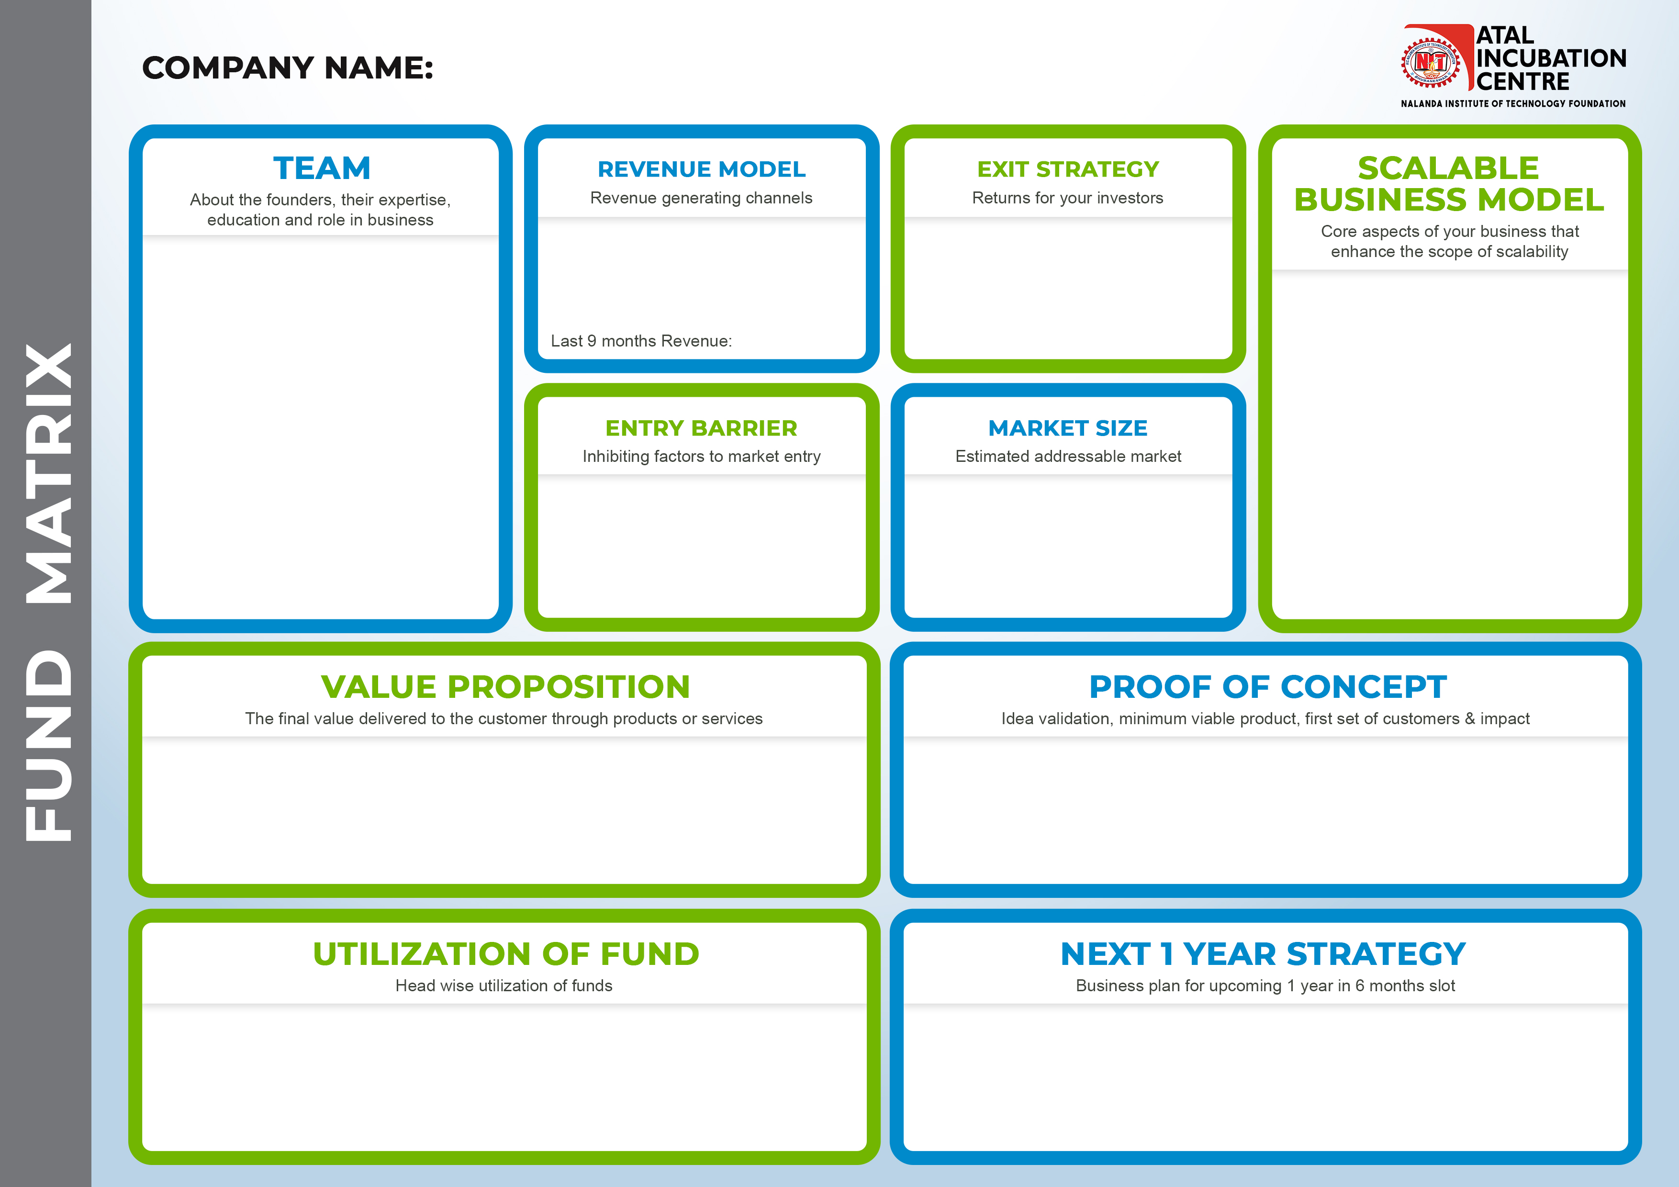
Homvery
Prahllad Mittal - CEO
B.Tech in civil engineering in 2018 from VSSUT (Formerly UCE), Burla.. Started Gift Graphite, where we provided handmade personalized sketches to customers. And during final year started Homvery. It was a part of Jagriti Yatra (2019-20) which Is a 15 days long, 8000+Km train journey covering length and breadth of India.
Rajat Kar – COO
Completed Diploma from Vikash Polytechnic College, Bargarh. Have Experience of Distributorship of various FMCG Companies.
Ritesh Mittal - COO/
Studied in Madnawati Public School. Have a great knowledge of customer wants and have great connection and network due to involvement in social activity.
Commission from Technician.
Advertisement.
Available in Pitch deck
45 Lakh
Asset Light Model
High Demand Market
Huge Marketing Budget
Cashbacks
Offers
Average Household expenses on Home Maintenance –
Rs 5000 / Year
No of Households (Urban) - 78,865,937 (CENSUS 2011)
Market Size – 400 Cr (Taking a min of 10% Market Share)
On Time Service.
Pocket Friendly Price
30 days service guarantee
Verified experts.
Already in market from last 4 year and served 10k+ customers.
Sl No | Investment Tranches | Funds | Utilization of fund | Target | Time Period
1 | Phase 1 | INR 10 Lakhs Expansion– 1 Lakh Digital Marketing – 3 Lakh CashBack & offers – 6 Lakh | Intra City Expansion & Product Development | Acquiring 10k Customer | Within 3 Months
3 | Phase 2 | INR 20 Lakhs Expansion – 2 Lakh TV Ad – 15 Lakh Digital Marketing – 3 Lakh | Marketing & Operational Cost | Expansion to Balangir, Berhampur & Raipur | Next 3 Month
4 | Phase 3 | INR 20 Lakhs TV Ad – 12 Lakh Digital Marketing – 3 Lakh | Marketing & Product Development | Acquiring 20K Customer | Next 3 Month
Total |  | 50 Lakh
Sl No | Time Period | Expansion Plan | Cumulative Customer Size (Current – 10k) | Cumulative Experts Onboard (Current – 100)
1 | Quarter 1 | Acquiring 10k Customers | 20,000 | 200
2 | Quarter 2 | Expansion to Balangir, Berhampur, Raipur | 25,000 | 300
3 | Quarter 3 | Acquiring 15k Customers | 40,000 | 600
4 | Quarter 4 | Acquiring 20k customers | 60,000 | 1000
Enter your text

