Slide 1
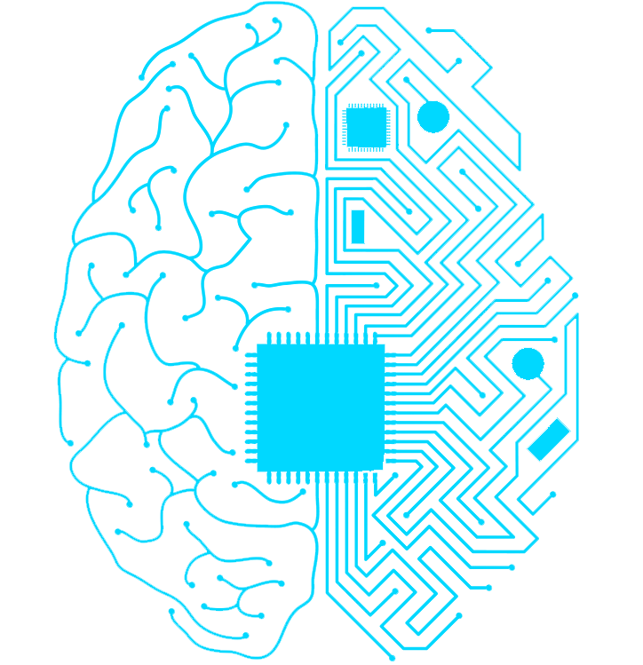


ARTIFICAL INTELLIGENCE
Developed by:-
Roshan Panigrahi 1701297041
Priyabrata Pattnayak 1701237021

Slide 2
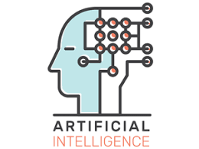
CONTEXT
INTRODUCTION
HISTORY
RESEARCH AREAS
AI TRENDS IN VARIOUS SECTORS
AI IN YOUR DAILY LIFE
PROS & CONS
CONCLUSION

Slide 3
INTRODUCTION
What is INTELLIGENCE ?
The ability to learn from experiences and apply knowledge acquired from experience, handle complex situations, solve problems.
What is ARTIFICIAL ?
It means which is not real or we can say which is not natural.
What is ARTIFICIAL INTELLIGENCE ?
It is an area of computer science that emphasizes the creation of intelligence that work and react like human.

Slide 4
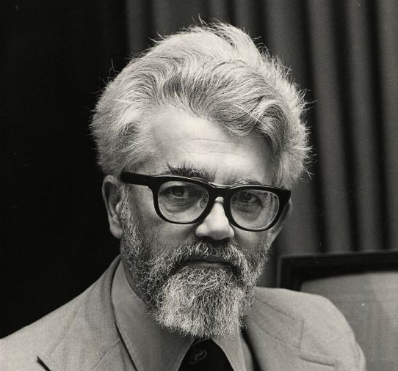
HISTORY
John McCarthy coined the AI term in 1956.
John McCarthy “Father of AI”
According to the father of Artificial Intelligence the definition of AI
“The science and engineering of making an intelligence machine”

Slide 5
RESEARCH AREAS
NEURAL NETWORKS
EXPERT SYSTEMS
NATURAL LANGUAGE PROCESSING
ARTIFICIAL INTELLIGENCE
ROBOTICS
FUZZY LOGIC SYSTEM

Slide 6
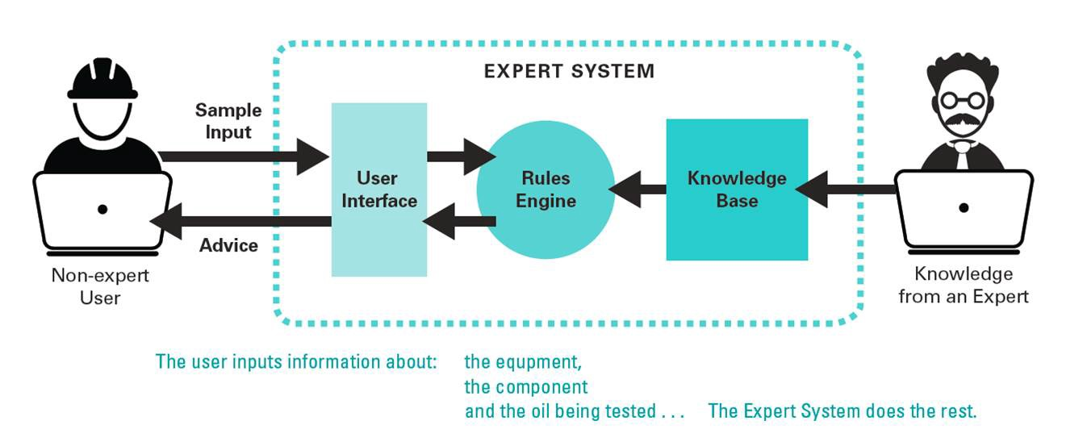
EXPERT SYSTEM
An expert system is a computer system that emulates the decision-making ability of human expert. Expert systems are designed to solve complex problems by reasoning through bodies of knowledge ,represented mainly as if-then rules rather then though conventional procedural code.

Slide 7
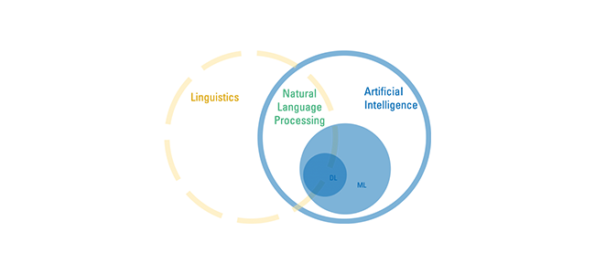
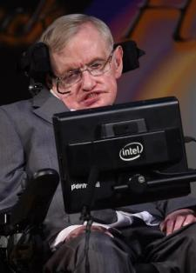
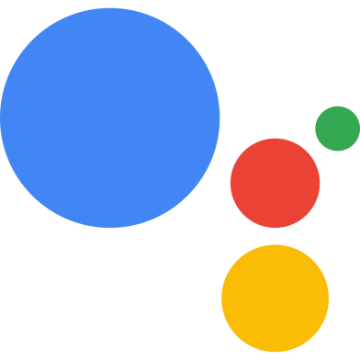
NATURAL LANGUAGE PROCESSING
Natural Language Processing (NLP) refers to AI method of communicating with an intelligent systems using a natural language such as English.
We can use NLP to create systems like speech recognition, document summarization, machine translation, spam detection, named entity recognition, question answering, auto complete, predictive typing and so on.

Slide 8
ROBOTICS
Robots are aimed at manipulating the objects by perceiving, picking, moving, modifying the physical properties of object, destroying it, or to have an effect thereby freeing manpower from doing repetitive functions without getting bored, distracted, or exhausted.
Robotics is a domain of AI, which is composed of Electrical Engineering, Mechanical Engineering, and Computer Science for designing, construction, and application of robots.

Slide 9
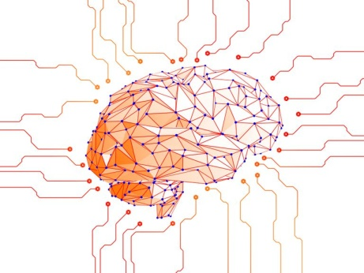
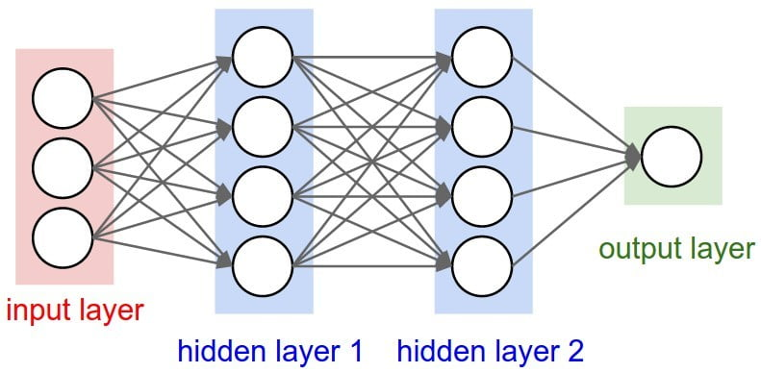
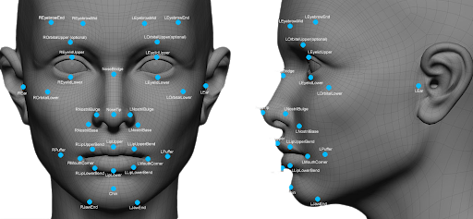
NEURAL NETWORKS
A neural network is either a system software or hardware that works similar to the tasks performed by neurons of human brain. Neural networks include various technologies like deep learning, and machine learning as a part of AI.
Examples:-Aerospace,Telecommunication, Face Recognition, Stock Market Production etc.

Slide 10
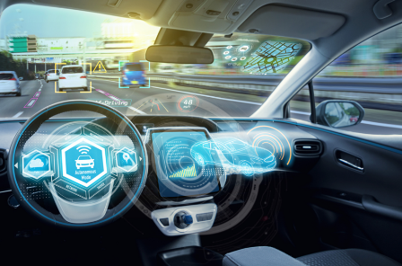
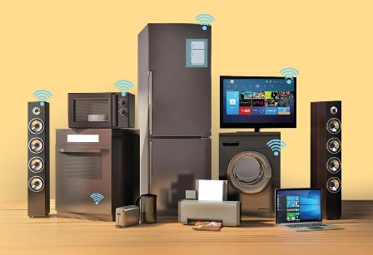
FUZZY LOGIC SYSTEM
Fuzzy Logic (FL) is a method of reasoning that resembles human reasoning. The approach of FL imitates the way of decision making in humans that involves all intermediate possibilities between digital values YES and NO.
Example:-Automotive Systems, Consumer Electronic Goods, Domestic Goods, Environment Control

Slide 11
AI TRENDS IN VARIOUS SECTORS
Medical and Healthcare with AI
With AI’s neural networks, scientists are analyzing the atypical risk factors that were too complicated to quantify.
Entertainment
A familiar application of AI in everyday life is seen with services like Netflix or Amazon. AI in media and entertainment will help automate certain production procedures.
Financial
Artificial intelligence in finance is transforming the way we interact with money. AI is helping the financial industry to streamline and optimize processes ranging from credit decisions to quantitative trading and financial risk management.

Slide 12
AI TRENDS IN VARIOUS SECTORS
Data Security
Automatic Exploit Generation (AEG) is a bot that can determine whether a software bug, which may cause security issues is exploitable. If a vulnerability is found, the bot automatically secure it.
Manufacturing
AI will perform manufacturing, quality control, shorten design time, and reduce materials waste, improve production reuse, perform predictive maintenance, and more.
Automotive Industry
Tesla introduced TeslaBot, allows user to interact with their car from their Smartphone.
Tesla also developed automatic driving cars.

Slide 13

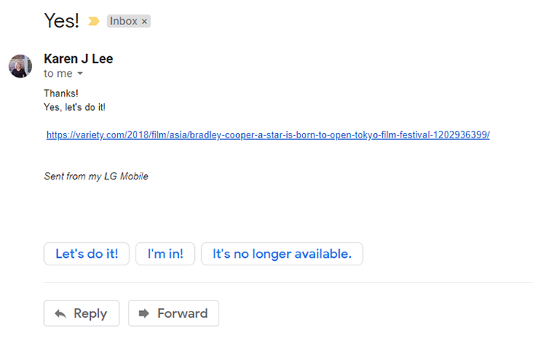
AI IN YOUR DAILY LIFE
Email Filters in Gmail
Smart Replies in Gmail

Slide 14
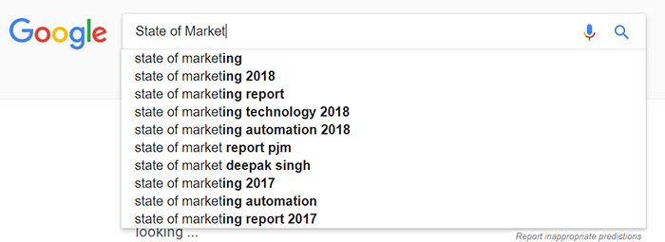
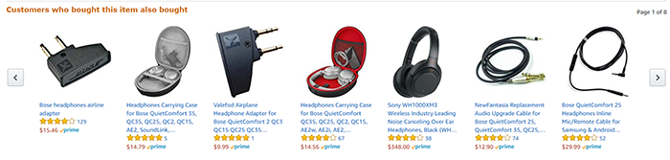
AI IN YOUR DAILY LIFE
Google Predictive Searches
Product Recommendations
Product Recommendations

Slide 15
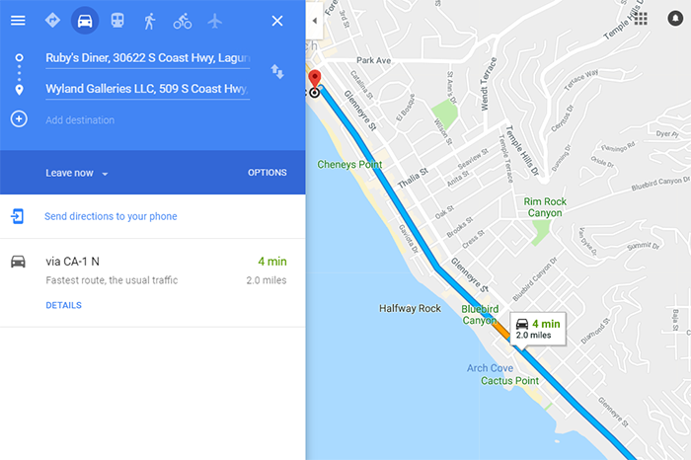
AI IN YOUR DAILY LIFE
Maps and Directions

Slide 16
PROS
AI would have a low error rate compared to humans, and they would have incredible precision, accuracy, and speed.
They won't be affected by hostile environments, thus able to complete dangerous tasks, explore in space, and endure problems that would injure or kill us.
Predict what a user will type, ask, search, and do. They can easily act as assistants.
Can detect fraud in card-based systems, and possibly other systems in the future.
Organized and manages records.
Interact with humans for entertainment or a task as avatars or robots.
They can think logically without emotions, making rational decisions with less or no mistakes.
They don't need to sleep, rest, take breaks, or get entertained, as they don't get bored or tired.

Slide 17
CONS
Can cost a lot of money and time to build, rebuild, and repair.
It's questionable: is it ethically and morally correct to have androids, human-like robots, or recreate intelligence, a gift of nature that shouldn't be recreated? This is a discussion about AI that's popular in the days.
Storage is expansive, but access and retrieval may not lead to connections in memory as well as humans could.
Robots, with them replacing jobs, can lead to severe unemployment,.
As seen partially with smart phones and other technology already, humans can become too dependent on AI and lose their mental capacities.
Machines can easily lead to destruction, if put in the wrong hands. That is, at least a fear of many humans.

Slide 18
CONCLUSION
In it' s short existence, AI has increased understanding of the nature of intelligence and provided an impressive array of application in a wide range of areas. It has sharpened understanding of human reasoning, and of the nature of intelligence in general.

Slide 19


