Slide 1
Exasol Hackathon
Project Name : COSTLENS
Team Name : Trial and Error
Team Members:
I S Arun Varshan
Roshan M

Slide 2
EXASOL HACKATHON | PROJECT PITCH
CostLens
A SIMPLE LENS ON COST GROWTH
1.10x
Active users
Find the drivers behind
growing data-platform spend.
x
1.03x
Queries / user
x
1.31x
Cost / query
Observe. Explain. Prioritize. Prove.
1.48x
Total modelled cost
An Exasol-powered view from query behavior to cost action, built to help teams move from "the bill went up" to "here is why."
ILLUSTRATIVE DEMO | SYNTHETIC WORKLOAD
Cost units are modeled estimates, not an Exasol or cloud-provider invoice.

Slide 3
01 | THE CHALLENGE
The cost problem is easy to see, hard to explain
A rising total does not tell a team which workload, pattern, or decision is driving it.
Spend rises faster than usage
The cause is hidden
More queries do not always mean proportionally more cost.
Teams need to separate user growth, query frequency, and per-query cost.
Fixes are often broad
Savings are hard to prove
Without workload evidence, teams risk tuning the wrong thing, or slowing useful work.
A recommendation matters only if its impact can be measured after the change.
The gap: connect observed query behavior to cost driver to targeted action to measured result.
COSTLENS | EXASOL HACKATHON 2026
02

Slide 4
02 | THE APPROACH
CostLens turns cost analysis into a repeatable loop
One workflow for platform teams and the business teams managing operational spend.
01
02
03
04
OBSERVE
>
EXPLAIN
>
PRIORITIZE
>
PROVE
Aggregate usage and workload signals in Exasol.
Attribute cost change to its contributing factors.
Surface expensive patterns and practical next steps.
Measure before and after a selected fix.
Outcome: explain what changed, direct attention to the biggest opportunity, and make the result visible.
COSTLENS | EXASOL HACKATHON 2026
03

Slide 5
03 | EXASOL INTEGRATION
Built around Exasol, not a disconnected spreadsheet
Heavy aggregation is performed against the Exasol workload tables; the app turns those results into a decision workflow.
EXASOL
ANALYZE
COSTLENS API
DASHBOARD
>
>
>
QUERY_LOG
usage history
Monthly + workload
aggregates in SQL
FastAPI / forecasts
role-checked endpoints
Drivers / actions
proof / team spend
What Exasol contributes
What CostLens contributes
Queryable workload history; SQL aggregation for monthly cost, repeated patterns, peak load, teams, and daily trends.
An explainable model, prioritized opportunities, forecasts, team views, and a measured fix workflow.
The demo connects to Exasol Personal. Included query history and operational/live-feed examples are synthetic.
COSTLENS | EXASOL HACKATHON 2026
04

Slide 6
04 | COST ATTRIBUTION
Explain the change, not just the chart
A symmetric factor split helps teams distinguish demand growth from query efficiency and cost intensity.
SHARE OF THE MODELED COST INCREASE
+47.9%
Active users
24.5%
+10.0% vs baseline
modelled cost
Apr to Sep
Queries per user
7.6%
+3.0% vs baseline
Query volume +13.3%
Active users +10.0%
Cost per query
67.9%
+30.5% vs baseline
1.10 x 1.03 x 1.31 = 1.48 | factor contributions total 100%
Illustrative synthetic demo data. Estimate = (runtime seconds + scanned MB / 100) x assumed rate card; not an invoice.
COSTLENS | EXASOL HACKATHON 2026
05

Slide 7
05 | ACTIONABLE ANALYSIS
From workload signal to a practical next step
CostLens puts high-signal opportunities in front of the team that can act on them.
Repeated heavy query
Look for a summary-table or pre-aggregation opportunity.
PRE-FLIGHT
Check before it runs
Wide scans
Review SELECT * and unused columns in recurring workloads.
Normalize a submitted SQL shape and compare it with historical workload patterns to estimate repeat frequency and cost.
Peak-hour load
Consider moving heavy refreshes outside busy hours.
The pasted SQL is not executed.
Unused tables
Forecasts, budget comparisons, and a demo live feed round out the workflow.
Review stale storage and ownership before cleanup.
Demo note: the live-feed generator and operations-health examples are simulated; production ingestion should use real audit/monitoring sources.
COSTLENS | EXASOL HACKATHON 2026
06

Slide 8
06 | ORGANIZATION SPEND
Connect platform efficiency to departmental spend
A complementary team ledger helps business owners understand budgets, trends, and data quality.
CSV / Excel
Screen OCR
Manual entry
TEAM LEDGER + BUDGET VIEW
>
>
Upload and review rows
Read only a user-drawn box
on the local device
Add a single reviewed row
Share / monthly trend / budget vs actual
See the split
Act with context
Keep an audit trail
Category percentages and totals; monthly amounts and change.
Budget variance, utilization, projection, anomaly flags, and what-if savings.
Team-scoped access and a tamper-evident ledger hash chain.
Synthetic department records are for demonstration. OCR results are reviewed before saving; the hash chain detects edits but is not a substitute for database security.
COSTLENS | EXASOL HACKATHON 2026
07

Slide 9
07 | TRUST & GOVERNANCE
Useful insight needs clear access boundaries
CostLens separates team visibility from platform-wide operations and keeps review in the workflow.
MEMBER
TEAM LEAD
ADMIN
Own uploaded files
Department scope
Platform scope
Upload and inspect own submissions
Team spend, files, and budgets
Cross-team view and database fixes
Privacy controls
Honest limits
Amount masking, a moving viewer watermark, and an inactivity lock deter casual exposure.
A browser cannot stop phone photos. OCR can misread digits. Hash chains do not defeat a full database administrator.
Production deployment still needs HTTPS, managed secrets, data-at-rest protections, and validated Exasol-version compatibility.
COSTLENS | EXASOL HACKATHON 2026
08

Slide 10
08 | HACKATHON WALKTHROUGH
A short demo tells the full story
Show the judges the path from evidence to action, then be explicit about what is synthetic.
1
Open platform analysis
Show cost trend, comparison period, and growth attribution.
2
Inspect a driver
Drill into repeated queries, scan patterns, peak load, or unused tables.
3
Check before running
Use pre-flight to match a SQL pattern to historical behavior.
4
Prove a fix
Run the before/after measurement and show the recorded result.
5
Switch to department spend
Show budget/actual and team-scoped files with readable amounts.
Keep the caveat visible: sample query history, department ledger data, and live-feed rows are synthetic.
COSTLENS | EXASOL HACKATHON 2026
09

Slide 11
09 | VALUE & NEXT STEP
Make cost optimization measurable and repeatable
CostLens is a decision-support layer for turning data-platform activity into accountable engineering work.
WHAT TEAMS GET
PATH TO PRODUCTION
A clearer explanation
Connect real telemetry
Attribute cost movement to a small set of understandable drivers.
Replace synthetic history and feed rows with approved Exasol monitoring sources.
A focused next step
Calibrate to real spend
Turn repeat and scan patterns into workload-specific actions.
Map the rate card to provider billing and validate the model with finance.
Evidence of impact
Operationalize safely
Compare before and after instead of reporting an unverified saving.
Set thresholds, owners, alerts, and a controlled change process.
CostLens helps teams ask a better question: not only "what did we spend?" but "which workload drove it, and did the fix work?"
COSTLENS | EXASOL HACKATHON 2026
10

Slide 12
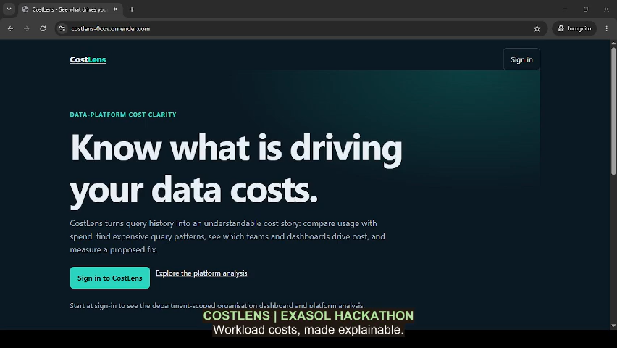

Slide 13


