Slide 1
HireMe
AI-Powered Job Search & Career Development Platform
HackInMotion • RICR-HIM-1007

Slide 2
1. Problem Statement
• Job seekers struggle to understand whether their resume matches a target job.
• Generic resume advice does not clearly identify missing skills, weak areas or relevant keywords.
• Candidates need realistic interview practice based on their own resume and target role.
• Interview preparation and career guidance are often scattered across different platforms.
• Users need a simple way to track their preparation and improve over time.
HireMe • HackInMotion RICR-HIM-1007 2

Slide 3
2. Proposed Solution
• HireMe is a unified career platform that combines job discovery, resume intelligence, AI mock interviews and career mentorship.
• The user provides career information and/or resume context and receives personalized AI-powered guidance.
• The platform connects the complete journey: Find a job → Analyze → Practice → Get feedback → Improve.
• The solution is available through web and mobile experiences.
HireMe • HackInMotion RICR-HIM-1007 3

Slide 4
3. User Account & Authentication
• Sign up and login flow for users.
• JWT-based authentication and protected backend routes.
• Each user can access their own career/application data.
• Authentication is handled through the backend instead of exposing sensitive credentials to the client.
HireMe • HackInMotion RICR-HIM-1007 4

Slide 5
4. Resume Upload & Parsing
• Users can provide their resume as part of the career workflow.
• Resume information is used as context for AI-powered analysis and interview preparation.
• Important information can be organized into useful career context such as skills, education, experience and projects.
• Supported document workflows can be extended for PDF/DOCX parsing and structured extraction.
HireMe • HackInMotion RICR-HIM-1007 5

Slide 6
5. Resume vs Job Description Analysis
• Compare the candidate's resume context with the target job requirements.
• Generate a role-focused match/fit assessment.
• Identify missing or weak skills and important job-related keywords.
• Give specific improvement suggestions instead of only generic resume advice.
• Help the candidate understand what to improve before applying or interviewing.
HireMe • HackInMotion RICR-HIM-1007 6

Slide 7
6. AI-Powered Mock Interview
• AI generates interview questions based on the candidate's career context and target role.
• Supports technical and behavioral interview preparation.
• Candidate answers questions through the interview experience.
• AI evaluates the response for relevance, clarity and quality.
• Provides feedback and improvement guidance after the interaction.
• Creates a repeatable practice loop: Question → Answer → Evaluation → Improvement.
HireMe • HackInMotion RICR-HIM-1007 7

Slide 8
7. Dashboard & History
• Central place for the user's career activities.
• Job search and job-management workflows.
• Resume analysis results can be reviewed again.
• Interview sessions and feedback can be used to track improvement.
• Provides a foundation for future performance analytics and progress tracking.
HireMe • HackInMotion RICR-HIM-1007 8

Slide 9
8. Career Mentor & AI Features
• Career Mentor Chat provides conversational guidance for career-related questions.
• Groq Cloud API is integrated through the backend using groq-sdk.
• AI can power resume analysis, mock interview generation/evaluation and mentor responses.
• Keeping the AI integration on the backend helps protect the API key and centralize AI logic.
HireMe • HackInMotion RICR-HIM-1007 9

Slide 10
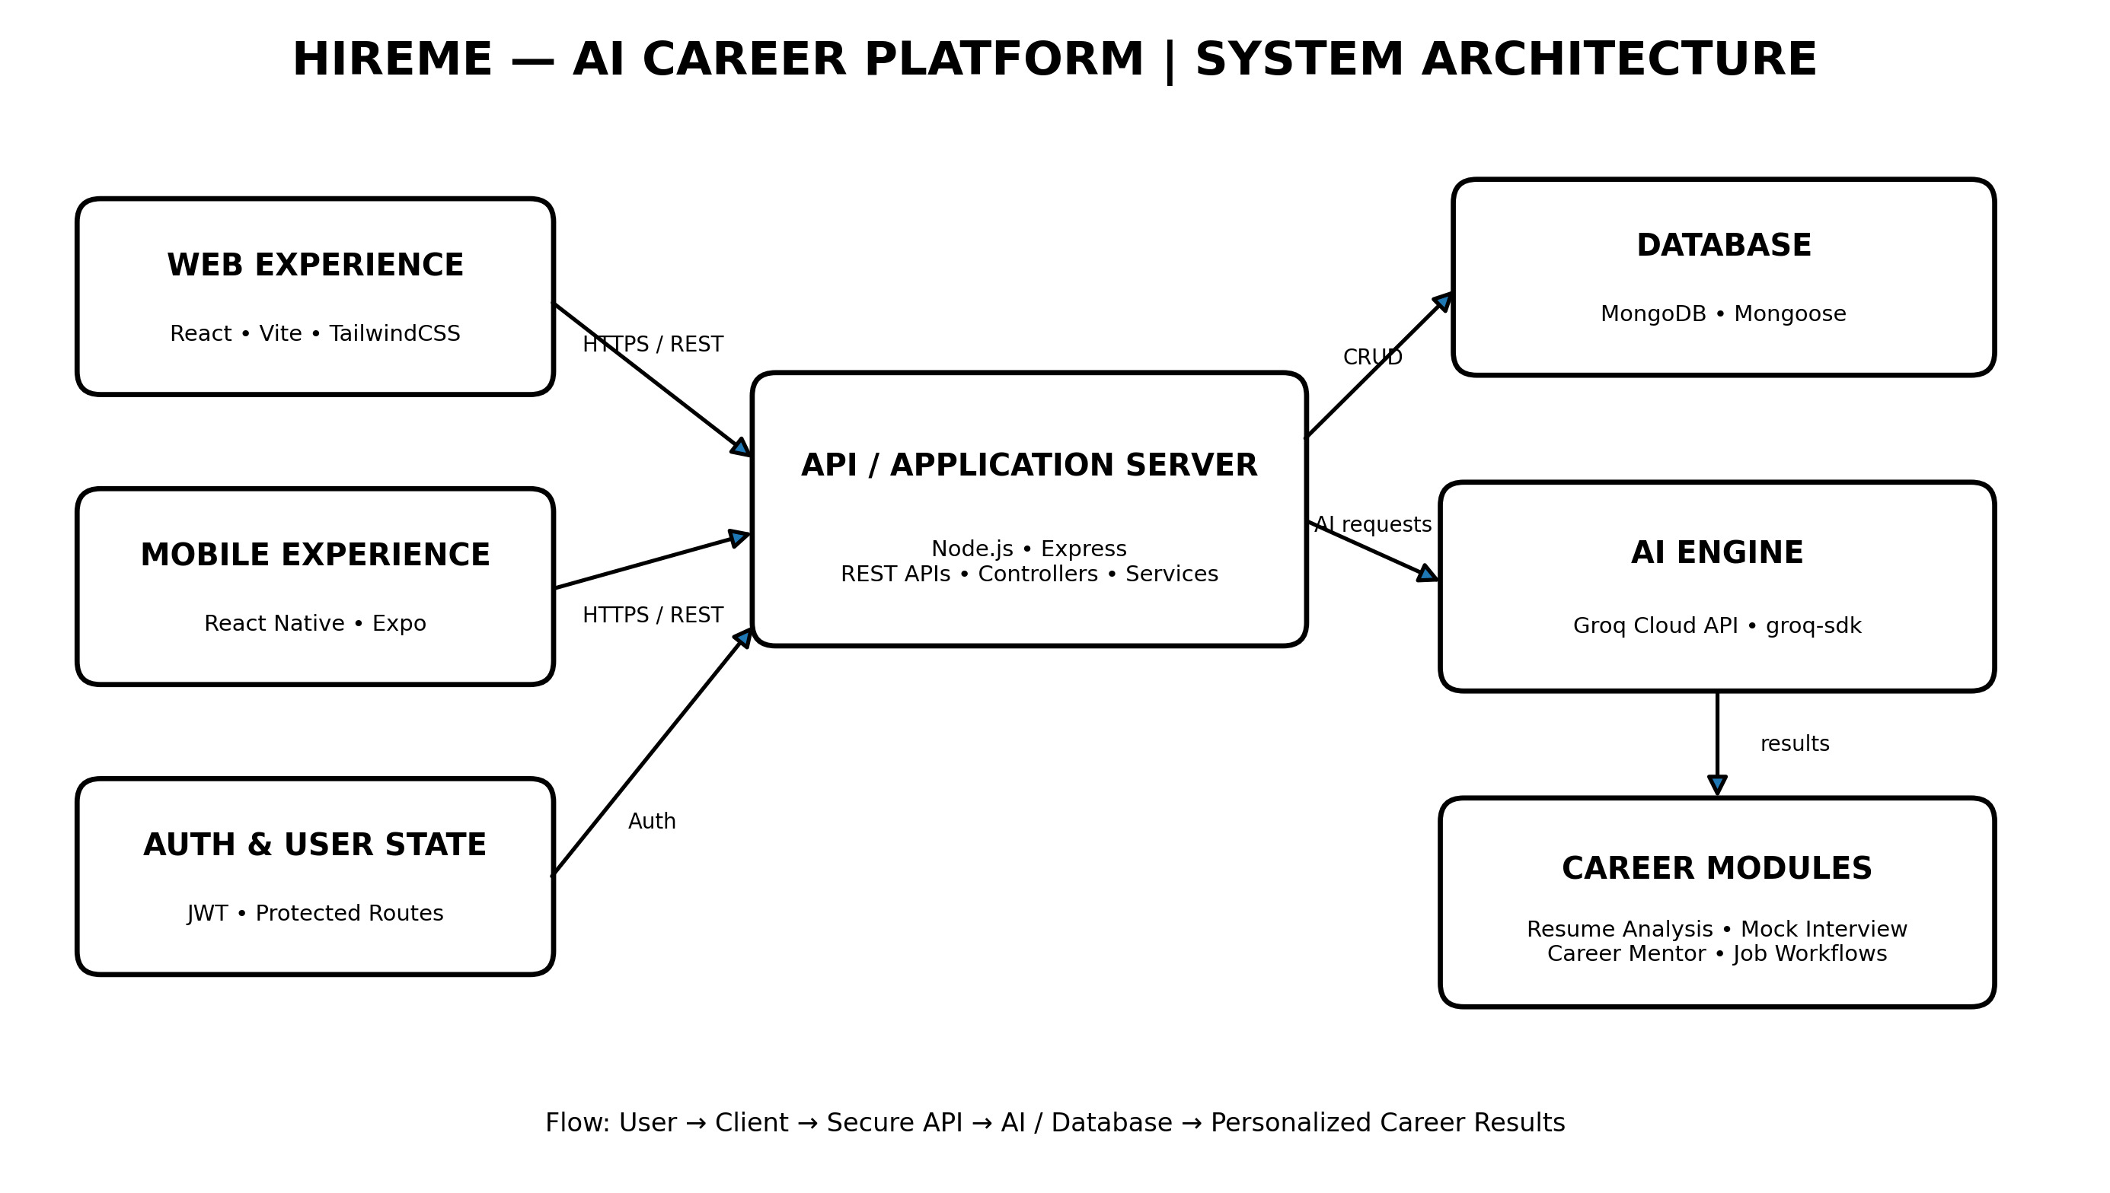
9. System Architecture
HireMe • HackInMotion RICR-HIM-1007 10

Slide 11
10. Technology Stack
• Web: React + Vite + TailwindCSS
• Mobile: React Native + Expo
• Backend: Node.js + Express
• Database: MongoDB + Mongoose
• Authentication: JWT
• AI: Groq Cloud API + groq-sdk
• Deployment: Netlify for web client + Render for backend
HireMe • HackInMotion RICR-HIM-1007 11

Slide 12
11. Problem Statement Coverage
• ✓ User Account & Login — implemented
• ✓ Resume / career information workflow — implemented
• ✓ AI-powered resume analysis — implemented
• ✓ Job discovery and job workflows — implemented
• ✓ AI mock interview — implemented
• ✓ AI feedback / career guidance — implemented
• ✓ Dashboard / application experience — implemented
• ✓ Web + mobile experience — implemented
• ✓ Secure backend AI integration — implemented
HireMe • HackInMotion RICR-HIM-1007 12

Slide 13
12. Advanced Features / Future Scope
• ATS Compatibility Checker for resume keywords and formatting.
• AI Resume Rewriter for job-specific bullet points.
• Voice-based mock interview using speech-to-text.
• Video interview analytics such as presentation/communication signals.
• Peer or recruiter sharing of reports.
• Long-term progress analytics and personalized career plans.
HireMe • HackInMotion RICR-HIM-1007 13

Slide 14
13. Live Demo Flow
• 1. Login / open HireMe
• 2. Browse and search for a relevant job
• 3. Open Resume Analysis
• 4. Review AI insights and improvement areas
• 5. Start Mock Interview
• 6. Answer questions and show AI feedback
• 7. Open Career Mentor for a follow-up question
• 8. Show mobile experience
HireMe • HackInMotion RICR-HIM-1007 14

Slide 15
14. Hackathon Submission
• Working full-stack application with web and mobile experiences.
• GitHub repository containing source code and project documentation.
• API documentation and README.
• System architecture diagram.
• Live product demonstration.
• Presentation covering the problem, solution, implementation, AI workflow and future scope.
HireMe • HackInMotion RICR-HIM-1007 15

Slide 16
Thank You
HireMe — Making career preparation smarter, personalized and accessible.
HireMe • HackInMotion RICR-HIM-1007 16

