Slide 1
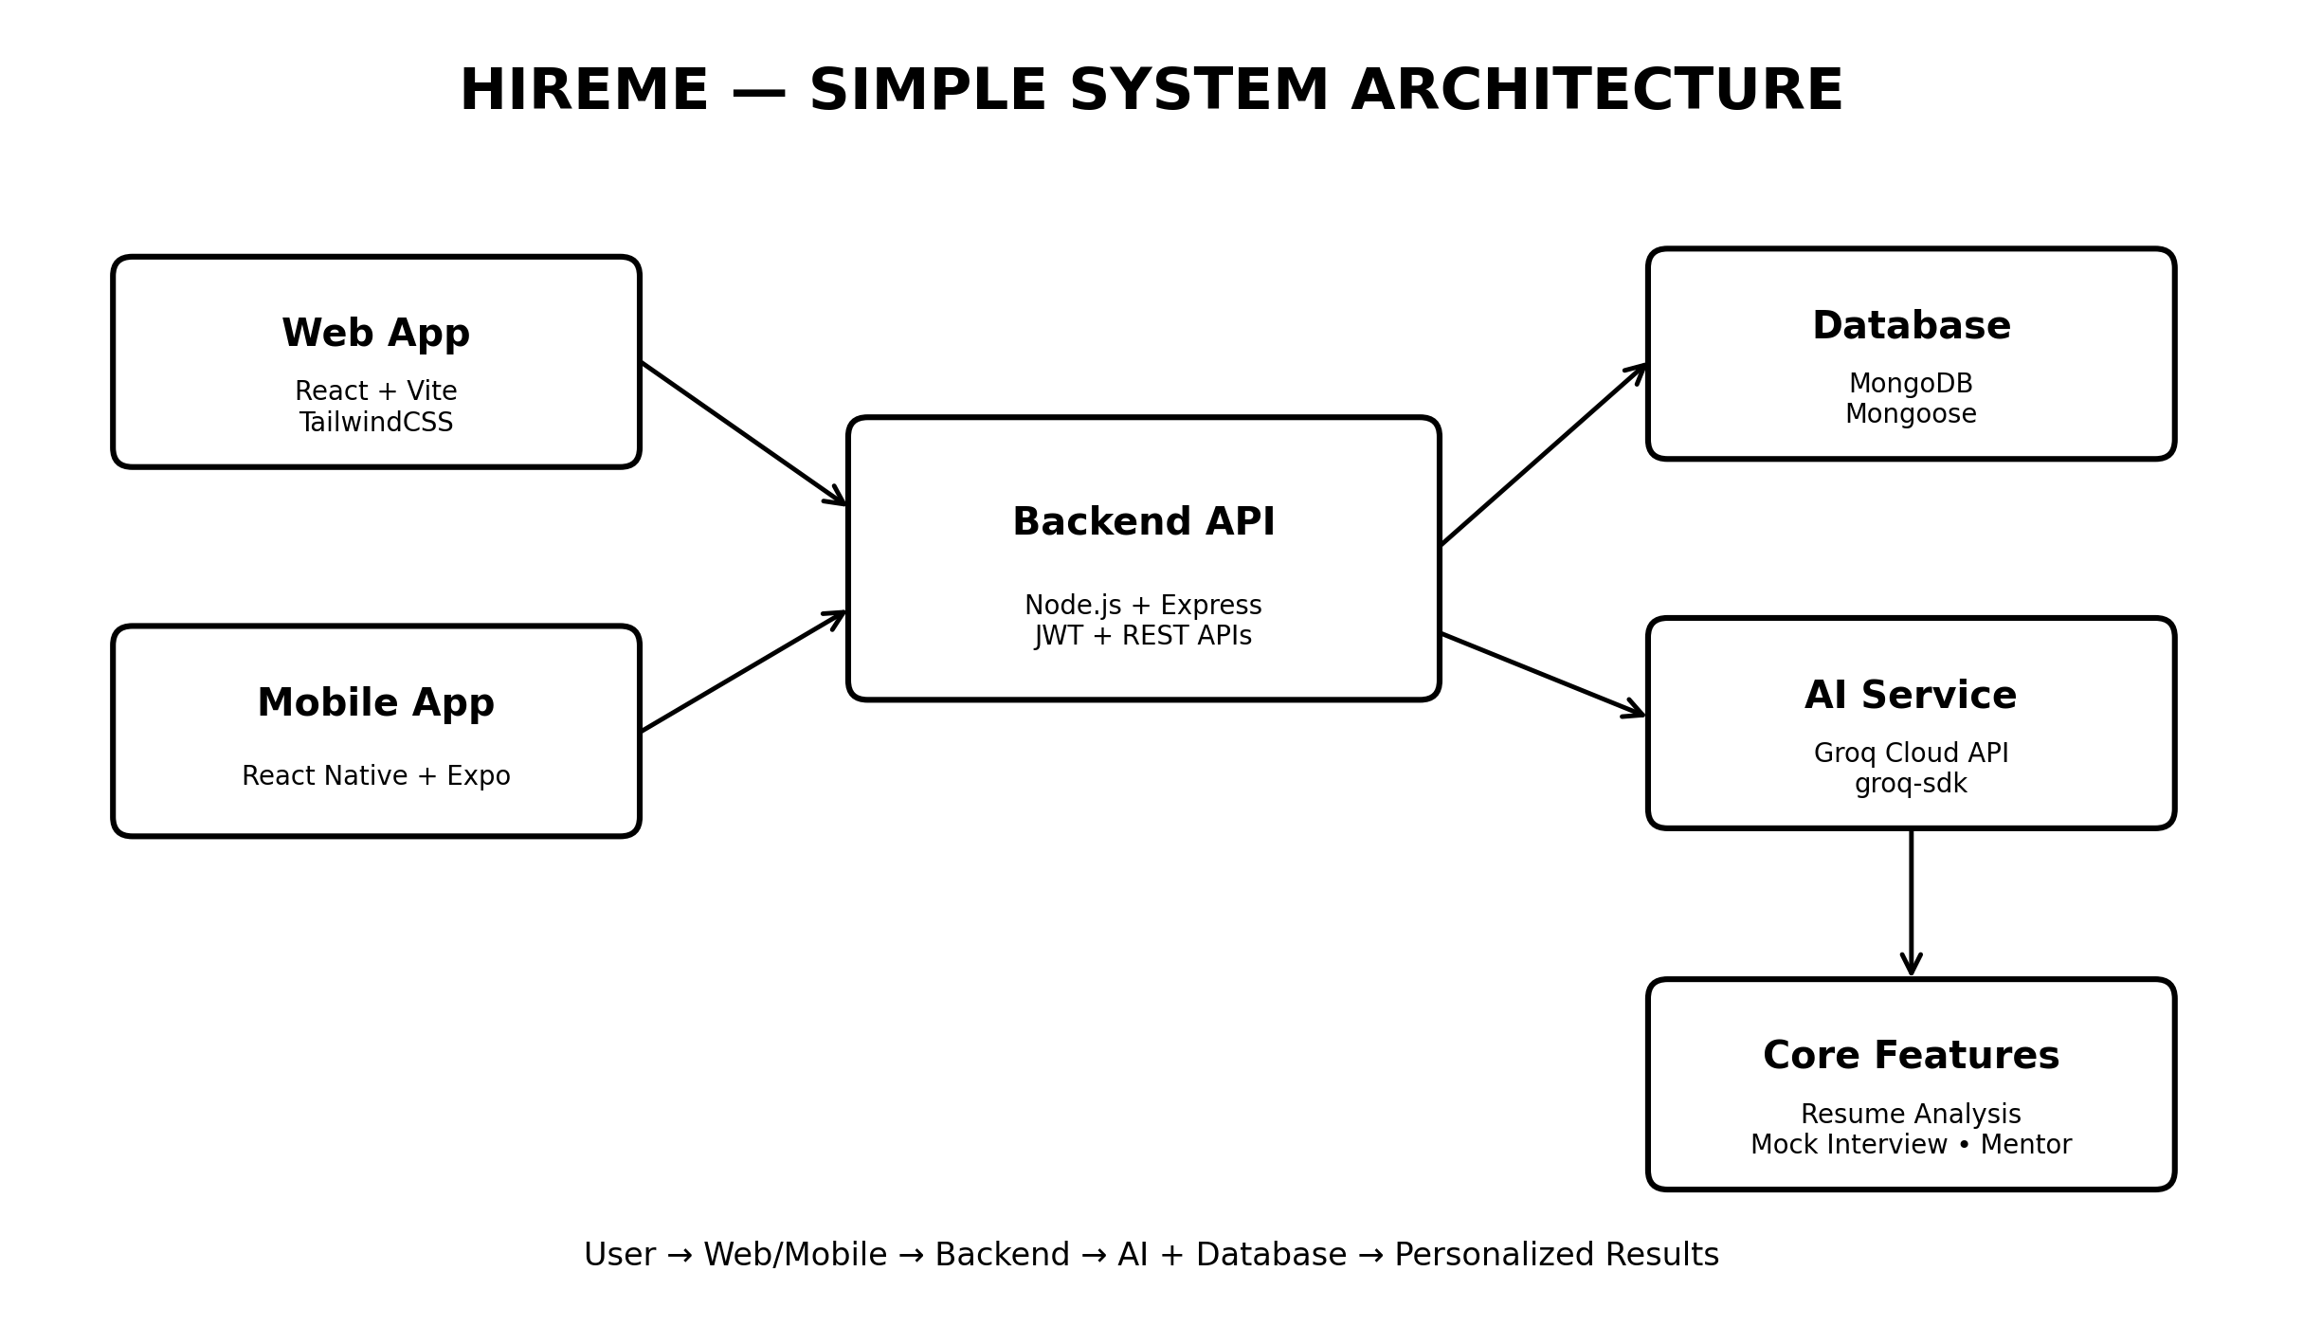
HireMe — System Architecture

