Slide 1
Analytical CRM Development for a Bank
Name : Manoj Pandit
Course : Data analytics (SQL Project)
Batch : December 2023
Date : 10-05-2024

Slide 2
Introduction
Enhancing Customer Relationship Management (CRM) with Data Analytics
Welcome to our Bank CRM project! Our main goal is to make our bank better at taking care of our customers.
We have lots of information about our customers like their credit score, geographical location, gender, age, tenure, account balance, product usage, credit card ownership, membership status, estimated salary, and exit status.
Understanding the interplay between these factors will enable us to identify patterns, trends, and correlations that can inform strategic decision-making.
We want to use all this information to figure out how to keep our customers happy and stop them from leaving.

Slide 3
Objective:
To reduce customer churn, improve service delivery, and enhance overall customer satisfaction
Reduce Customer Churn: Identify high-risk customer segments and develop targeted strategies to reduce the rate at which customers leave the bank.
We can collect feedback from customers, to see how happy they are with the bank and resolve customer issue as soon as.

Slide 4
Goals of the Project
Identify High-Risk Customer Segments
Assess Effectiveness of Retention Strategies
Optimize Cross-Selling Opportunities Based on Product Affinity
Evaluate Impact of Customer Demographics on Service Delivery
Forecast Customer Tenure Value to Prioritize Retention Efforts

Slide 5
Data Cleaning & Handling Missing values
Data Validation:
Check if the data we collected is accurate and reliable by comparing it to trusted sources and doing quality checks.
Handling Missing Values:
Fix any missing or incomplete data
Identify missing values in your dataset by looking for blank cells
Replace missing values using Excel functions like IF, ISBLANK
Replace missing values with a specific value (e.g., 0 or "Unknown")

Slide 6
Removing Duplicates:
Check any repeated data entries available in datasets so our analysis isn't messed up by having the same thing multiple times.
Standardization:
Make sure all the data looks the same by using the same formats, units, and names. This helps us compare different sets of data easily.
Data Transformation:
Segment customers based on their demographic like age_group, creditscore.
Normalize numerical variables like Balance, NumOfProducts, Estimated Salary, and CreditScore.
Convert the numerical credit score values into categorical such as “Excellent”, “Very Good”, “Good”, “Fair”, and “Poor” based on the defined ranges.

Slide 7
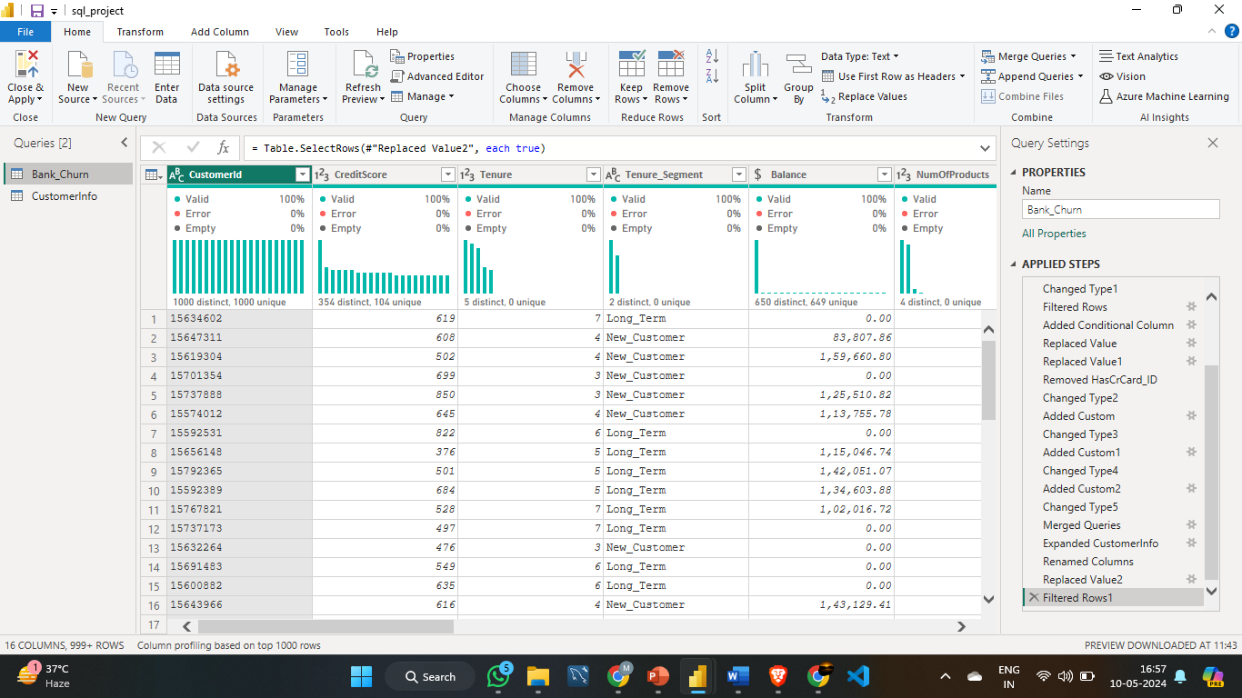

Slide 8
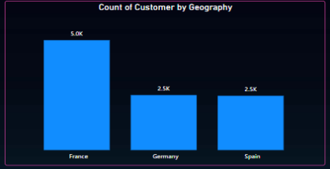
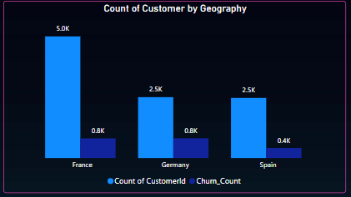
Analyze number of customer By region
Visuals:
In this visualization, we focus on the distribution of customers across different regions.
we see how many customers are in each region and how many of them left the bank. Our main goal is to figure out why customers leave and find those who might leave soon. We're looking for similar reasons why people leave the bank in different places. By understanding this, we can work on ways to keep customers happy and stop them from leaving. This picture helps us find out which areas have more people leaving the bank, so we can focus on helping those customers stay.

Slide 9
Overview of Customer Datasets
RowNumber: The row number in the dataset, likely used for reference or indexing.
CustomerId: A unique identifier for each customer.
CreditScore: A numerical representation of the customer's creditworthiness.
Credit score:
Excellent: 800–850
Very Good: 740–799
Good: 670–739
Fair: 580–669
Poor: 300–579
GeographyID: A numerical identifier that likely corresponds to a geographical location, such as a country or region.
GenderID: A numerical identifier for the customer's gender, where for example, '1' could represent male and '2' could represent female.
Age: The age of the customer.
Exited: whether or not the customer left the bank.
0 represents Retain
1 represents Exit

Slide 10
Tenure: The number of years the customer has been with the bank.
Balance: Current balance in the customer's account.
NumOfProducts: refers to the number of products that a customer has purchased through the bank.
HasCrCard: denotes whether or not a customer has a credit card. This column is also relevant, since people with a credit card are less likely to leave the bank.
1 represents credit card holder
0 represents non credit card holder
IsActiveMember: active customers are less likely to leave the bank (as per the criteria defined by the bank for identifying the activeness).
1 represents Active Member
0 represents Inactive Member
Estimated Salary: as with balance, people with lower salaries are more likely to leave the bank compared to those with higher salaries.
Bank DOJ: date when the Customer associated/joined with the bank.

Slide 11
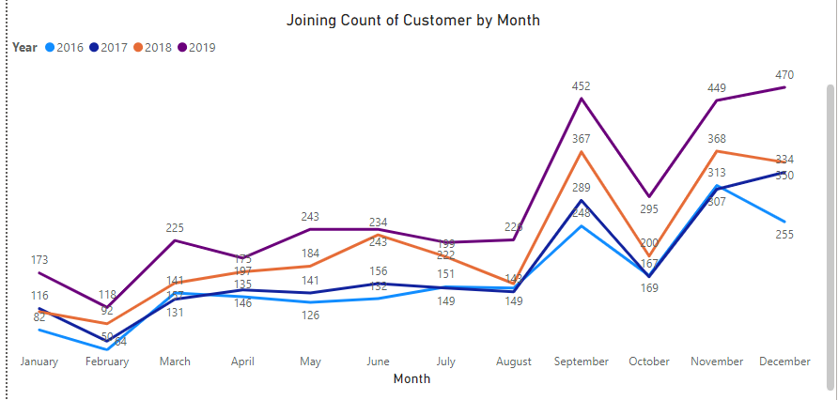
Analytical

Slide 12
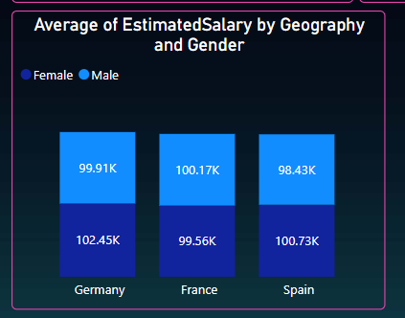
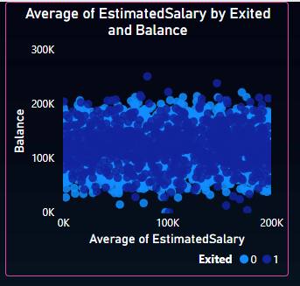
Visualization
In the above visual, The estimated average salary of the customer by gender and the Geographic region
In the above visual, analyse the correlation between salary and balance and determine it differs for customers who have exited or not.

Slide 13
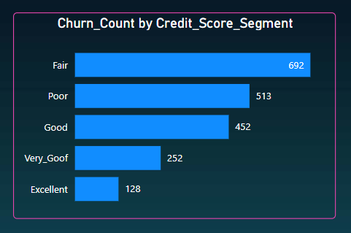
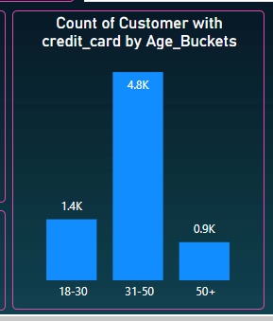
In the above visual, Firstly I segment the customer on the basis of their Credit score and then visualize this on the basis of credit score segment wise customer churn.
In the above visual, Firstly I segment the customer on the basis of their age and then visualize this on the basis of age segment and Number of Customer .

Slide 14
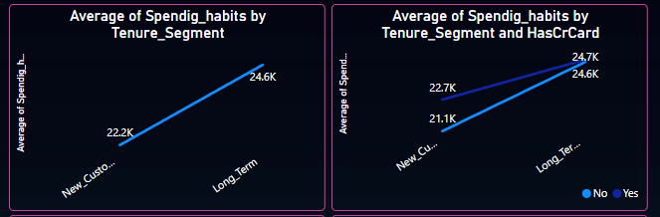
Customer Behaviour Analysis
About the observed patterns in spending habits
The Long-term customers has higher spending levels and the new customers has lowest spending habits.
The Long-term customers that have credit card and have no credit card are almost same spending levels.

Slide 15
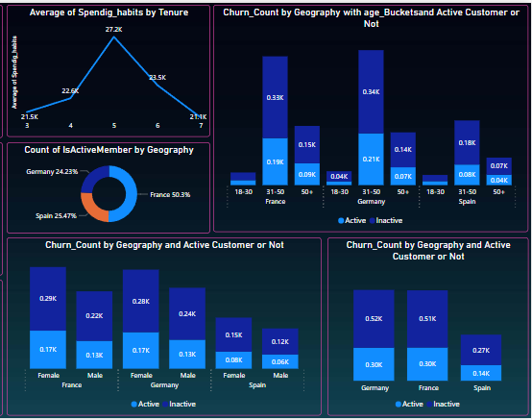
Geographic Market Trends
Here we can compare the geographic distribution of active accounts or not Active and churn count with demographic factors such as age, gender, to identify any patterns or trends.
According to the visual, there is age bucket, geographic region, Gender and Active or Inactive.
The customer churns the bank more who are Inactive Customers.

Slide 16
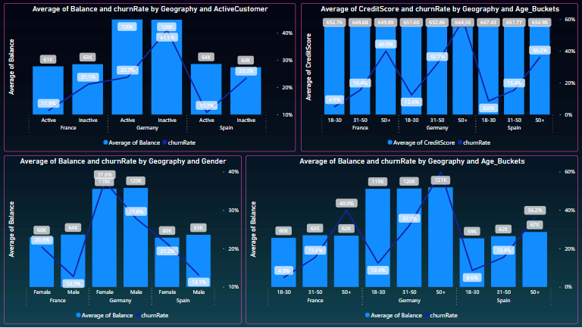
Risk Management Assessment

Slide 17
Aggregate the customer data by demographic segments to calculate average credit score.
Demographic segments like age groups, gender, geographic regions.
Identify financial risk:
low credit scores, or low account balances.
Higher risk:
Look for patterns or trends such as:
Here age groups 50+ have average credit scores or higher debt levels.
Every geographic region where female customer higher churn rate.
Have more inactive accounts, have higher churn rates.

Slide 18
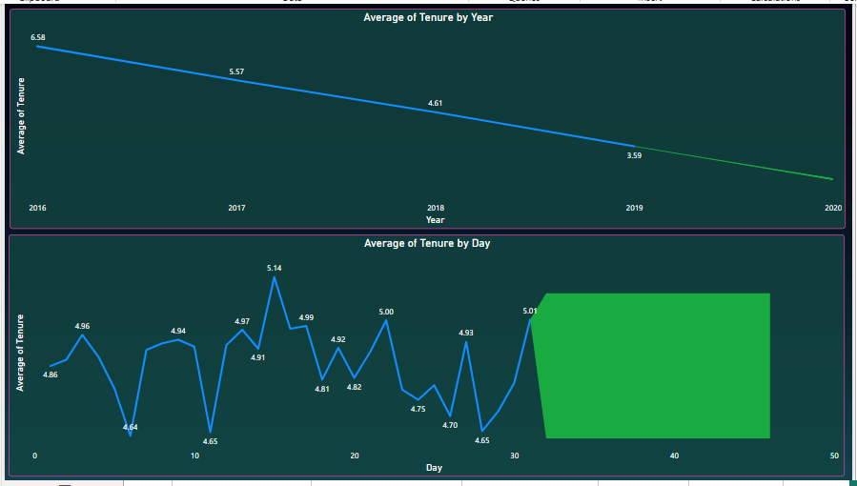
Customer Tenure Value Forecast
With the confidence interval is 95 % forecast the tenure value for 1year
There is Forecast value is 2.61 and upper band value is 2.64 lower band value is 2.58.
And also forecast for day.

Slide 19
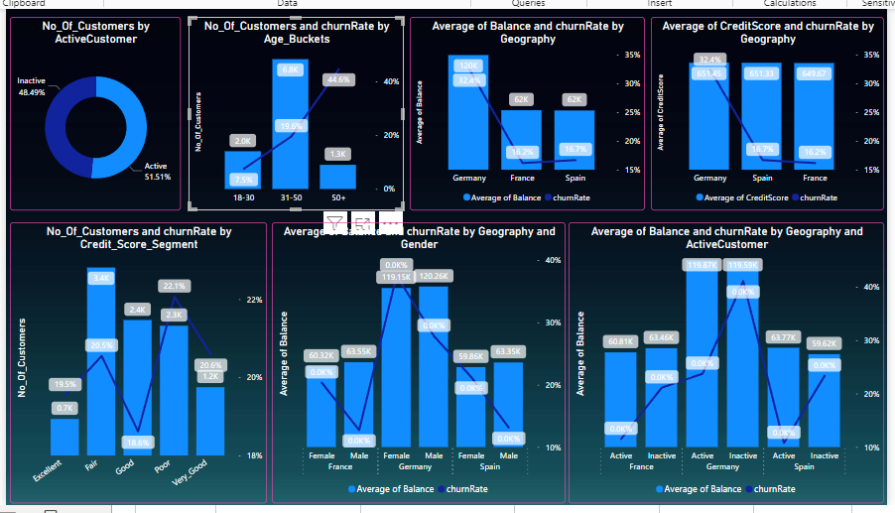
Customer Exit Reasons Exploration

Slide 20
Analyse the distribution of exit reasons
Analyse the visualizations to identify any common characteristics or trends among customers who have exited the bank.
As, I analysed the customer from Germany geographic regions and inactive customer has higher exit rates or age groups above 50 have higher exit rates.
There are also differences in exit rates between male and female customers, in every geographic region the female customers have higher exit rates.
In almost all geographic region the average credit scores have no more different
There are also pattern inactive and female customer have higher exit rates.

Slide 21
Conclusion:
In this project, we learned a lot about our customers by looking at their data.
We found out things like who might leave us, how well our plans to keep customers are working, and what products we should offer based on what customers already use.
By using data to understand our customers better, we can make smarter decisions to keep them happy and satisfied.
We'll keep working on making our bank better at taking care of our customers, so they'll stay with us for a long time.

Slide 22
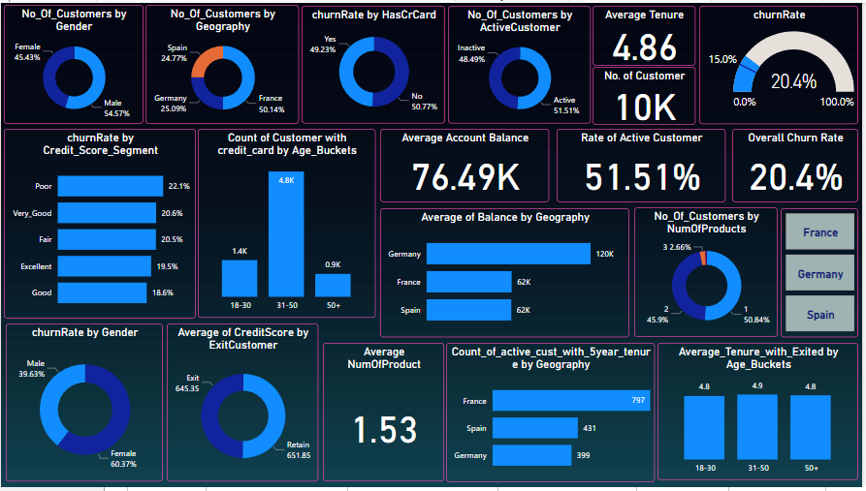

Slide 23


