Slide 1
Exceptions and Exception Handling in Java

Slide 2
Index:
Exception.
Exception Handling
Try and catch block
Nested try
Finally block
Throw keyword
Throws keyword
Java Exception propagation

Slide 3
Exception
An exception is a problem that arises during the execution of a program. When an Exception occurs the normal flow of the program is disrupted and the program/Application terminates abnormally, which is not recommended, therefore, these exceptions are to be handled. An exception can occur for many different reasons.
Following are some scenarios where an exception occurs.
A user has entered an invalid data.
A file that needs to be opened cannot be found.
A network connection has been lost in the middle of communications or the JVM has run out of memory

Slide 4
Types of Exception
1) Checked Exception: The classes which directly inherit Throwable class except RuntimeException and Error are known as checked exceptions e.g. IOException, SQLException etc. Checked exceptions are checked at compile-time.
2) Unchecked Exception: The classes which inherit RuntimeException are known as unchecked exceptions e.g. ArithmeticException, NullPointerException, ArrayIndexOutOfBoundsException etc. Unchecked exceptions are not checked at compile-time, but they are checked at runtime.
3) Error: Error is irrecoverable e.g. OutOfMemoryError, VirtualMachineError, AssertionError etc.

Slide 5
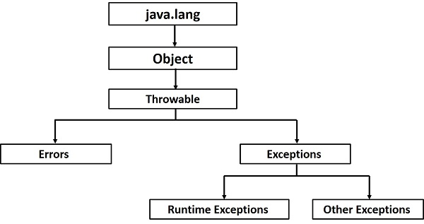
Exception Hierarchy

Slide 6
Java Exception Keywords
There are 5 keywords which are used in handling exceptions in Java:-
1. try: The "try" keyword is used to specify a block where we should place exception code. The try block must be followed by either catch or finally. It means, we can't use try block alone.
2. catch: The "catch" block is used to handle the exception. It must be preceded by try block which means we can't use catch block alone. It can be followed by finally block later.

Slide 7
Java Exception Keywords
3. finally: The "finally" block is used to execute the important code of the program. It is executed whether an exception is handled or not.
4. throw: The "throw" keyword is used to throw an exception.
5. throws: The "throws" keyword is used to declare exceptions. It doesn't throw an exception. It specifies that there may occur an exception in the method. It is always used with method signature.

Slide 8
Exceptions in Java
1. Arithmetic Exception:- It is thrown when an exceptional condition has occurred in an arithmetic operation.
class ArithmeticExceptionDemo {
public static void main(String args[])
{
try {
int a = 30, b = 0;
int c = a/b; // cannot divide by zero
System.out.println ("Result = " + c);
}
catch(ArithmeticException e) {
System.out.println ("Can't divide a number by 0");
}
}
}

Slide 9
2. ArrayIndexOutOfBoundException:- It is thrown to indicate that an array has been accessed with an illegal index. The index is either negative or greater than or equal to the size of the array.
class NullPointerDemo {
public static void main(String args[]) {
try {
String a = null; //null value
System.out.println(a.charAt(0));
} catch(NullPointerException e) {
System.out.println("NullPointerException..");
}
}
}

Slide 10
3. ClassNotFoundException This Exception is raised when we try to access a class whose definition is not found
class StringIndexOutOfBoundDemo {
public static void main(String args[]) {
try {
String a = "This is like chipping "; // length is 22
char c = a.charAt(24); // accessing 25th element
System.out.println(c);
}
catch(StringIndexOutOfBoundsException e) {
System.out.println("StringIndexOutOfBoundsException");
}
}
}

Slide 11
4. FileNotFoundException This Exception is raised when a file is not accessible or does not open.
import java.io.File;
import java.io.FileNotFoundException;
import java.io.FileReader;
class FileNotFoundDemo {
public static void main(String args[]) {
try {
// Following file does not exist
File file = new File("E://file.txt");
FileReader fr = new FileReader(file);
} catch (FileNotFoundException e) {
System.out.println("File does not exist");
}
}
}

Slide 12
5. NumberFormatException This exception is raised when a method could not convert a string into a numeric format.
class NumberFormatDemo {
public static void main(String args[])
{
try {
// “abc" is not a number
int num = Integer.parseInt (“abc") ;
System.out.println(num);
} catch(NumberFormatException e) {
System.out.println("Number format exception");
}
}
}

Slide 13
6. ArrayIndexOutOfBoundException It is thrown to indicate that an array has been accessed with an illegal index. The index is either negative or greater than or equal to the size of the array.
class ArrayIndexOutOfBoundDemo {
public static void main(String args[])
{
try{
int a[] = new int[5];
a[6] = 9; // accessing 7th element in an array of
// size 5
}
catch(ArrayIndexOutOfBoundsException e){
System.out.println ("Array Index is Out Of Bounds");
}
}
}

Slide 14
7. NullPointerException
This exception is raised when referring to the members of a null object. Null represents nothing
class NullPointerDemo {
public static void main(String args[])
{
try {
String a = null; //null value
System.out.println(a.charAt(0));
} catch(NullPointerException e) {
System.out.println("NullPointerException..");
}
}
}

Slide 15
Java Exception Handling Example
public class JavaExceptionExample{
public static void main(String args[]){
try{
//code that may raise exception
int data=100/0;
}catch(ArithmeticException e)
{
System.out.println(e);
}
//rest code of the program
System.out.println("rest of the code...");
}
}

Slide 16
Java try-catch block
Java try block:
Java try block is used to enclose the code that might throw an exception. It must be used within the method.
If an exception occurs at the particular statement of try block, the rest of the block code will not execute. So, it is recommended not to keeping the code in try block that will not throw an exception.
Java try block must be followed by either catch or finally block.

Slide 17
Java try-catch block
Syntax of Java try-catch:
try{
//code that may throw an exception
}catch(Exception_class_Name ref)
{
}

Slide 18
Java try-catch block
Syntax of try-finally block:
try{
//code that may throw an exception
}finally
{
}

Slide 19
Java try-catch block
Java catch block:
Java catch block is used to handle the Exception by declaring the type of exception within the parameter. The declared exception must be the parent class exception ( i.e., Exception) or the generated exception type. However, the good approach is to declare the generated type of exception.
The catch block must be used after the try block only. You can use multiple catch block with a single try block.

Slide 20
Problem without exception handling
Let's try to understand the problem if we don't use a try-catch block.
public class TryCatchExample1 {
public static void main(String[] args) {
int data=50/0; //may throw exception
System.out.println("rest of the code");
}
}

Slide 21
Solution by exception handling
Let's see the solution of the above problem by a java try-catch block.
public class TryCatchExample2 {
public static void main(String[] args) {
try {
int data=50/0; //may throw exception
}
//handling the exception
catch(ArithmeticException e) {
System.out.println(e);
}
System.out.println("rest of the code");
}
}

Slide 22
Java Multi-catch block
public class MultipleCatchBlock1 {
public static void main(String[] args) {
try{
int a[]=new int[5];
a[5]=30/0;
}
catch(ArithmeticException e) {
System.out.println("Arithmetic Exception occurs");
}
catch(ArrayIndexOutOfBoundsException e) {
System.out.println("ArrayIndexOutOfBounds Exception occurs");
}
catch(Exception e) {
System.out.println("Parent Exception occurs");
}
System.out.println("rest of the code");
}
}

Slide 23
Java Nested try block
class Exception{
public static void main(String args[]){
try{
try{
System.out.println("going to divide");
int b =39/0;
}catch(ArithmeticException e){System.out.println(e);}
try{
int a[]=new int[5];
a[5]=4;
}catch(ArrayIndexOutOfBoundsException e){System.out.println(e);}
System.out.println("other statement);
}catch(Exception e){System.out.println("handled");}
System.out.println("normal flow..");
}
}

Slide 24
Java finally block
Java finally block is a block that is used to execute important code such as closing connection, stream etc.
Java finally block is always executed whether exception is handled or not.
Java finally block follows try or catch block.

Slide 25
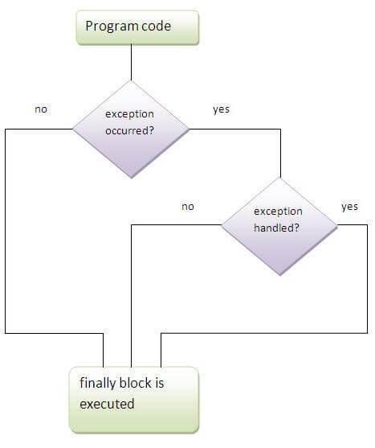
Java finally block

Slide 26
Java finally block
class TestFinallyBlock1{
public static void main(String args[]){
try{
int data=25/0;
System.out.println(data);
}
catch(NullPointerException e){
System.out.println(e);
}
finally{System.out.println("finally block is always executed");
}
System.out.println("rest of the code...");
}
}

Slide 27
Java throw keyword
The Java throw keyword is used to explicitly throw an exception.
We can throw either checked or unchecked exception in java by throw keyword. The throw keyword is mainly used to throw custom exception. We will see custom exceptions later.
The syntax of java throw keyword is given below:
throw exception;

Slide 28
Java throw keyword
we have created the validate method that takes integer value as a parameter. If the age is less than 18, we are throwing the ArithmeticException age welcome to vote.
public class TestThrow1{
static void validate(int age){
if(age<18)
throw new ArithmeticException("not valid");
else
System.out.println("welcome to vote");
}
public static void main(String args[]){
validate(13);
System.out.println("rest of the code...");
}
}

Slide 29
Java throws keyword
. Q) Which exception should be declared
Ans) checked exception only, because:
unchecked Exception: under your control so correct your code.
error: beyond your control e.g. you are unable to do anything if there occurs VirtualMachineError or StackOverflowError

Slide 30
Java throws keyword
Advantage of Java throws keyword
Now Checked Exception can be propagated (forwarded in call stack).
It provides information to the caller of the method about the exception.

Slide 31
Java throws keyword
import java.io.IOException;
class Testthrows1{
void m()throws IOException{
throw new IOException("device error");//checked exception
}
void n()throws IOException{
m();
}
void p(){
try{
n();
}catch(Exception e){System.out.println("exception handled");}
}
public static void main(String args[]){
Testthrows1 obj=new Testthrows1();
obj.p();
System.out.println("normal flow...");
}
}

Slide 32
Java Exception propagation
An exception is first thrown from the top of the stack and if it is not caught, it drops down the call stack to the previous method, If not caught there, the exception again drops down to the previous method, and so on until they are caught or until they reach the very bottom of the call stack. This is called exception propagation.

Slide 33
Example
class TestExceptionPropagation1{
void m(){
int data=50/0;
}
void n(){
m();
}
void p(){
try{
n();
}catch(Exception e){System.out.println("exception handled");}
}
public static void main(String args[]){
TestExceptionPropagation1 obj=new TestExceptionPropagation1();
obj.p();
System.out.println("normal flow...");
}
}

