Slide 1
Loops & Control Statements

Slide 2
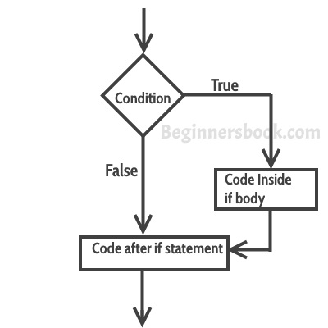
if Statement
The statements gets executed only when the given condition is true. If the condition is false then the statements inside if statement body are completely ignored.
Syntax:
if(condition){
//code to be executed
}

Slide 3
Example of if statement
public class IfStatementExample {
public static void main(String args[]){
int num=70;
if( num < 100 ){
/* This println statement will only execute,
* if the above condition is true
*/
System.out.println("number is less than 100");
}
}
}

Slide 4
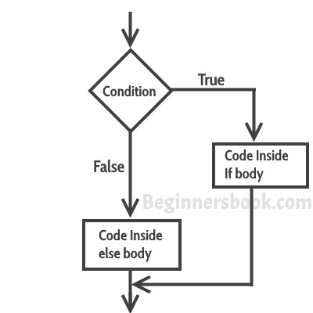
if-else Statement
if-else statement also tests the condition. It executes the if block if condition is true other wise else block is executed.
Syntax:-
if(condition){
//code if condition is true
}else{
//code if condition is false
}

Slide 5
Example of if-else statement
public class IfElseExample {
public static void main(String[] args) {
//defining a variable
int number=13;
//Check if the number is divisible by 2 or not
if(number%2==0){
System.out.println("even number");
}else{
System.out.println("odd number");
}
}
}

Slide 6
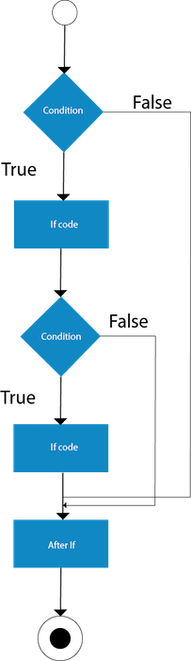
Nested if statement
When there is an if statement inside another if statement then it is called the nested if statement.
Syntax:
if(condition){
//code to be executed
if(condition){
//code to be executed
}
}

Slide 7
Example of Nested if statement
public class JavaNestedIfExample2 {
public static void main(String[] args) {
//Creating two variables for age and weight
int age=25;
int weight=48;
//applying condition on age and weight
if(age>=18){
if(weight>50){
System.out.println("You are eligible to donate blood");
} else{
System.out.println("You are not eligible to donate blood");
}
} else{
System.out.println("Age must be greater than 18");
}
} }

Slide 8
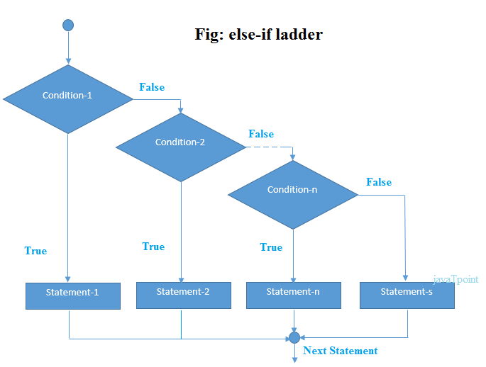
if-else-if ladder Statement
The if-else-if ladder statement executes one condition from multiple statements.

Slide 9
Syntax:
if(condition1){
//code to be executed if condition1 is true
}else if(condition2){
//code to be executed if condition2 is true
}
else if(condition3){
//code to be executed if condition3 is true
}
...
else{
//code to be executed if all the conditions are false
}

Slide 10
Example
public class IfElseIfExample {
public static void main(String[] args) {
int marks=65;
if(marks<50){
System.out.println("fail"); }
else if(marks>=50 && marks<60){
System.out.println("D grade"); }
else if(marks>=60 && marks<70){
System.out.println("C grade"); }
else if(marks>=70 && marks<80){
System.out.println("B grade"); }
else if(marks>=80 && marks<90){
System.out.println("A grade");
}else if(marks>=90 && marks<100){
System.out.println("A+ grade");
}else{ System.out.println("Invalid!"); }
} }

Slide 11
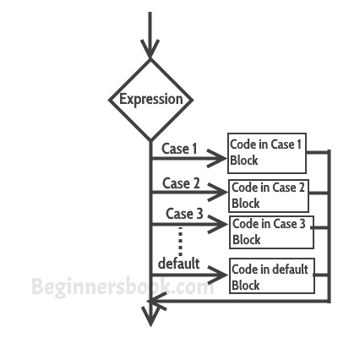
Switch Statement
switch statement executes one statement from multiple conditions. It is like if-else-if ladder statement. The switch statement works with byte, short, int, long, enum types, String and some wrapper types like Byte, Short, Int, and Long. Since Java 7, you can use strings in the switch statement.

Slide 12
Count…
Few points about Switch Case
Case doesn’t always need to have order 1, 2, 3 and so on. It can have any integer value after case keyword. Also, case doesn’t need to be in an ascending order always, you can specify them in any order based on the requirement.
You can also use characters in switch case.
Each case statement can have a break statement which is optional. When control reaches to the break statement, it jumps the control after the switch expression. If a break statement is not found, it executes the next case.

Slide 13
Syntax:
switch (variable or an integer expression){
case constant: //constant is a variable whose value cannot change
//Java code
break;
case constant:
//Java code
break;
default:
//Java code
}

Slide 14
Example
public class SwitchExample {
public static void main(String[] args) {
//Declaring a variable for switch expression
int number=20;
//Switch expression
switch(number){
//Case statements
case 10: System.out.println("10");
break;
case 20: System.out.println("20");
break;
case 30: System.out.println("30");
break;
//Default case statement
default:System.out.println("Not in 10, 20 or 30");
}
}
}

Slide 15
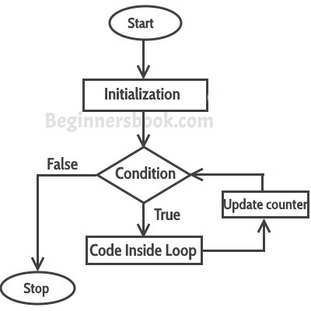
For loop
for loop is used to iterate a part of the program several times. If the number of iteration is fixed, it is recommended to use for loop.

Slide 16
Count…
First step: In for loop, initialization happens first and only one time, which means that the initialization part of for loop only executes once.
Second step: Condition in for loop is evaluated on each iteration, if the condition is true then the statements inside for loop body gets executed. Once the condition returns false, the statements in for loop does not execute and the control gets transferred to the next statement in the program after for loop.
Third step: After every execution of for loop’s body, the increment/decrement part of for loop executes that updates the loop counter.
Fourth step: After third step, the control jumps to second step and condition is re-evaluated.
Syntax: for(initialization; condition ; increment/decrement)
{
statement(s);
}

Slide 17
Example for loop
public class ForLoopExample {
public static void main(String args[]){
for(int i=1;i<=10;i++){
System.out.println("The value of i is: "+i);
}
}
}
In the above program: int i=1 is initialization expression i<=1 is condition(Boolean expression) i+ Increment operation

Slide 18
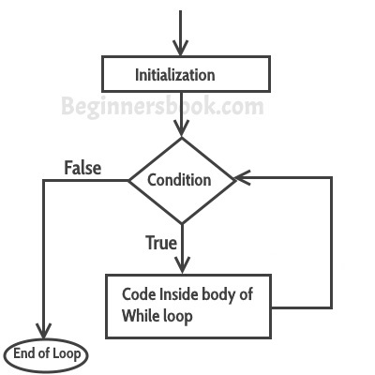
While Loop
while loop is used to iterate a part of the program several times. If the number of iteration is not fixed, it is recommended to use while loop.
while loop, condition is evaluated first and if it returns true then the statements inside while loop execute. When condition returns false, the control comes out of loop and jumps to the next statement after while loop.
Syntax:
while(condition)
{
statement(s);
}

Slide 19
Example
public class WhileExample {
public static void main(String[] args) {
int i=1;
while(i<=10){
System.out.println(i);
i++;
}
}
}

Slide 20
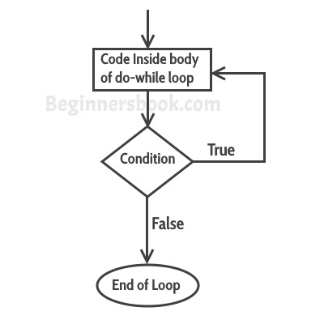
do-while loop
The Java do-while loop is used to iterate a part of the program several times. If the number of iteration is not fixed and you must have to execute the loop at least once, it is recommended to use do-while loop.
The Java do-while loop is executed at least once because condition is checked after loop body.
First, the statements inside loop execute and then the condition gets evaluated, if the condition returns true then the control gets transferred to the “do” else it jumps to the next statement after do-while.
Syntax:
do{
//code to be executed
}while(true);

Slide 21
Example
public class DoWhileExample {
public static void main(String[] args) {
int i=1;
do{
System.out.println(i);
i++;
}while(i<=10);
}
}

Slide 22
Scanner Class
Scanner class comes under the java.util package. Java has various ways to read input from the keyboard, the java.util.Scanner class is one of them.
Scanner class method:-
1. | double | nextDouble()
2. | float | nextFloat()
3. | int | nextInt()
4. | String | nextLine()

Slide 23
import java.util.*;
public class ScannerClassExample1 {
public static void main(String args[]){
String s = "Hello, This is java";
Scanner scan = new Scanner(s); //Create scanner Object and pass string in it
System.out.println("Boolean Result: " + scan.hasNext());
System.out.println("String: " +scan.nextLine()); //Print the string
scan.close();
System.out.println("--------Enter Your Details-------- ");
Scanner in = new Scanner(System.in);
System.out.print("Enter your name: ");
String name = in.next();
System.out.println("Name: " + name);
System.out.print("Enter your age: ");
int i = in.nextInt();
System.out.println("Age: " + i);
System.out.print("Enter your salary: ");
double d = in.nextDouble();
System.out.println("Salary: " + d);
in.close(); } }

Slide 24
import java.util.Scanner;
public class ScannerDemo1 {
public static void main(String[] args) {
Scanner sc = new Scanner(System.in);
String name = sc.nextLine();
char gender = sc.next().charAt(0);
int age = sc.nextInt();
long mobileNo = sc.nextLong();
double cgpa = sc.nextDouble();
System.out.println("Name: "+name);
System.out.println("Gender: "+gender);
System.out.println("Age: "+age);
System.out.println("Mobile Number: "+mobileNo);
System.out.println("CGPA: "+cgpa);
}
}

Slide 25
public class NewClass2 {
public static void main(String args[] ){
int marksObtained, passingMarks;
passingMarks = 40;
Scanner input = new Scanner(System.in);
System.out.println("Input marks scored by you");
marksObtained = input.nextInt();
if (marksObtained >= passingMarks) {
System.out.println("You passed the exam.");
}
else {
System.out.println("Unfortunately, you failed to pass the exam.");
}
}
}

Slide 26
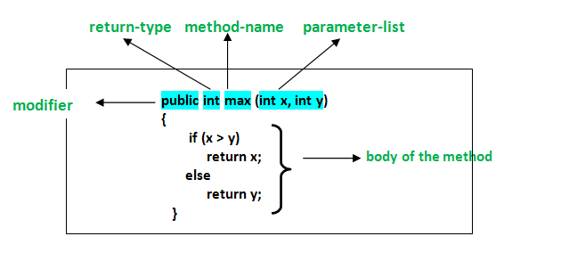
Methods in Java
A method is a collection of statements that perform some specific task and return result to the caller. A method can perform some specific task without returning anything. Methods allow us to reuse the code without retyping the code.
Types of methods:

Slide 27
Example
class Addition {
int sum = 0;
public int addTwoInt(int a, int b){
// adding two integer value.
sum = a + b;
//returning summation of two values.
return sum;
}
}
class GFG {
public static void main (String[] args) {
// creating an instance of Addition class
Addition add = new Addition();
// calling addTwoInt() method to add two integer using instance created
// in above step.
int s = add.addTwoInt(1,2);
System.out.println("Sum of two integer values :"+ s);
}
}

Slide 28
Constructors
constructor is a block of codes similar to the method. It is called when an instance of the object is created, and memory is allocated for the object.
It is a special type of method which is used to initialize the object.
When is a constructor called
Every time an object is created using new() keyword, at least one constructor is called. It calls a default constructor.
Note: It is called constructor because it constructs the values at the time of object creation. It is not necessary to write a constructor for a class. It is because java compiler creates a default constructor if your class doesn't have any.
Rules for creating Java constructor
There are two rules defined for the constructor.
Constructor name must be the same as its class name
A Constructor must have no explicit return type
A Java constructor cannot be abstract, static, final, and synchronized

Slide 29
Example:
class Student4{
int id;
String name;
Student4(int i,String n){ //creating a parameterized constructor
id = i;
name = n;
}
//method to display the values
void display(){System.out.println(id+" "+name);}
public static void main(String args[]){
Student4 s1 = new Student4(111,"Karan"); //creating objects and passing values
Student4 s2 = new Student4(222,"Aryan");
//calling method to display the values of object
s1.display();
s2.display();
} }

Slide 30
Constructor Overloading
Constructor overloading in Java is a technique of having more than one constructor with different parameter lists. They are arranged in a way that each constructor performs a different task. They are differentiated by the compiler by the number of parameters in the list and their types.

Slide 31
Example
class Student{
int id;
String name;
int age;
Student(int i,String n){
id = i;
name = n; }
Student(int i,String n,int a){
id = i;
name = n;
age=a; }
void display(){System.out.println(id+" "+name+" "+age);}
public static void main(String args[]){
Student5 s1 = new Student5(111,"Karan");
Student5 s2 = new Student5(222,"Aryan",25);
s1.display();
s2.display();
} }

Slide 32
Copy Constructor
There is no copy constructor in java. However, we can copy the values from one object to another like copy constructor in C++.
There are many ways to copy the values of one object into another in java. They are:
By constructor
By assigning the values of one object into another
By clone() method of Object class

Slide 33
Example
class Student6{
int id;
String name;
Student6(int i,String n){ //constructor to initialize integer and string
id = i;
name = n;
}
Student6(Student6 s){ //constructor to initialize another object
id = s.id;
name =s.name; }
void display(){System.out.println(id+" "+name);}
public static void main(String args[]){
Student6 s1 = new Student6(111,"Karan");
Student6 s2 = new Student6(s1);
s1.display();
s2.display();
} }

Slide 34
Exception Handling
An exception is a problem that arises during the execution of a program. When an Exception occurs the normal flow of the program is disrupted and the program/Application terminates abnormally, which is not recommended, therefore, these exceptions are to be handled.
An exception can occur for many different reasons. Following are some scenarios where an exception occurs.
A user has entered an invalid data.
A file that needs to be opened cannot be found.
A network connection has been lost in the middle of communications or the JVM has run out of memory.

Slide 35
Types of Exception
1) Checked Exception: The classes which directly inherit Throwable class except Runtime Exception and Error are known as checked exceptions e.g. IOException, SQLException etc. Checked exceptions are checked at compile-time.
2) Unchecked Exception: The classes which inherit Runtime Exception are known as unchecked exceptions e.g. Arithmetic Exception, NullPointerException, ArrayIndexOutOfBoundsException etc. Unchecked exceptions are not checked at compile-time, but they are checked at runtime.
3) Error: Error is irrecoverable e.g. OutOfMemoryError, VirtualMachineError, AssertionError etc.

Slide 36
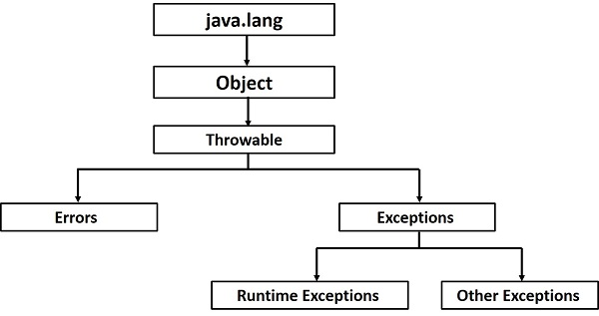
Exception Hierarchy

Slide 37
References
https://www.javatpoint.com
https://www.tutorialspoint.com/java/
https://www.w3schools.com/java/default.asp
https://docs.oracle.com/javase/tutorial/reallybigindex.html
Head First Java: A Brain-Friendly Guide, 2nd Edition (Covers Java 5.0)
Author Name: Kathy Sierra & Bert Bates
"The Complete Reference" by Herbert Schildt.

