Slide 1
Loops & Control Statements

Slide 2
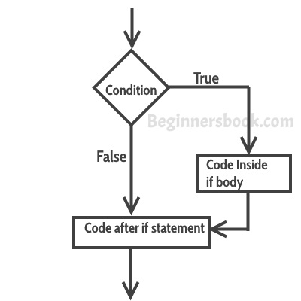
if Statement
The statements gets executed only when the given condition is true. If the condition is false then the statements inside if statement body are completely ignored.
Syntax:
if(condition){
//code to be executed
}

Slide 3
Example of if statement
public class IfStatementExample {
public static void main(String args[]){
int num=70;
if( num < 100 ){
/* This println statement will only execute,
* if the above condition is true
*/
System.out.println("number is less than 100");
}
}
}

Slide 4
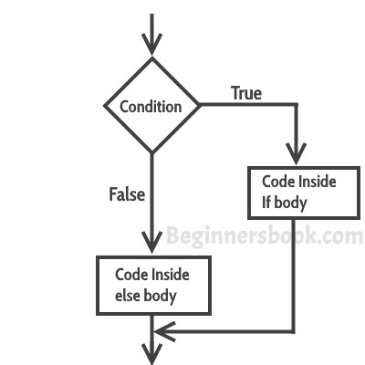
if-else Statement
if-else statement also tests the condition. It executes the if block if condition is true other wise else block is executed.
Syntax:-
if(condition){
//code if condition is true
}else{
//code if condition is false
}

Slide 5
Example of if-else statement
public class IfElseExample {
public static void main(String[] args) {
//defining a variable
int number=13;
//Check if the number is divisible by 2 or not
if(number%2==0){
System.out.println("even number");
}else{
System.out.println("odd number");
}
}
}

Slide 6
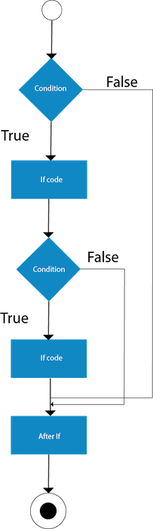
Nested if statement
When there is an if statement inside another if statement then it is called the nested if statement.
Syntax:
if(condition){
//code to be executed
if(condition){
//code to be executed
}
}

Slide 7
Example of Nested if statement
public class JavaNestedIfExample2 {
public static void main(String[] args) {
//Creating two variables for age and weight
int age=25;
int weight=48;
//applying condition on age and weight
if(age>=18){
if(weight>50){
System.out.println("You are eligible to donate blood");
} else{
System.out.println("You are not eligible to donate blood");
}
} else{
System.out.println("Age must be greater than 18");
}
} }

Slide 8
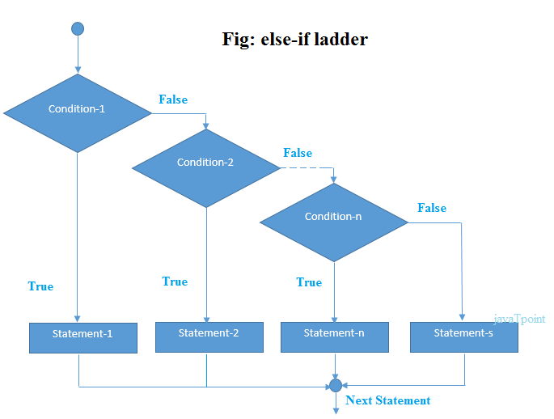
if-else-if ladder Statement
The if-else-if ladder statement executes one condition from multiple statements.

Slide 9
Syntax:
if(condition1){
//code to be executed if condition1 is true
}else if(condition2){
//code to be executed if condition2 is true
}
else if(condition3){
//code to be executed if condition3 is true
}
...
else{
//code to be executed if all the conditions are false
}

Slide 10
Example
public class IfElseIfExample {
public static void main(String[] args) {
int marks=65;
if(marks<50){
System.out.println("fail"); }
else if(marks>=50 && marks<60){
System.out.println("D grade"); }
else if(marks>=60 && marks<70){
System.out.println("C grade"); }
else if(marks>=70 && marks<80){
System.out.println("B grade"); }
else if(marks>=80 && marks<90){
System.out.println("A grade");
}else if(marks>=90 && marks<100){
System.out.println("A+ grade");
}else{ System.out.println("Invalid!"); }
} }

Slide 11
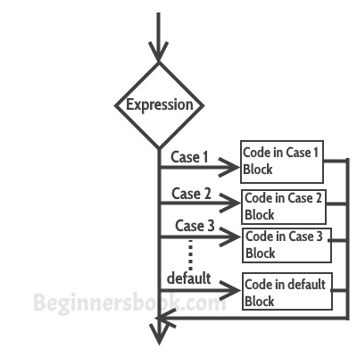
Switch Statement
switch statement executes one statement from multiple conditions. It is like if-else-if ladder statement. The switch statement works with byte, short, int, long, enum types, String and some wrapper types like Byte, Short, Int, and Long. Since Java 7, you can use strings in the switch statement.

Slide 12
Count…
Few points about Switch Case
Case doesn’t always need to have order 1, 2, 3 and so on. It can have any integer value after case keyword. Also, case doesn’t need to be in an ascending order always, you can specify them in any order based on the requirement.
You can also use characters in switch case.
Each case statement can have a break statement which is optional. When control reaches to the break statement, it jumps the control after the switch expression. If a break statement is not found, it executes the next case.

Slide 13
Syntax:
switch (variable or an integer expression){
case constant: //constant is a variable whose value cannot change
//Java code
break;
case constant:
//Java code
break;
default:
//Java code
}

Slide 14
Example
public class SwitchExample {
public static void main(String[] args) {
//Declaring a variable for switch expression
int number=20;
//Switch expression
switch(number){
//Case statements
case 10: System.out.println("10");
break;
case 20: System.out.println("20");
break;
case 30: System.out.println("30");
break;
//Default case statement
default:System.out.println("Not in 10, 20 or 30");
}
}
}

Slide 15
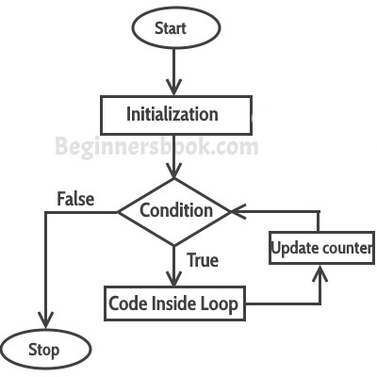
For loop
for loop is used to iterate a part of the program several times. If the number of iteration is fixed, it is recommended to use for loop.

Slide 16
Count…
First step: In for loop, initialization happens first and only one time, which means that the initialization part of for loop only executes once.
Second step: Condition in for loop is evaluated on each iteration, if the condition is true then the statements inside for loop body gets executed. Once the condition returns false, the statements in for loop does not execute and the control gets transferred to the next statement in the program after for loop.
Third step: After every execution of for loop’s body, the increment/decrement part of for loop executes that updates the loop counter.
Fourth step: After third step, the control jumps to second step and condition is re-evaluated.
Syntax: for(initialization; condition ; increment/decrement)
{
statement(s);
}

Slide 17
Example for loop
public class ForLoopExample {
public static void main(String args[]){
for(int i=1;i<=10;i++){
System.out.println("The value of i is: "+i);
}
}
}
In the above program: int i=1 is initialization expression i<=1 is condition(Boolean expression) i+ Increment operation

Slide 18
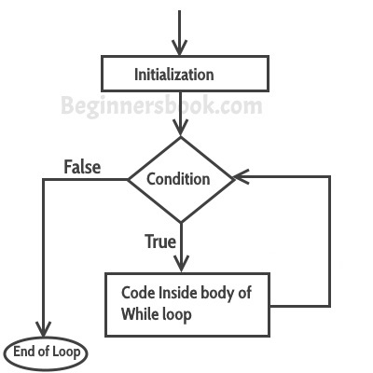
While Loop
while loop is used to iterate a part of the program several times. If the number of iteration is not fixed, it is recommended to use while loop.
while loop, condition is evaluated first and if it returns true then the statements inside while loop execute. When condition returns false, the control comes out of loop and jumps to the next statement after while loop.
Syntax:
while(condition)
{
statement(s);
}

Slide 19
Example
public class WhileExample {
public static void main(String[] args) {
int i=1;
while(i<=10){
System.out.println(i);
i++;
}
}
}

Slide 20
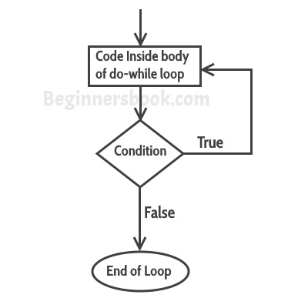
do-while loop
The Java do-while loop is used to iterate a part of the program several times. If the number of iteration is not fixed and you must have to execute the loop at least once, it is recommended to use do-while loop.
The Java do-while loop is executed at least once because condition is checked after loop body.
First, the statements inside loop execute and then the condition gets evaluated, if the condition returns true then the control gets transferred to the “do” else it jumps to the next statement after do-while.
Syntax:
do{
//code to be executed
}while(true);

Slide 21
Example
public class DoWhileExample {
public static void main(String[] args) {
int i=1;
do{
System.out.println(i);
i++;
}while(i<=10);
}
}

Slide 22
References
https://www.javatpoint.com
https://www.tutorialspoint.com/java/
https://www.w3schools.com/java/default.asp
https://docs.oracle.com/javase/tutorial/reallybigindex.html
Head First Java: A Brain-Friendly Guide, 2nd Edition (Covers Java 5.0)
Author Name: Kathy Sierra & Bert Bates
"The Complete Reference" by Herbert Schildt.

