Slide 1
Oops Concepts
Object means a real-world entity such as a pen, chair, table, computer, watch, etc. Object-Oriented Programming is a methodology to design a program using classes and objects. It simplifies the software development maintenance by providing some concepts:
Object
Class
Inheritance
Polymorphism
Abstraction
Encapsulation

Slide 2
Object
An entity that has state and behaviour is known as an object. Object is a real-world entity.
e.g. chair, bike, marker, pen, table, car etc.
An object has three characteristics:
State: represents the data (value) of an object.
Behaviour: represents the behaviour (functionality) of an object such as deposit, withdraw, etc.
Identity: An object identity is typically implemented via a unique ID. The value of the ID is not visible to the external user. However, it is used internally by the JVM to identify each object uniquely.

Slide 3
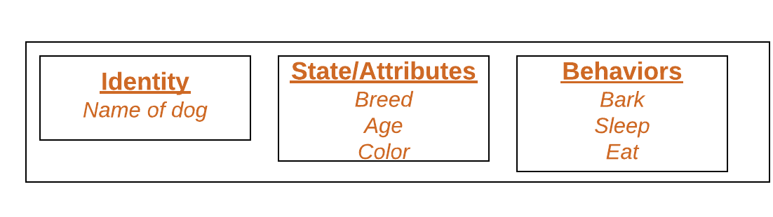
Example
Example of an object : dog

Slide 4
Program
public class Demo{
String name= “Hello java”;
public static void main(String args []){
Demo demo= new Demo(); //using new keyword for initialize/create an object.
System.out.println(demo.name);
}
}

Slide 5
Class
Collection of objects is called class. It is a logical entity.
A class can also be defined as a blueprint from which you can create an individual object. Class doesn't consume any space.
Example:
We can think of class as a sketch (prototype) of a house. It contains all the details about the floors, doors, windows etc. Based on these descriptions we build the house. House is the object.
Since, many houses can be made from the same description, we can create many objects from a class.

Slide 6
Example
class Student{
int id=10; //field or data member or instance variable
String name=“ABC”; //creating main method inside the Student class
public static void main(String args[]){
Student s1=new Student(); //creating an object of Student
System.out.println(s1.id);
System.out.println(s1.name);
}
}

Slide 7
Inheritance
The class which inherits the properties of other is known as subclass (derived class, child class) and the class whose properties are inherited is known as superclass (base class, parent class).
Inheritance represents the IS-A relationship which is also known as a parent-child relationship.
extends Keyword:
extends is the keyword used to inherit the properties of a class. Following is the syntax of extends keyword.

Slide 8
Syntax
class Super{
---------
---------
}
class Sub extends Super{
-------------
-------------
}

Slide 9
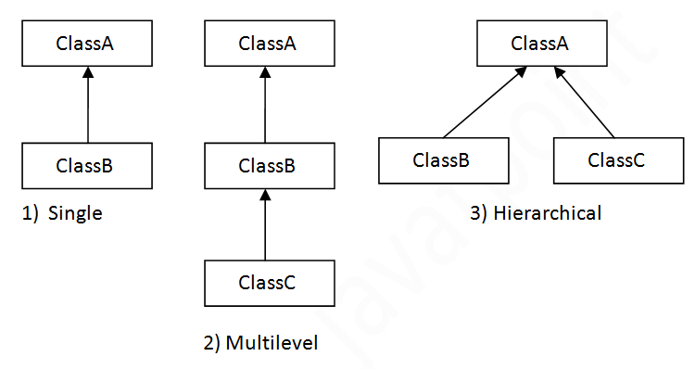
Types of Inheritance

Slide 10
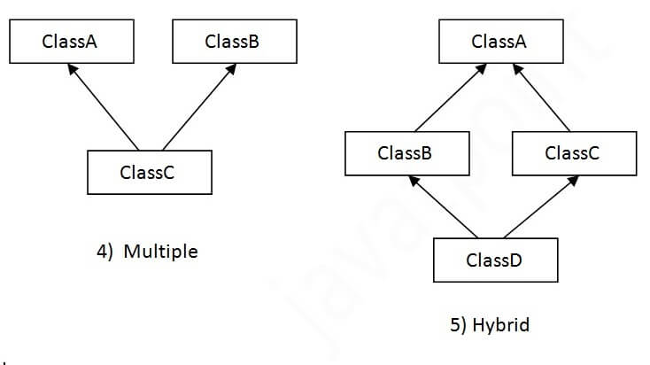
Count…

Slide 11
Example
class Employee{ // super class
float salary=20000;
}
class Programmer extends Employee{ // sub class
int bonus=10000;
public static void main(String args[]){
Programmer p=new Programmer();
System.out.println("Programmer salary is:"+p.salary);
System.out.println("Bonus of Programmer is:"+p.bonus);
}
}

Slide 12
Polymorphism
Polymorphism in Java is a concept by which we can perform a single action in different ways. Polymorphism is derived from 2 Greek words: poly and morphs. The word "poly" means many and "morphs" means forms. So polymorphism means many forms.
There are two types of polymorphism in Java: compile-time polymorphism and runtime polymorphism. We can perform polymorphism in java by method overloading and method overriding.

Slide 13
Example
If a girl is married and mother of 2 children doing teaching job then she is a women first ,, teacher in a school when she is in school, wife of someone at home,, mother of her children,, and obvious daughter of someone means a woman plays different roles at different times that’s the polymorphism.

Slide 14
Runtime Polymorphism
Method Overriding is an example of run time polymorphism and requires inheritance between two or more classes. A parent class method can be overridden in child class by keeping the method signature intact.
Syntax:
class ABC{
method A(){
// do something
}
}
class PQR extends ABC{
// method overriding
method A(){
// do something else
}
}

Slide 15
Example
class Bike{
void run(){
System.out.println("running");
}
}
class Splendor extends Bike{
void run(){
System.out.println("running safely with 60km");
}
public static void main(String args[]){
Bike b = new Splendor(); //upcasting
b.run();
}
}

Slide 16
Compile Time Polymorphism
Method Overloading is an example of compile time polymorphism and usually occurs inside the same class. Methods are overloaded by changing the method signature(return type+parameter list). It is called compile time polymorphism because compiler decides which method to call based on the signature.
Syntax:
Class ABC{
method A(){
// do something
}
method A(int){
// do something else
}
}

Slide 17
Example
class MethodOverloading {
private static void display(int a){
System.out.println("Arguments: " + a);
}
private static void display(int a, int b){
System.out.println("Arguments: " + a + " and " + b);
}
public static void main(String[] args) {
display(1);
display(1, 4);
}
}

Slide 18
Difference b/w method overloading and method overriding
Method Overloading | Method Overriding
1. Method overloading is used to increase the readability of the program. | 1. Method overriding is used to provide the specific implementation of the method that is already provided by its super class
2. Method overloading is performed within class. | 2. Method overriding occurs in two classes that have IS-A (inheritance) relationship.
3. method overloading, parameter must be different | 3. method overriding, parameter must be same
4. Method overloading is the example of compile time polymorphism. | 4. Method overriding is the example of run time polymorphism.

Slide 19
Abstraction
Abstraction is a process of hiding the implementation details and showing only functionality to the user. example sending SMS where you type the text and send the message. You don't know the internal processing about the message delivery.
Another E.g. Tv Remote.. Remote is a interface between user and to. Right. which has buttons like 0 to 10 ,on /of etc but we don't know circuits inside remote...User does not need to know. Just he is using essential thing that is remote.
There are two ways to achieve abstraction in java
Abstract class
Interface

Slide 20
Difference between abstract class and interface
Abstract class | Interface
1. Abstract class can have abstract and non-abstract methods. | 1. Interface can have only abstract methods. Since Java 8, it can have default and static methods also.
2. Abstract class doesn't support multiple inheritance. | 2. Interface supports multiple inheritance.
3. Abstract class can have final, non-final, static and non-static variables. | 3. Interface has only static and final variables.
4. An abstract class can be extended using keyword "extends". | 4. An interface class can be implemented using keyword "implements".

Slide 21
Example
abstract class Bike{
abstract void run();
}
class Honda extends Bike{
void run(){
System.out.println("running safely");
}
public static void main(String args[]){
Bike obj = new Honda();
obj.run();
}
}

Slide 22
Interface
interface printable{
void print();
}
class Print implements printable{
public void print(){
System.out.println("Hello");}
public static void main(String args[]){
Print obj = new Print();
obj.print();
}
}

Slide 23
Encapsulation
Encapsulation in Java is a process of wrapping code and data together into a single unit for example: a capsule which is mixed of several medicines.
We can create a fully encapsulated class in Java by making all the data members of the class private. Now we can use setter and getter methods to set and get the data in it.

Slide 24
Example
A car is having multiple parts..like steering,wheels,engine...etc..which binds together to form a single object that is car. So, Here multiple parts of cars encapsulates itself together to form a single object that is Car. In real time we are using Encapsulation for security purpose...

Slide 25
Program
class Test{
public static void main(String[] args){
//creating instance of the encapsulated class
Student s=new Student();
//setting value in the name member
s.setName(“XYZ");
System.out.println(s.getName());
}
}

Slide 26
Thank you

