Slide 1

CO3-AT2- INTERACTIVE TREE SIMULATOR
Course Code: CSA0313
Course Name: Data Structures
Presented By:
Roshan R(192524085)
Under the supervision:
Dr. Shakila M

Slide 2


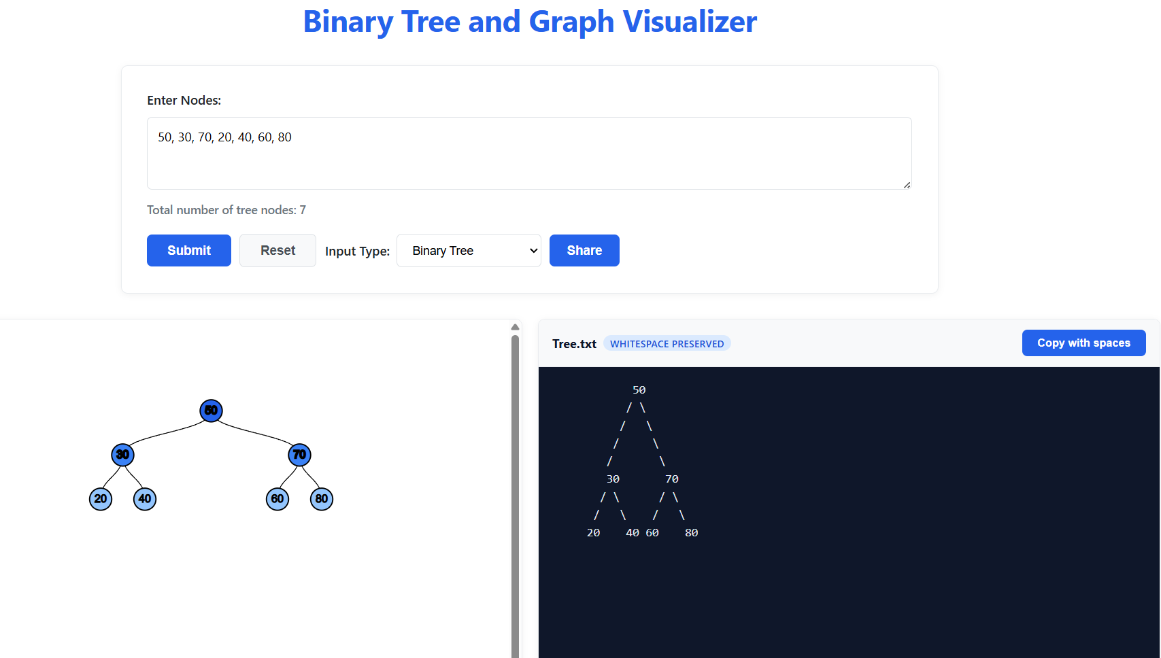
Tree 1 — Basic
2

Slide 3
Solution
Tool Used - Binary Tree Visualizer and Converter

Slide 4
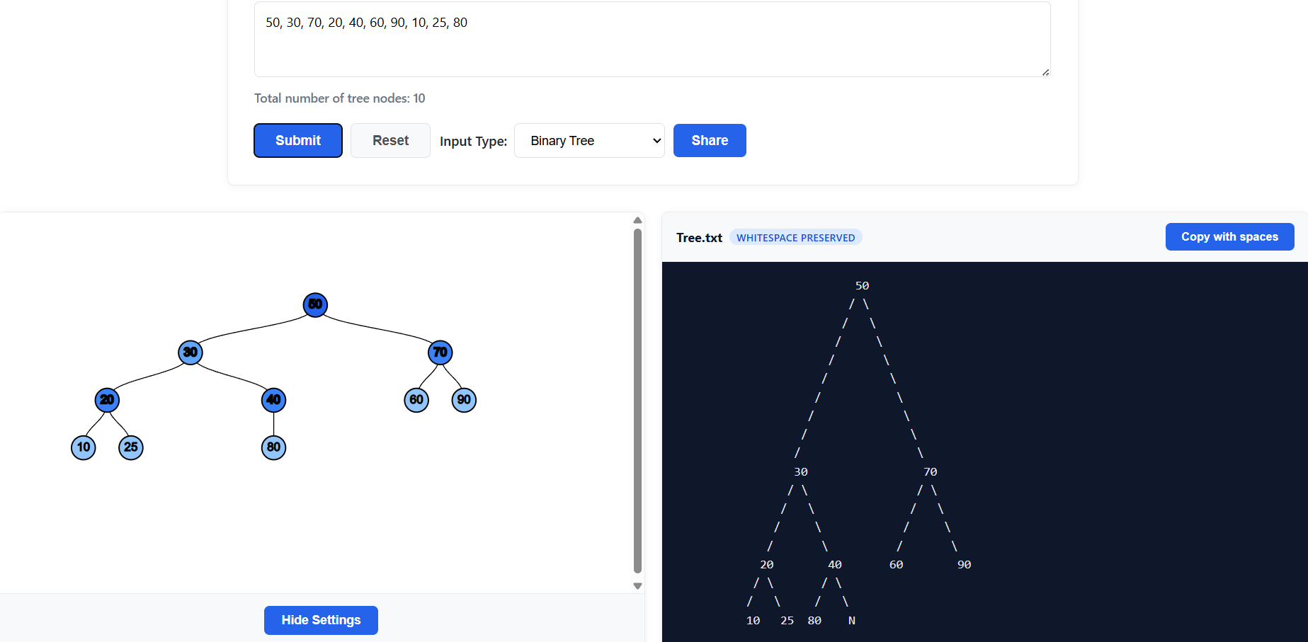
Tree 2 — Unbalanced
4

Slide 5
.
Solution
Tool Used - Binary Tree Visualizer and Converter
3

Slide 6
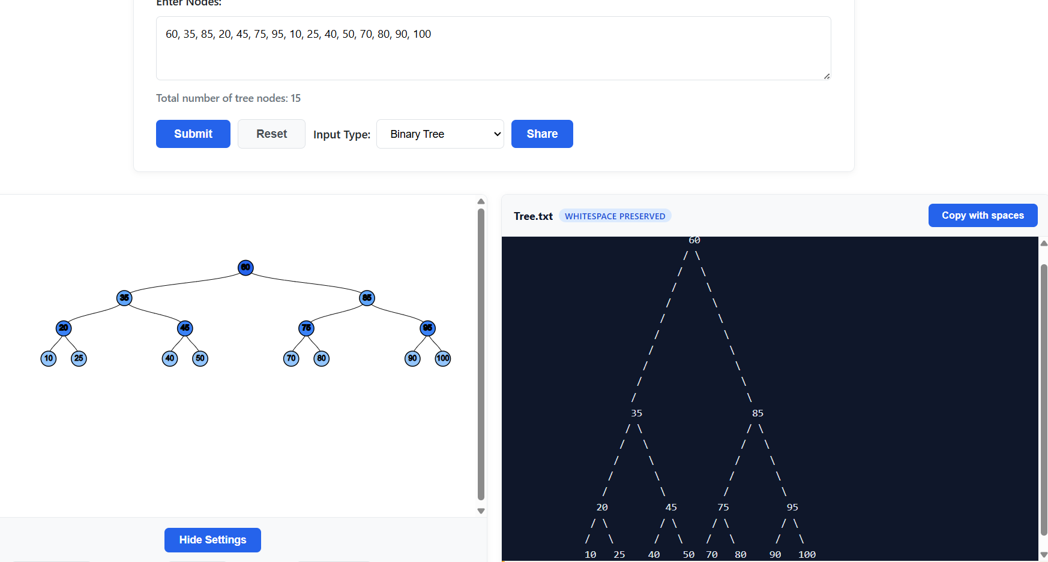
Tree 3 — Advanced
6

Slide 7
Solution
Tool Used - Binary Tree Visualizer and Converter
Input: 60, 35, 85, 20, 45, 75, 95, 10, 25, 40, 50, 70, 80, 90, 100
Number of nodes: 15
Root: 60
Leaf nodes: 10, 25, 40, 50, 70, 80, 90, 100
Levels: 4
7

Slide 8
THANK YOU

