Slide 1

CO3-AT3- TRAVERSAL CHALLENGE
Course Code: CSA0313
Course Name: Data Structures
Presented By:
Roshan R(192524085)
Under the supervision:
Dr. Shakila M

Slide 2


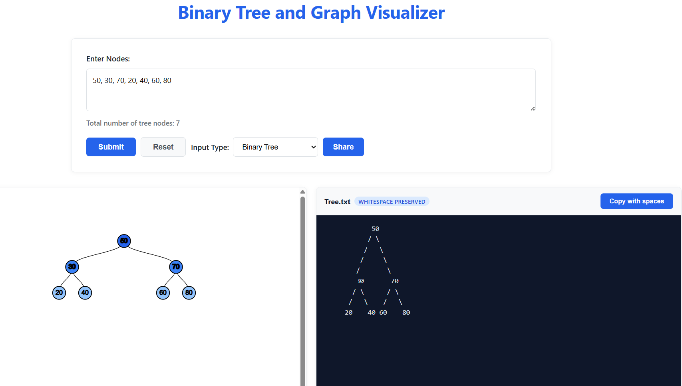
Tree 1 — Basic
2

Slide 3
Solution
Tool Used - Binary Tree Visualizer and Converter

Slide 4
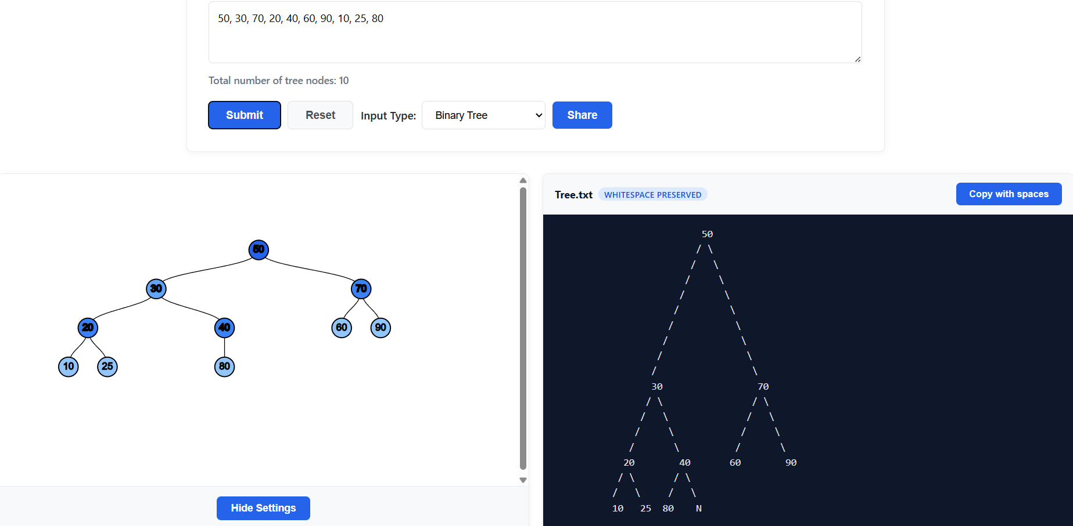
Tree 2 — Unbalanced
4

Slide 5
.
Solution
Tool Used - Binary Tree Visualizer and Converter
3

Slide 6
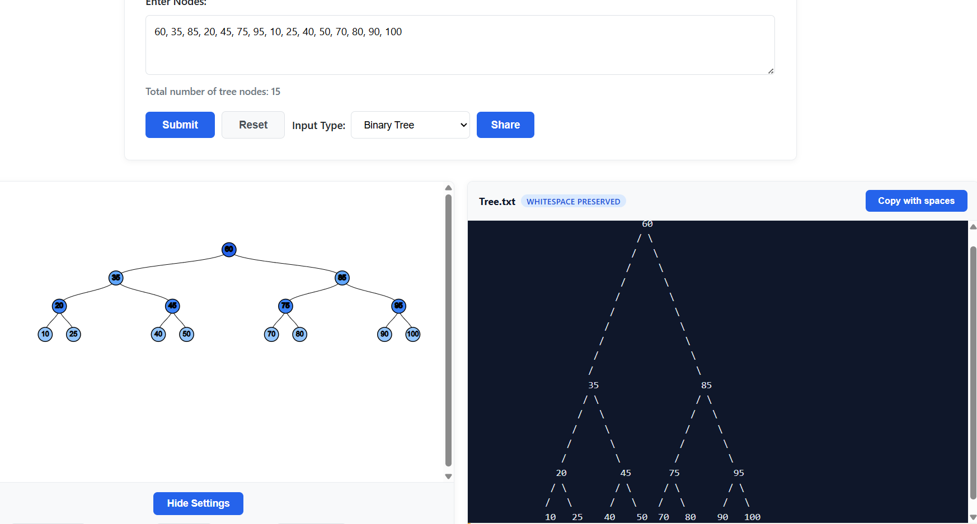
Tree 3 — Advanced
6

Slide 7
Solution
Tool Used - Binary Tree Visualizer and Converter
Preorder: 60, 35, 20, 10, 25, 45, 40, 50, 85, 75, 70, 80, 95, 90, 100
Inorder: 10, 20, 25, 35, 40, 45, 50, 60, 70, 75, 80, 85, 90, 95, 100
Postorder: 10, 25, 20, 40, 50, 45, 35, 70, 80, 75, 90, 100, 95, 85, 60
7

Slide 8
THANK YOU

