Slide 1
Convolutional neural networks
By,
Roshan Badrinath
(1NT15CS140)

Slide 2
Brief introduction to neural networks
Neural networks are a computational model that resembles a human brain in which there are many small units working in parallel with no centralized control unit. Smallest unit in a neural network is called as a perceptron.
A neural network architecture consists of a certain number of layers. Each layer consists of a certain number of neurons. Each neuron is connected to several other neurons.
The algorithm used for training a neural network is called Backpropogation.
The process of training a neural network is done by readjusting the weights and biases.
An image of height 32 pixels and width 32 pixels with 3 channels (RGB) will require 3072 weights per neuron in the first hidden layer.
A normal image of a resolution of 300 x 300 would require 270,000 weights per neuron in the first hidden layer.
This will create a huge number of parameters to train for the complete neural network.

Slide 3
Convolutional neural networks (CNN)
Convolution neural network’s are designed to take images as their input. Different types of hidden layers are used to train efficiently.
Neurons in a CNN can be arranged in a three-dimensional structure as width (Image width in pixels), height (Image height in pixels) and depth (RGB channels).
A CNN consists of three major groups of layers:
Input layer
Feature-extraction layers
Classification layers
The two main types of hidden layers are:
Convolution layers with ReLU activation function
Pooling layers

Slide 4
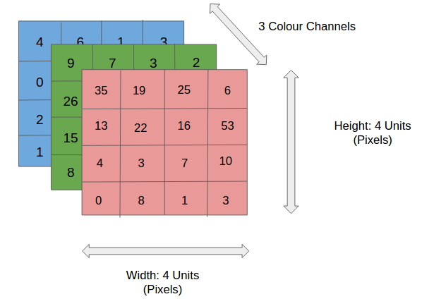
Fig 1: 3-D input given to a CNN

Slide 5
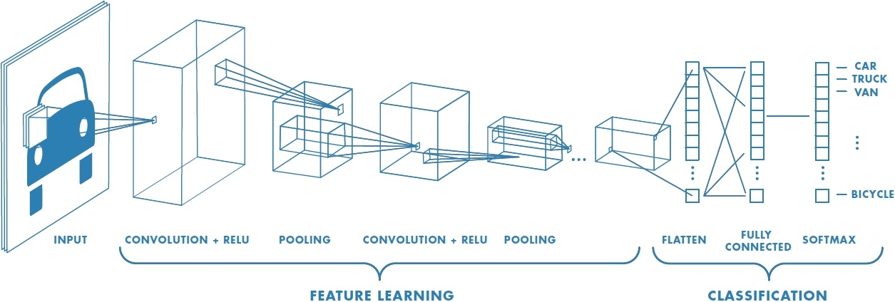
Fig 2: Major groups of layers present in CNN

Slide 6
Convolution Layer
Convolution is a mathematical operation of merging two sets of information.
In the convolution layer, a neuron is locally connected to a patch of neurons in the previous layer. The matrix formed by these neurons is called as a receptive field.
The locally connected weights are called as filters or kernels.
This layer will compute a dot product between all receptive fields and the kernel. Hence the parameters are shared.
The size of kernel is very much less than the size of the input. Hence there are less parameters to be learned.
Each kernel can be associated with one bias value.
The output of the layer results in a feature map, also called as activation map.
When a filter “activates”, it means that the filter lets information pass through it.

Slide 7
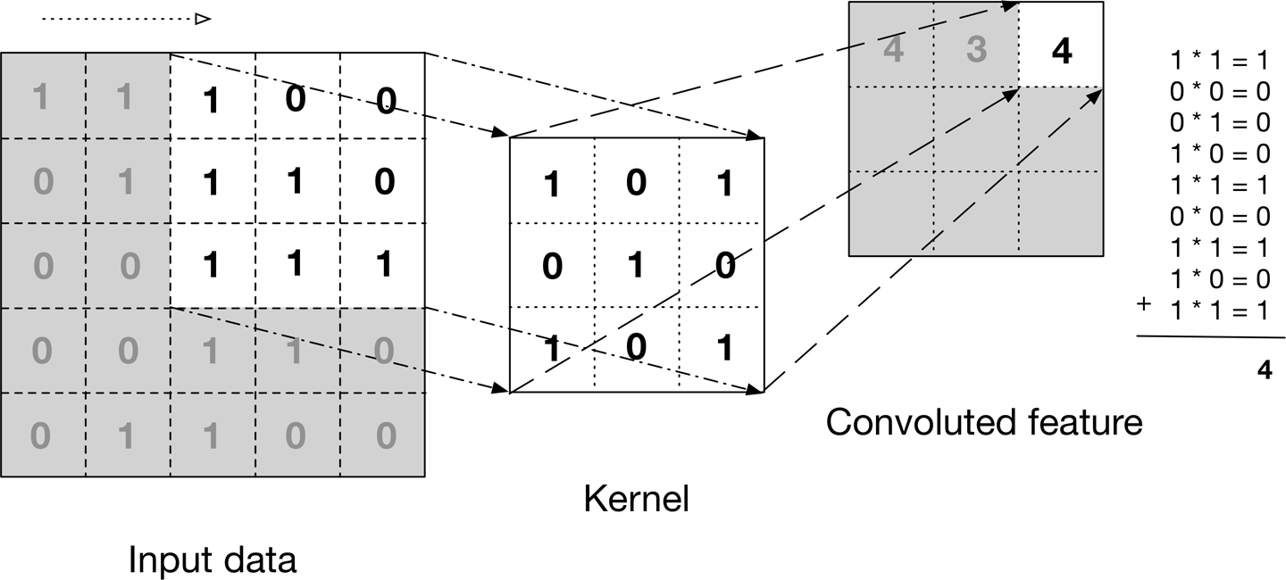
Fig 3: Convolution operation using kernels/filters.

Slide 8
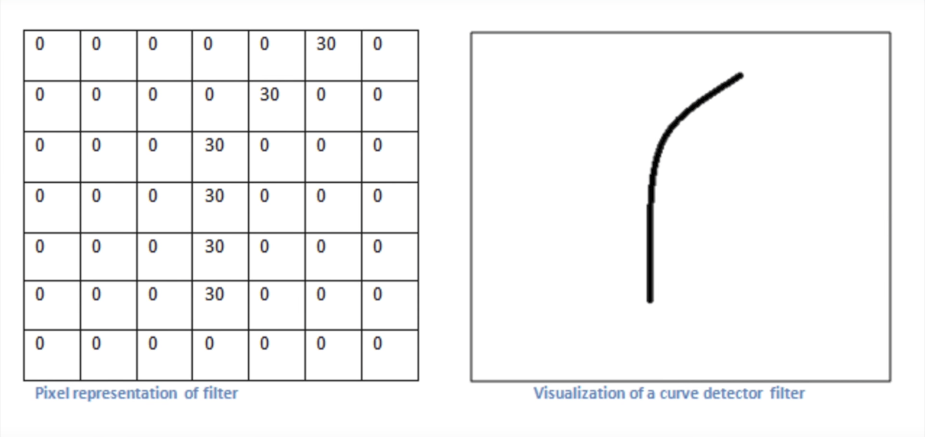
Fig 4: Example of a trained filter or a feature learned

Slide 9
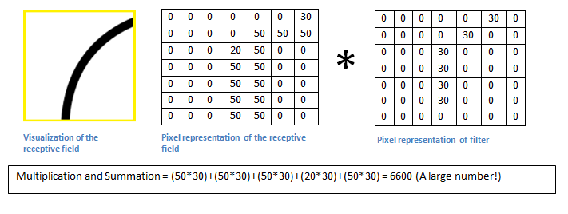
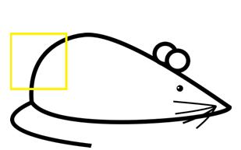
Fig 5: Example of a filter allowing the information to pass as the dot product is a large value.

Slide 10
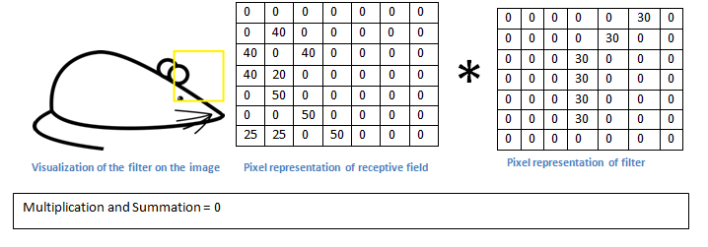
Fig 6: Example of a filter not allowing the information to pass as the dot product is zero.

Slide 11
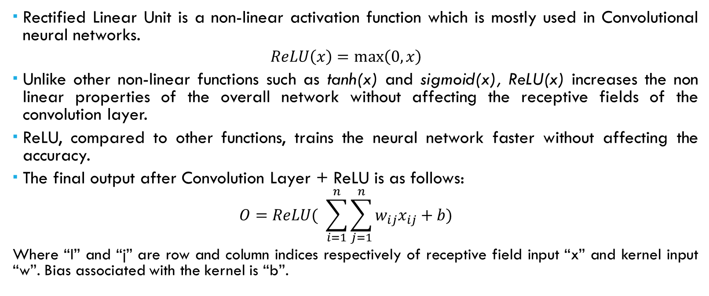
Rectified linear unit (Relu)
Rectified Linear Unit is a non-linear activation function which is mostly used in Convolutional neural networks.
$$ReLU\left(x\right)=\max\left(0, x\right)$$
Unlike other non-linear functions such as tanh(x) and sigmoid(x), ReLU(x) increases the non linear properties of the overall network without affecting the receptive fields of the convolution layer.
ReLU, compared to other functions, trains the neural network faster without affecting the accuracy.
The final output after Convolution Layer + ReLU is as follows:
$$O=ReLU( \sum_{i=1}^{n}{\sum_{j=1}^{n}{w_{ij}x_{ij}}}+b)$$
Where “I” and “j” are row and column indices respectively of receptive field input “x” and kernel input “w”. Bias associated with the kernel is “b”.

Slide 12
Pooling layer
Pooling layer is generally inserted between successive convolution layers.
Pooling layer is used after convolution layer to progressively reduce the special size of the data.
By reducing the special size, polling layer helps control the problem of overfitting.
Pooling layers use filters to perform the downsampling process on the input volume.
MaxPooling is the most common pooling operation. With a 2 × 2 filter size, the MaxPooling operation is taking the largest of four numbers in the filter area.
If a MaxPooling filter of size 2 x 2 is applied to an input of size 32 x 32 x 3, an output of size 16 x 16 x 3 is obtained.
The depth of the input is not affected.

Slide 13
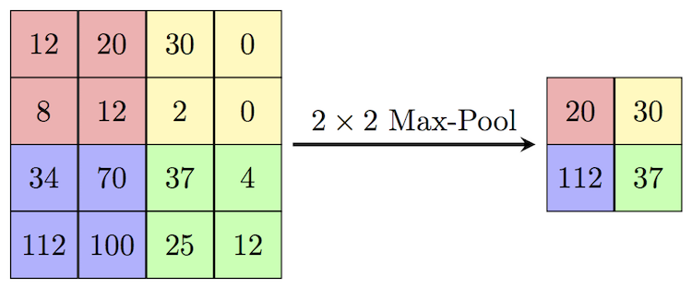
Fig 7: MaxPooling operation with filter of size 2 x 2.

Slide 14
Hyperparameters
In convolution layer
Number of filters/kernels
Size of the filter/kernel
Stride: The amount by which the filter/kernel shifts is called as stride.
Padding: The process of adding zeroes to input volume around the border to control the special size of the output volume is called as padding. Zero-padding is used to obtain an output volume of same size as the input volume.
In pooling layer:
Size of the filter/kernel

Slide 15
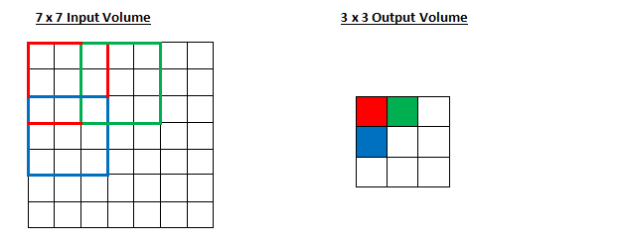
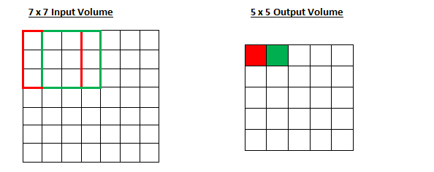
Fig 8: (above) Stride is equal to 2. (below) Stride is equal to 1.

Slide 16
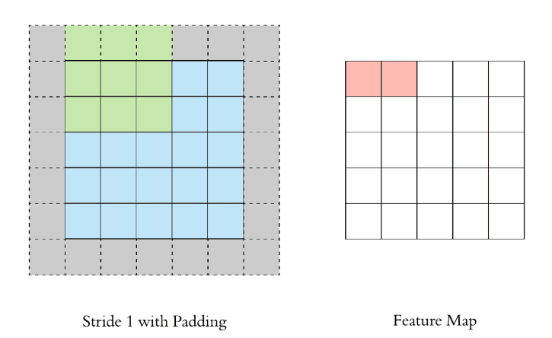
Fig 9: Example of zero-padding for stride equals1.

Slide 17
Summary information
Let the input volume be of size W1×H1×D1and the output volume be of size W2×H2×D2. Let the hyperparameters be as follows:
Number of filters K
Spatial extent F (Equal height and width)
Stride S
Padding P
For Convolution layer:
W2 = (W1−F+2P)/S +1
H2 = (H1−F+2P)/S +1
D2 = K
For Pooling layer:
W2 = (W1−F)/S +1
H2 = (H1−F)/S +1
D2 = K

Slide 18
Fully-connected layers
After high level features are extracted from convolution layers and pooling layers, the feature maps are flattened and are given to a series of fully connected layers.
These fully connected layers are meant for classification.
The final/output layer produces a 1-D vector of size N, where N is the number of classes. Softmax activation function is generally used with this layer.
The final output vector consists of probability values.

Slide 19
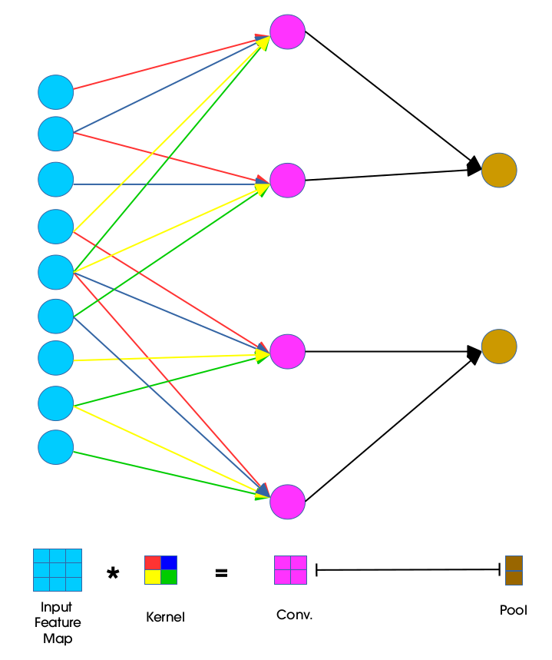
Fig 10: Local connectivity of CNN

Slide 20
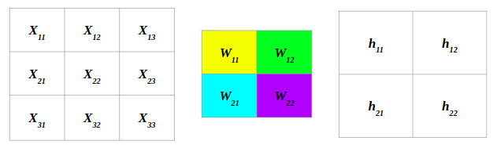
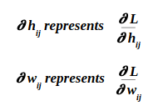
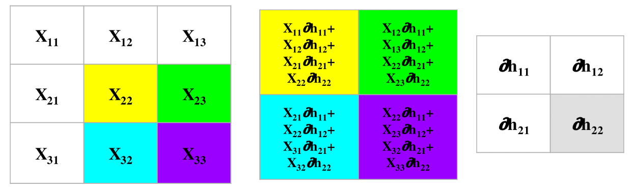
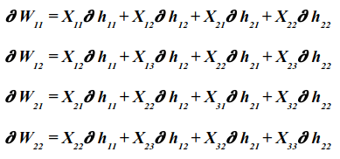
Fig 11: Backpropogation in CNN

Slide 21
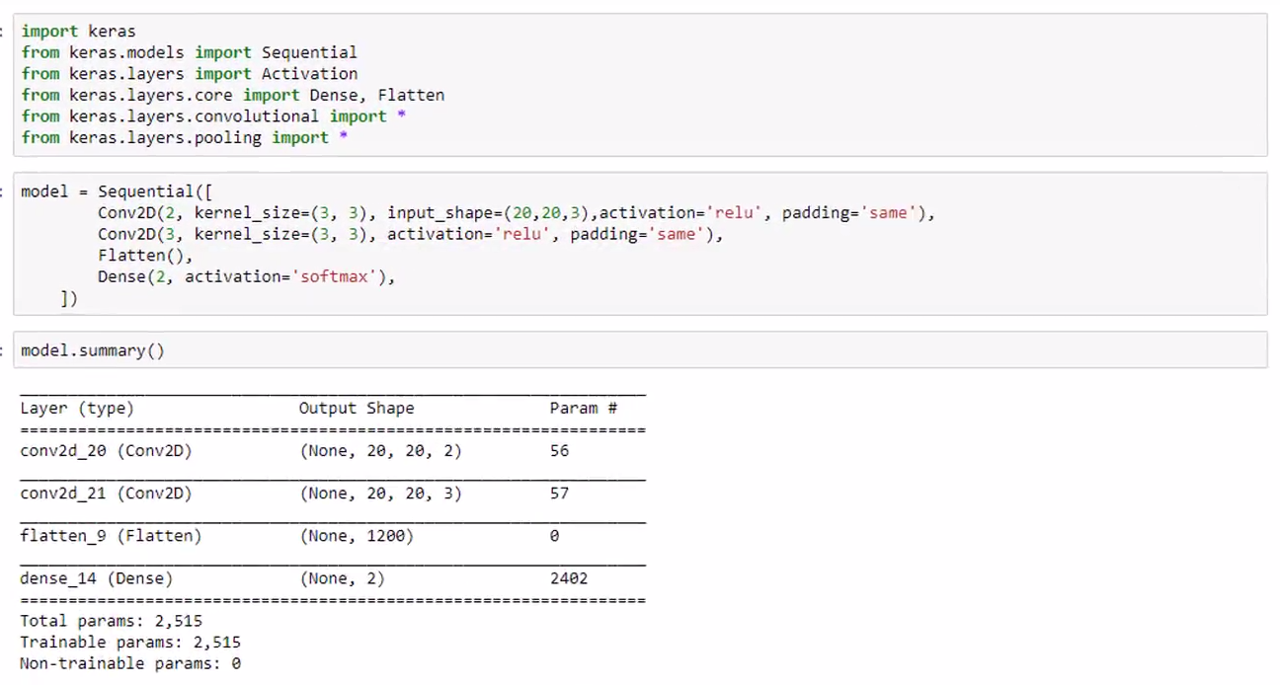
Fig 12: Building a CNN using Keras

Slide 22
THANK YOU!

