Slide 1



Toy Compiler
A Compiler Design Project

Slide 2
Group Members
Roshan Baghwar (IIT2017147)
Akash Singh (BIM2017004)
Yashwant Panchal (BIM2017006)
Mayank Taskande (ITM2017008)
Ashutosh Kumar (ISM2017003)
Anup Bediya (ISM2017002)
under the guidance of ;
Dr. S. Venkatesan

Slide 3
myCompiler - a Toy Compiler
The compiler is based on following phases
LEXIcal
aNALYSIS
01
SYNTAX
ANALYSIS
02
SEMANTIC
ANALYSIS
03
INTERMEDIATE
CODE
GENERATION
04

Slide 4
It is also called scanner.
It reads the characters from source program and groups them into lexemes.
Each lexeme corresponds to a token.
Tokens are defined by regular expressions which are understood by the lexical analyzer.
It also removes lexical errors.
lexical
aNALYzer

Slide 5
It is sometimes called as parser.
It constructs the parse tree.
It takes all the tokens one by one and uses Context Free Grammar to construct the parse tree.
Syntax error can be detected at this level if the input is not in accordance with the grammar.
Using these productions we can represent what the program actually is.
syntax
aNALYzer

Slide 6
It verifies the parse tree, whether it’s meaningful or not.
It furthermore produces a verified parse tree.
It also does type checking, Label checking and Flow control checking.
semantic
aNALYzer

Slide 7
It generates intermediate code, that is a form which can be readily executed by machine.
Intermediate code is converted to machine language using the last two phases which are platform dependent.
Till intermediate code, it is same for every compiler out there, but after that, it depends on the platform.
To build a new compiler we don’t need to build it from scratch.
We can take the intermediate code from the already existing compiler and build the last two parts.
Intermediate
Code
generator

Slide 8
myCompiler – Usage Screenshosts
The compiler is based only for Linux OS
Comments.c
File
01
Invalidc.c
file
02
Validc.c
file
03

Slide 9
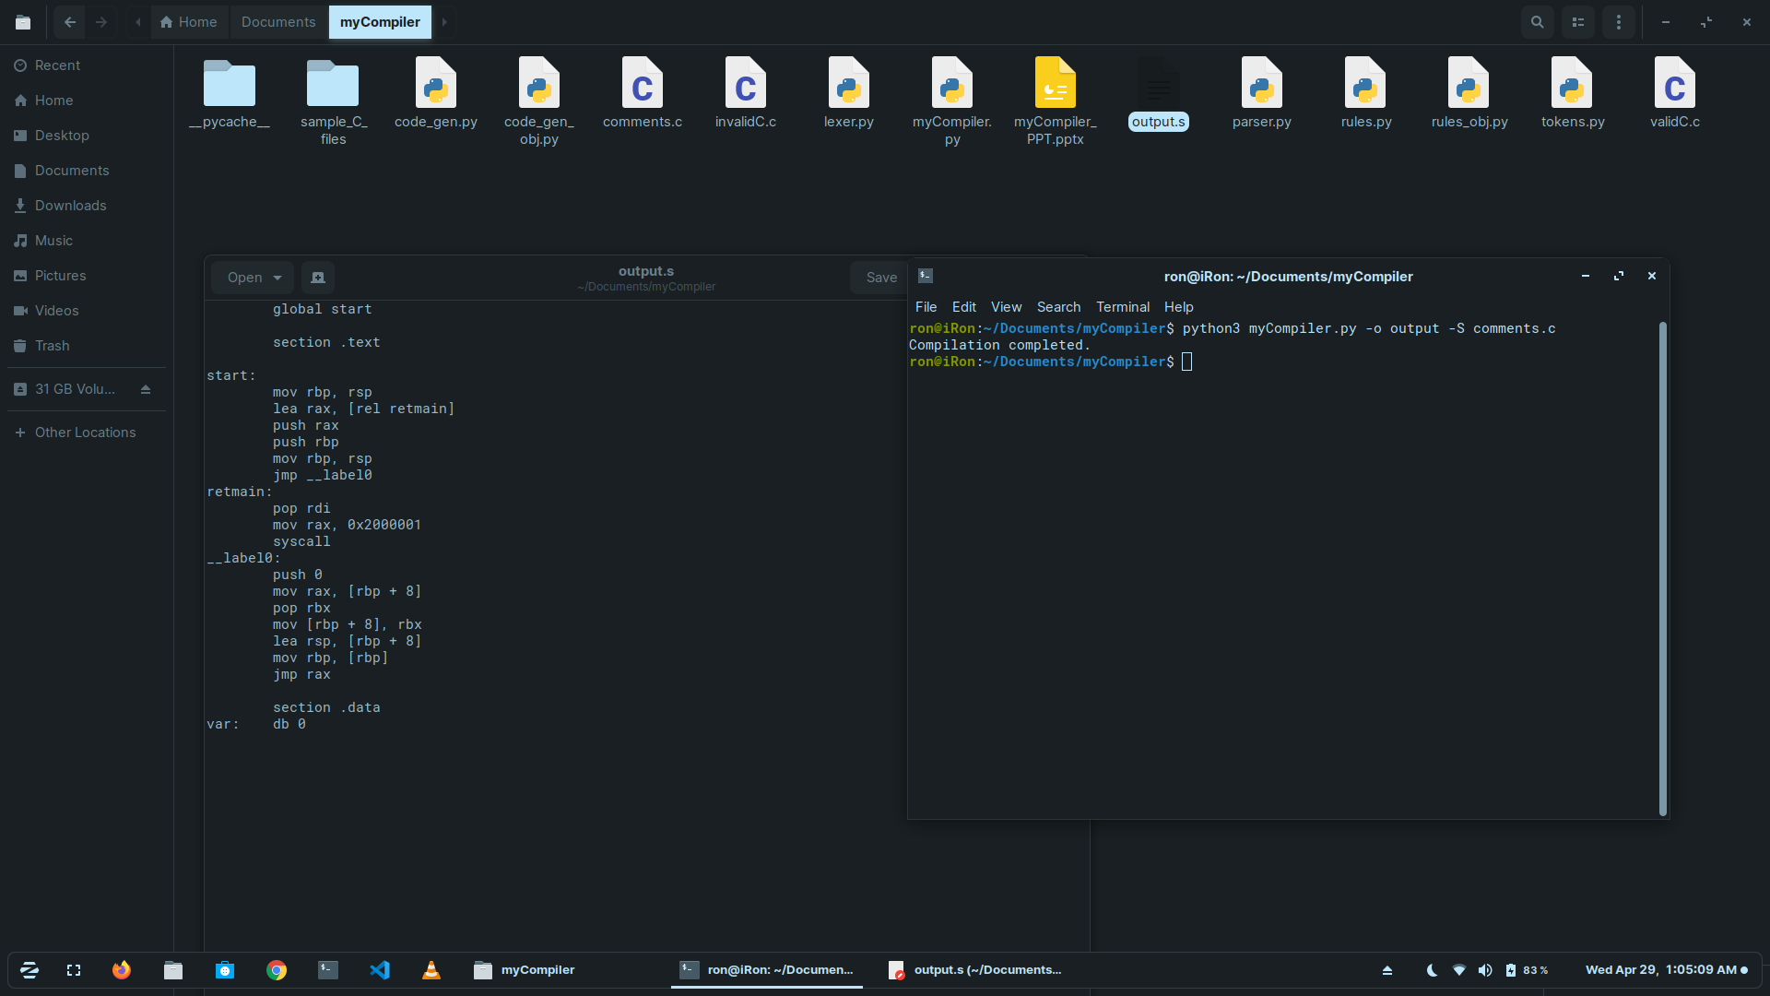
COMMENTS.C
FILE

Slide 10
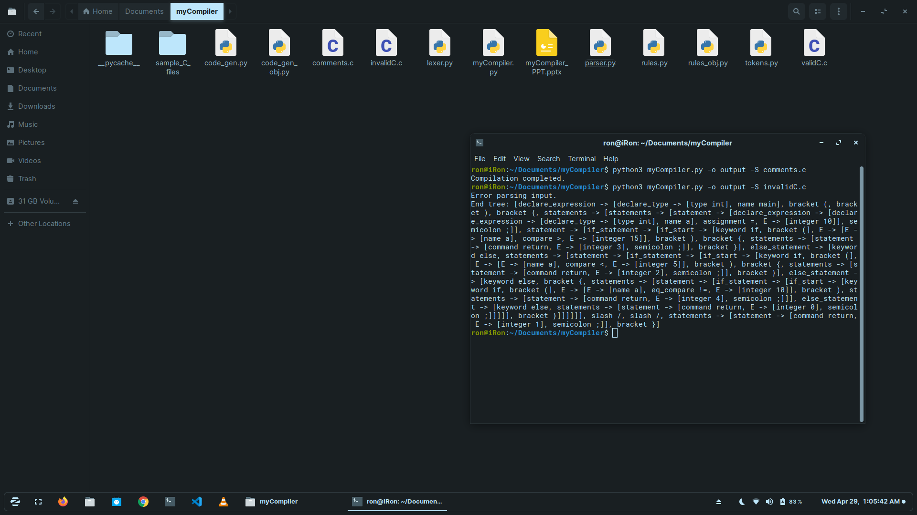
invalidc.C
FILE

Slide 11
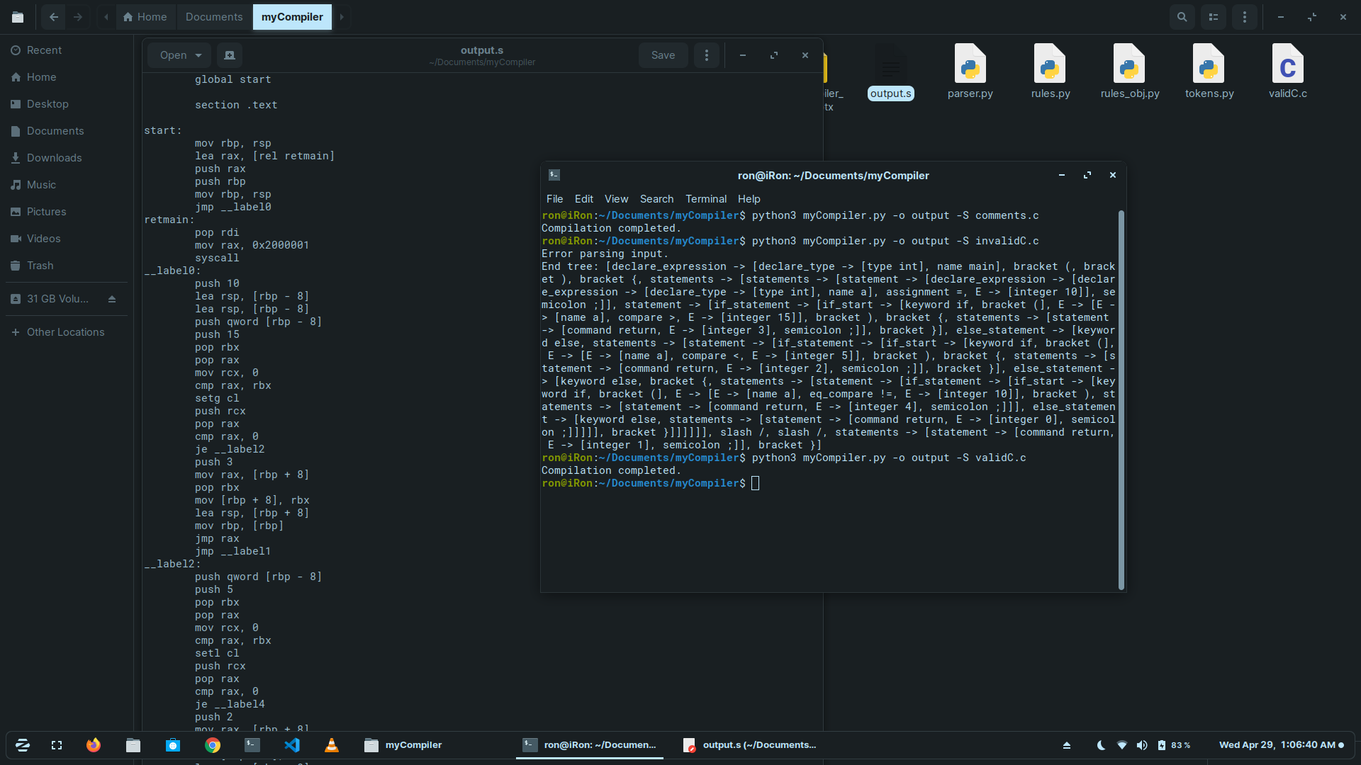
validc.C
FILE

Slide 12
Thank You!

