Slide 1

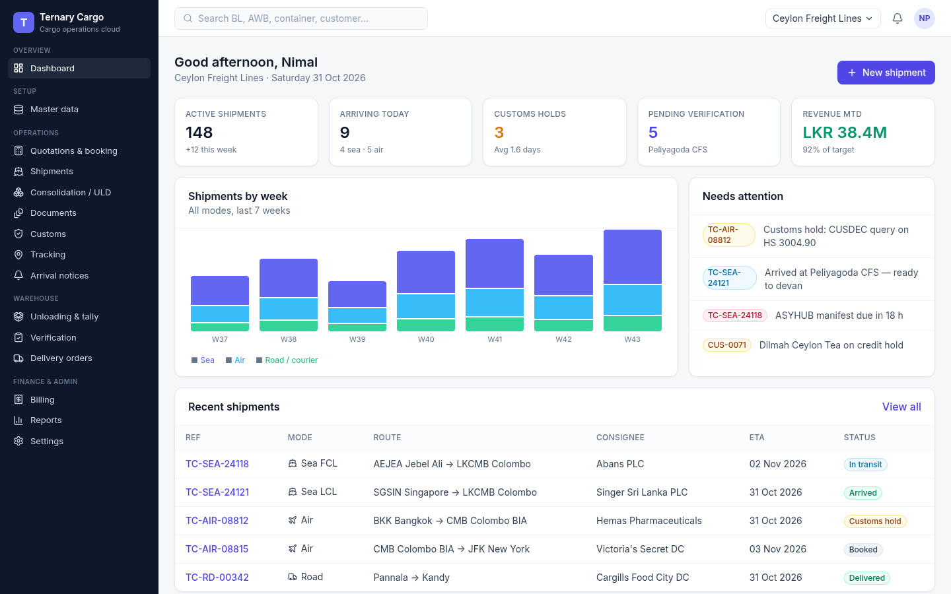

Ternary Cargo
UI prototype walkthrough: cargo management from master data to unloading and verification
Sea · Air · Road · Courier
For review and approval by Roshan Gamage, founder · 31 Oct 2026
Prototype dashboard (screen 03)
Ternary Systems · Research. Invent. Deliver.
1
Notes:
Title slide. Screenshot: /workspace/cargo/screens/03-dashboard.png.

Slide 2
Context
What
Ternary Cargo, a cargo management system sold as SaaS.
We are parking SME credit to build a product we can ship
Scope
Master data through to unloading and verification, for sea, air, road and courier.
Inspiration
iforce.live inspired the patterns (clean master data, KPI dashboards, mobile-first field work), not the features.
SME credit is parked as a long-term project, with its key details kept for later.
The priority now is a product we can build and ship.
This deck
A UI-only prototype, one screenshot per step, for you to check slide by slide.
Then
After your approval, we move on to the full implementation.
Ternary Systems · Research. Invent. Deliver.
2
Notes:
Source: Roshan’s brief (31 Oct 2026): park the SME credit project as a long-term shot; build a cargo management SaaS inspired by iforce.live; master data to unloading and verification; sea, air and more; UI-only prototype with screenshots of each step for review; full implementation after confirmation.

Slide 3

Research 1 of 4 · The inspiration
iforce.live gave us patterns, not features
What iforce.live is
What we borrow for cargo
Not a cargo product: a sales force automation platform for FMCG field teams.
Offline mobile orders, route planning, distributor control and real-time dashboards.
Run by Prologics, Borella, Colombo 08: a local Sri Lankan SaaS.
Clean master data
Screen 04
Duplicate checks on shipper and consignee records (theirs match outlet name, phone and GPS).
KPI dashboards
Screen 03
Live KPIs and exceptions for managers.
Mobile-first field work
Screens 28–31
22,000+
A mobile-friendly tally and verification screen for warehouse staff.
Simple SaaS
Screens 01–02
outlets on one named customer (Bellose), with 250+ reps and 200+ distributors
Simple SaaS deployment, multi-tenant from sign-in.
Source: https://iforce.live (redirects to iforce.lk)
Ternary Systems · Research. Invent. Deliver.
3
Notes:
Source: https://iforce.live (redirects to iforce.lk), via /workspace/cargo/research.md section 1.

Slide 4
Research 2 of 4 · Comparable platforms
Established platforms share one standard module set
Platform | Scope | Source
Magaya | Quotes to bookings, pickup orders, warehouse receipts, shipments and invoices without re-entry; built-in WMS, customs, accounting, tracking, customer portal | magaya.com
CargoWise | Enterprise single platform: forwarding across modes, customs, warehouse, accounting | cargowise.com
Freightos | Rate management, quoting, booking, milestone visibility; not a full FMS (no native WMS, customs or accounting) | wifitalents.com (third-party review)
Logixboard | Customer-facing shipment visibility, configurable stages, document-linked milestones | wifitalents.com, gitnux.org (third-party reviews)
Shared module set
Master data · quotation and rates · booking · shipment per mode · consolidation · documents · customs · tracking · warehouse (receiving, devanning) · billing · reports · customer portal
Ternary Systems · Research. Invent. Deliver.
4
Notes:
Sources: https://www.magaya.com/ ; https://www.magaya.com/freight-forwarding-software/ ; https://www.cargowise.com/ ; https://wifitalents.com/best/freight-forwarders-software/ (third-party review) ; https://gitnux.org/best/freight-forwarders-software/ (third-party review). Via /workspace/cargo/research.md section 2.

Slide 5
Research 3 of 4 · Sri Lanka specifics
Sri Lankan rules set the clock for sea manifests
72 h
7 May 2025
CUSDEC
Inward sea cargo e-manifests are due 72 hours before arrival at the first Sri Lankan port, filed by licensed agents, forwarders or NVOCCs.
Since this date, cargo manifests go only via ASYHUB (UNCTAD). ASYCUDA World still handles vessel registration and clearance.
Imports are declared through a Customs House Agent (CHA) with an online Customs Declaration in ASYCUDA World.
Electronic Sea Cargo Reporting Regulations No. 1 of 2014
Sri Lanka Customs notice
Sri Lanka Customs, importing goods
Air: the air cargo advance e-manifest regulation is drafted but not yet approved. At BIA (CMB), the pilot-in-command delivers cargo and stores manifests in duplicate with the General Declaration.
Ternary Systems · Research. Invent. Deliver.
5
Notes:
Sources: https://www.customs.gov.lk/services/importing-goods/ ; https://www.customs.gov.lk/wp-content/uploads/2021/07/1886_55-E.pdf ; https://www.customs.gov.lk/mandatory-submission-of-manifests-via-asyhub-system-effective-from-07th-may-2025/ ; https://www.customs.gov.lk/services/asyhub/ ; https://airport.lk/aasl/AIS/AMDT%20WEB/AIP%20FROM%2020%20APR%202023/htm/33.htm . The 72 h rule falls back to departure from the last foreign port when the voyage is under 72 h. Via /workspace/cargo/research.md section 3.

Slide 6
Research 4 of 4 · Product implications
Three local differentiators, and what is still open
01
02
03
ASYHUB-ready manifest
CHA declaration workflow
Mobile tally and verification
A manifest-ready export for sea, built for the ASYHUB-only rule.
The Customs House Agent workflow for the declaration.
A tally and verification screen for warehouse staff.
Screens 17, 25
Screen 25
Screens 28–31
Not verified yet
SLPA terminal integrations (JCT, SAGT, CICT, ECT).
AASL and SriLankan cargo terminal APIs.
Pricing benchmarks.
Sri Lanka HS tariff lines and duty rates (check against the Customs tariff).
"Ternary Cargo" is a working name.
Ternary Systems · Research. Invent. Deliver.
6
Notes:
Source: /workspace/cargo/research.md section 4 (synthesis of sections 1–3; Customs links on the previous slide).

Slide 7
End-to-end flow
One flow from sign-in to a verified, released and billed shipment
01
02
03
04
05
Access and master data
Quote, booking and shipment
Consolidation, documents and customs
Tracking, arrival, unloading and verification
Release, billing, reports and settings
Screens 01–10
Screens 11–18
Screens 19–25
Screens 26–31
Screens 32–37
Sign-in, tenant, dashboard; customers, carriers, ports, warehouses, HS codes, containers, charges
Quote to booking; four-step wizard for every mode; shipment created
Container and ULD build-up; HBL, AWB, invoice, packing list; CUSDEC and ASYHUB
Milestones, arrival notice, package tally, discrepancy check, two-person sign-off
Delivery order, invoice, reports; users, roles, plan
Four modes, one wizard
Sea FCL and LCL, air, road and courier share the same shipment flow. Routing switches between ports and vessels for sea and airports and flights for air.
Ternary Systems · Research. Invent. Deliver.
7
Notes:
Flow order from /workspace/cargo/screens/index.md (screens 01–37). Phase 4 is highlighted in teal: unloading and verification is where the scope ends.

Slide 8
01
Access and master data
Screens 01–10
Ternary Systems · Research. Invent. Deliver.
8
Notes:
Section divider: Access and master data (Screens 01–10).

Slide 9
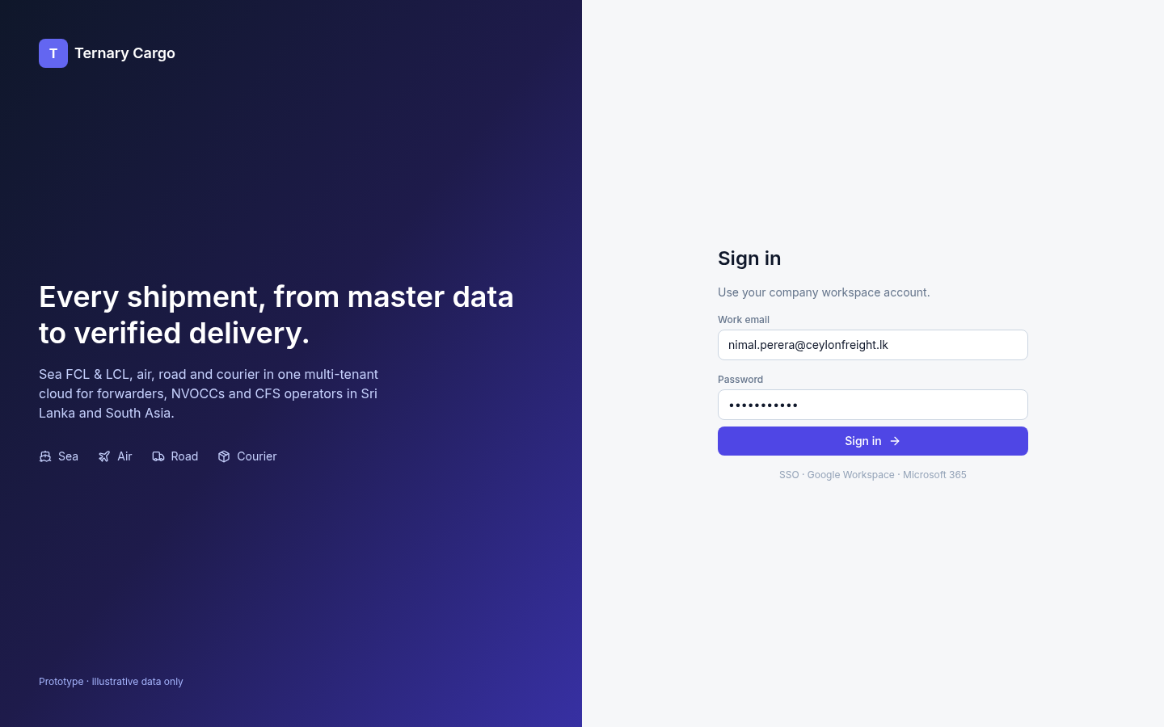
Screen 01 · Access and master data
Sign-in is the one front door for every tenant
What it shows
Workspace sign-in with single sign-on (SSO) options.
The entry point for every tenant user, whatever their organisation.
Ternary Systems · Research. Invent. Deliver.
9
Notes:
Screenshot: /workspace/cargo/screens/01-login.png. Facts from /workspace/cargo/screens/index.md.

Slide 10
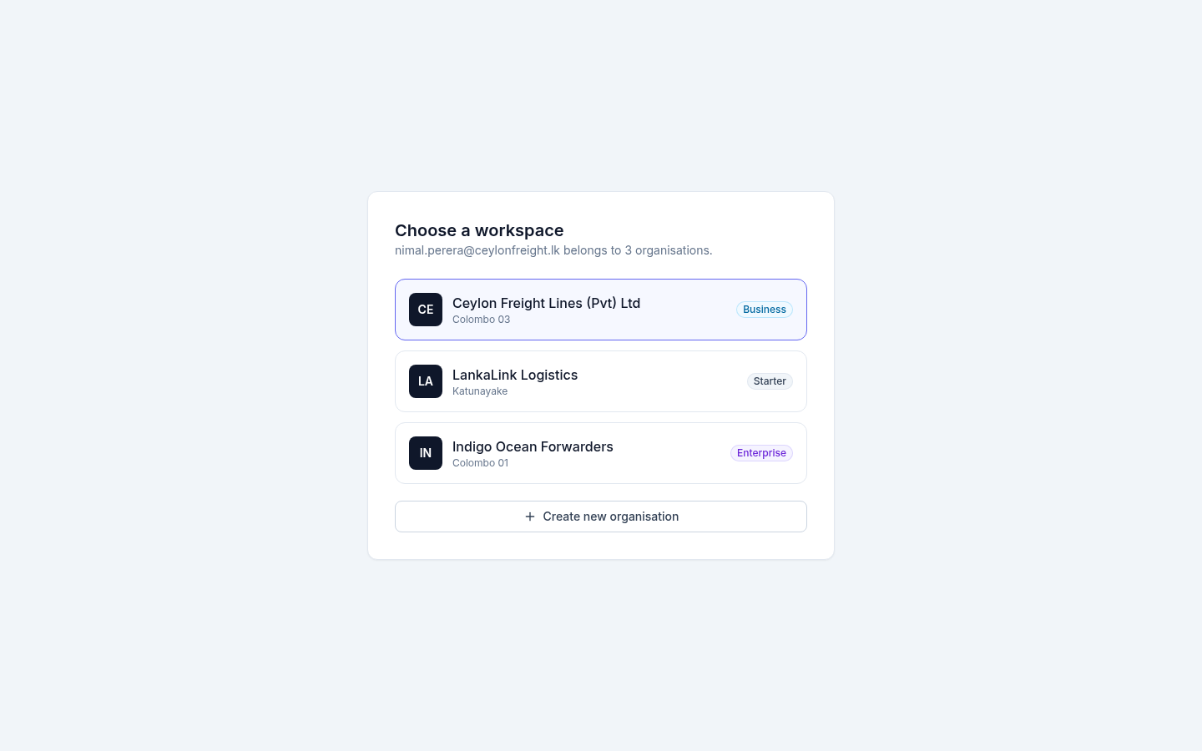
Screen 02 · Access and master data
One user can work across several organisations
What it shows
After sign-in, the user picks the organisation (tenant) to work in.
One person can belong to several organisations.
This is the multi-tenant core of the SaaS model.
Ternary Systems · Research. Invent. Deliver.
10
Notes:
Screenshot: /workspace/cargo/screens/02-tenant-select.png. Facts from /workspace/cargo/screens/index.md.

Slide 11
Screen 03 · Access and master data
The dashboard shows managers what needs action
What it shows
Key performance indicators (KPIs) across the top.
Weekly volume, split by mode.
An exceptions list, so managers see what needs action first.
Ternary Systems · Research. Invent. Deliver.
11
Notes:
Screenshot: /workspace/cargo/screens/03-dashboard.png. Facts from /workspace/cargo/screens/index.md.

Slide 12
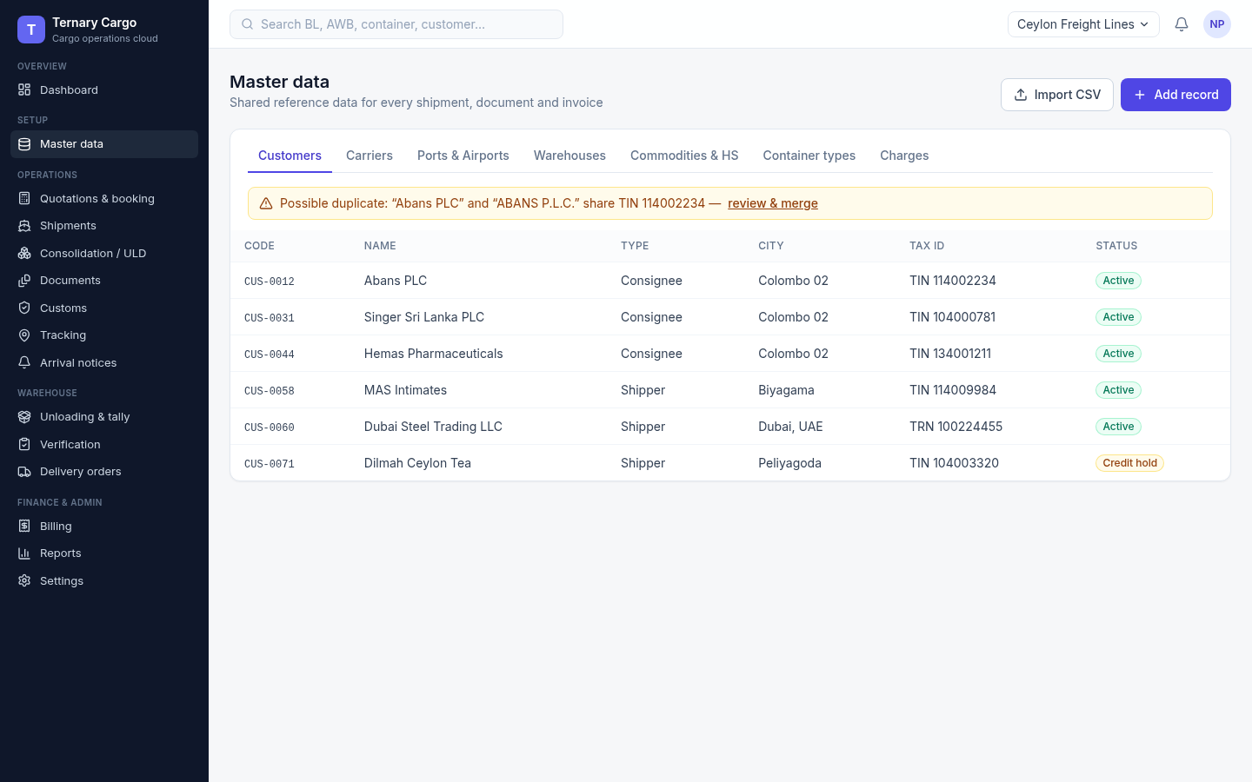
Screen 04 · Access and master data
Customer records warn on a duplicate TIN
What it shows
Shippers and consignees kept in one customer register.
A duplicate-TIN warning keeps master data clean.
This is the pattern borrowed from iforce.live’s duplicate validation.
Ternary Systems · Research. Invent. Deliver.
12
Notes:
Screenshot: /workspace/cargo/screens/04-master-customers.png. Facts from /workspace/cargo/screens/index.md. Pattern source: https://iforce.live

Slide 13
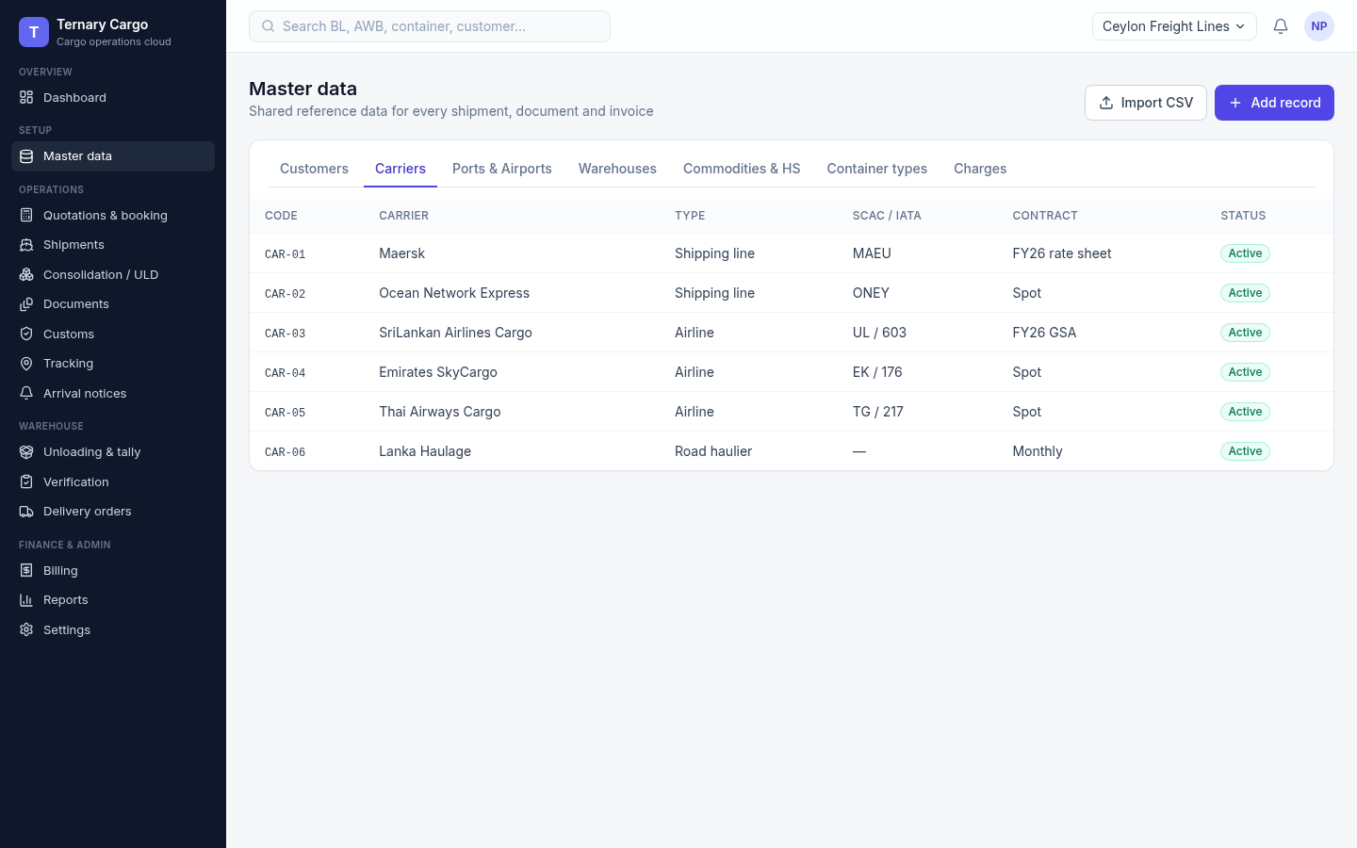
Screen 05 · Access and master data
Carriers cover sea, air and road in one list
What it shows
Shipping lines, airlines and road hauliers together.
Each carrier holds its codes and contracts.
Ternary Systems · Research. Invent. Deliver.
13
Notes:
Screenshot: /workspace/cargo/screens/05-master-carriers.png. Facts from /workspace/cargo/screens/index.md.

Slide 14
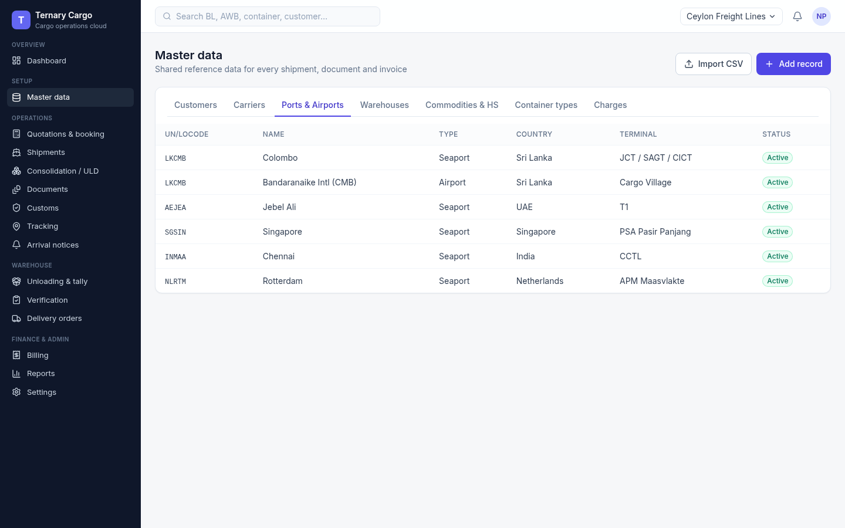
Screen 06 · Access and master data
Ports and airports use UN/LOCODEs
What it shows
Locations keyed by UN/LOCODE.
Includes LKCMB, CMB airport, Jebel Ali and Singapore.
Ternary Systems · Research. Invent. Deliver.
14
Notes:
Screenshot: /workspace/cargo/screens/06-master-ports.png. Facts from /workspace/cargo/screens/index.md.

Slide 15
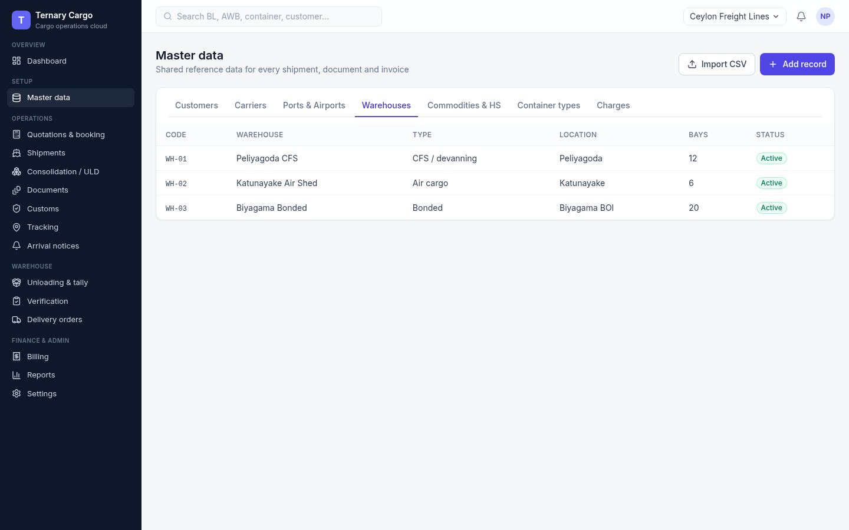
Screen 07 · Access and master data
Warehouses are where unloading happens
What it shows
Container freight station (CFS), air shed and bonded warehouses.
These are the sites where unloading and verification take place.
Ternary Systems · Research. Invent. Deliver.
15
Notes:
Screenshot: /workspace/cargo/screens/07-master-warehouses.png. Facts from /workspace/cargo/screens/index.md.

Slide 16
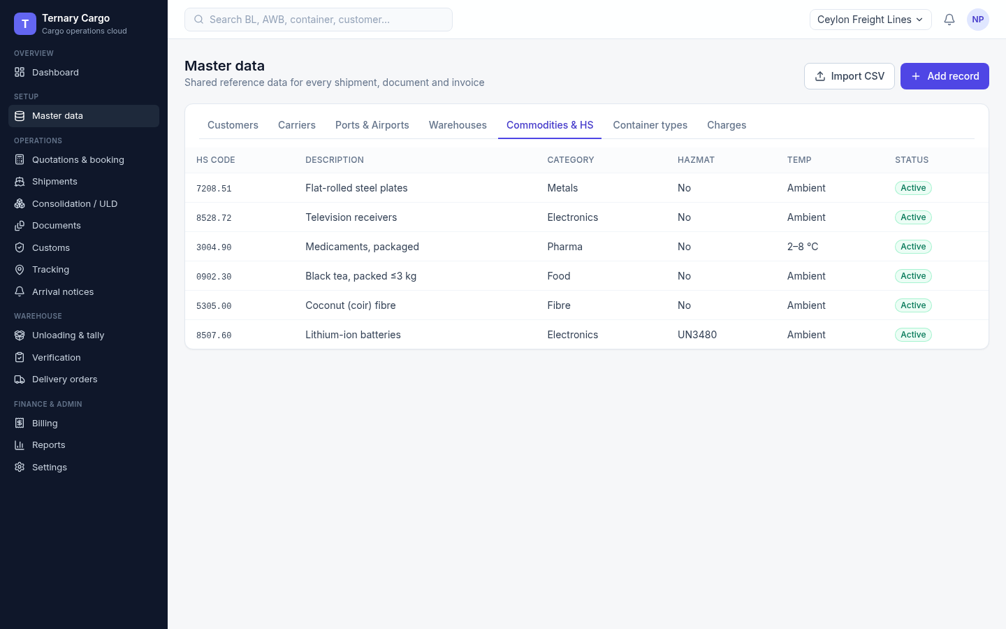
Screen 08 · Access and master data
HS codes drive customs and handling
What it shows
Commodities with Harmonised System (HS) codes.
Hazmat and temperature flags on each code drive customs and handling.
Example 6-digit headings only; Sri Lanka tariff lines are not verified.
Ternary Systems · Research. Invent. Deliver.
16
Notes:
Screenshot: /workspace/cargo/screens/08-master-hs.png. Facts from /workspace/cargo/screens/index.md. HS caveat: /workspace/cargo/research.md section 3.

Slide 17
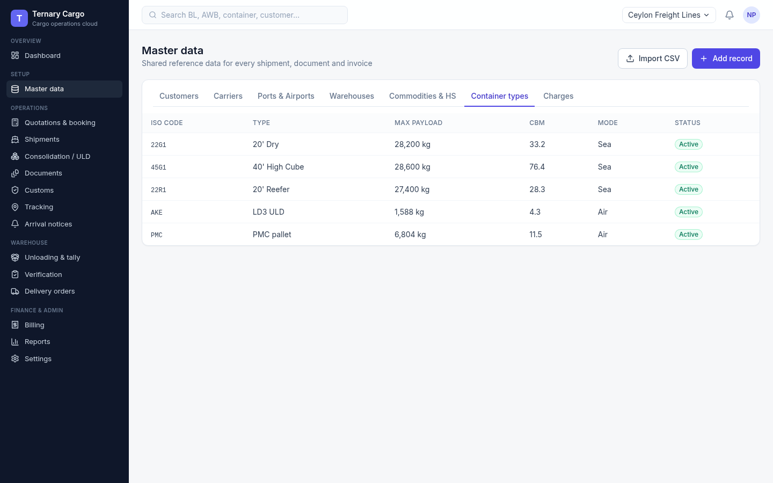
Screen 09 · Access and master data
Container and ULD types size each consolidation
What it shows
ISO container types and air unit load device (ULD) types.
Payload and volume per type feed the consolidation screens.
Ternary Systems · Research. Invent. Deliver.
17
Notes:
Screenshot: /workspace/cargo/screens/09-master-containers.png. Facts from /workspace/cargo/screens/index.md.

Slide 18
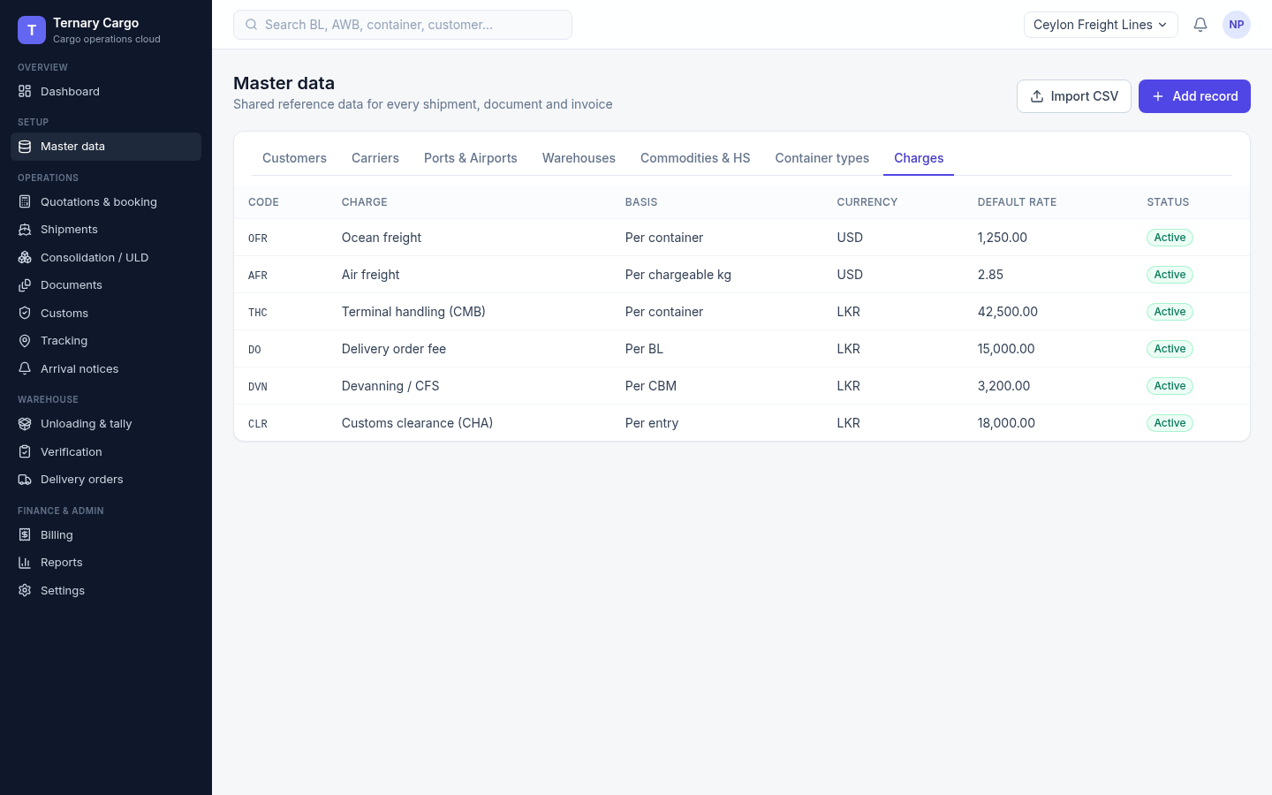
Screen 10 · Access and master data
Charge codes price both quotes and invoices
What it shows
Charge codes with default rates in USD and LKR.
The same codes feed quotations and invoices.
Rates shown are placeholders.
Ternary Systems · Research. Invent. Deliver.
18
Notes:
Screenshot: /workspace/cargo/screens/10-master-charges.png. Facts from /workspace/cargo/screens/index.md.

Slide 19
02
Quote, booking and shipment
Screens 11–18
Ternary Systems · Research. Invent. Deliver.
19
Notes:
Section divider: Quote, booking and shipment (Screens 11–18).

Slide 20
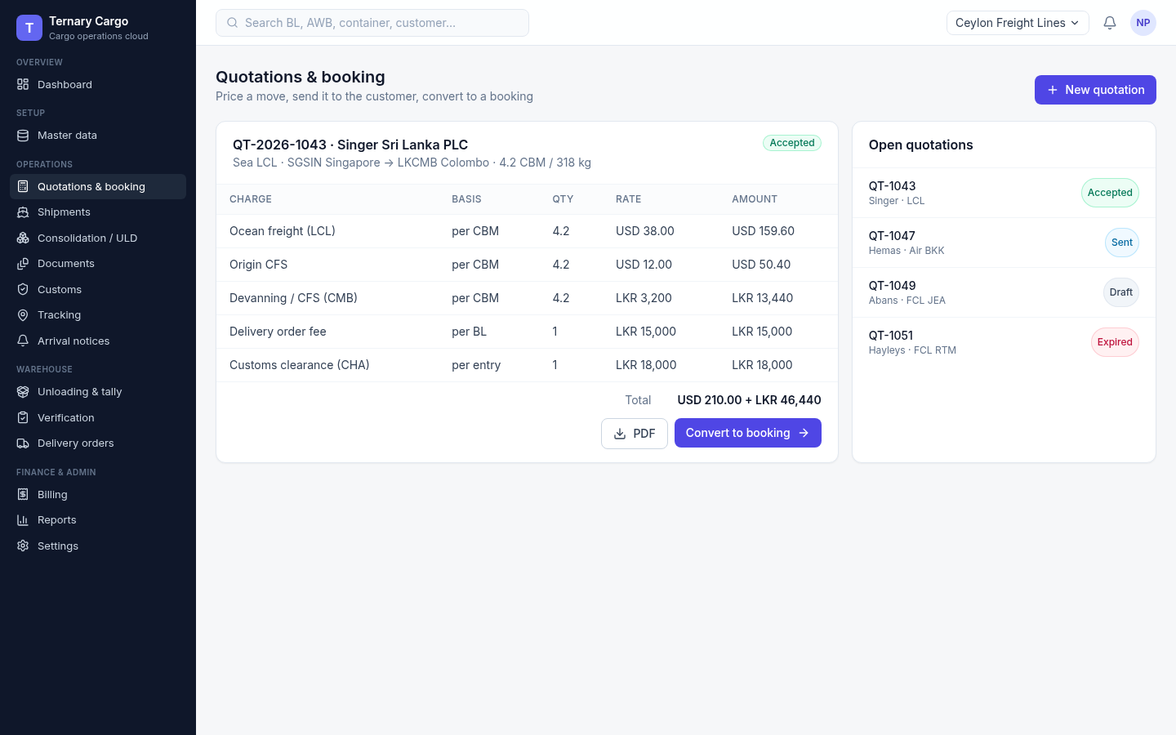
Screen 11 · Quote, booking and shipment
An accepted quote becomes a booking in one click
What it shows
A priced less-than-container-load (LCL) quote, marked accepted.
One click converts it into a booking.
Ternary Systems · Research. Invent. Deliver.
20
Notes:
Screenshot: /workspace/cargo/screens/11-quotation.png. Facts from /workspace/cargo/screens/index.md.

Slide 21
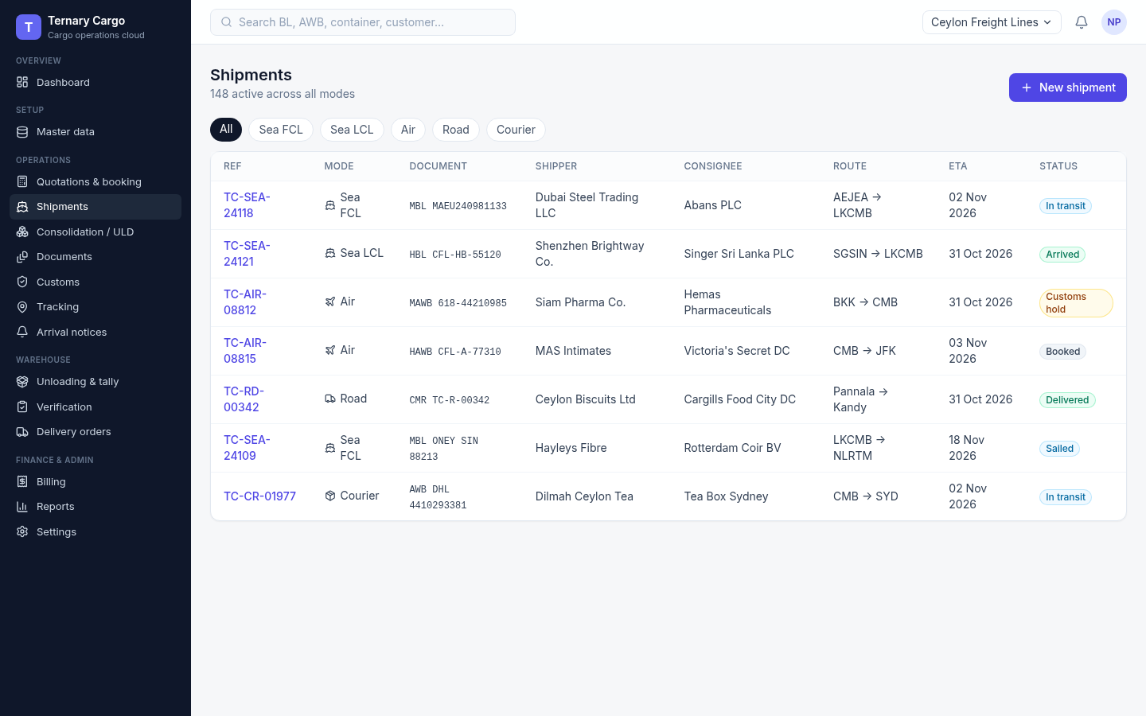
Screen 12 · Quote, booking and shipment
Every mode sits in one shipments list
What it shows
Sea FCL and LCL, air, road and courier side by side.
Bill of lading (BL) and air waybill (AWB) numbers with status.
Ternary Systems · Research. Invent. Deliver.
21
Notes:
Screenshot: /workspace/cargo/screens/12-shipments-list.png. Facts from /workspace/cargo/screens/index.md.

Slide 22
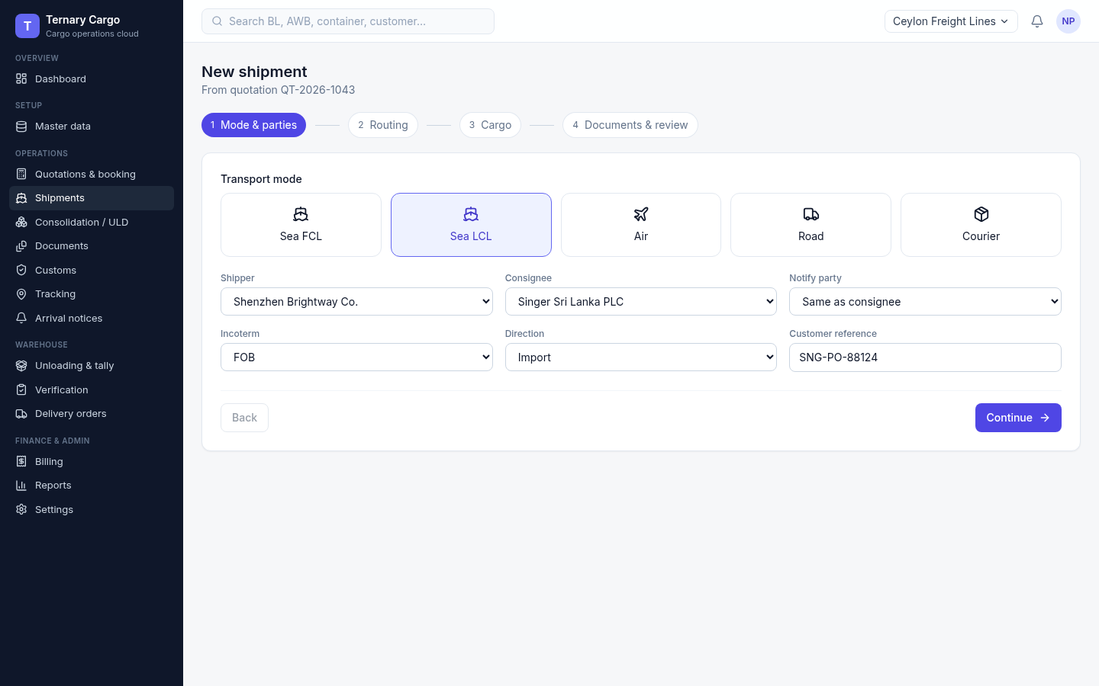
Screen 13 · Quote, booking and shipment
Wizard step 1: choose the mode and the parties
What it shows
Pick the transport mode and the parties.
The same flow serves every mode.
Ternary Systems · Research. Invent. Deliver.
22
Notes:
Screenshot: /workspace/cargo/screens/13-wizard-1-mode.png. Facts from /workspace/cargo/screens/index.md.

Slide 23
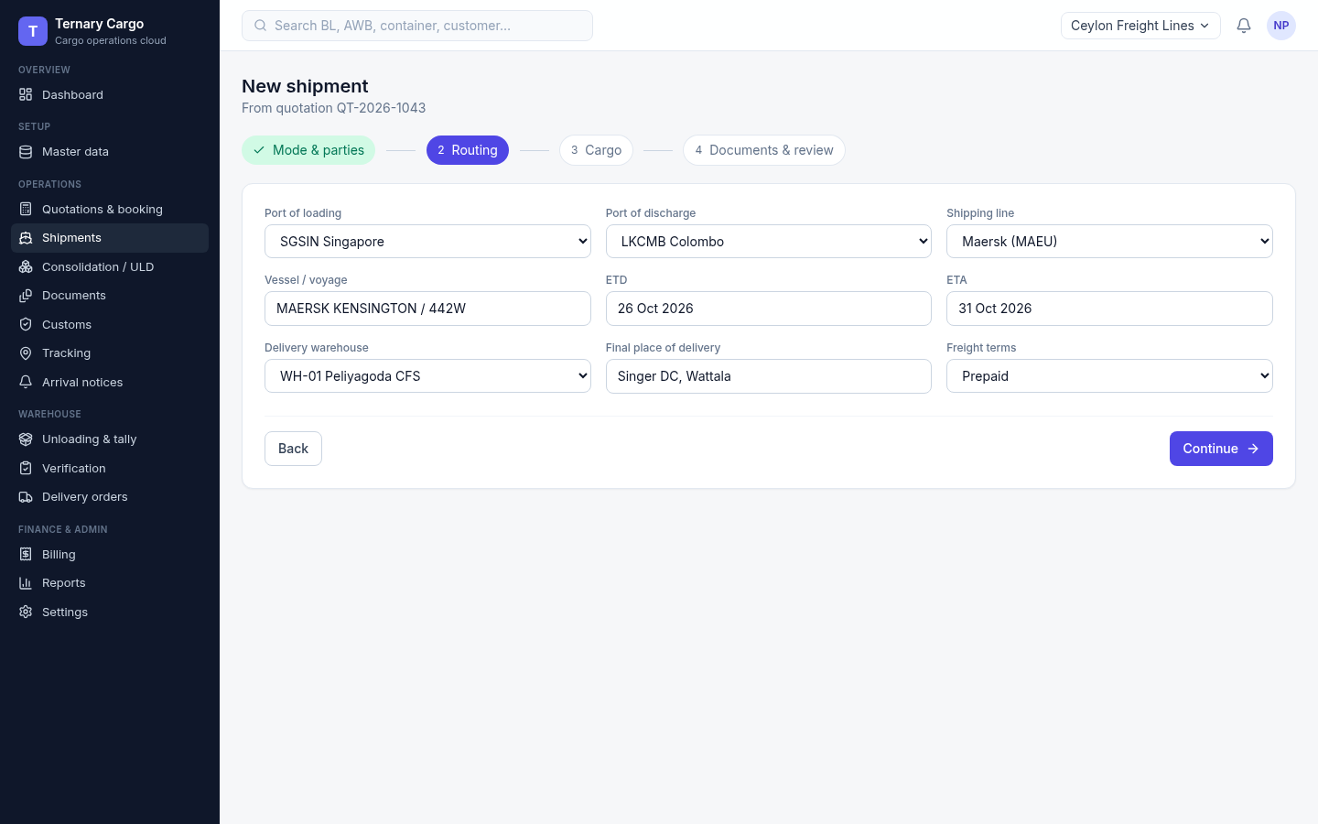
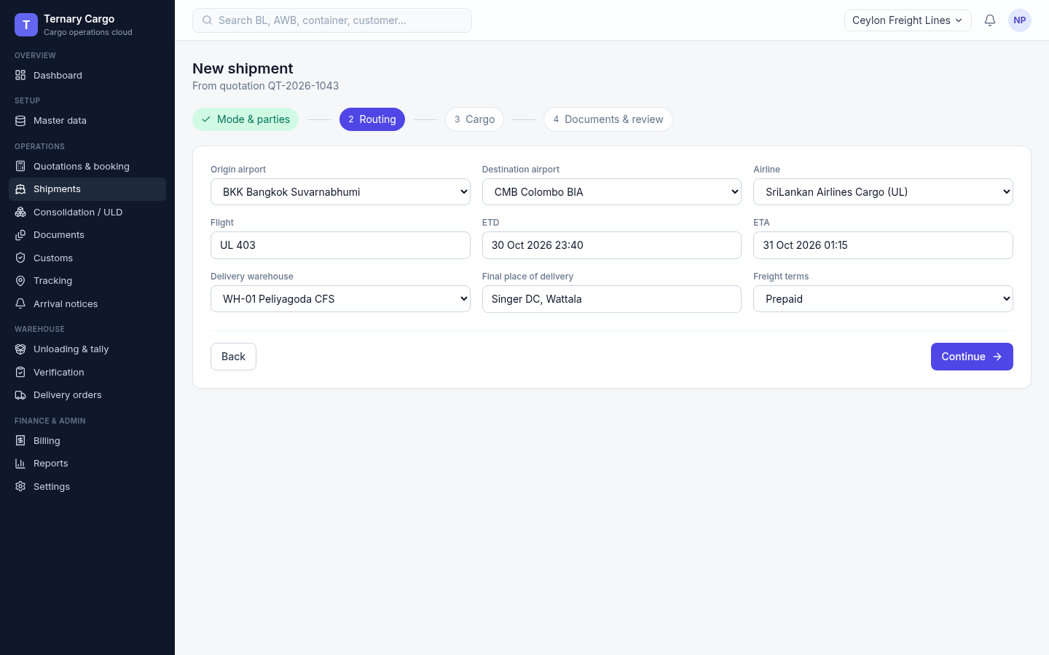
Screens 14 + 15 · Quote, booking and shipment
Wizard step 2: routing adapts to sea or air
Sea routing (screen 14)
Air routing (screen 15)
Sea: ports, shipping line, vessel and voyage, ETD/ETA, delivery warehouse.
Air: the same step switches to airports, airline and flight.
Ternary Systems · Research. Invent. Deliver.
23
Notes:
Screenshot: /workspace/cargo/screens/14-wizard-2-routing-sea.png, /workspace/cargo/screens/15-wizard-2-routing-air.png. Facts from /workspace/cargo/screens/index.md.

Slide 24
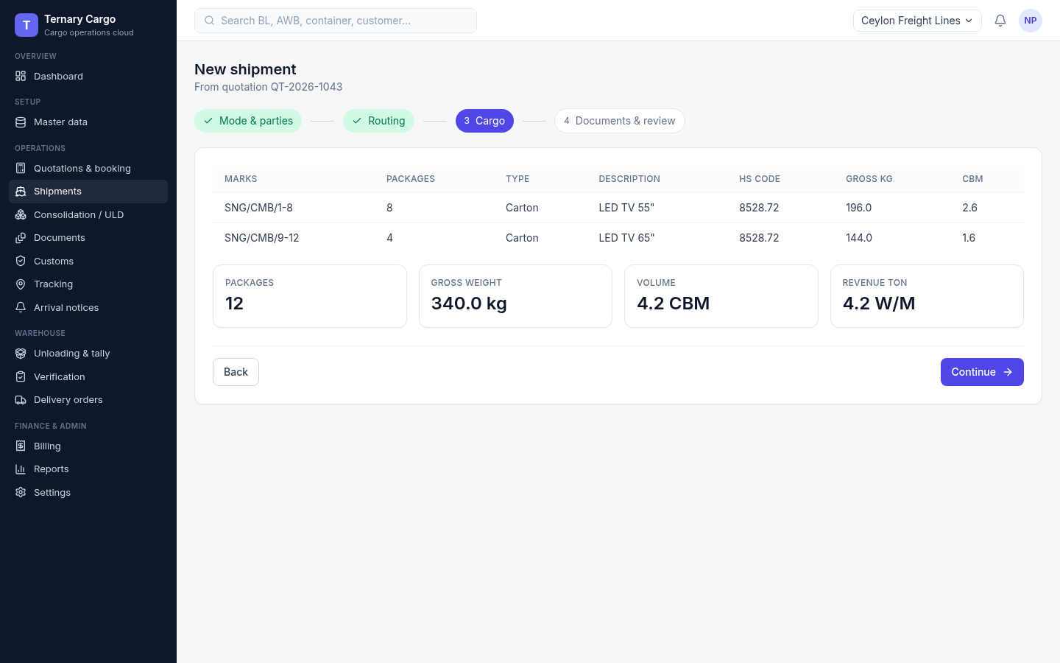
Screen 16 · Quote, booking and shipment
Wizard step 3: cargo lines total themselves
What it shows
Packages, HS codes, weight and cubic metres (CBM) per line.
Totals are calculated automatically.
Ternary Systems · Research. Invent. Deliver.
24
Notes:
Screenshot: /workspace/cargo/screens/16-wizard-3-cargo.png. Facts from /workspace/cargo/screens/index.md.

Slide 25
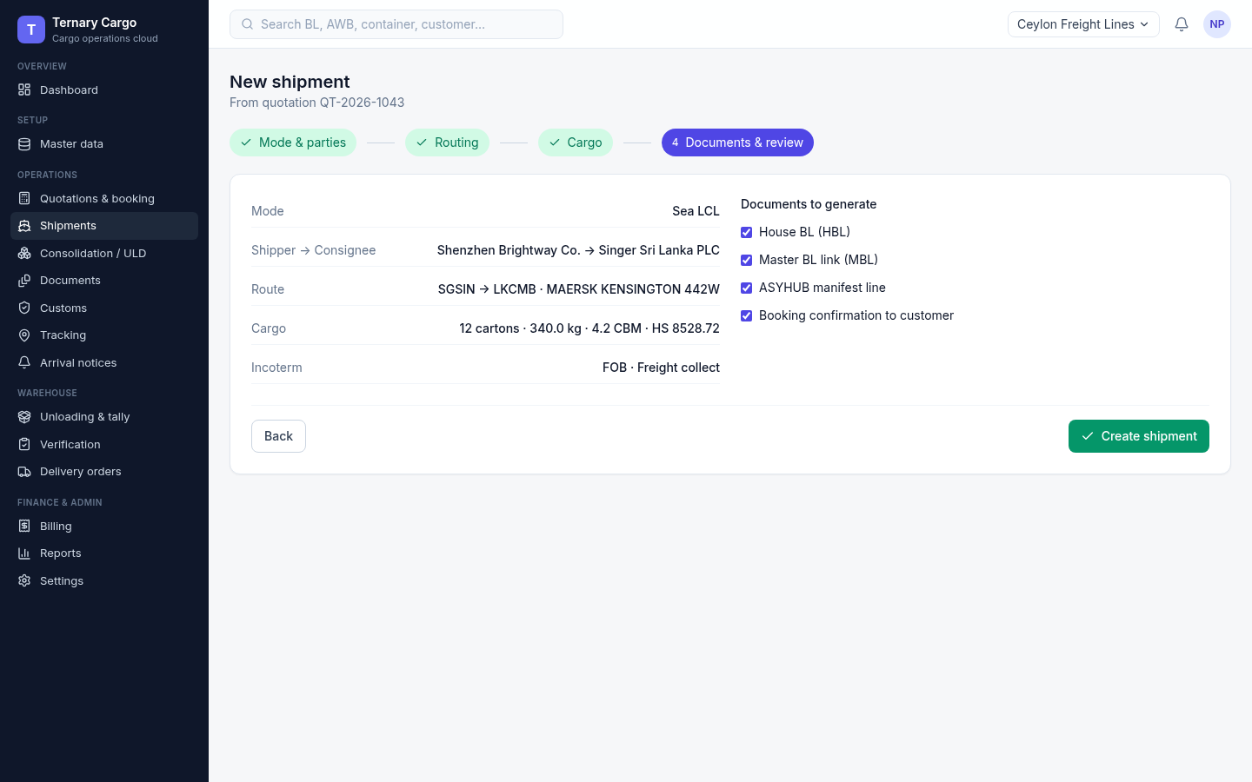
Screen 17 · Quote, booking and shipment
Wizard step 4: review, then pick the documents
What it shows
Review the whole shipment before saving.
Choose house and master BLs (HBL/MBL), the ASYHUB manifest line and the confirmation.
Ternary Systems · Research. Invent. Deliver.
25
Notes:
Screenshot: /workspace/cargo/screens/17-wizard-4-review.png. Facts from /workspace/cargo/screens/index.md.

Slide 26
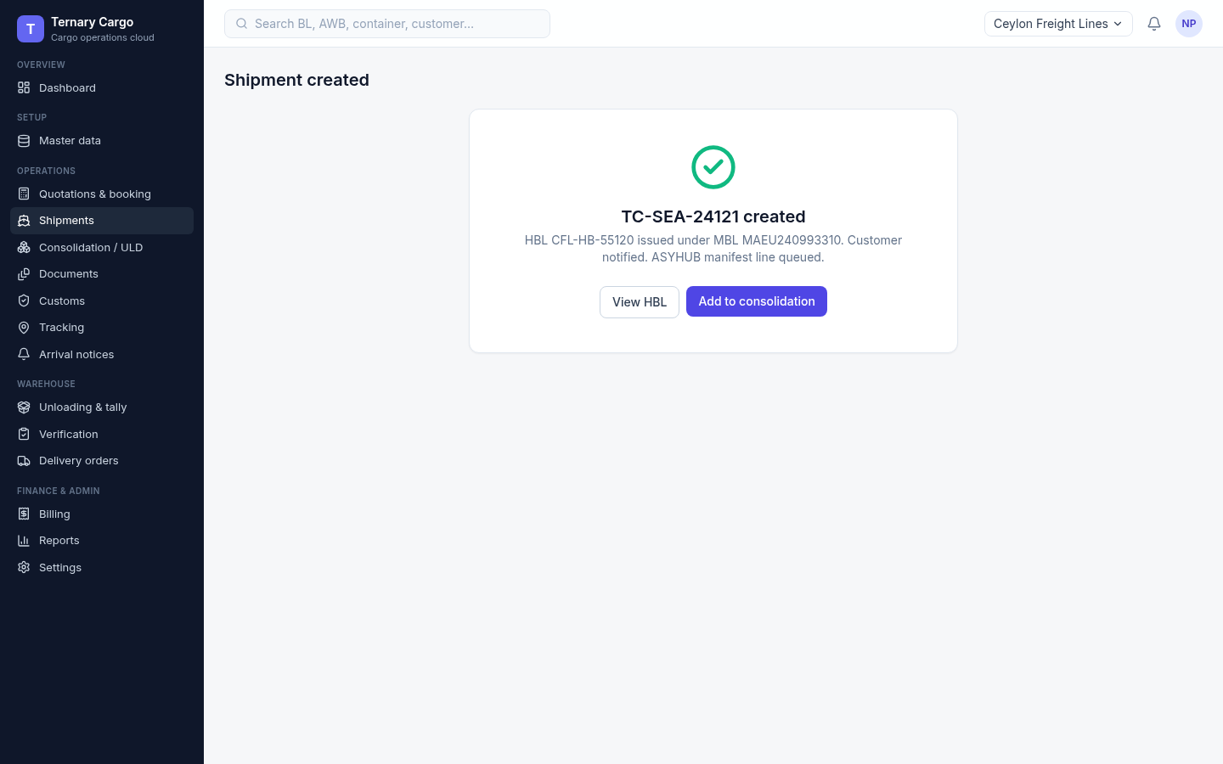
Screen 18 · Quote, booking and shipment
The shipment is created, with next actions
What it shows
Confirmation shows the HBL and MBL numbers.
Next actions lead straight on to the following step.
Ternary Systems · Research. Invent. Deliver.
26
Notes:
Screenshot: /workspace/cargo/screens/18-shipment-created.png. Facts from /workspace/cargo/screens/index.md.

Slide 27
03
Consolidation, documents and customs
Screens 19–25
Ternary Systems · Research. Invent. Deliver.
27
Notes:
Section divider: Consolidation, documents and customs (Screens 19–25).

Slide 28
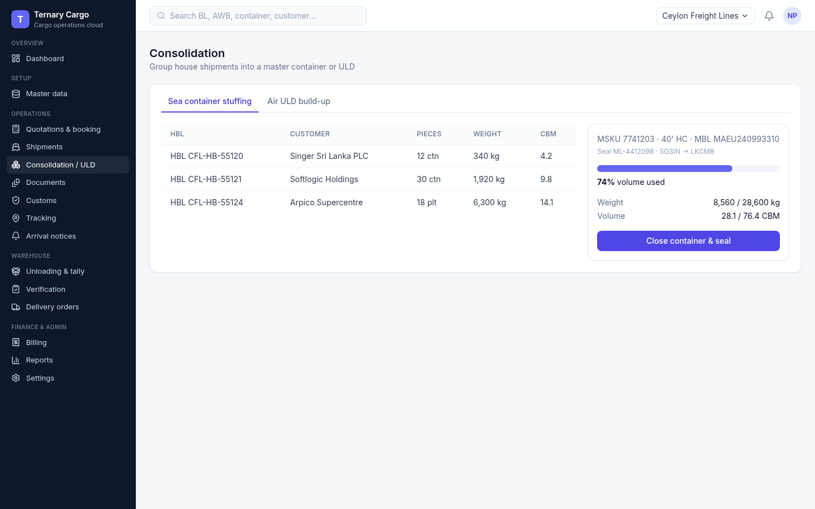
Screen 19 · Consolidation, documents and customs
House BLs are stuffed into one container
What it shows
House BLs consolidated into a 40’ high-cube (HC) container.
Fill percentage, weight and seal number on screen.
Ternary Systems · Research. Invent. Deliver.
28
Notes:
Screenshot: /workspace/cargo/screens/19-consolidation-sea.png. Facts from /workspace/cargo/screens/index.md.

Slide 29
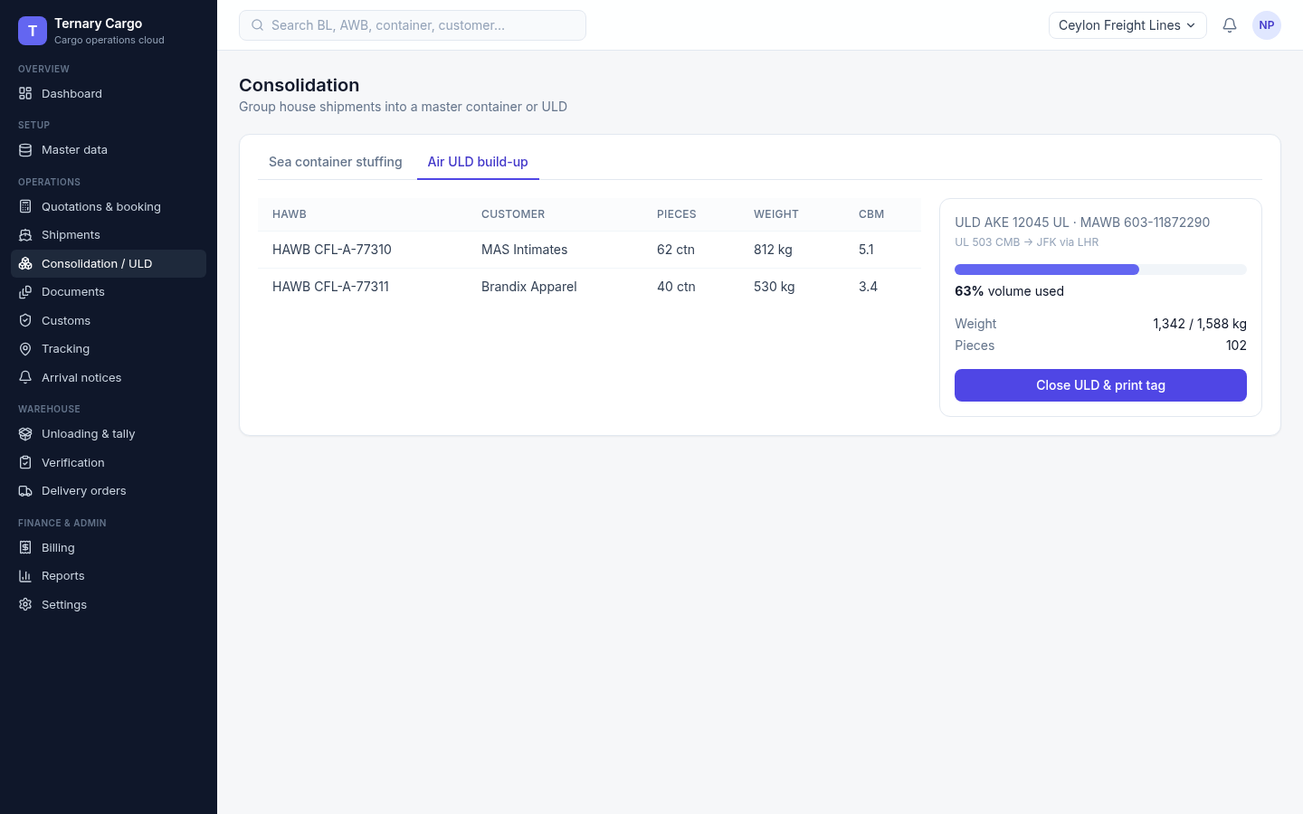
Screen 20 · Consolidation, documents and customs
Air shipments build up on a ULD
What it shows
House air waybills (HAWBs) built onto an AKE ULD.
All grouped under one master air waybill (MAWB).
Ternary Systems · Research. Invent. Deliver.
29
Notes:
Screenshot: /workspace/cargo/screens/20-consolidation-air-uld.png. Facts from /workspace/cargo/screens/index.md.

Slide 30
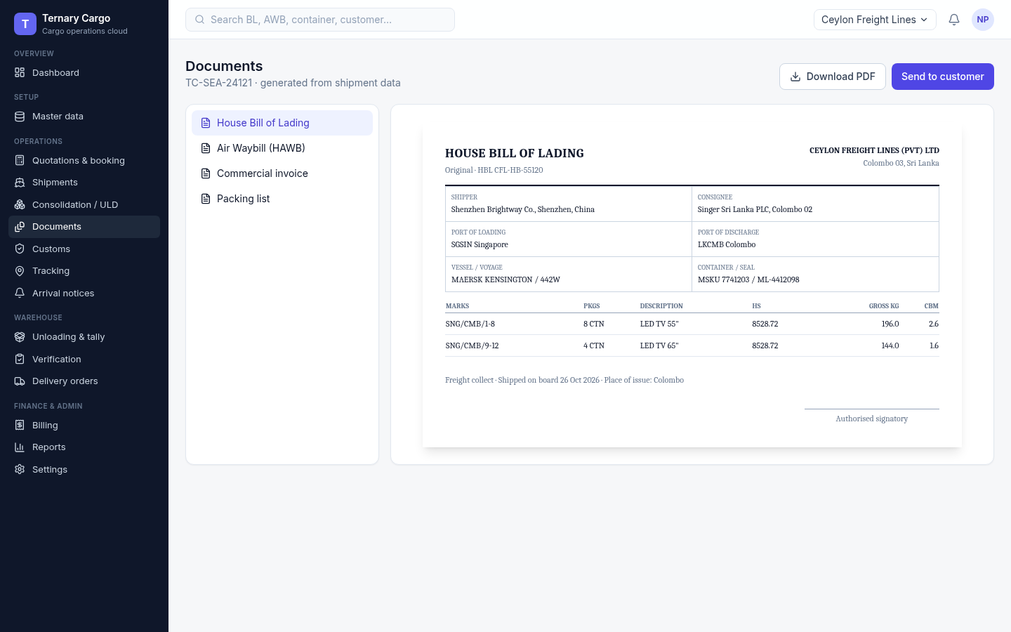

Screens 21 + 22 · Consolidation, documents and customs
Transport documents come from shipment data
House BL (screen 21)
House air waybill (screen 22)
House BL generated from shipment data, ready to download or send.
HAWB preview for the air flow.
Ternary Systems · Research. Invent. Deliver.
30
Notes:
Screenshot: /workspace/cargo/screens/21-doc-hbl.png, /workspace/cargo/screens/22-doc-awb.png. Facts from /workspace/cargo/screens/index.md.

Slide 31


Screens 23 + 24 · Consolidation, documents and customs
Invoice and packing list complete the set
Commercial invoice (screen 23)
Packing list (screen 24)
Commercial invoice with values per line.
Packing list, used later at the unloading tally.
Ternary Systems · Research. Invent. Deliver.
31
Notes:
Screenshot: /workspace/cargo/screens/23-doc-invoice.png, /workspace/cargo/screens/24-doc-packing.png. Facts from /workspace/cargo/screens/index.md.

Slide 32
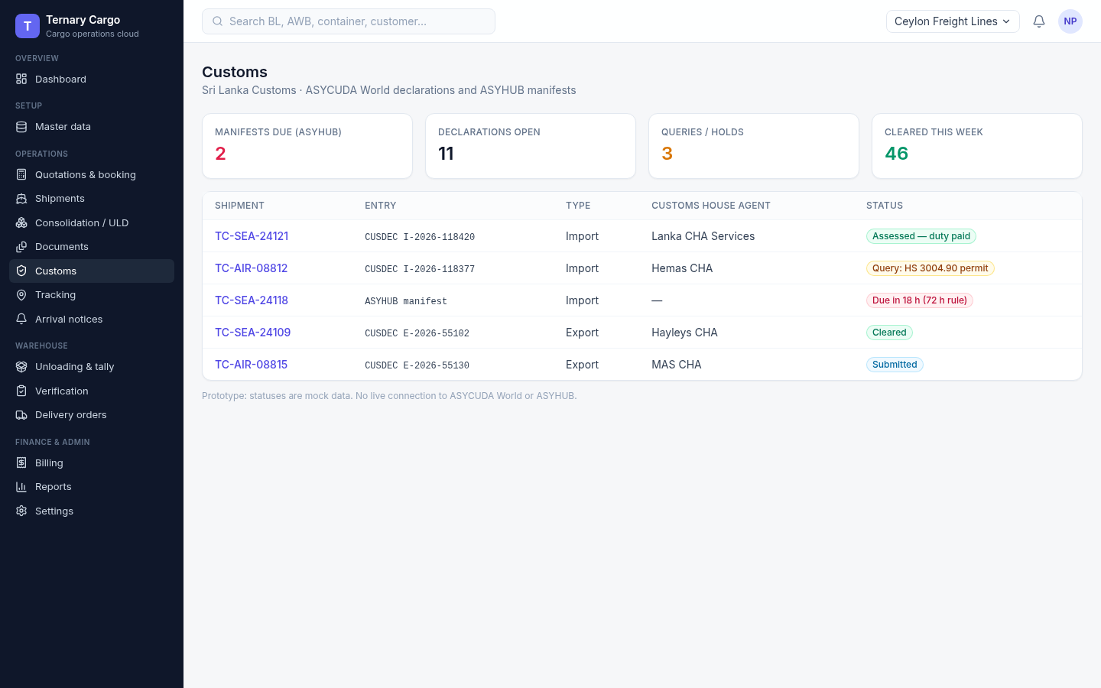
Screen 25 · Consolidation, documents and customs
Customs status and the 72-hour manifest clock
What it shows
Customs declaration (CUSDEC) status per entry.
ASYHUB manifest due date, using the 72 h sea rule.
Since 7 May 2025, manifests go only via ASYHUB (Sri Lanka Customs).
Ternary Systems · Research. Invent. Deliver.
32
Notes:
Screenshot: /workspace/cargo/screens/25-customs.png. Facts from /workspace/cargo/screens/index.md. ASYHUB-only rule: https://www.customs.gov.lk/mandatory-submission-of-manifests-via-asyhub-system-effective-from-07th-may-2025/

Slide 33
04
Tracking, arrival, unloading and verification
Screens 26–31
Ternary Systems · Research. Invent. Deliver.
33
Notes:
Section divider: Tracking, arrival, unloading and verification (Screens 26–31).

Slide 34
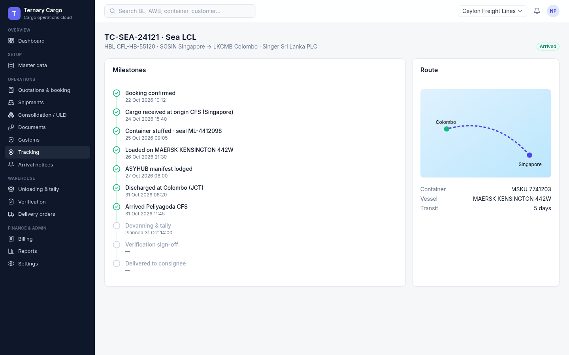
Screen 26 · Tracking, arrival, unloading and verification
Tracking runs from booking to delivery
What it shows
Milestone timeline from booking to delivery.
Route and container shown alongside.
Ternary Systems · Research. Invent. Deliver.
34
Notes:
Screenshot: /workspace/cargo/screens/26-tracking.png. Facts from /workspace/cargo/screens/index.md.

Slide 35
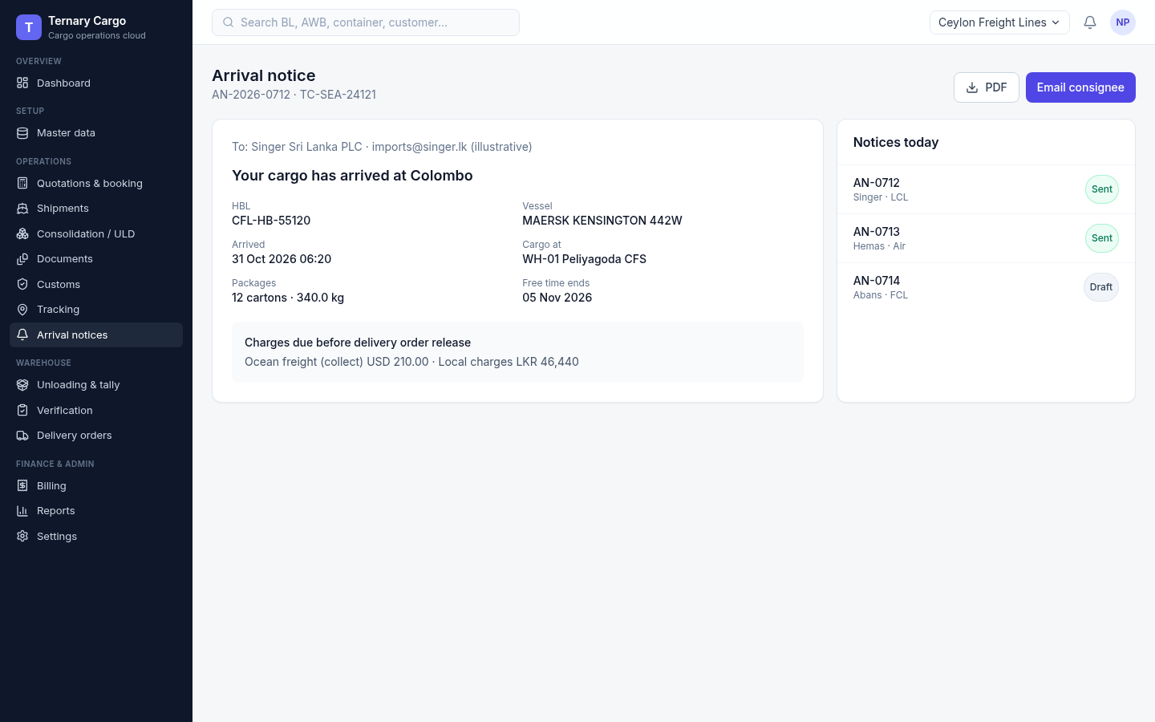
Screen 27 · Tracking, arrival, unloading and verification
The arrival notice tells the consignee what is due
What it shows
Notice sent to the consignee.
Shows free time and the charges due.
Ternary Systems · Research. Invent. Deliver.
35
Notes:
Screenshot: /workspace/cargo/screens/27-arrival-notice.png. Facts from /workspace/cargo/screens/index.md.

Slide 36
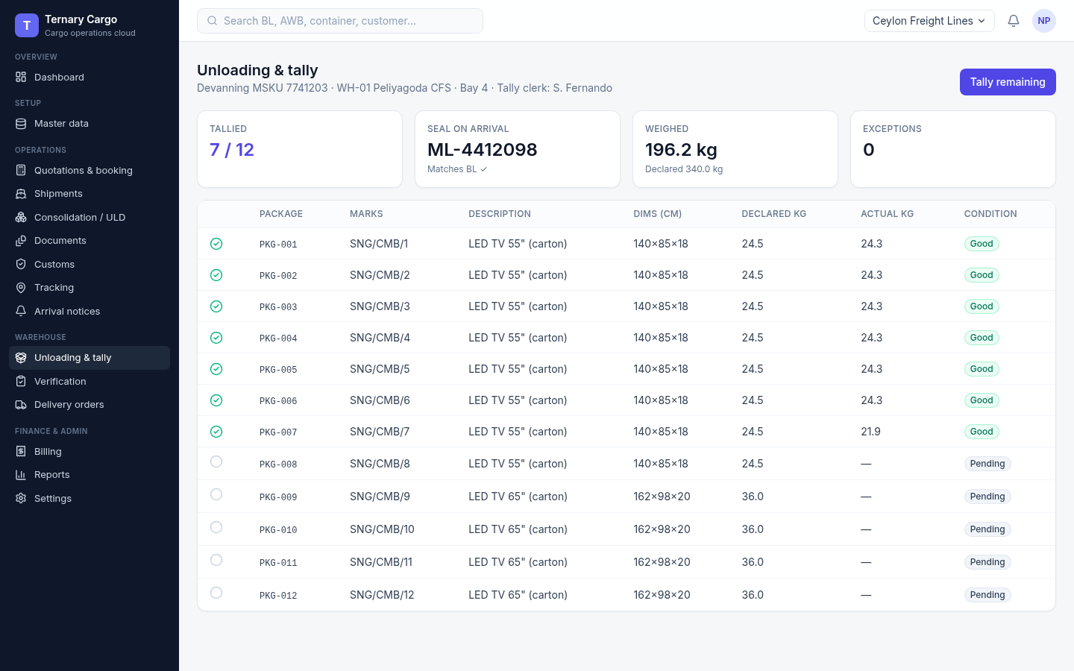
Screen 28 · Tracking, arrival, unloading and verification
Unloading is tallied package by package
What it shows
Devanning tally per package: seal, actual weight and condition.
Progress on screen: 7 of 12 packages done.
Checked against the packing list from the documents step.
Ternary Systems · Research. Invent. Deliver.
36
Notes:
Screenshot: /workspace/cargo/screens/28-unloading-in-progress.png. Facts from /workspace/cargo/screens/index.md.

Slide 37
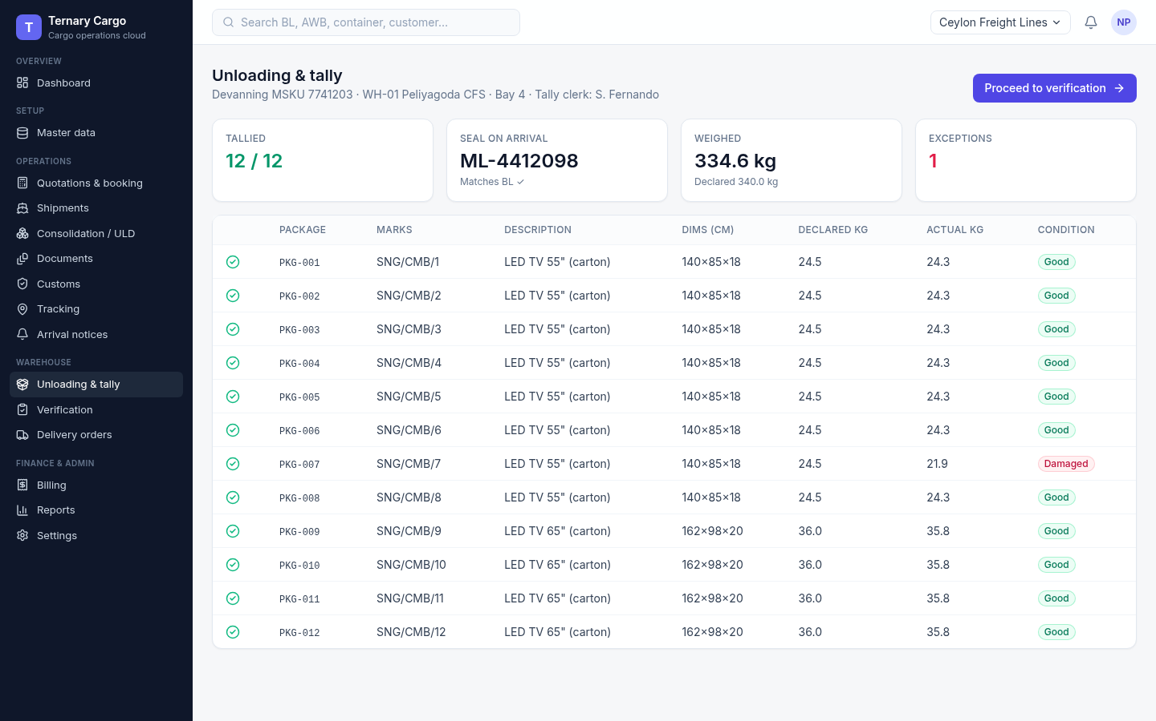
Screen 29 · Tracking, arrival, unloading and verification
Unloading complete, with one package flagged
What it shows
All 12 packages tallied.
One package flagged as damaged, which carries into verification.
Ternary Systems · Research. Invent. Deliver.
37
Notes:
Screenshot: /workspace/cargo/screens/29-unloading-complete.png. Facts from /workspace/cargo/screens/index.md.

Slide 38
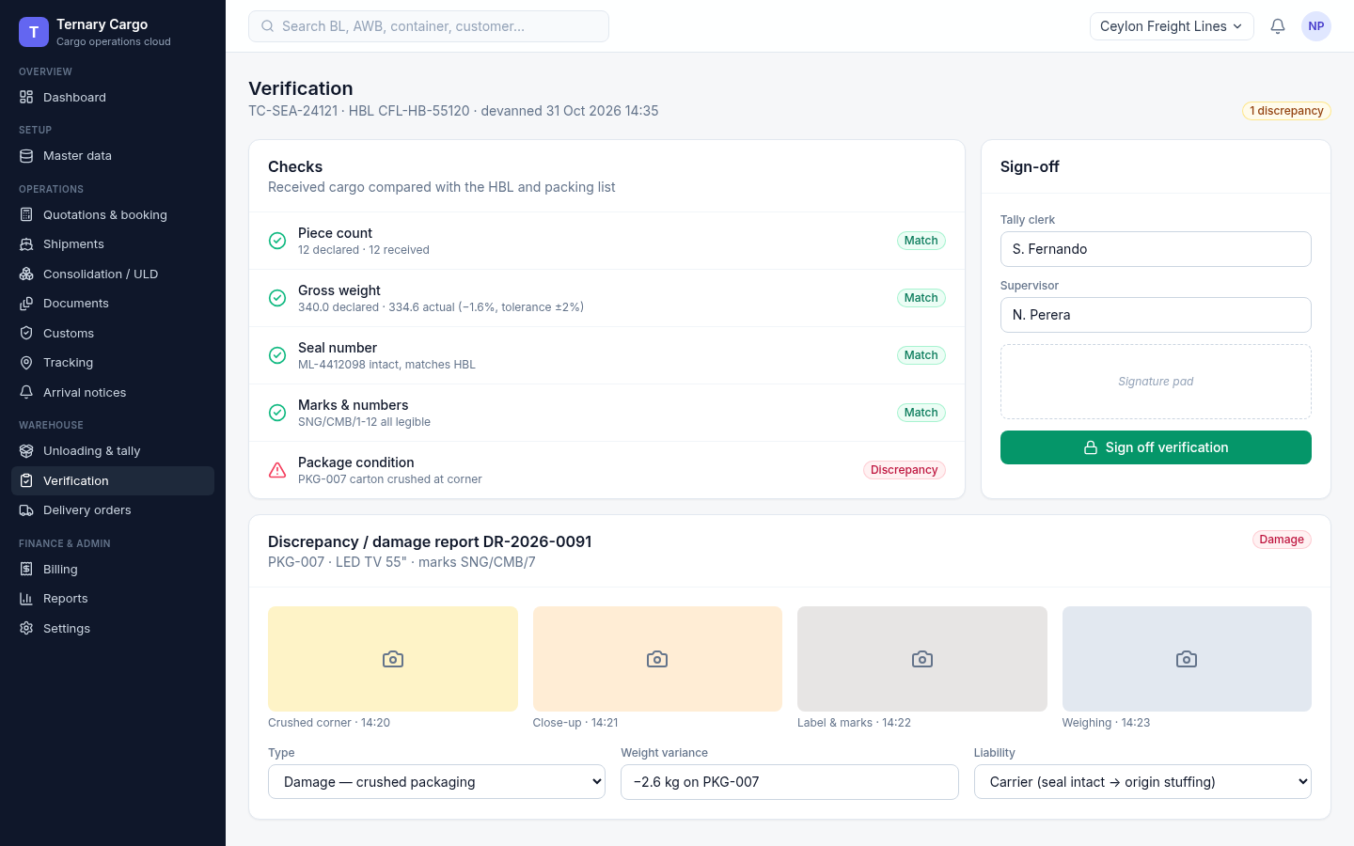
Screen 30 · Tracking, arrival, unloading and verification
Verification catches the discrepancy
What it shows
Checks on pieces, weight, seal and marks.
Damage report with photos for PKG-007.
The photos are placeholders.
Ternary Systems · Research. Invent. Deliver.
38
Notes:
Screenshot: /workspace/cargo/screens/30-verification-discrepancy.png. Facts from /workspace/cargo/screens/index.md.

Slide 39
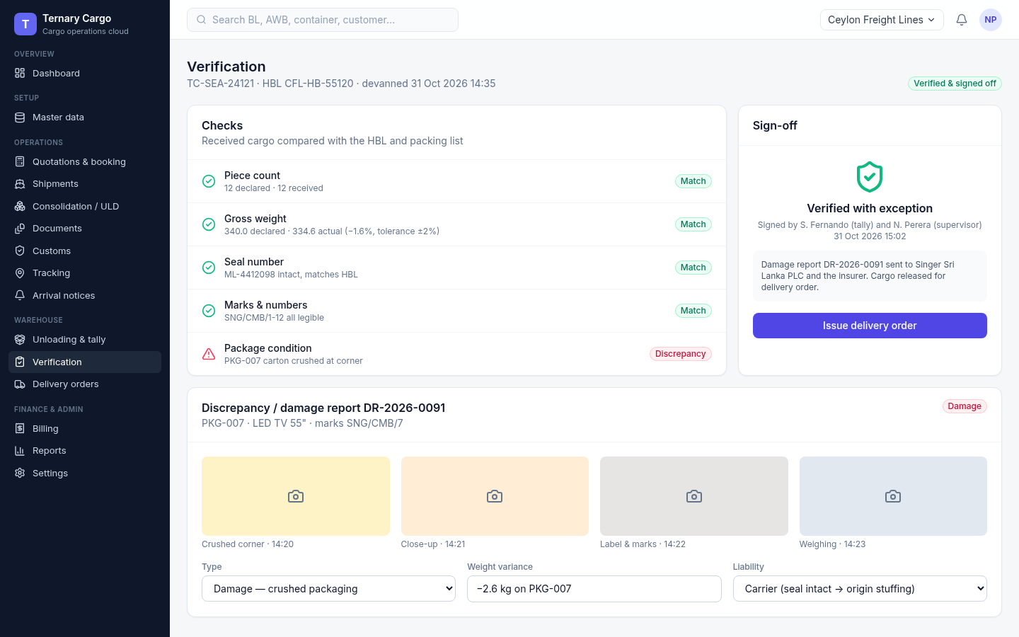
Screen 31 · Tracking, arrival, unloading and verification
A two-person sign-off releases the cargo
What it shows
Two-person sign-off on the verification.
Damage report sent.
Cargo released for the delivery order (DO).
Ternary Systems · Research. Invent. Deliver.
39
Notes:
Screenshot: /workspace/cargo/screens/31-verification-verified.png. Facts from /workspace/cargo/screens/index.md.

Slide 40
05
Release, billing, reports and settings
Screens 32–37
Ternary Systems · Research. Invent. Deliver.
40
Notes:
Section divider: Release, billing, reports and settings (Screens 32–37).

Slide 41
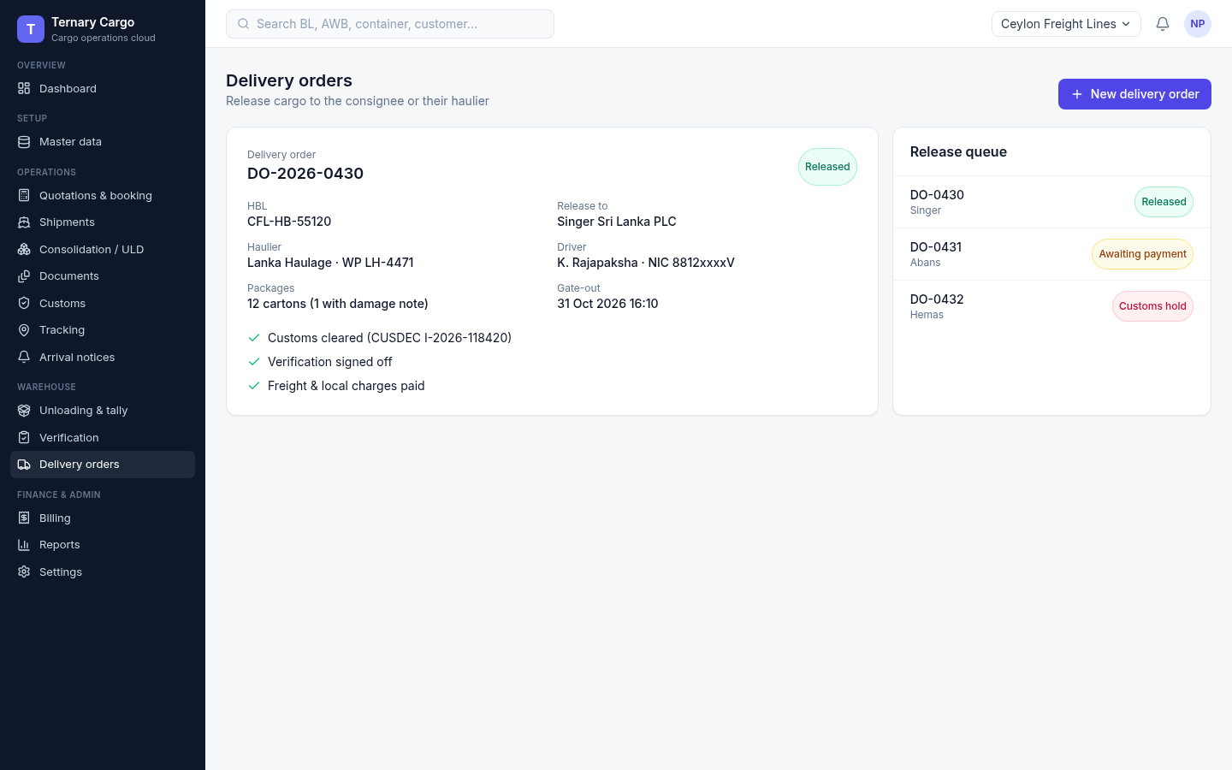
Screen 32 · Release, billing, reports and settings
The delivery order waits for three checks
What it shows
DO with haulier and driver details.
Release is gated on customs, verification and payment.
Ternary Systems · Research. Invent. Deliver.
41
Notes:
Screenshot: /workspace/cargo/screens/32-delivery-order.png. Facts from /workspace/cargo/screens/index.md.

Slide 42
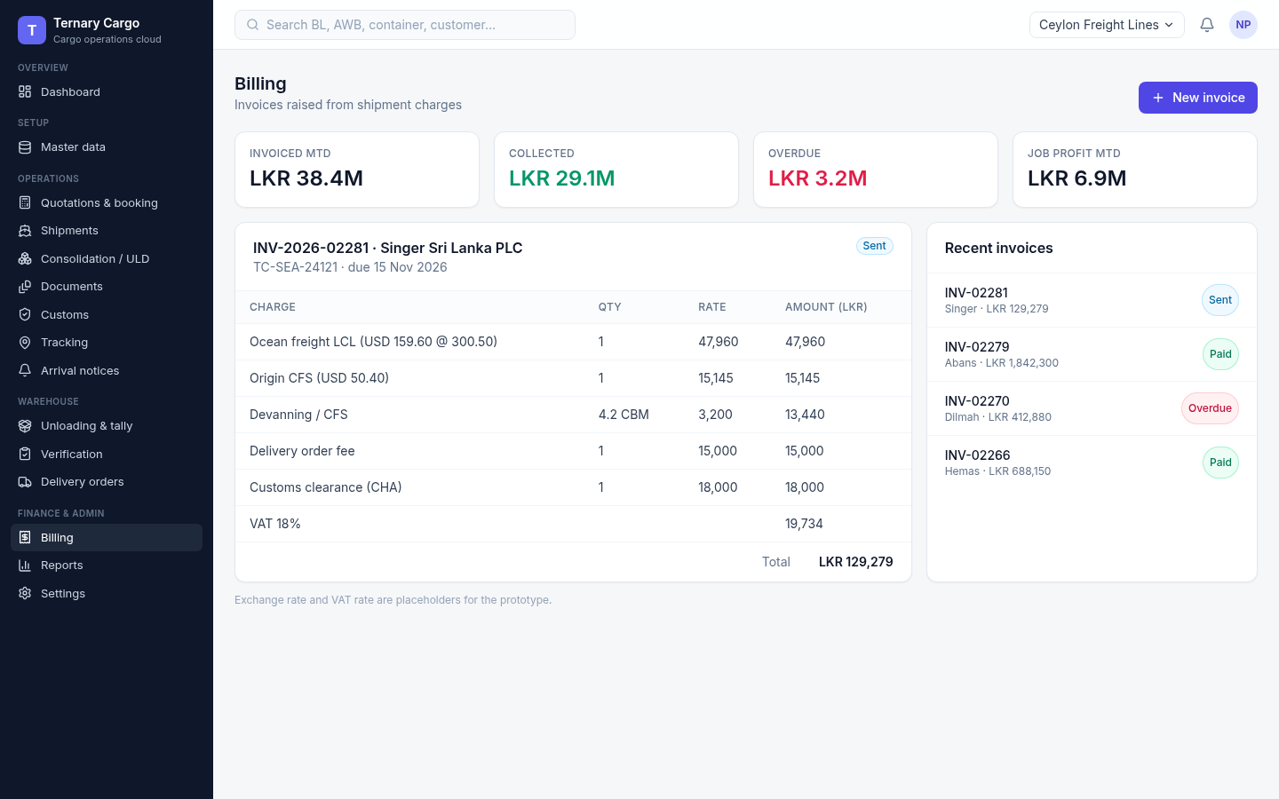
Screen 33 · Release, billing, reports and settings
The invoice is built from shipment charges
What it shows
Invoice lines come from the shipment’s charges.
VAT and USD to LKR conversion applied.
The FX rate and VAT are placeholders.
Ternary Systems · Research. Invent. Deliver.
42
Notes:
Screenshot: /workspace/cargo/screens/33-billing.png. Facts from /workspace/cargo/screens/index.md.

Slide 43
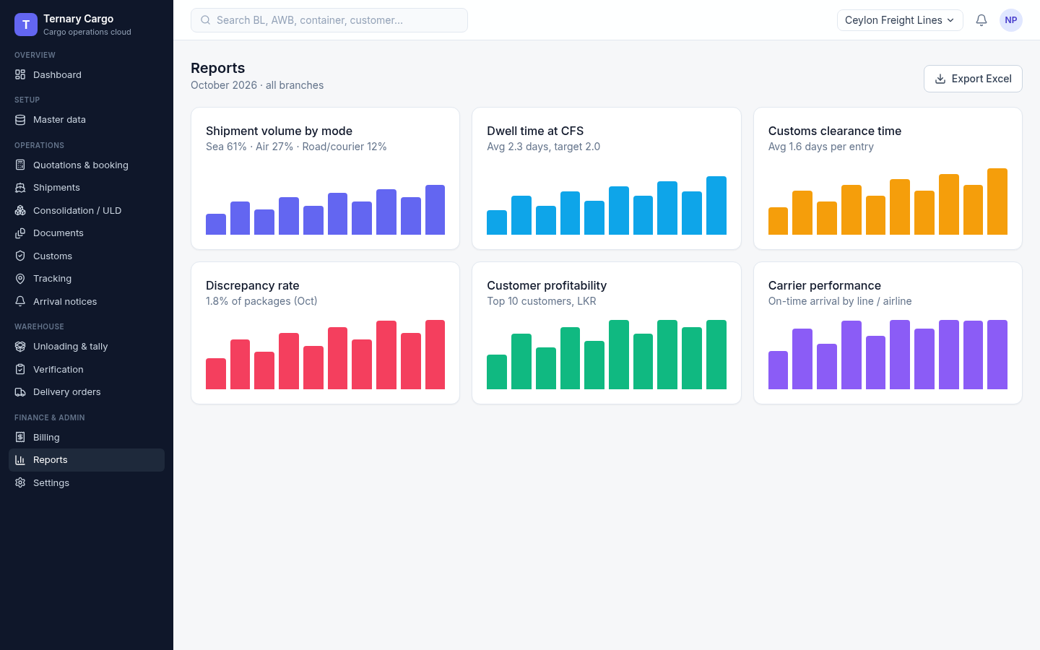
Screen 34 · Release, billing, reports and settings
Reports run from volume to profitability
What it shows
Volume, dwell and clearance time.
Discrepancy rate, profitability and carriers.
Ternary Systems · Research. Invent. Deliver.
43
Notes:
Screenshot: /workspace/cargo/screens/34-reports.png. Facts from /workspace/cargo/screens/index.md.

Slide 44
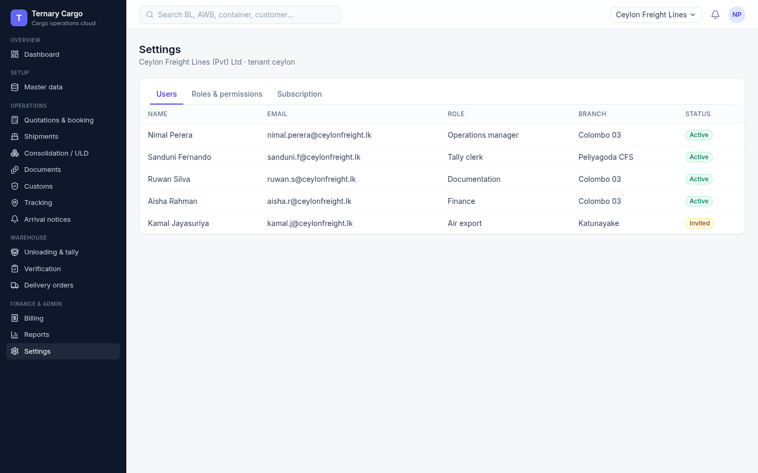
Screen 35 · Release, billing, reports and settings
Users are managed by role and branch
What it shows
Tenant users listed with their role and branch.
Roles link to the permission matrix on the next screen.
Ternary Systems · Research. Invent. Deliver.
44
Notes:
Screenshot: /workspace/cargo/screens/35-settings-users.png. Facts from /workspace/cargo/screens/index.md.

Slide 45
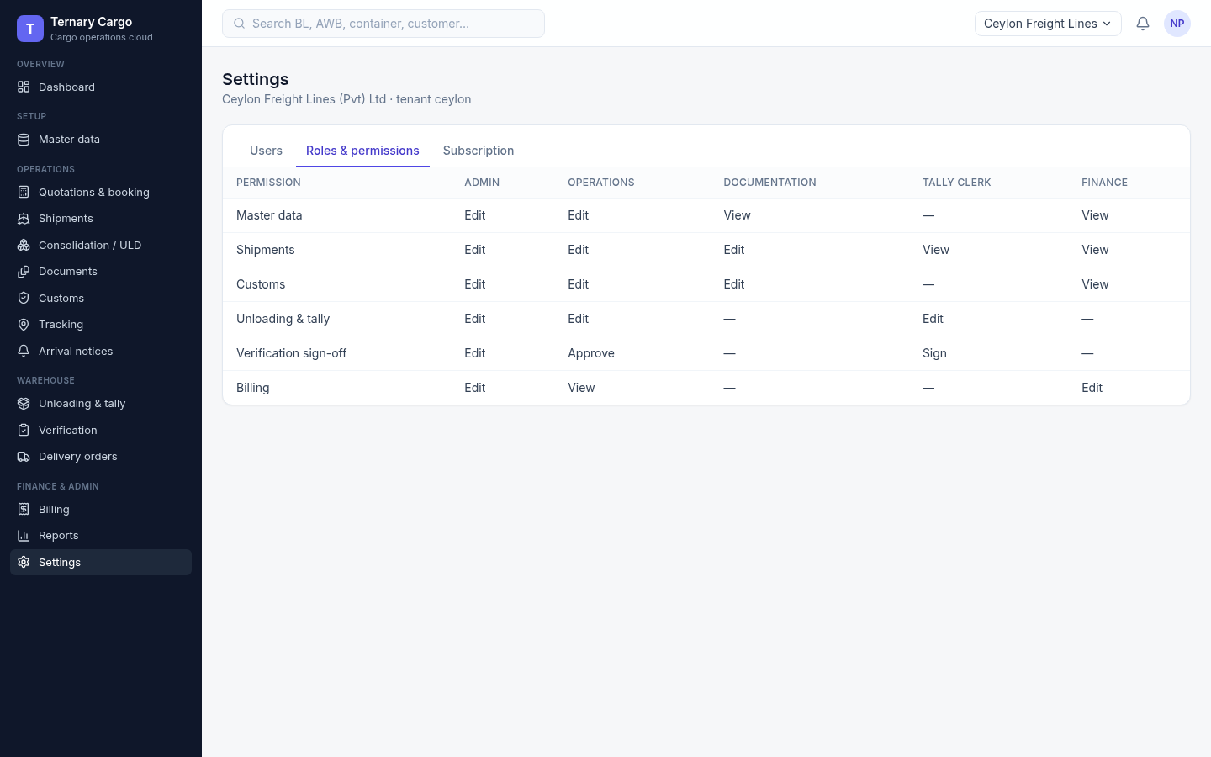
Screen 36 · Release, billing, reports and settings
The role matrix decides who may sign off
What it shows
Roles and permissions in one matrix.
Includes who may sign off verification.
Ternary Systems · Research. Invent. Deliver.
45
Notes:
Screenshot: /workspace/cargo/screens/36-settings-roles.png. Facts from /workspace/cargo/screens/index.md.

Slide 46
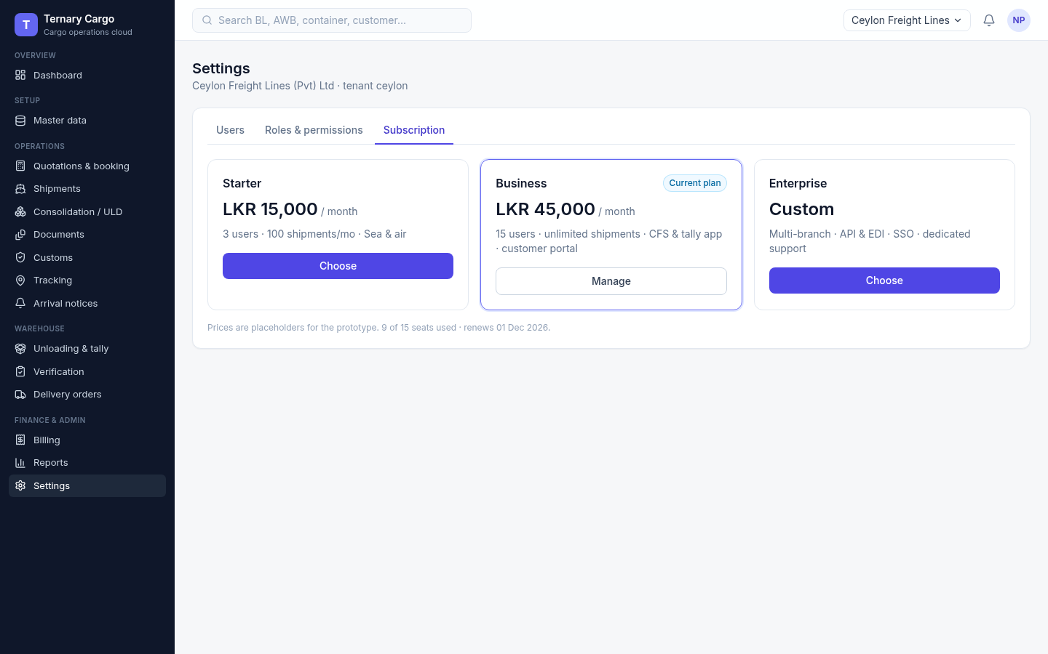
Screen 37 · Release, billing, reports and settings
Subscription plans and seat usage
What it shows
SaaS plans with seat usage for the tenant.
Prices shown are placeholders.
Ternary Systems · Research. Invent. Deliver.
46
Notes:
Screenshot: /workspace/cargo/screens/37-settings-plan.png. Facts from /workspace/cargo/screens/index.md.

Slide 47
Placeholders and caveats
What in the prototype is not real yet
Placeholders
Not verified
Not built
Prices (charges and subscription plans)
The USD to LKR FX rate
VAT
Damage photos
The tracking map
HS codes: example 6-digit headings only
Duty rates
Both must be checked against the Sri Lanka Customs tariff before the real build
A per-shipment detail page
There is no screen for it in this walkthrough
Ternary Systems · Research. Invent. Deliver.
47
Notes:
Sources: Roshan’s brief for this deck; /workspace/cargo/screens/index.md (screens 10, 30, 33, 37 mark placeholders); /workspace/cargo/research.md section 3 (HS codes and duty rates not verified).

Slide 48
Next steps
Your approval unlocks the full implementation plan
1
2
3
Review
Approve
Plan
You check each slide and screen of this walkthrough.
You approve the UI prototype, or list the changes you want first.
We prepare the full implementation plan for Ternary Cargo.
roshanchamika842@gmail.com · 0763963701 · ternary.roshangamage.com
Ternary Systems · Research. Invent. Deliver.
48
Notes:
Source: Roshan’s brief: after confirmation, move on to complete implementation. Contact details from the Ternary Brand Guide v1.0.

