Slide 1


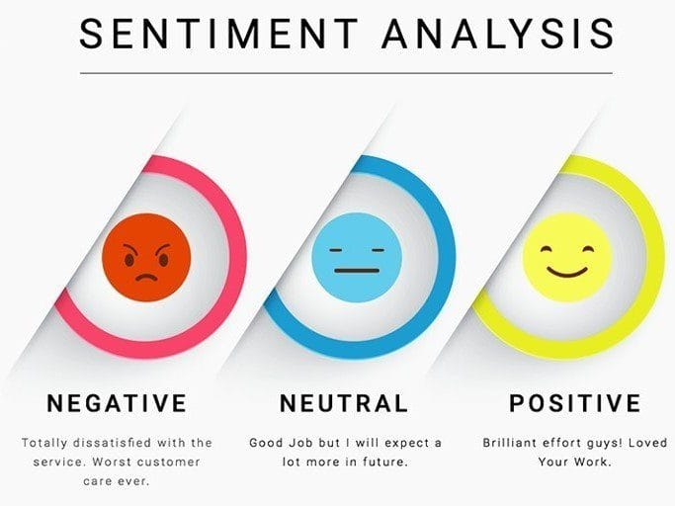
Bharati Vidyapeeth College, Navi Mumbai
Presented By:
Roshan Ghadge
Seat No. 2322305507 PRN No. 2228100226
Aspect Based Sentimental Analysis
Guided By:
Prof.
S.Y. MCA (Masters in Computer Application) SEMESTER-IV
ACADEMIC YEAR 2024-2025

Slide 2
Objectives of Project
The objective of the project "Aspect-Based Sentiment Analysis" is to develop a system capable of analyzing text data and extracting sentiment polarity (positive, negative, or neutral) associated with specific aspects or features mentioned within the text.
This technology enables businesses to gain deeper insights into customer opinions, preferences, and feedback by understanding sentiments expressed towards different aspects of their products or services​

Slide 3
Scope of Research Methodology
Aspect Extraction: Developing algorithms and techniques for accurately identifying and extracting specific aspects or entities mentioned in text data using NLP techniques like Named Entity Recognition (NER), Part-of-Speech (POS) tagging, and dependency parsing.
Sentiment Analysis: Determining the polarity (positive, negative, or neutral) of sentiments expressed towards each extracted aspect using machine learning and deep learning approaches.
Domain Adaptability: Ensuring the ABSA framework can be adapted to different domains and industries, allowing for the analysis of sentiments related to diverse products, services, or topics.
Evaluation and Validation: Rigorous evaluation and validation of the ABSA framework to assess its accuracy, reliability, and performance.
Practical Applications: Demonstrating the utility and effectiveness of the ABSA framework in real-world scenarios such as customer feedback analysis, product review summarization, social media monitoring, brand reputation management, and market research​

Slide 4
Finding of Projects
Aspect Based Sentimental Analysis :- The findings of the Aspect-Based Sentiment Analysis (ABSA) project offer significant insights into customer sentiments concerning specific aspects or features of products, services, or experiences.
Identification of Key Aspects: The ABSA analysis identified frequently mentioned aspects in customer feedback. For example, in smartphone reviews, battery life, camera quality, performance, and design were the most discussed topics.
Sentiment Distribution: Sentiment analysis revealed the sentiment distribution associated with each aspect. For instance, battery life received predominantly positive sentiments, while camera quality and performance showed a mix of positive and negative sentiments, indicating potential areas for improvement.
Aspect-Specific Insights: The analysis provided specific insights into customer perceptions and preferences. For example, customers praised battery life for its longevity but were dissatisfied with the camera's low-light performance.
Identification of Influencing Factors: The ABSA analysis identified factors influencing customer sentiments towards specific aspects. For instance, in hotel reviews, aspects such as cleanliness and customer service were strongly correlated with overall satisfaction.

Slide 5
Conclusion
In conclusion, Aspect-Based Sentiment Analysis (ABSA) projects provide critical insights into customer sentiments regarding specific aspects of products, services, or experiences.
These insights are invaluable for businesses aiming to understand detailed customer feedback and drive targeted improvements. Despite facing several limitations, such as challenges in aspect identification, data sparsity, and contextual understanding, ABSA projects remain a vital tool in the business analytics arsenal.
Addressing these limitations systematically is crucial throughout the ABSA project lifecycle.
Employing advanced techniques for aspect extraction, sentiment classification, and contextual understanding can significantly enhance the accuracy and reliability of ABSA models.
Additionally, overcoming data sparsity and imbalance through data augmentation and balancing techniques improves model robustness, ensuring more reliable outcomes.

Slide 6
Thank You

