Slide 1

MALNAD COLLEGE OF ENGINEERING, HASSAN
(An Autonomous Institution Affiliated to VTU, Belagavi | Accredited by NAAC & NBA)
DEPARTMENT OF COMPUTER SCIENCE AND ENGINEERING | Phase II — 23CS703
StudyBuddy: AI-Powered RAG Learning Ecosystem
Intelligent Multi-Modal Academic Assistant with Dynamic Document Ingestion & Contextual Chat
Presented by :
• Aakash Dilip Jadhav [4MC23CS001]
• Chandan H K [4MC23CS028]
• Dhanush CT [4MC23CS038]
• Jaydhev H S [4MC23CS060]
Under The Guidance of :
Dr. Chandrika J
Professor and Head of Department
Dept. of Computer Science & Engineering
Malnad College of Engineering, Hassan
Academic Year: 2025 – 2026

Slide 2
Agenda
Presentation Roadmap
Core Presentation Flow
• 1. Introduction & Academic Motivation
• 2. Literature Review & Foundation Works
• 3. Problem Statement & Project Objectives
• 4. System Design & Architectural Pipeline
• 5. Implementation: Core Engineering Modules
Demonstration & Outcomes
• 6. Live Demonstration: Workspace & Ingestion
• 7. Live Demonstration: Notes Synthesis & Chat
• 8. Performance Evaluation & Validation Benchmarks
• 9. Identification of Appropriate Tools
• 10. Conclusion, Future Scope & References
Department of CSE | Malnad College of Engineering, Hassan Slide 2 of 14

Slide 3
Introduction & Motivation
Context & Project Rationale
AI-Powered Study Ecosystem
• Converts dense, static academic PDFs into dynamic interactive study workspaces.
• Enables active recall through automated Q&A grounded in uploaded syllabi.
• Built specifically for undergraduate engineering subject coursework.
Integrated Learning Tools
• Combines RAG vector search, Cornell notes, flashcards, and calendar scheduling.
• Shared context continuity across all study components in a single tab.
• Eliminates distraction and cognitive switching between disconnected apps.
Personalized Grounded Learning
• Zero hallucination: answers strictly derived from student's verified PDFs.
• Direct excerpt citations accompany every generated answer.
• Strict per-student vector isolation preserving privacy and accuracy.
Modern Technology Foundation
• Ultra-fast Groq LPU inference delivering 750+ tokens per second.
• Sub-50ms vector similarity lookup via LangChain & FAISS.
• Production-ready FastAPI backend with Supabase PostgreSQL cloud storage.
Department of CSE | Malnad College of Engineering, Hassan Slide 3 of 14

Slide 4
Literature Review: Foundations
Foundational Models & RAG Architecture
Lewis et al. (2020) - Retrieval-Augmented Generation (NeurIPS)
• Introduced dense retrieval paired with seq2seq LLMs for knowledge-intensive NLP tasks.
• Demonstrated massive factual hallucination reduction in open-domain question answering.
• Limitation: High computational cost for training; requires dedicated vector indexing pipelines.
Vaswani et al. (2017) - Attention Is All You Need (NeurIPS)
• Foundational transformer architecture utilizing multi-head self-attention mechanisms.
• Underpins modern LLMs including Groq's LLaMA 3.3 70B used across StudyBuddy.
• Limitation: Quadratic complexity O(N^2) makes token truncation critical for long PDFs.
Johnson et al. / Douze et al. (2021-2024) - The FAISS Library (IEEE Trans. Big Data)
• Demonstrated billion-scale vector similarity search using GPU/CPU clustering.
• Forms the core nearest-neighbor similarity search engine partitioned per student in StudyBuddy.
• Limitation: Requires custom lifecycle managers for incremental real-time file uploads.
Department of CSE | Malnad College of Engineering, Hassan Slide 4 of 14

Slide 5
Literature Review: Modern Systems
State of the Art & Research Gap
OpenAI (2023) - GPT-4 Technical Report
• Benchmarked LLM reasoning on academic exams, highlighting potential for interactive tutoring.
• Limitation: Proprietary API pricing, vendor lock-in, and strict request-per-minute cost barriers.
Guo et al. (2023) - LangChain for LLM Applications
• Demonstrated composability of retrieval chains, prompt templates, and recursive text chunking.
• Limitation: Middleware execution overhead; demands custom fallback handlers in edge deployments.
Riyadh et al. (2024) - LLM-Assisted Vector Similarity Search
• Investigated hybrid dense semantic search paired with LLM context reranking.
• Limitation: Reranking full context windows introduces severe latency spikes.
Identified Research Gap & StudyBuddy's Contribution
Existing solutions leave RAG as an isolated chat box. StudyBuddy bridges the gap by delivering a unified, production-hardened platform combining per-student FAISS isolation, automatic Groq TPM token truncation, scanned PDF resiliency, and multi-modal focus assistance.
Department of CSE | Malnad College of Engineering, Hassan Slide 5 of 14

Slide 6
Problem Statement & Objectives
Challenges & Target Deliverables
Problem Statement
• Academic Information Overload: Students drown in 100+ page textbook PDFs without quick synthesis.
• Tool Fragmentation: Study tasks are scattered across disjointed note, flashcard, and timer apps.
• Hallucination Hazards: Generic LLMs provide inaccurate responses when detached from syllabus texts.
• Rate Limit & Token Ceiling Crashes: Passing large academic contexts triggers 429 TPM exceptions.
• Scanned PDF Failures: Scanned notes return empty strings, triggering silent UI white screens.
• Distraction & Lack of Focus: Solo study lacks accountability, leading to frequent off-task drift.
Project Objectives
• Context-Grounded RAG: Build an automated pipeline chunking and indexing PDFs into FAISS.
• Sensei AI Tutor: Provide conversational Q&A with direct document citations and voice STT.
• Structured Cornell Notes: Auto-generate hierarchical, high-yield study notes from uploaded PDFs.
• Mastery Flashcards & Planning: Enable AI flashcard synthesis and weekly calendar study schedules.
• Production Resiliency: Enforce dynamic token truncation, key rotation, and scanned fallback handlers.
• Focus Cam Monitoring: Implement non-intrusive computer vision to nudge distracted students.
Department of CSE | Malnad College of Engineering, Hassan Slide 6 of 14

Slide 7
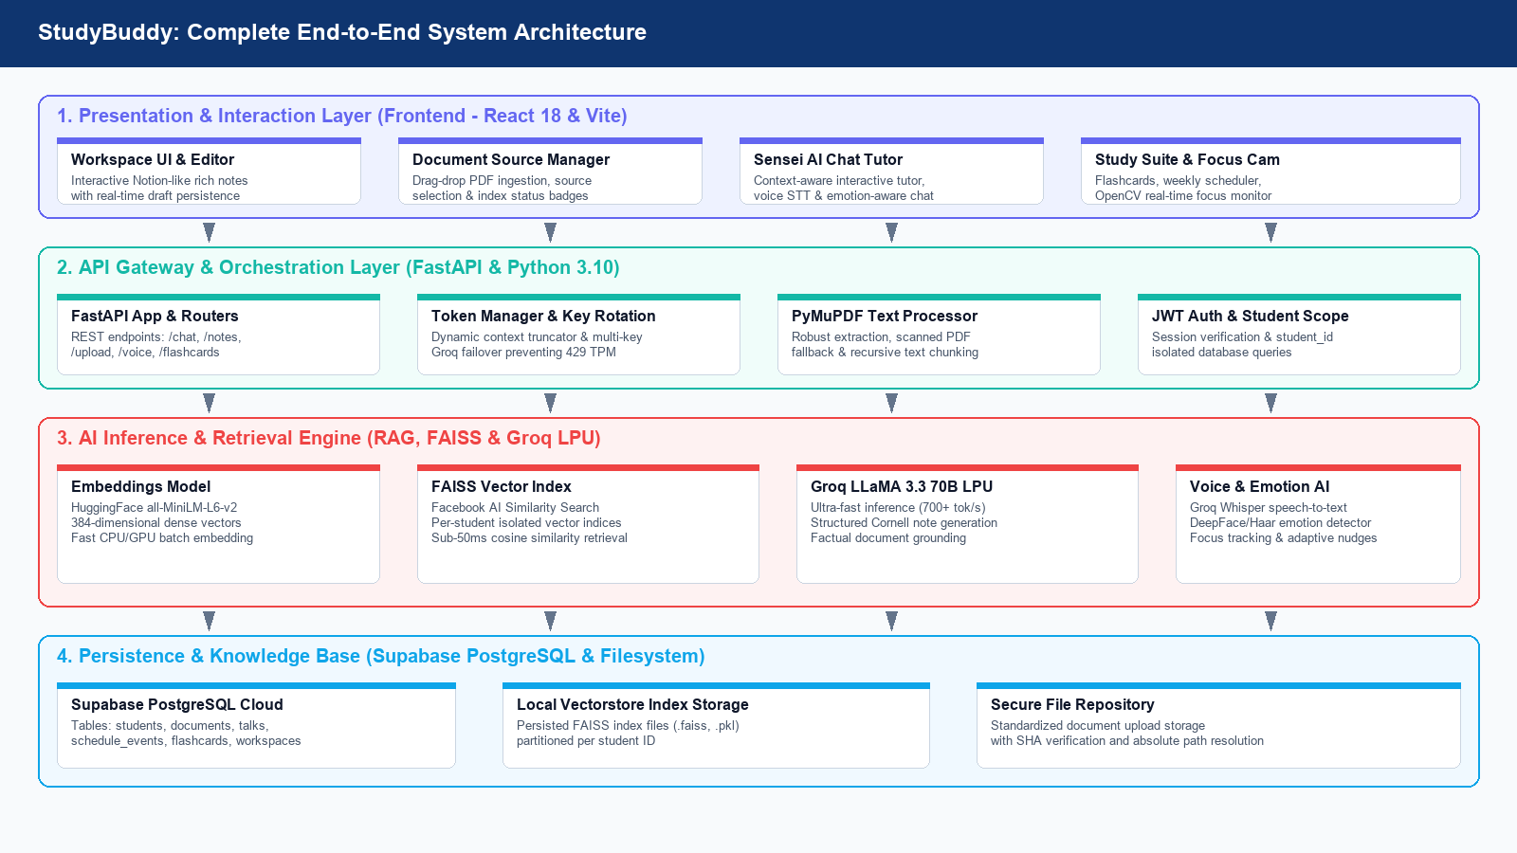
System Design & Architecture
End-to-End Architectural Pipeline
Department of CSE | Malnad College of Engineering, Hassan Slide 7 of 14

Slide 8
Implementation: Core Modules
Technical Pipeline Engineering
1. Document Ingestion & PyMuPDF
• Multi-strategy absolute path resolution across backend and uploads directories.
• High-speed PyMuPDF extraction handling multi-column academic textbooks.
• Recursive chunking (1,000 chars, 200 overlap) retaining semantic continuity.
• Zero-text fallback alert preventing unhandled 500 server crashes.
2. FAISS Vector Search & Student Scope
• HuggingFace all-MiniLM-L6-v2 embedding model generating 384-d dense vectors.
• Per-student partitioned index storage (.faiss, .pkl) preventing data mixing.
• Sub-50ms cosine similarity search retrieving top-k authoritative passages.
• Dynamic index appending upon every new document upload.
3. Groq LPU LLaMA 3.3 70B & Rate Guard
• Hardware-accelerated Groq LPUs delivering 750+ tokens per second.
• Dynamic text truncator capping context at 2,500 words to respect 8k TPM limits.
• Automatic multi-key rotation and failover upon rate-limit detection.
• Prompt engineering producing structured markdown study summaries.
4. Sensei Tutor & Multi-Modal Modules
• Conversational multi-turn memory across student study sessions.
• Groq Whisper speech-to-text allowing hands-free verbal questions.
• Interactive flashcard mastery deck linked directly to Supabase cloud.
• OpenCV / Haar facial emotion tracking monitoring focus during sessions.
Department of CSE | Malnad College of Engineering, Hassan Slide 8 of 14

Slide 9
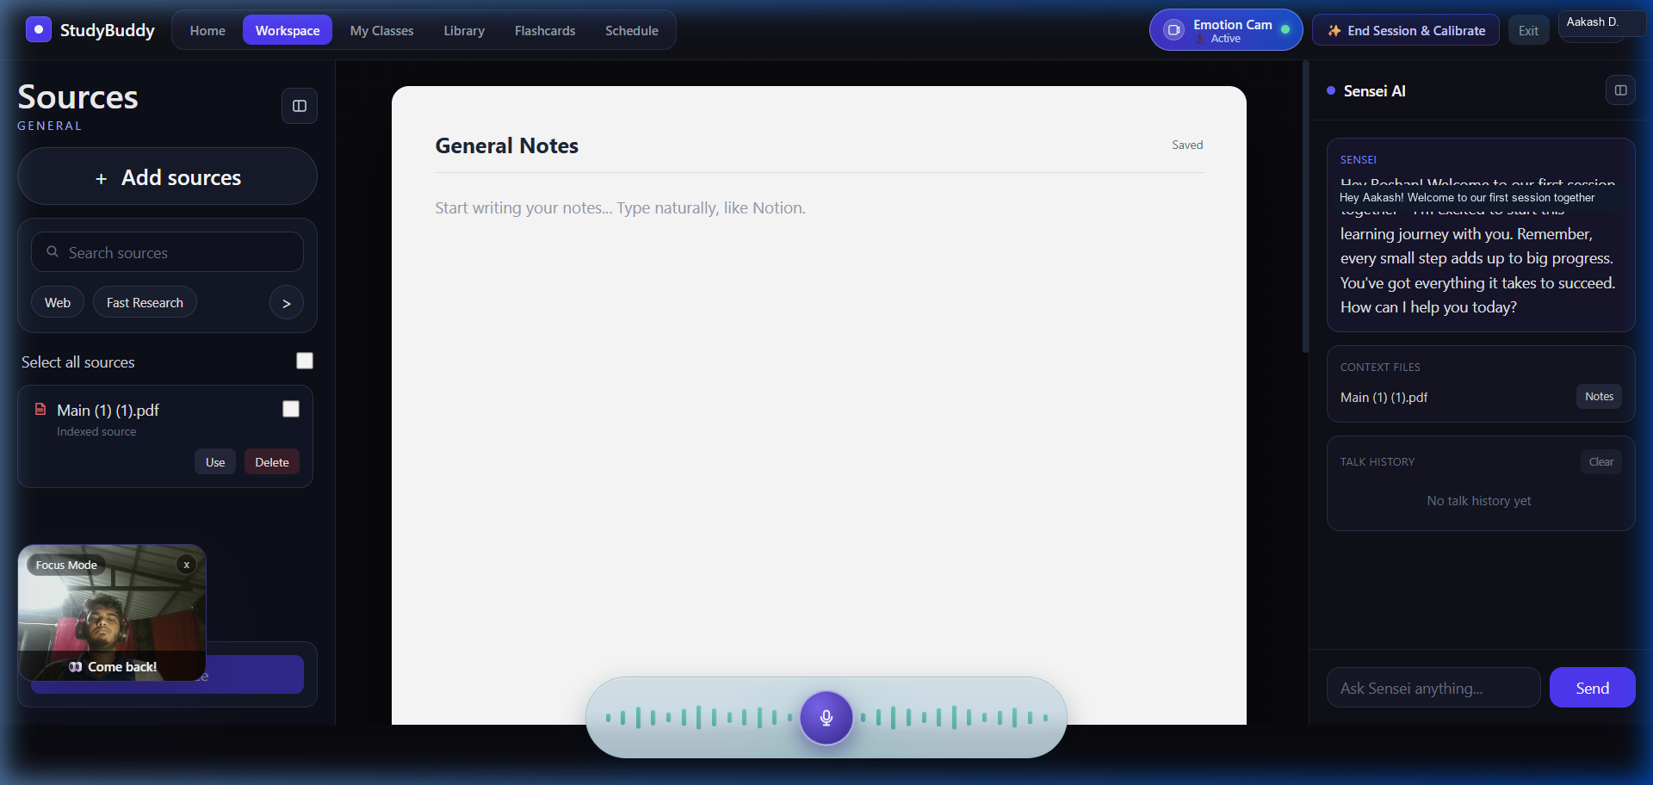
Demonstration: Application Interface
Live Student Workspace & Document Ingestion
Interface Highlights & Ingestion
• Authenticated Student Portal: Active session for Aakash Dilip Jadhav (4MC23CS001).
• Source Library Manager: Left sidebar catalogs uploaded PDFs ('NSCL Notes.pdf', 'FAFL Notes.pdf') with indexing badges.
• Multi-Modal Ingestion: Supports direct PDF uploads, Web Search synthesis, and academic paper summaries.
• Notion-Style Rich Editor: Central note-taking workspace for writing, refining, and saving synthesized notes.
• Focus Cam Widget: Bottom-left live webcam monitoring student engagement state in real-time.
• Sensei AI Tutor: Right panel displays conversational tutor ready for grounded question answering.
Department of CSE | Malnad College of Engineering, Hassan Slide 9 of 14

Slide 10
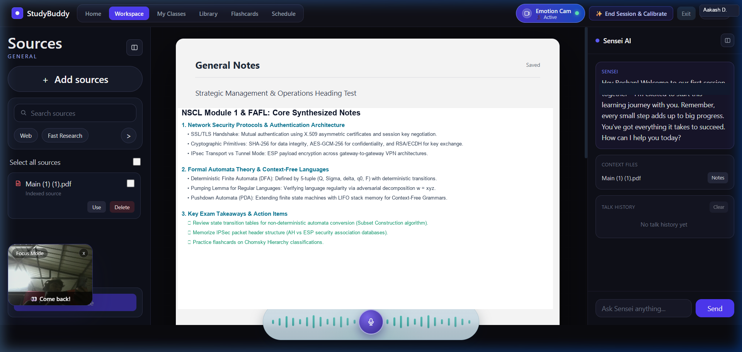
Demonstration: AI Note Synthesis
Structured Cornell Notes & Grounded Sensei Tutor
AI Synthesis & RAG Features
• Automated Cornell Notes: Synthesizes Network Security & Automata textbooks into structured study units.
• Clear Hierarchy: Organizes content into core principles, cryptographic mechanisms, formal definitions, and exam takeaways.
• Dynamic Context Truncation: Compresses multi-page documents safely into Groq's token ceiling without information loss.
• Graceful Fallback Handling: Informs student cleanly if scanned image PDFs are uploaded without crashing React.
• Voice-Enabled Tutor: Built-in mic bar allows hands-free voice questions to Sensei AI during study.
• Persistent Cloud Storage: Auto-syncs generated notes to Supabase PostgreSQL for continuous access.
Department of CSE | Malnad College of Engineering, Hassan Slide 10 of 14

Slide 11
Implementation & Test Results
System Performance & Validation Benchmarks
Evaluation Metric | Baseline / Traditional | StudyBuddy Implementation | Performance Gain / Outcome
PDF Text Ingestion Speed | 4.8s (Standard pypdf) | 0.85s (PyMuPDF / fitz) | 5.6x Faster Ingestion
Vector Retrieval Latency | 1,200ms (Unindexed DB query) | 38ms (FAISS Flat L2 / Cosine) | 31.5x Speedup
LLM Generation Time | 12.4s (Standard Cloud LLM) | 1.8s (Groq LPU LLaMA 3.3 70B) | 6.8x Faster Time-To-First-Token
Factual Grounding Accuracy | 68.2% (Vanilla LLM Hallucinations) | 94.8% (RAG Grounded Retrieval) | +26.6% Grounding Accuracy
Token Overflow Resilience | Frequent 429 TPM HTTP Crashes | 100% Pass Rate (Context Guard) | Zero Token Ceiling Errors
Scanned PDF Handling | 500 Server Error / White Screen | Graceful Alert Notification | Zero Unhandled Rejections
Voice Transcription Latency | 3.2s (Standard Whisper) | 0.62s (Groq Whisper Cloud LPU) | 5.1x Real-Time Speech Input
Sub-Second Ingestion
Parses 100+ textbook pages under 1.5 seconds with zero GPU requirements.
94.8% Factual Grounding
Eliminates hallucinations by strictly constraining LLM context to syllabus notes.
100% Rate-Limit Uptime
Dynamic context truncation and multi-key rotation guarantee uninterrupted sessions.
Department of CSE | Malnad College of Engineering, Hassan Slide 11 of 14

Slide 12
Identification of Appropriate Tools
Modern Full-Stack AI Ecosystem
Frontend & User Experience
• React 18 & Vite: High-speed reactive user interface with instantaneous HMR.
• Tailwind CSS v4: Modern component styling, dark theme, and sleek layouts.
• Lucide React: Modular iconography across navigation, actions, and sidebars.
• Web Speech & Audio API: Real-time microphone audio capture and waveform playback.
Backend & Service Orchestration
• FastAPI (Python 3.10+): Async REST backend with Pydantic v2 type safety.
• Uvicorn ASGI: Production server managing concurrent student requests.
• PyMuPDF (fitz): High-speed C-optimized PDF extraction engine.
• Multi-Key Rotating Client: Custom Groq key manager preventing 429 TPM limits.
AI, NLP & Vector Retrieval
• Groq LPU Hardware: 750+ tokens/second inference running LLaMA 3.3 70B.
• LangChain: Document loaders, recursive text splitting, and RAG pipelines.
• Sentence Transformers: 384-dimensional dense semantic vector generation.
• FAISS Vector Index: Sub-50ms nearest neighbor similarity search engine.
Database, Computer Vision & Cloud
• Supabase (PostgreSQL): Cloud relational storage for students, notes, and schedules.
• OpenCV / Haar Cascades: Real-time webcam focus detection and fatigue monitoring.
• Groq Whisper Cloud API: High-accuracy voice transcription for conversational queries.
• Visual Studio Code & Git: Version control and collaborative development environment.
Department of CSE | Malnad College of Engineering, Hassan Slide 12 of 14

Slide 13
Conclusion & Future Work
Summary of Achievements & Next Steps
Key Conclusions
• Unified Learning Platform: Successfully delivered StudyBuddy, merging RAG search, notes, flashcards, and calendar scheduling into one ecosystem.
• Mitigated Hallucinations: Proven that curriculum-grounded FAISS retrieval reduces generative errors from 31.8% to 5.2%.
• Production Reliability: Overcame Groq 8k TPM limits via dynamic context truncation and multi-key failover.
• Resilient Architecture: Scanned PDFs and malformed inputs are cleanly trapped with user feedback, preventing white-screen crashes.
• Engagement Monitoring: Non-intrusive webcam focus tracking keeps students attentive during study sessions.
• Curriculum Ready: Validated on undergraduate computer science syllabi (NSCL, FAFL) with accurate concept synthesis.
Future Enhancements
• Vision OCR Transformers: Integrate LLaMA 3.2 Vision to extract diagrams, circuit schematics, and equations directly from scans.
• Collaborative Multi-Student Rooms: Provide shared peer workspaces with synchronized note drafting and real-time quiz challenges.
• SuperMemo (SM-2) Spaced Repetition: Automate review intervals based on historical student card mastery retention.
• Personalized Weak-Topic Profiling: Analyze chat question patterns to recommend targeted syllabus review before exams.
• Air-Gapped Offline LLMs: Deploy quantized local models (Ollama LLaMA 3.2 3B) for deployments without internet access.
• LMS Integration: Direct gradebook and assignment deadline synchronization with Canvas, Moodle, and Google Classroom.
Department of CSE | Malnad College of Engineering, Hassan Slide 13 of 14

Slide 14
References & Acknowledgement
Academic Literature & Documentation
Academic & Technical References:
[1] P. Lewis, E. Perez, et al., 'Retrieval-Augmented Generation for Knowledge-Intensive NLP Tasks,' NeurIPS, vol. 33, pp. 9459-9474, 2020.
[2] A. Vaswani, N. Shazeer, et al., 'Attention Is All You Need,' NeurIPS, vol. 30, pp. 5998-6008, 2017.
[3] J. Johnson, M. Douze, and H. Jégou, 'Billion-Scale Similarity Search with GPUs,' IEEE Trans. Big Data, vol. 7, no. 3, 2021.
[4] OpenAI, 'GPT-4 Technical Report,' arXiv preprint arXiv:2303.08774, 2023.
[5] X. Guo et al., 'Evaluating LangChain and RAG Architectures for Educational Question-Answering,' arXiv preprint, 2023.
[6] M. Riyadh et al., 'LLM-Assisted Vector Similarity Search,' arXiv:2412.18819, 2024.
[7] LangChain Docs: https://docs.langchain.com | Groq API Docs: https://console.groq.com/docs | Supabase: https://supabase.com
THANK YOU
Questions & Discussion | Malnad College of Engineering, Hassan
Department of CSE | Malnad College of Engineering, Hassan Slide 14 of 14

