Slide 1

Presentation Topic “LITHIUM-ION BATTERY”
NAME OF STUDENT:ROSHAN JADHAV
Roll Number:311066
Gr. Number:22220205
Department of Electronics and Telecommunication Engineering
Course Name: Intellectual Property Rights
Guide: Dr. Ketki P. Kshirsagar
BRACT’S, Vishwakarma Institute of Information Technology, Pune-48
(An Autonomous Institute affiliated to Savitribai Phule Pune University)
(NBA and NAAC accredited, ISO 9001:2015 certified)

Slide 2

Title : “LITHIUM-ION BATTERY”
• Applicant Details: CRP SERVICES.R.I., Modena (IT)
• Inventor: Zhenhua Mao (US)., Anaba Anani (US).
• Assignee: Motorola, Inc (US)..
• Application No: 09/727,730
• Filed: Dec. 1, 2000
• Publication No: US 6,617,075 B2
• Publication Date: Sep. 9, 2003
ROSHAN JADHAV, Department of Entc Engineering, VIIT, Pune-48

Slide 3
Subject of a Patent: LITHIUM-ION BATTERY
This invention relates generally to electricity-producing batteries and their construction.
More particularly, this invention relates to electrode and electrolyte compositions for lithium-ion and lithium polymer batteries that improve capacity-fade resistance characteristics of the battery.
ROSHAN JADHAV, Department of Entc Engineering, VIIT, Pune-48

Slide 4
Importance of this Patent
The need for higher energy and power is becoming increasingly valuable in most portable applications as manufacturers continue to incorporate more features in their products.
End users continue to also demand longer operation times as well as longer life. These demands and features place a very Strong requirement on the Storage energy and cycle life characteristics of the associated energy Source.
Marketing Benefit:
Low cost, low-self discharge rate, and minimal installation space are some of the key factors driving the adoption of Li-ion batteries in smart grid and energy storage systems. Since these batteries are more resistant to high temperatures, they are ideal for use in remote areas and thermal control applications.
ROSHAN JADHAV, Department of Entc Engineering, VIIT, Pune-48

Slide 5
Market Overview:
The global lithium-ion battery market size was USD 45.70 Billion in 2022 and is expected to register a revenue CAGR of 13.1% during the forecast period.
Revenue Source:
The consumer electronics segment was the largest revenue share in 2021. Batteries can be found in both consumer electronics and portable electronics. Smartphones, tablets, computers and smartphones all have batteries. The CAGR for the consumer electronics segment is high during the forecast period.
Most Common Pitfalls:
Li-ion batteries require safety mechanisms to limit voltage and internal pressures, which can increase weight and limit performance in some cases. Li-ion batteries are also subject to aging, meaning that they can lose capacity and frequently fail after a number of years.
ROSHAN JADHAV, Department of Entc Engineering, VIIT, Pune-48

Slide 6
Novelty / Uniqueness
Lithium-based battery cells are an attractive energy Source for portable applications, due in part to their ability to provide relatively high energies and long cycle life.
Lithium is the lightest of all the metals, with a high electrochemical potential, thus providing high energy densities. Rechargeable batteries using lithium as the electrochemical material are capable of providing higher energy to weight ratio than those using other chemistries.
After repeated charges and discharges of a Li-polymer battery with a PVDF gel electrolyte, the overall capacity of the Li-polymer battery to hold an adequate charge fades. This quality is disadvantageous in a battery because the battery will very quickly cease to provide a functional charge to a host device, Such as a cellular telephone.
ROSHAN JADHAV, Department of Entc Engineering, VIIT, Pune-48

Slide 7
Utility/Industrial Application
Presently, the main application of rechargeable Li-ion batteries is in portable electronic devices, such as cellular phones, digital cameras, global positioning system devices, tablets, and laptop computers.
Lithium-ion batteries (LIBs) feature high energy density, high discharge power, and long service life. These characteristics facilitated a remarkable advance in portable electronics technology and the spread of information technology devices throughout society.
ROSHAN JADHAV, Department of Entc Engineering, VIIT, Pune-48

Slide 8
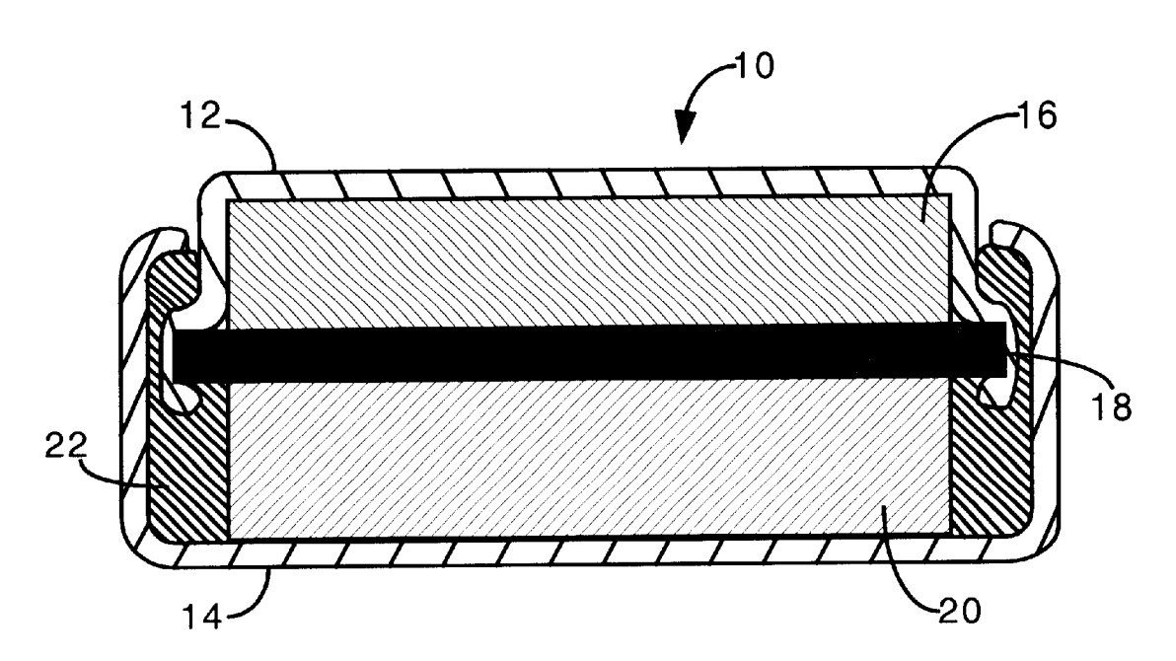
DETAILED DESCRIPTION OF THE INVENTION
lithium-polymer battery 10 having an upper component 12 and a lower component 14, which are constructed of a conductive material. However, the battery 10 can be constructed in any Li-ion configuration as is known in the art. Within the upper component 12 is an anode 16, and within lower component 14 is a cathode 20,with separator 18 between anode 16 and cathode 20. The insulator 22 insures that the anode 16 is only in conductive connection with the upper component 12, and the cathode 20 is in conductive connection with the lower component 14 whereby conductive contact with both the upper component 12 and lower component 14 will close a circuit and allow current to flow due to the electrochemical reaction of the anode 16 and cathode 20.
ROSHAN JADHAV, Department of Entc Engineering, VIIT, Pune-48

Slide 9
The separator 18 between the anode 16 and cathode 20 is coated with PVDF such that the anode 16. cathode 20, and separator 18 are held together when the electrolyte and PVDF is gelled by temperature curing, as is known in the art.
The operation voltage window of the battery using the above component; is in a range of 2.5 to 4.1 volts. Furthermore, a Li-polymer battery constructed with above design has a charging cycle-life of over 300 cycles.
ROSHAN JADHAV, Department of Entc Engineering, VIIT, Pune-48

Slide 10
Claims:
A lithium-ion battery, the battery comprising:
An anode comprised of at least carbon and has a density being in a range from 1.2 to 1.5 g/cm. A cathode comprised of LiNiO2, the cathode density being in a range from 3.0 to 3.3 g/cm^3. An electrolyte, and a separator between the anode and cathode, the Separator coated with PVDF Such that the anode, cathode, and Separator are held together, wherein the ratio by weight of active LiNiO to active carbon present in the battery cathode and anode respec tively is no greater than 2.0 to 1.
The battery of claimed, wherein the lithium-ion battery is a lithium-polymer battery.
The battery in claim 1, wherein the operating Voltage window is between 2.5V to 4.1V.
The battery of claim 1, wherein: the anode has a density of 1.4 g/cm; and the cathode has a density of 3.1 g/cm;
. A lithium-ion battery, the battery comprising: an anode, a cathode; an electrolyte, and a separator between the anode and cathode, the Separator coated with PVDF Such that the anode, cathode, and Separator are held together;
ROSHAN JADHAV, Department of Entc Engineering, VIIT, Pune-48

Slide 11
Conclusion
While the preferred embodiments of the invention have been illustrated and described, it is clear that the invention is not So limited. Numerous modifications, changes, variations, Substitutions, and equivalents will occur to those skilled in the art without departing from the Spirit and Scope of the present invention as defined by the following claims.
ROSHAN JADHAV, Department of Entc Engineering, VIIT, Pune-48

Slide 12
Thank You
ROSHAN JADHAV, Department of Entc Engineering, VIIT, Pune-48

