Slide 1
Building Behavioural Scorecard for Default Prediction and Identifying key Feature for Delinquency
Roshan Kachwal MSc Data Analytics
Student: 22851496

Slide 2
Abstract
This study aims to improve credit risk management in the banking sector by building predictive models for identifying loan defaults and delinquencies. Our study provides significant insights by leveraging data from a financial institution including 1750 loan accounts with up to 40 monthly snapshots per account. Our findings highlight the critical impact of overdue payments, gross income, MoB and age range in predicting defaults, with missed payments showing as a particularly strong predictor. Furthermore, we find behavioural scores, application scores, MOB, Monthly Income, and age range as critical indicators of delinquencies.
To accomplish this, the research conducted a thorough analysis using Excel, Python, and SAS. Using data from the final 6 months of the observation period, we developed a static behavioural scorecard for predicting defaults. In addition, we use the powerful Random Forest model to assess the strength of particular characteristics as default indications. Using a variety of validation methodologies, our scorecard exhibits strong discriminating strength, which improves its precision in default estimates. Three unique scorecard models have been created, each using a different attribute to predict the likelihood of an account defaulting.
Simultaneously, our study extends to the development of numerous prediction models targeted at identifying key features indicating delinquency using account behavioural data. These models were carefully tested using the 5-fold cross-validation process. It's important to highlight that the dataset we started with was unbalanced, resulting in the use of many statistical approaches to balance and assess the data properly in order to achieve desired accuracy.
Our study presents a thorough behavioural scorecard that allows for accurate default prediction by assigning scores. Furthermore, the prediction models and feature relevance ranking enable financial institutions to proactively manage delinquency risk with an accuracy rate of up to 97%, supporting efficient credit risk assessment practises.

Slide 3
BUSINESS UNDERSTANDING & METHODOLOGY

Slide 4
DATA UNDERSTANDING
The dataset utilised in this study was obtained from a financial institution in the form of an Excel file. It is a comprehensive collection of data taken from clients who acquired loans from this organisation. The dataset contains a total of 1,750 unique accounts, each with a maximum of 40 associated snapshots. The dataset was originally provided as an Excel file, making it easy to analyse.
This dataset contains 25036 records and 19 variables of both numerical and categorical type. The status variable is the target variable for creating Behavioural scorecard whereas category is the target variable for predicting the strong indicator of delinquency.
DATA Quality:
This dataset contains approximately 364 duplicates records out of 25036. After removing all the duplicates, this dataset contains approximately 24672 records and 19 variables
Variable Exclusion:
For, creating behavioural scorecard we won’t be needing variable like application score and behavioural score but for identifying the important feature for the delinquency we will be using variable such as application score and behavioural score.
Distribution and Outliers:
For variable app_score & beh_score, minimum whisker is 481 & 507 respectively and maximum whisker is 702 & 743 respectively and any records containing value beyond this are outliers. And these records will be excluded before predicting the important feature for the delinquency.

Slide 5
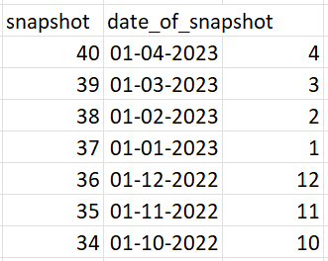
DATA PREPARATION
DATA PREPARATION FOR BEHAVIOURAL SCORECARD
Selecting The Observation Period
Each unique key in our dataset acts as an identification for individual accounts, and we have around 40 snapshots inside each key, with the 40th snapshot being the most recent.
To determine our observation window, we used particular criteria. First, we ensured that each account in the dataset had at least 6 months of observable data. Second, the observation window was limited to the 34th and 40th snapshots.
All independent variable values for that account are obtained from the 34th snapshot. The response variable, which represents the default status, is obtained from the 40th snapshot (Credit Scoring Series Part Two: Credit Scorecard Modeling Methodology, 2022).
After this procedure, this dataset will have about 1269 unique records. And the proportion of output variables is 99.07% Good and 0.93% Bad.

Slide 6
Exclusion Criteria
Exclusion criteria are constraints or limits given to a dataset to identify and reject individual accounts or data points that are inappropriate for inclusion in the research.
Closed Default Status: Any accounts that are marked as having a default status of ‘C’ will be excluded from the analysis. This exclusion is logical since accounts that have already been closed are no longer relevant to assessing current credit behaviour.
Delinquency Category (Closed): Similarly, accounts with a delinquency category of 'Closed' which indicates a closed account, will also be excluded. These closed delinquency records do not contribute to the assessment of current risk evaluation.
Loan Amount Equals 0: Accounts with zero loan balances will be excluded from the study. This is because such accounts don't include any active credit or debt, making them irrelevant to creditworthiness evaluation.
Delinquency Stage 2: Accounts in the second stage of delinquency will be eliminated from the analysis. While these accounts are not yet classed as defaults, they do qualify a "grey area" in which credit risk is missed last payments but not defaulted. Excluding these helps to balance the data and keeps our attention on clearer default indicators.
After this procedure, this dataset will have about 704 unique records. And the proportion of output variables is 97.59% Good and 2.41% Bad.

Slide 7
Defining The Default & Data Transformation
When preparing data for the behavioural scorecard, it is critical to develop a clear and well-defined criterion for what constitutes a "default".
Category Stage 3+ (60 Days Past Due): An account is said to be in default if it is assigned a delinquency stage 3 or above, which often means it is 60 days or more past due (Team, 2023).
Status "Bad": Additionally, if an account's status is labelled as "bad," it is classified as being in a state of default.
During the data transformation process,
Delinquency Category Variable:
"Current" will be encoded as 0.
"6+" will be encoded as 7.
All other categories will retain their existing numerical values.
Default Status Variable:
"G" will be encoded as 0.
"B" will be encoded as 1.
My final target variable distribution is 97.28% Good and 2.72% Bad.

Slide 8

DATA EXPLORATION
The majority of persons who defaulted did so between the months of 36 and 40.
Overall, this trend supports the idea that accounts with a "Good" status are less likely to have late balances, but accounts with a "Closed" or "Bad" status are more likely to have overdue amounts
The delinquency stage grows, so does the risk of an account entering into default. Accounts at the "4" delinquency stage and higher do not have any "Good" status accounts. This implies that accounts in these phases of delinquency are more likely to default.
DATA EXPLORATION
Label Encoding Technique: An essential reason for implementing label encoding in this context is its role in preparing the data for the Synthetic Minority Over-sampling Technique (SMOTE).
By applying label encoding to selected categorical variables such as 'capbal', 'loan', 'overdue', 'payment_plan', 'employmnt_status', 'age_range', and 'gross_income', we convert these variables into numerical representations.
SMOTE Technique:
SMOTE has the ability to add noise into the dataset by producing synthetic samples that are highly close to existing ones.

Slide 9
Weight of Evidence (WOE) & Information Value (IV)
Weight of Evidence (WoE) is a statistical technique used in credit risk modelling to assess the strength of the relationship between a predictor variable and the likelihood of a binary outcome, such as defaulting on a loan (Siddiqi N. 2006).
WoE is calculated by taking the natural logarithm (ln) of the ratio of the percentage of non-default clients to the percentage of default clients within each category or bin (Siddiqi N. 2006).
The WoE values provide insights into the predictive power of a variable. Positive WoE values indicate that the category is associated with a higher likelihood of default, while negative WoE values suggest a lower likelihood of default (Siddiqi N. 2006).
Information Value (IV):
Information Value (IV) is a statistical measure used to assess the predictive power of a variable or feature in a binary classification problem.
IV helps prioritize variables based on their ability to distinguish between the positive (default) and negative (non-default) cases.
The interpretation of IV values is as follows:
IV < 0.02: Very weak relationship
0.02 ≤ IV < 0.1: Weak relationship
0.1 ≤ IV < 0.3: Medium strength relationship
IV ≥ 0.3: Strong relationship

Slide 10
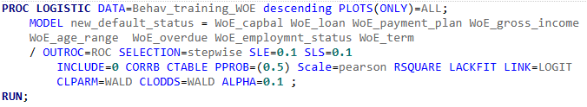
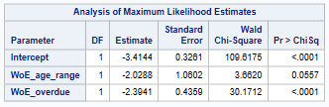
MODELLING & EVALUATION
Logistic Regression Model for Behavioural Scorecard
Logistic Regression is a fundamental statistical approach that is used in predictive modelling and classification problems. It is ideal for developing a Behavioural Scorecard in credit risk management.
Reason for choosing this model: Interpretability & Simple yet powerful.
Generative Model 1:

Slide 11
The model's variable selection procedure was led by a stepwise method. This strategy includes adding and eliminating predictor variables repeatedly based on their statistical significance.
Backward selection is a variable selection method used in logistic regression modelling. Backward selection begins with a model that contains all predictor variables and repeatedly removes the least significant ones, as opposed to forward selection
Characteristic | Attribute | Scorepoints
overdue | O | 72
overdue | 1 = < Overdue <100 | 36
overdue | Neutral | 62
Age Range | 18 =< Age < 23 | 54
Age Range | 23 <= Age | 99
Age Range | Neutral | 92

Slide 12
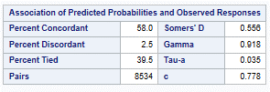
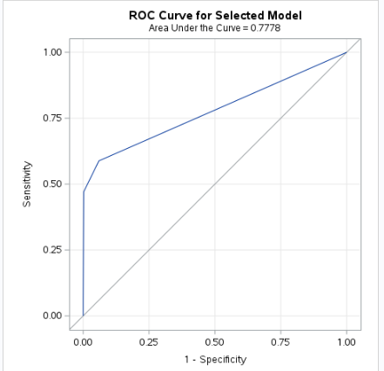
Mode Validation
As indicated by the high values of Somers' D (0.556) and Gamma (0.918), the model reveals a good correlation between projected probabilities and observed reactions. This shows that the model's projected probability matches the actual results, which is an important feature for a credit risk assessment model. Furthermore, the AUC, a commonly used indicator of discriminating power, reaches a significant value of 0.7778. This implies that the model successfully differentiates between accounts at risk of default and those that are not, exhibiting strong discrimination skills (Finalyse, n.d.).

Slide 13
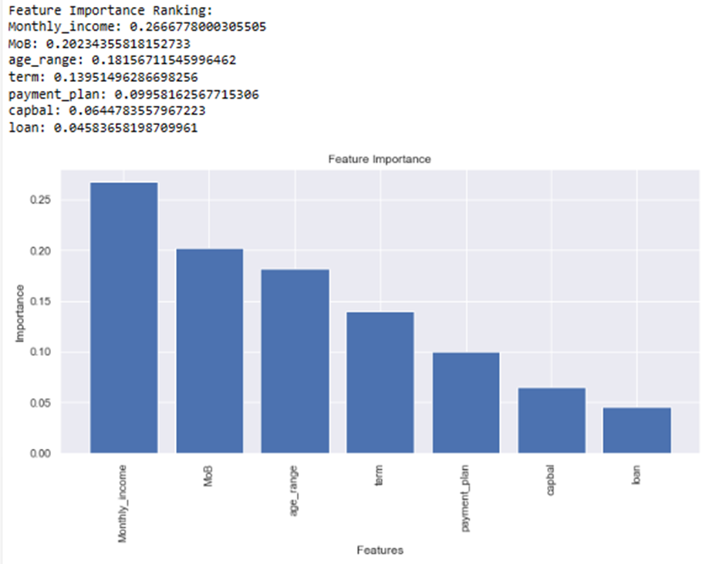
Feature Importance Ranking Using Random Forest
Each feature importance score indicates the relative significance of a feature in predicting default. Larger values suggest that this feature contributes more to the overall predictive power of the Random Forest model. Lower value might not be as influential as some other features, but it still contributes to the model's performance.
This model attained a remarkable mean accuracy of 96%.

Slide 14
Identifying key Feature for Delinquency

Slide 15
DATA PREPARATION FOR Identifying IMPORTANT FEATURE FOR DELIENQUENCY
Selecting The Observation Period
Like the data preparation for the behavioural scorecard, the process of selecting the observation period is a crucial step in preparing data for predicting important features related to delinquency. The main distinction here is that, unlike the behavioural scorecard, we will be utilizing data from all snapshots between the 34th and 40th month for each unique key (Credit Scoring Series Part Two: Credit Scorecard Modeling Methodology, 2022).
To summarize, we will use all snapshots from the 34th to the 40th month for each unique key, allowing us to capture a comprehensive view of credit behaviour leading up to potential delinquency events. This wide data window will serve as the foundation for our study, which will anticipate the key factors associated with delinquency (Credit Scoring Series Part Two: Credit Scorecard Modeling Methodology, 2022).
After this procedure, this dataset will have about 8726 records. And the proportion of output variables is 99.07% Good and 0.93% Bad.

Slide 16
Exclusion Criteria
Loan Amount Equals 0: Accounts with zero loan balances will be eliminated from the study. Accounts with no related loan amount are not relevant to the evaluation of delinquency risk since there is no credit exposure to consider.
Outliers in Application Score and Behavioural Score: Accounts that exhibit extreme outlier values in both application score and behavioural score variables will also be excluded from the analysis. Outliers have the potential to skew statistical analysis and predictive models. As a result, eliminating these extreme data points contributes to the integrity of our study.
After this procedure, this dataset will have about 4852 records. And the proportion of output variables is 98.58% Good and 1.42% Bad.
Data Transformation
Delinquency Stage Recategorization: We will reclassify accounts into two distinct categories based on their delinquency stage:
Delinquent Accounts: Accounts with a delinquency stage of "2" or "2+" will be categorized as delinquent. This consolidation simplifies the representation of delinquent accounts.
Non-Delinquent Accounts: Accounts with a delinquency stage of "1" or any value less than "1" will be categorized as non-delinquent. This category encompasses accounts that are not in a delinquent state (LendFoundry.com, 2021).
Final Target variable distribution is 96.54% Good and 3.46% Default.

Slide 17

DATA PRE-PrOCESSING
Label Encoding Technique
Normalisation Technique
Normalisation, also known as standard scaling, is a data preparation process used to rescale numerical features to have a mean of 0 and a standard deviation of 1.
SMOTE Technique
Splitting Data in Train & Test
Data Splitting: The original dataset is divided into two or more subsets: typically, a training set and a testing set
Importance of Split and Train" technique for Predicting the feature importance of Delinquency:
Model Evaluation
Feature Importance:

Slide 18
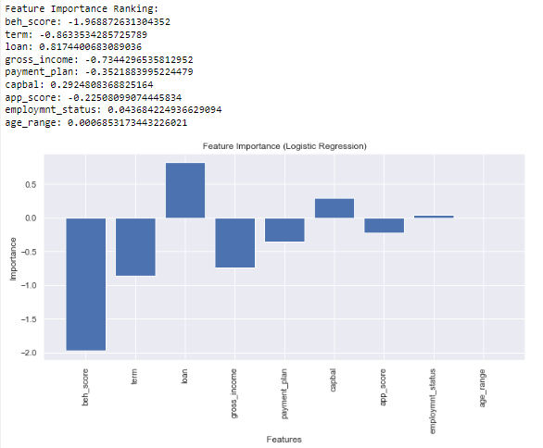
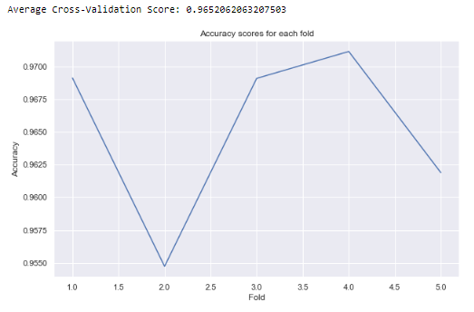
MODELLING & EVALUATION
Each feature importance score indicates the relative significance of a feature in predicting delinquency. The lower the behaviour score, the greater the chance of delinquency, and a value closer to -2 suggests that it is a highly influential factor. Term and Gross income in negative values show that the lower the term and gross income, the greater the odds of delinquency, and values more than 0.5 suggest that it is still a very important feature. In the case of a loan, it implies that the more the loan amount, the greater the likelihood of delinquency. Finally, factors such as payment plan, capbal, app score, employment status, and age range have a much smaller effect on delinquency prediction. In summary, the feature importance scores indicate the direction and strength of the relationship between each feature and the likelihood of delinquency.

Slide 19
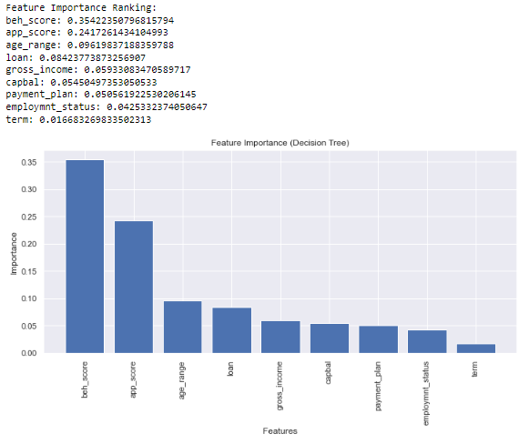
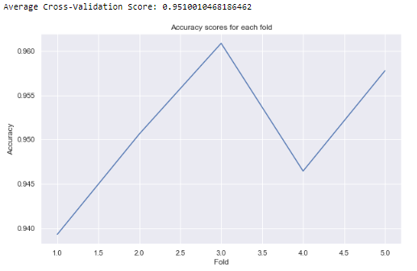
Decision Tree Model
Each feature importance score indicates the relative significance of a feature in predicting delinquency. Larger values suggest that this feature contributes more to the overall predictive power of the decision Tree model. Lower value might not be as influential as some other features, but it still contributes to the model's performance. In this model most important features are behavioural score, application score, loan amount and age range. . In summary, the feature importance scores indicate the relative contribution of each feature to the model's ability to make accurate predictions.

Slide 20
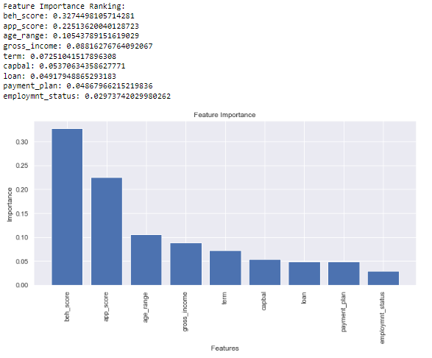
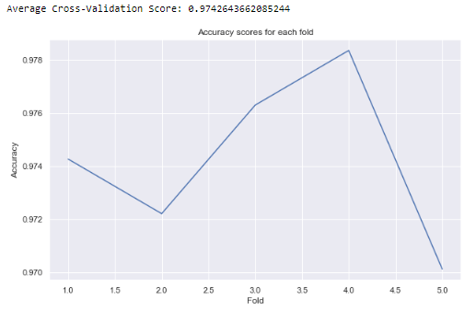
Random Forest Model
Each feature importance score indicates the relative significance of a feature in predicting delinquency. Larger values suggest that this feature contributes more to the overall predictive power of the Random Forest model. Lower value might not be as influential as some other features, but it still contributes to the model's performance. In this model most important features are behavioural score, application score, gross Income and age range. In summary, the feature importance scores indicate the relative contribution of each feature to the model's ability to make accurate predictions.

Slide 21
Business Evaluation & Recommendations
Behavioural Scorecard Development: We successfully created a behavioural scorecard that assigned scores based on the estimated likelihood of defaults. ROC curves and Gini indices verified the scorecard's powerful discriminating powers, emphasising its dependability in distinguishing between high-risk and low-risk accounts. By adding these models into risk assessment procedures, businesses may greatly improve their capacity to detect high-risk accounts. This results into more targeted and effective risk management techniques, lowering the possibility of default losses (Fibe, n.d.).
Delinquency Prediction Models: We built three separate models to predict delinquency: a logistic regression model, a decision tree, and a random forest. We confirmed the dependability of these models via rigorous 5-fold cross-validation (Brownlee, 2020). The random forest model has the best accuracy of 97% among them, suggesting its excellent predictive potential. Businesses can better deploy resources, such as collection efforts and risk mitigation methods, by identifying high-risk accounts early on. This avoids wasteful expenditure on low-risk accounts while prioritising measures for those with a higher possibility of delinquency (LendFoundry.com, 2021).
Feature Importance Ranking: The application of feature importance ranking, generated from the logistic regression, decision tree, and random forest models, unveiled the most critical features for predicting delinquency. With a 96% accuracy rate, logistic regression identified Beh_score, term, and loan as the top three features. With 95% accuracy, the decision tree prioritised Beh_score, app_score, and age_range. The random forest model, which had the best accuracy of 97%, highlighted Beh_score, app_score, MOB, Monthly income, and age_range as significant features. These findings highlighted the robustness of Beh_score, Monthly income and age_range across all models. A company may streamline its data-driven decision-making processes by concentrating on five important elements. This enables firms to give credit to low-risk consumers while taking required safeguards for high-risk ones, allowing for a more precise evaluation of customer creditworthiness.

Slide 22
Limitations
Longer Observation Period: Extending the observation period beyond six months, as recommended by IFRS guidelines, can provide a more robust dataset for behavioural scorecard creation. A more extended time frame may capture nuanced changes in borrower behaviour.
Dynamic Scorecard: Shifting from a static to a dynamic behavioural scorecard can capture real-time changes in borrower behaviour, reducing the likelihood of missed information.
Imbalanced Data Handling: Further exploration of techniques to handle imbalanced datasets, such as Synthetic Minority Over-sampling Technique (SMOTE) or data augmentation, can mitigate potential biases introduced by oversampling.
Feature Engineering: Investigate advanced feature engineering techniques to extract additional information from existing variables, enhancing model performance.
Missing Data Handling: Implement strategies for imputing or handling missing data effectively to prevent information loss.
Variable Formatting: Standardize variable formats consistently across the dataset to avoid numerical variables in range formats.

Slide 23
Conclusion
The dataset utilised in this research comes from a financial institution and contains information about 1750 clients, as well as 19 numerical and categorical characteristics. The descriptive statistical analysis was performed using Python, SAS, and Excel to assess the dataset's quality and structure, as well as the features of its attributes and the connection of the variables to the target variable (default & Delinquency). The research further recommended data transformation and purification procedures to increase the dataset's quality, as well as input for a variety of data mining and machine learning algorithms. We made tremendous progress in understanding and predicting defaults and delinquency in our comprehensive research on credit risk management, eventually contributing to more effective risk assessment and mitigation measures. our findings give useful tools and insights for credit risk management. While there are limitations, but our models and behavioural scorecard provide substantial benefits in enhancing risk assessment and minimising financial exposure, eventually protecting lending institutions' financial health.

Slide 24
REFERENCES
Abdou, H. A., & Pointon, J. (2011). CREDIT SCORING, STATISTICAL TECHNIQUES AND EVALUATION CRITERIA: A REVIEW OF THE LITERATURE. International Journal of Intelligent Systems in Accounting, Finance & Management, 18(2–3), 59–88. https://doi.org/10.1002/isaf.325
Al Amari A. 2002. The credit evaluation process and the role of credit scoring: a case study of Qatar. PhD thesis, University College Dublin.
Ali, S. E. A., Rizvi, S. S. H., Lai, F., Ali, R. F., & Jan, A. A. (2021). Predicting Delinquency on Mortgage Loans: An exhaustive parametric comparison of machine learning techniques. International Journal of Industrial Engineering and Management, Volume 12(Issue 1), 1–13. https://doi.org/10.24867/ijiem-2021-1-272
Anderson R. 2007. The Credit Scoring Toolkit: Theory and Practice for Retail Credit Risk Management and Decision Automation. Oxford University Press: New York.
Brownlee, J. (2021). SMOTE for Imbalanced Classification with Python. MachineLearningMastery.com. https://machinelearningmastery.com/smote-oversampling-for-imbalanced-classification/
Brownlee, J. (2020). A Gentle Introduction to k-fold Cross-Validation. MachineLearningMastery.com. https://machinelearningmastery.com/k-fold-cross-validation/

