Slide 1

Implement matrix multiplication using 8085 assembly language.
Project by
Aayush Neupane
RA2211003012078
Roshan Kr. Mishra
RA2211003012079
Manish Mahasetha
RA2211003012083

Slide 2
Abstract of the project Implementation of matrix multiplication using the 8085 assembly language. Microprocessor Architecture: Utilizing the classic 8085 microprocessor architecture. Algorithm Breakdown: Breaking down the matrix multiplication algorithm into key steps. Instruction Set Usage: Leveraging the 8085's arithmetic and logical instructions for efficient element-wise multiplication and accumulation of products. Matrix Handling: Designing assembly code capable of handling matrices with varying dimensions. Optimization Focus: Emphasizing code optimization and minimizing memory usage within the constraints of the 8085. Educational Resource: Serving as a valuable resource for students studying assembly language programming and computer architecture. Insights Offered: Providing insights into algorithm implementation on a historic microprocessor architecture. Capabilities Showcase: Demonstrating the capabilities of the 8085 microprocessor through practical application.

Slide 3
ACKNOWLEDGEMENT We express our heartfelt thanks to our honorable Vice Chancellor Dr. C. MUTHAMIZHCHELVAN, for beingthe beacon in all our endeavors. We would like to express my warmth of gratitude to our Registrar Dr. S.Ponnusamy, for his encouragement.We express our profound gratitude to our Dean (College of Engineering and Technology) Dr. T. Gopal, forbringing out novelty in all executions. We would like to express my heartfelt thanks to Chairperson, School ofComputing Dr. Revathi Venkataraman, for imparting confidence to complete my course project.We are highly thankful to our Course project Faculty Dr. R. Brindha, Assistant Professor, Department ofComputing Technologies, for her assistance, timely suggestion and guidance throughout the duration of thiscourse project.We extend my gratitude to our HoD, Dr. Pushpalatha M, Professor &amp; Head, Department of ComputingTechnologies and my Departmental colleagues for their Support.Finally, we thank our parents and friends near and dear ones who directly and indirectly contributed to thesuccessful completion of our project. Above all, I thank the almighty for showering his blessings on me tocomplete my Course project.

Slide 4
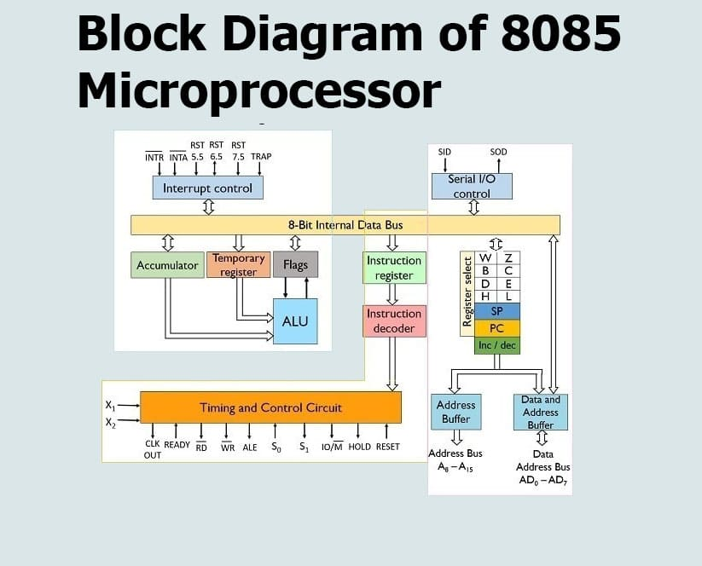

Slide 5
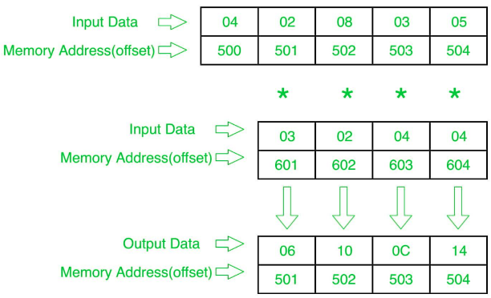
Block diagram for matrix multiplication

Slide 6
Problem Statement Microprocessor Architecture: Utilizing the seminal 8085 microprocessor architecture. Optimization Challenge: Creating optimized assembly code for efficient execution of the matrix multiplication algorithm within 8085 constraints. Algorithmic Accommodation: Adapting the assembly code to handle varying matrix dimensions. Efficiency Focus: Ensuring efficient performance and minimal memory usage within the limitations of the 8085 architecture. Showcasing Viability: Demonstrating the viability of matrix multiplication using 8085 assembly language. Educational Goals: Providing insights into low-level programming, algorithm implementation, and microprocessor capabilities. .

Slide 7
Algorithm 1. Initialization: - `MVI C, 00`: Initializes register C with the value 00 (presumably for loop counter or some other purpose). - `LXI H, 8500`: Loads HL with the memory address 8500. 2. LOOP2: - This is the start of a loop. - `LXI D, 8600`: Loads DE with the memory address 8600. - *Call Subroutine MUL*: This subroutine seems to multiply the contents of memory locations pointed by DE and HL, and store the result in A. - `MOV B, A`: Copies the content of A to B. - `INX H`: Increments HL. - `INX D`: Increments DE twice. - *Call Subroutine MUL* again. - `ADD B`: Adds the content of B to A. - *Call Subroutine STORE*: This subroutine seems to store the content of A in a memory location pointed by BC. - `DCX H`: Decrements HL. - `DCX D`: Decrements DE twice. - *Call Subroutine MUL* once more. - `MOV B, A`: Copies the content of A to B. - `INX H`: Increments HL. - `INX D`: Increments DE twice. - `ADD B`: Adds the content of B to A. - *Call Subroutine STORE*: Stores the content of A in a memory location pointed by BC. - `MOV A, C`: Moves the content of C to A. - `CPI 04`: Compares A with the immediate value 04.

Slide 8
3. Conditional Jump: - `JZ LOOP1`: Jumps to LOOP1 if the Zero flag is set (meaning A is equal to 4). 4. More Incrementing and Looping: - `INX H`: Increments HL. - `JMP LOOP2`: Jumps back to the start of. 5. LOOP1: - This is the label where the program goes if A is equal to 4. - `HLT`: Halts the microprocessor. 6. Subroutine MUL: - This subroutine performs the following steps: - `LDAX D`: Loads A from the memory location pointed by DE. - `MOV D, A`: Copies A to D. - `MOV H, M`: Copies the content of the memory location pointed by HL to H. - `DCR H`: Decrements H. - `JZ LOOP3`: Jumps to LOOP3 if H is zero. - *LOOP4*: This is a loop label. - `ADD D`: Adds D to A. - `DCR H`: Decrements H. - `JNZ LOOP4`: Jumps to LOOP4 if H is not zero. - `LOOP3`: This is a label that is reached if H became zero. - `MVI H, 85`: Sets H to 85. - `MVI D, 86`: Sets D to 86. - `RET`: Returns from the subroutine.

Slide 9
7. Subroutine STORE: - This subroutine does the following: - `MVI B, 87`: Sets B to 87. - `STAX B`: Stores A in the memory location pointed by BC. - `INR C`: Increments C. - `RET`: Returns from the subroutine. This code is designed to multiply two matrices and store the result in a different memory location. It uses a few subroutines (`MUL` and `STORE`) for modularity and scalability.

Slide 10
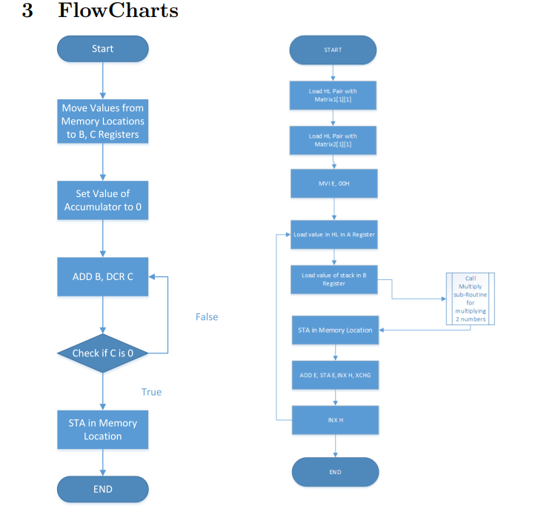
~ FlowCharts Figure 1: Multiplication of 2 numbers Figure 2: Mutliplying row with column

Slide 11
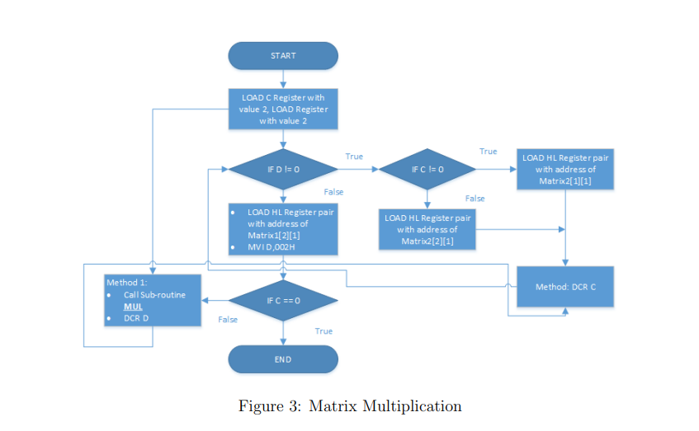
~ FlowCharts contd….

Slide 12
Implementation 1)code for multiplication(memory management of the code) ; two numbers to be multiplied ; are stored in 0002H and ; 0003H, ;output is stored in 0004H MOV B,0002H MOV C,0003H MVI A,00H LOOP: ADD B DCR C JNZ LOOP STA 0004H

Slide 13
; Load immediate value 8500H into register pair H LXI H, 8500H ; Push the content of memory address 8508H onto the stack PUSH 8508H ; Method: Store the content of register A into memory location pointed by HL MOV M, A ; Exchange the content of DE and HL register pairs XCHG ; Store the content of register B into memory location pointed by HL MOV M, B ; Call a subroutine named "MUL" CALL MUL ; Store the content of accumulator A into memory address 8516H STA 8516H
Multiplying rows with column

Slide 14
; Increment the value of register pair H (HL) INX H ; Exchange the content of DE and HL register pairs XCHG ; Increment the value of register pair H (HL) INX H ; Unconditional jump to the label "Method" JMP Method

Slide 15
MVI C, 00 ; Initialize register C with 00 LXI H, 8500 ; Load HL with memory address 8500 LOOP2: LXI D, 8600 ; Load DE with memory address 8600 ; Call subroutine MUL CALL MUL MOV B, A ; Move the content of A to B INX H ; Increment HL INX D ; Increment DE INX D ; Increment DE ; Call subroutine MUL CALL MUL ADD B ; Add B to A CALL STORE ; Call subroutine STORE DCX H ; Decrement HL DCX D ; Decrement DE ; Call subroutine MUL CALL MUL
Final code

Slide 16
MOV B, A ; Move the content of A to B INX H ; Increment HL INX D ; Increment DE INX D ; Increment DE ADD B ; Add B to A CALL STORE ; Call subroutine STORE MOV A, C ; Move the content of C to A CPI 04 ; Compare A with immediate value 04 ; Jump to LOOP1 if A is equal to 4 JZ LOOP1 INX H ; Increment HL JMP LOOP2 ; Jump to LOOP2 LOOP1: HLT ; Halt the microprocessor MUL: LDAX D ; Load A from memory address pointed by DE MOV D, A ; Move A to D MOV H, M ; Move the content of memory address pointed by HL to H DCR H ; Decrement H JZ LOOP3 ; Jump to LOOP3 if H is zero LOOP4: ADD D ; Add D to A DCR H ; Decrement H JNZ LOOP4 ; Jump to LOOP4 if H is not zero

Slide 17
LOOP3: MVI H, 85 ; Move immediate value 85 to H MVI D, 86 ; Move immediate value 86 to D RET ; Return from subroutine MUL STORE: MVI B, 87 ; Move immediate value 87 to B STAX B ; Store A in memory address pointed by BC INR C ; Increment C RET ; Return from subroutine STORE

Slide 18
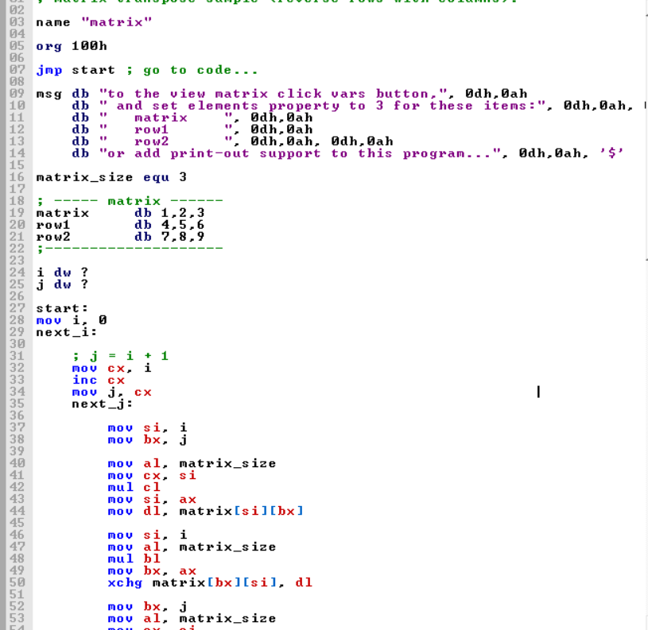
Visual representation of the code

Slide 19
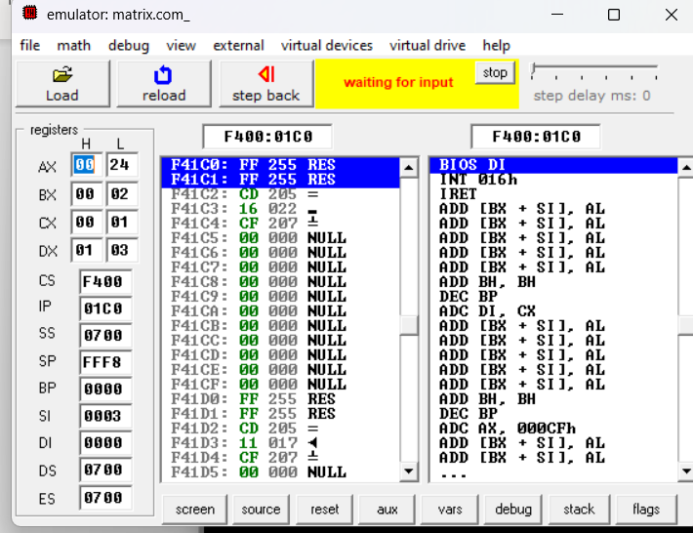
RESULTS ON VARIOUS COMPILER
1)EMU 8086

Slide 20
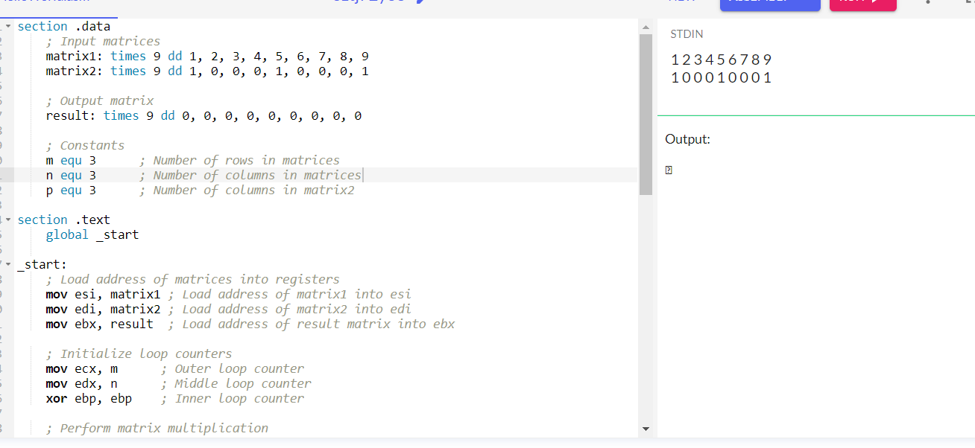
2)General Assembly Compiler

Slide 21
This project aims to implement an efficient matrix multiplication algorithm using the 8085 assembly language, showcasing the capabilities of the 8085 microprocessor in performing complex mathematical tasks. The goal is to optimize the assembly code for memory usage and performance while accommodating matrices of varying dimensions. This project also demonstrates the practical application of assembly language programming in scientific computing and other fields. Ultimately, the project seeks to highlight the microprocessor's potential for advanced calculations and underscore its significance in historical and contemporary computing contexts.
Objective of the project

Slide 22
• Matrix multiplication is used in graphics and computer animation for transforming 2D and 3D objects and creating realistic animations. • It finds application in engineering and physics for solving linear equations and analyzing electrical circuits. • Economics and finance utilize matrix multiplication in Markov chain modeling and portfolio optimization. • In machine learning and data analysis, it underpins neural networks and principal component analysis (PCA).
Application of the project

Slide 23
Timeplan 10-Week Project Summary Week 1-2: Planning & Research Conducted market research. Drafted preliminary blueprints. Excluded development, marketing, and post-launch activities. Week 3-4: Algorithm Implementation Developed 2x2 matrix multiplication in 8085 assembly. Laid groundwork for future enhancements. Week 5-6: Microprocessor Adaptation Modified algorithm for 8085 constraints. Addressed memory limitations and register efficiency. Week 7-8: Interface Development Crafted UIs for library admin and patrons. Incorporated search, dashboard, and reservation tools. Week 9-10: Testing & Optimization Conducted comprehensive tests. Identified and rectified bottlenecks. Optimized for 8085 capabilities. Conclusion: Over 10 weeks, the team transitioned from foundational research to creating an efficient matrix multiplication algorithm tailored for the 8085 microprocessor, along with user-centric interfaces for library operations.

Slide 24
1) Microprocessor Architecture, Programming, and Applications with the 8085 - S Gaonka 2) http://google.com 3)http://en.wikipedia.org/wiki/Matrix multiplication
References

