Slide 1
Kernel Density Based Linear Regression
A Superior Approach To Handle Outliers and Data Patterns
A novel approach to linear regression that leverages kernel density estimation to enhance model robustness and performance
Roshan Niranjan Kalpavruksha
RK68465N

Slide 2
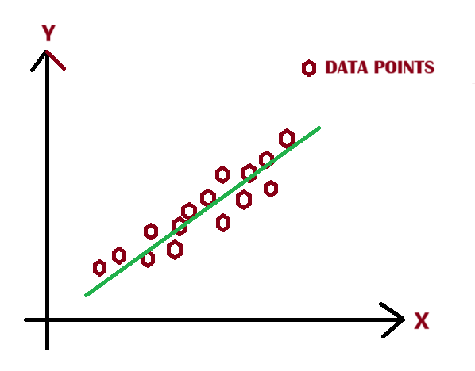
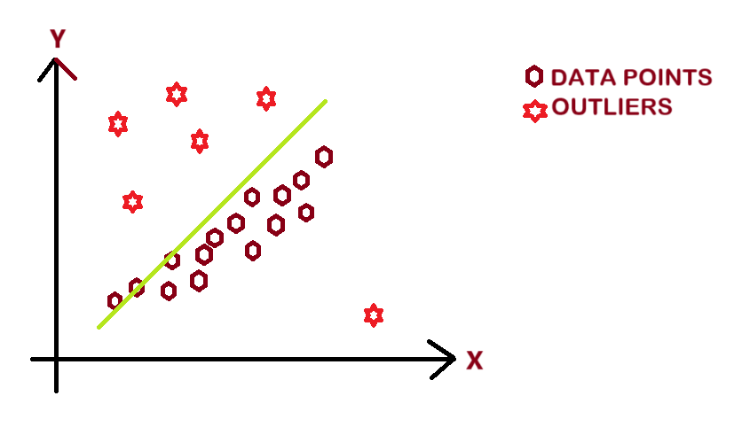

The Real Challenge:
Ignoring density-driven patterns leads to inaccurate models that miss critical insights
Linear Regression Falls Short:
Assumes that all data points are equally significant and struggles with outliers
motivation
Motivating Question:
How to emphasize true patterns while ignoring noise for more accurate pattern recognition?
Can we create a regression method that not only fits data better but also learns the structure and resists noise?

Slide 3
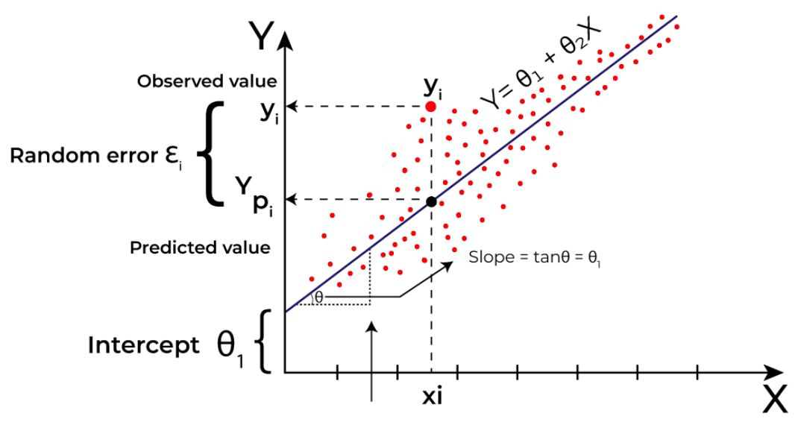
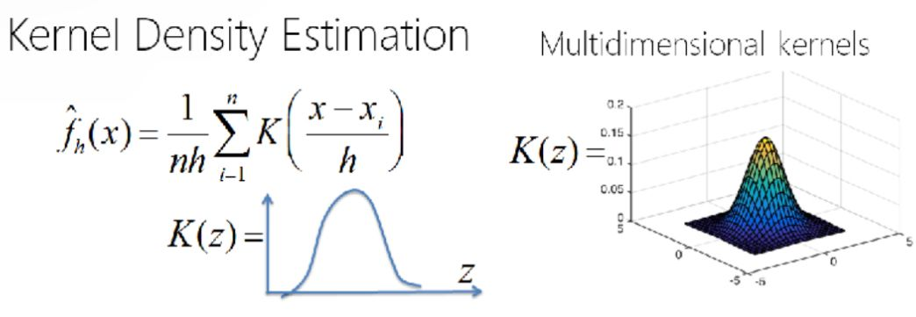

Linear Regression
Fits a line by minimizing the residual sum of squares
Equal weight to all data points, making it susceptible to noise and outliers
Kernel Density Estimation
Assigns higher weights to dense regions and lower weights to sparse regions
Doesn't directly integrate with regression models to make predictions
novelty
Kernel Density Based Linear Regression
Combines strengths of KDE and tackles limitations of LR
KDLR dynamically adjusts influence of each point based on density
KDLR improves robustness, enhances pattern recognition

Slide 4
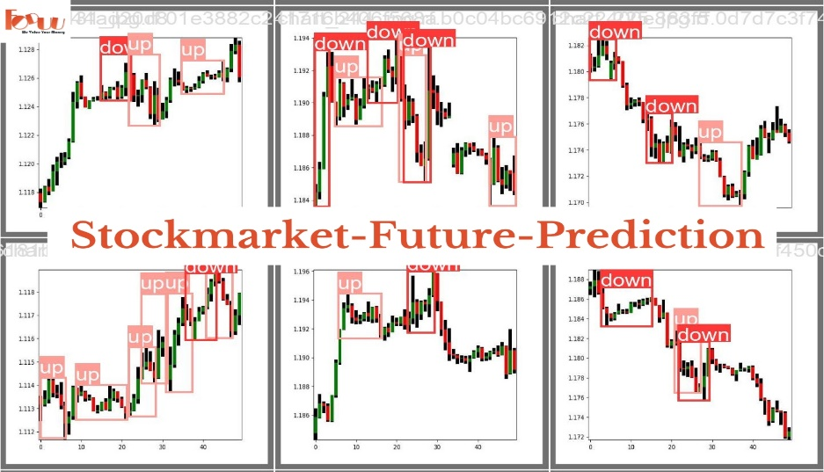
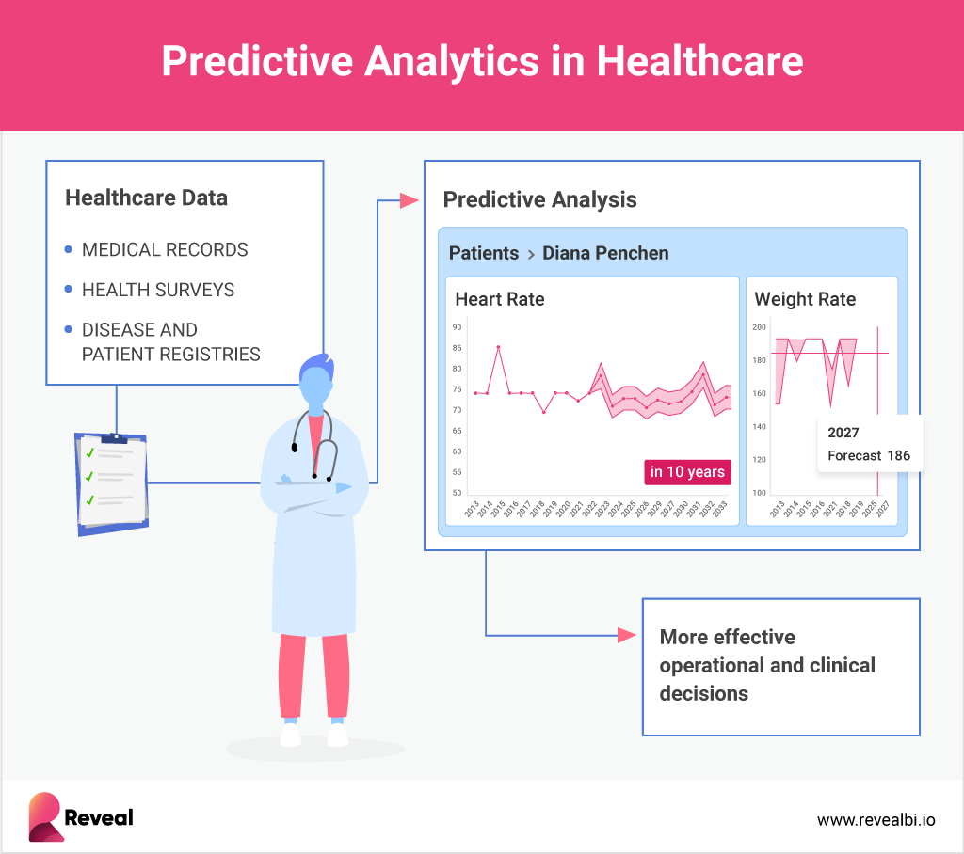

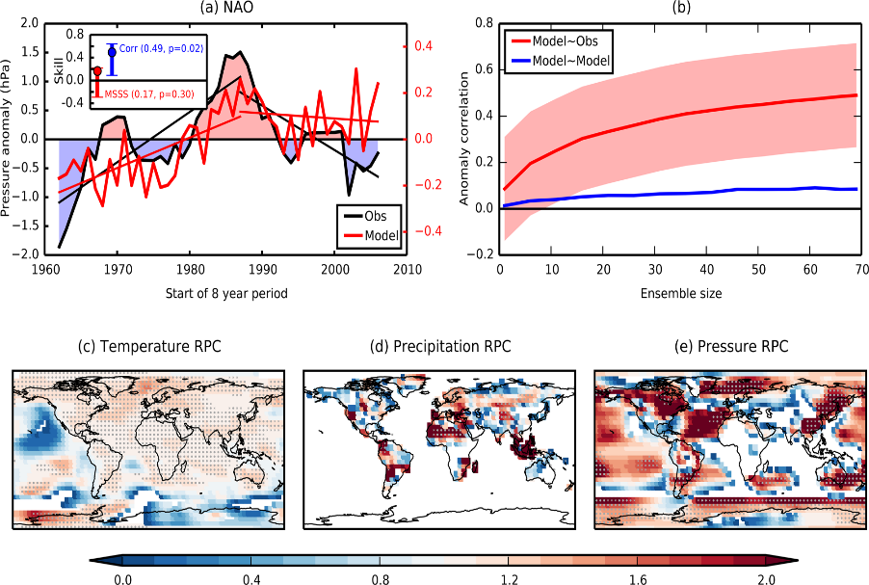
Finance: Stock price prediction with sparse anomalies
Healthcare: Modelling patient data with outliers (e.g. rare conditions)
application
Environment: Robust regression in climate modelling.

Slide 5
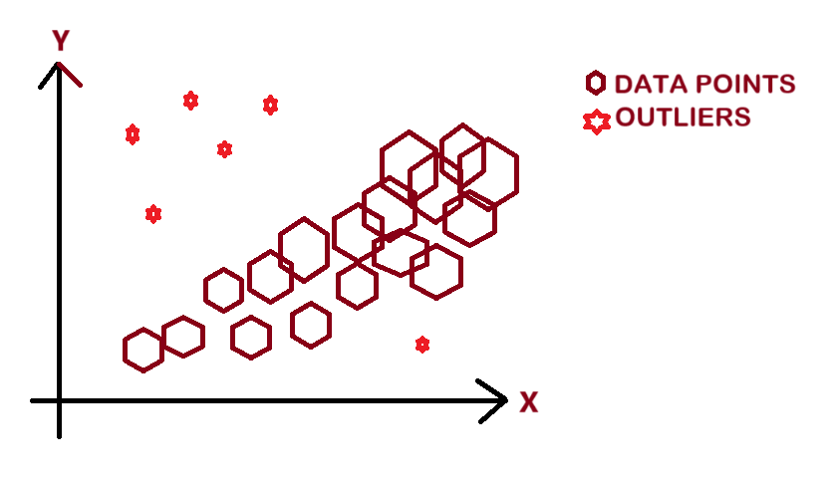
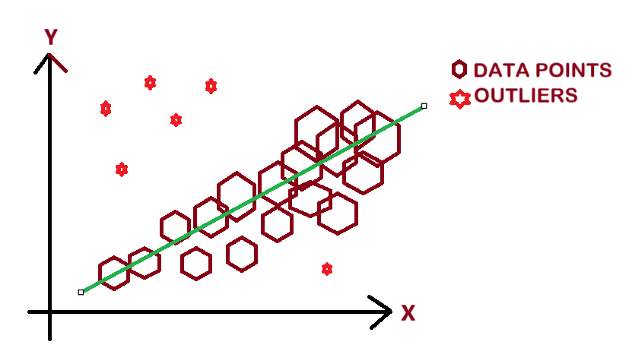
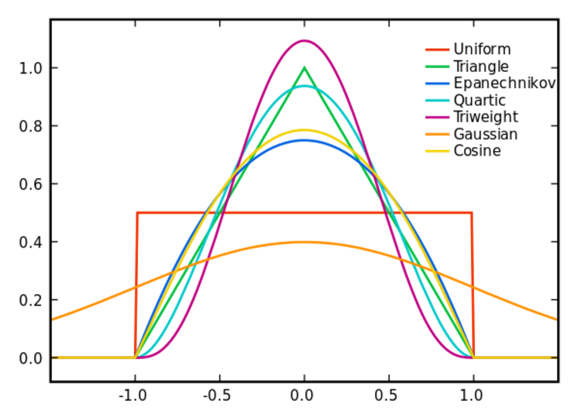
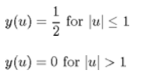

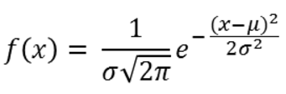




Slide 6

KDE
Weight Calculation
Compute kernel density for each data point using a kernel function
Derive weights prioritizing densely regions & reducing the influence of outliers
methodology
Weighted LR
Evaluation
Fit the linear regression model using those weights
Compare performance with traditional regression (MSE & R²)

Slide 7
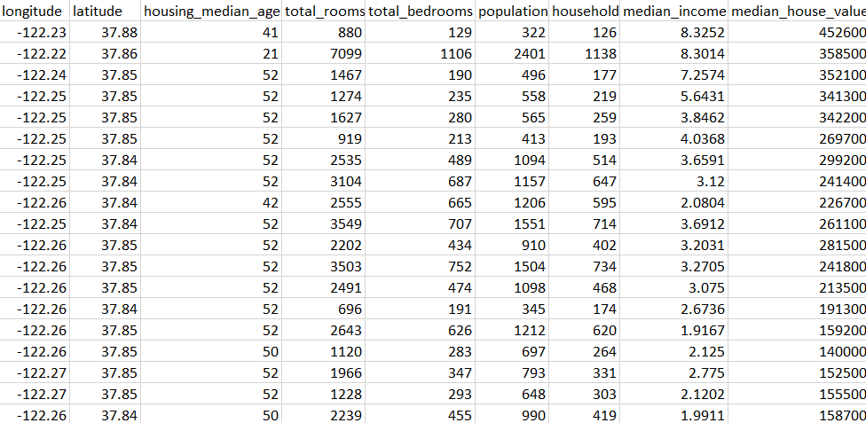
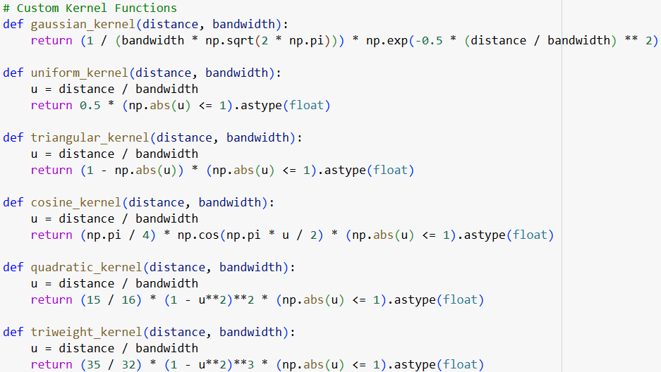


Slide 8
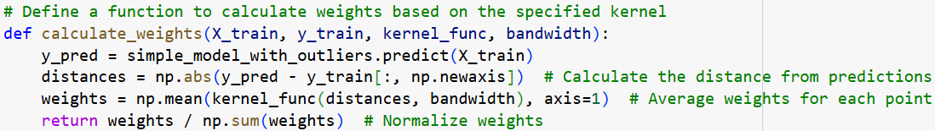
Kernel Density Estimation: Computing Data Density
Uses kernel functions to calculate distances between predicted values and actual values
These distances are converted into weights based on density using the specified kernel function
algorithm
Weight Assignment: Assign Higher Weights to Denser Regions
The kernel function assigns higher weights to denser regions (smaller distances) and lower weights to sparser or outlier regions (larger distances)
Weights are normalized to ensure they sum to 1

Slide 9
Weighted Linear Regression: Fit the Model with Adjusted Weights
The Linear Regression model is trained using the computed weights via the sample_weight parameter.
This ensures that denser data points influence the model more, while sparse or outlier points have less impact
algorithm
Evaluation: Measure Performance (MSE, R²)
The performance of the KDLR model is compared with the simple linear regression model.
Metrics like Mean Squared Error (MSE) and R² are computed for evaluation

Slide 10
Dataset | SLR MSE | Best Kernel’s MSE | |Simple MSE – Kernel MSE| | SLR R² | Best Kernel’s R² | |Simple R² - Kernel R²|
Original | 0.5559 | C:0.5547 G:0.5550 Q:0.5558 | 0.0012 | 0.5758 | C:0.5767 G:0.5764 Q:0.5759 | 0.0009
50 Outliers | 0.5688 | C:0.5547 G:0.5552 Q:0.5553 | 0.141 | 0.5659 | C:0.5767 G:0.5763 Q:0.5763 | 0.0108
200 Outliers | 0.7392 | Q:0.5546 C:0.5547 G:0.5547 | 0.1845 | 0.4359 | Q:0.5767 C:0.5766 G:0.5766 | 0.1408
350 Outliers | 1.1043 | U:0.5554 G:0.5554 C:0.5556 | 0.5489 | 0.1573 | U:0.5762 G:0.5762 C:0.5760 | 0.4159
results

Slide 11
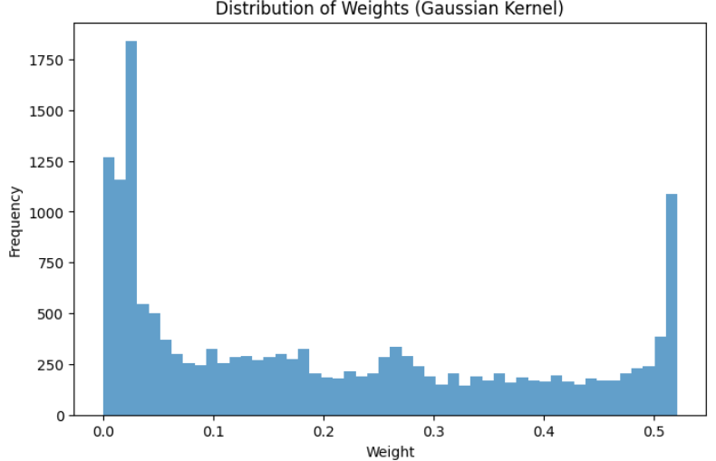
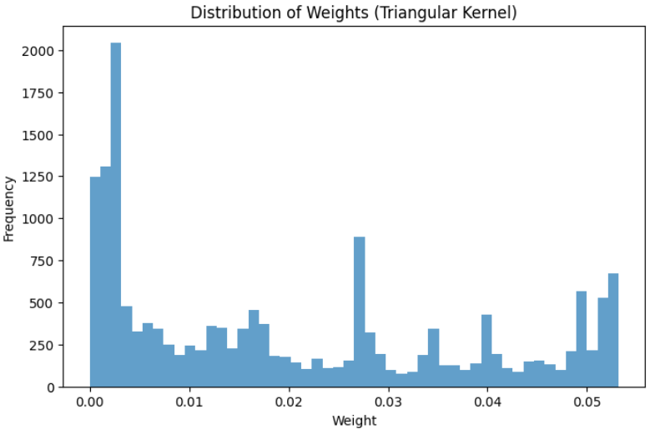

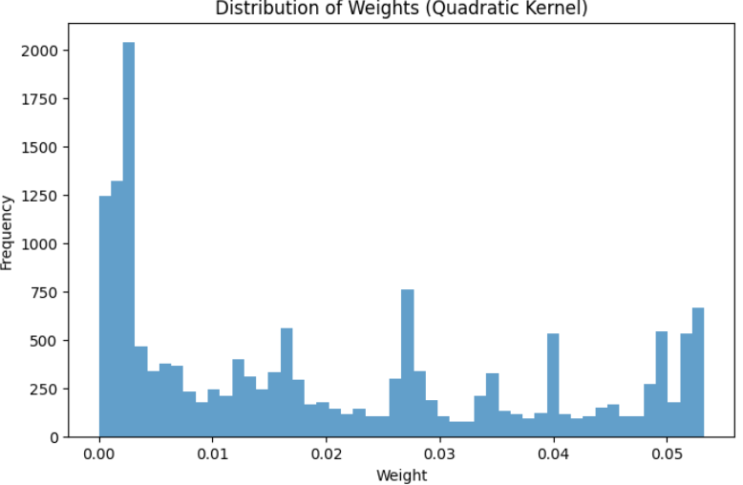
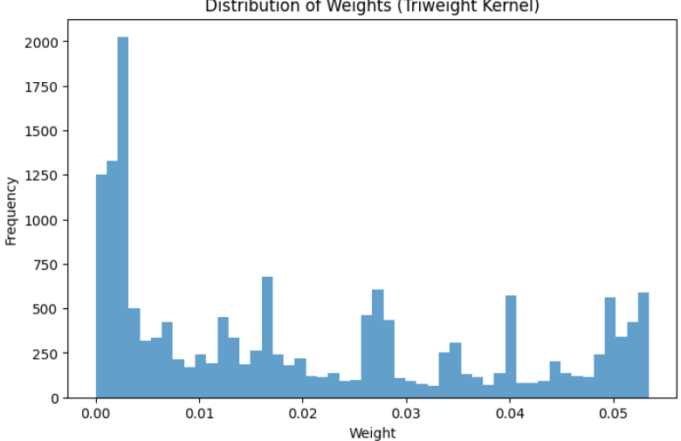
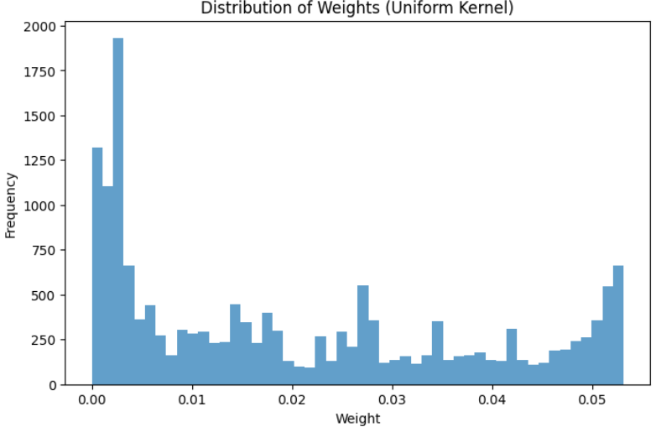
Distribution of Weights for different Kernels

Slide 12
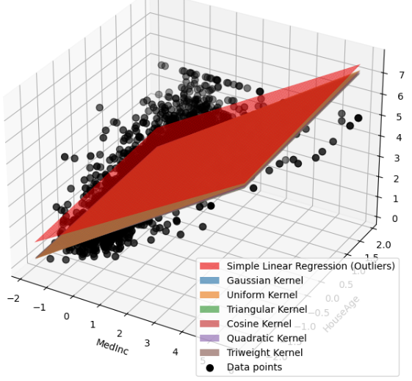
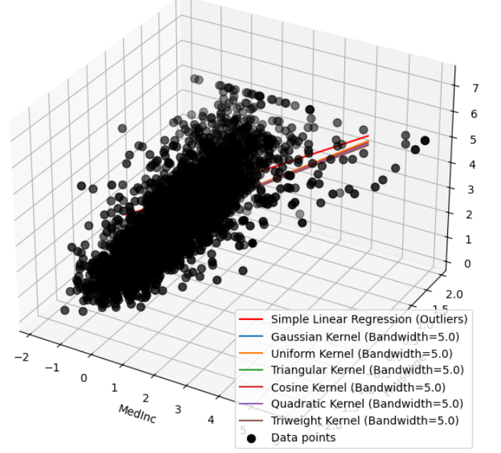
350 Outliers

Slide 13
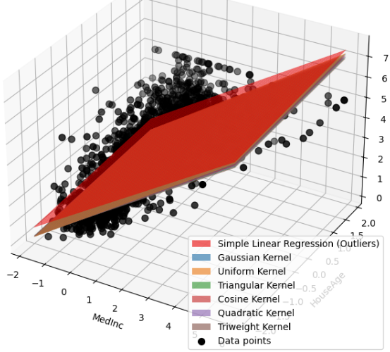
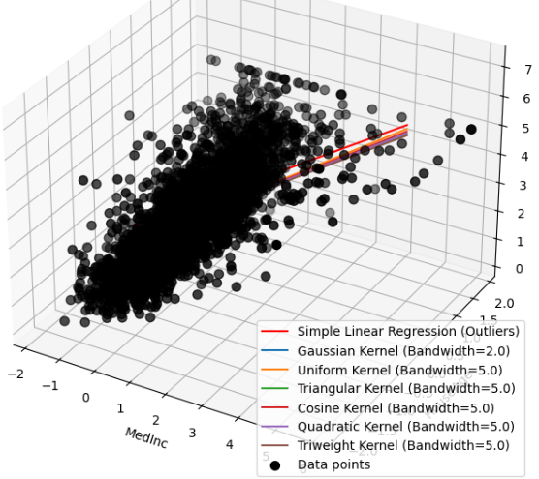
200 Outliers

Slide 14
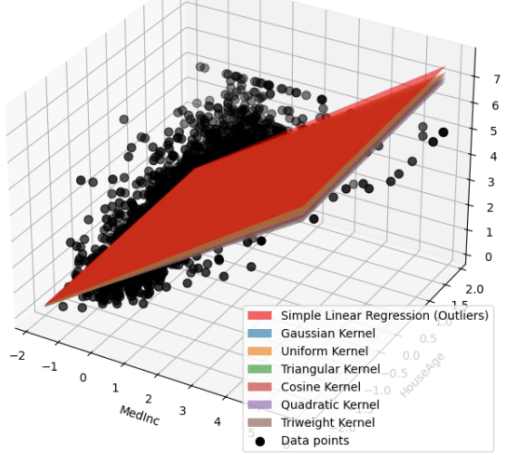
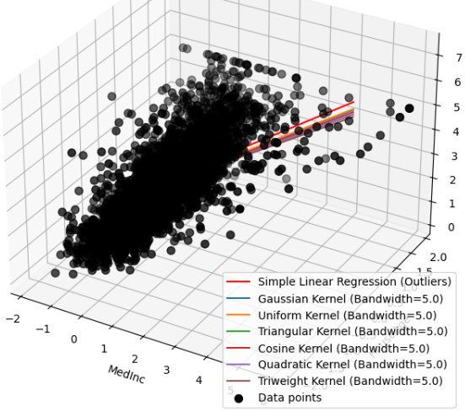
50 Outliers

Slide 15
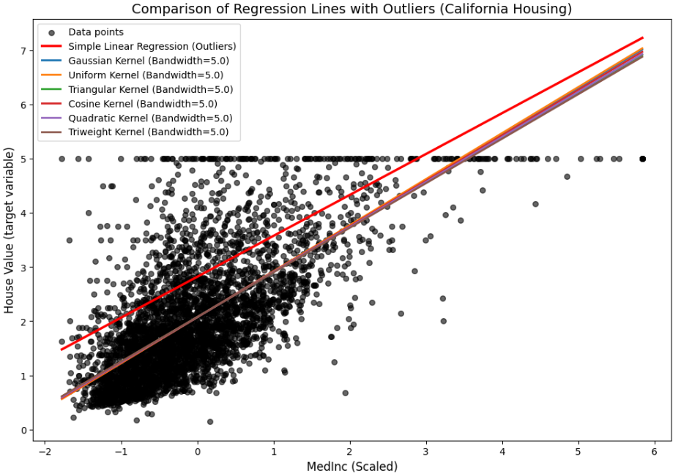
UNIVARIATE ANALYSIS

Slide 16
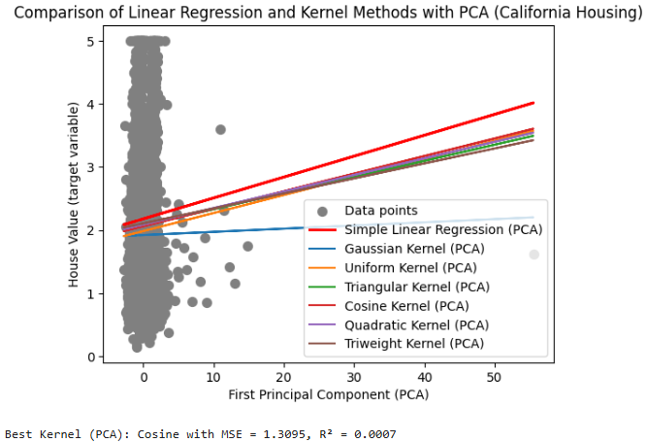
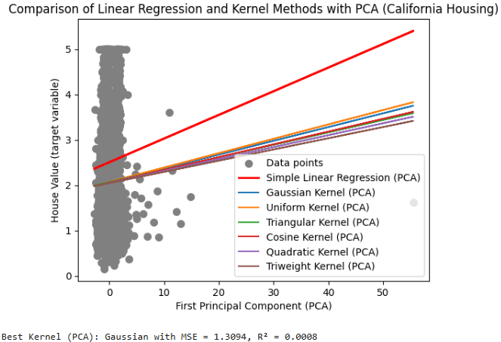
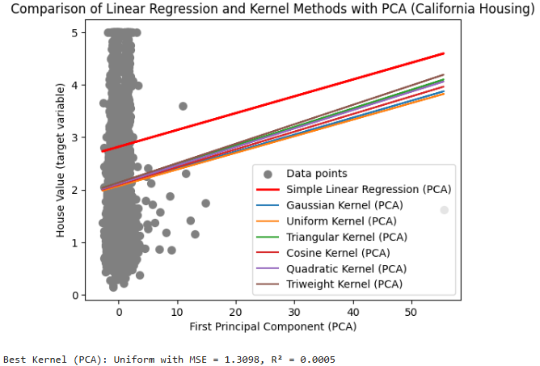
Applied PCA to Data
50 Outliers
200 Outliers
350 Outliers

Slide 17


Key Takeaways
Improved Robustness: Reduces influence of outliers, resulting in more reliable predictions
Enhanced Flexibility: Offers a practical alternative to LR in complex real-world scenarios and adaptable for various domains.
Scalable Methodology: Extendable to ensemble models and hybrid techniques
conclusion
Future Scope
Explore applications in advanced fields such as anomaly detection and time-series forecasting
Integrate KDLR into machine learning pipelines for hybrid modelling

