Slide 1
Each group should present their project for about 15 minutes which will be followed by 15 minutes of questions from the academics assembled. Things to consider presenting include:
· Your understanding of the project and the tasks involved.
· Why are you doing it? What’s the end goal? What’s the measure of success?
· A breakdown of these tasks against team member
· A coherent plan of action for the project including important milestones etc. Perhaps a Gantt chart.
· Identify any risks, requirements, training needs, lab usage etc.
· Any work to date
This is purely a formative exercise, there will be no marks awarded instead see this as a valuable opportunity for you to get some feedback on what you propose to do (or have done so far) from academics other than your supervisor. You will be expected to present your project next June so this is also a good opportunity to practice your presentation skills.

Slide 2
Group Design Project No.13 Design, Build and Test of a Smart Wing UAV

Slide 3
Project Scope
"Develop a Smart UAV main wing capable of maintaining a steady trajectory profile, by measuring and controlling the lift distribution across the main wing using trailing edge flaps.”

Slide 4
Motivation
Notes:
Fintan

Slide 5
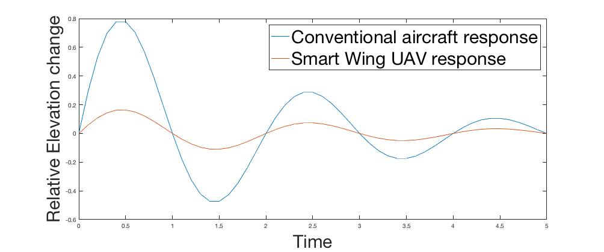

Project Aim
Design and build a UAV which is able to maintain steady flight by keeping a constant lift on the main wing.
Gusts can alter the static stability of the aircraft, as ideally ($\frac{∂C_{L}{\left.​\right|}_{Main Wing}}{∂α}=0)$, resulting in a but lower amplitude response to gusts in terms of elevation change.
Notes:
Why we want to steady trajectory?

Slide 6
Project Objectives
Develop a system to measure the pressure distribution across a main wing.
Design a control system to control the pressure distribution across the main wing.
Validate the measurement and control system in both wind tunnel tests and as part of a UAV.

Slide 7
Work Break Down
Control System Design and Electronics:
Roshan Pasupathy
Anthony Aldo Hill
Simulation and Aerodynamics
Christopher Bunn
Fintan Healy
Parts Design and Manufacturing
Fang Hwa Ting
Louis Winter
Nikolay Tarasov
Notes:
Felicia

Slide 8
Project Planning: Gantt Chart

Slide 9
Project Planning: Gantt Chart (Continued)

Slide 10
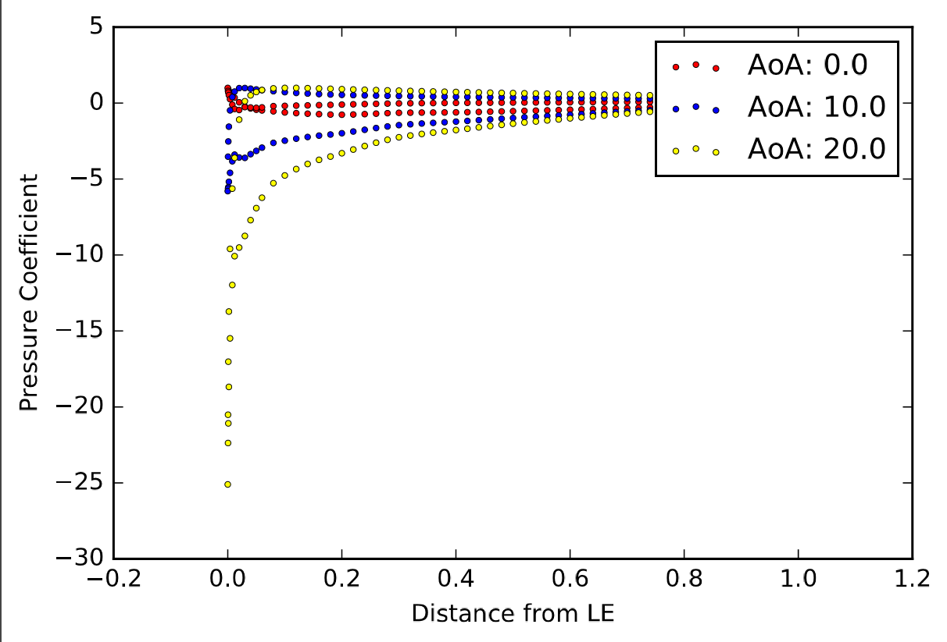
Measuring Pressure – Using Pressure Sensors
Used to measure pressure at points on the wing during flight.
This can then be used to predict lift.
Flap angles will be driven by predicted lift to try and maintain a constant trajectory.
Pressure Distribution at varying Angles of Attack for a Clark Y Aerofoil in Xfoil
Notes:
Clark Y Aerofoil

Slide 11
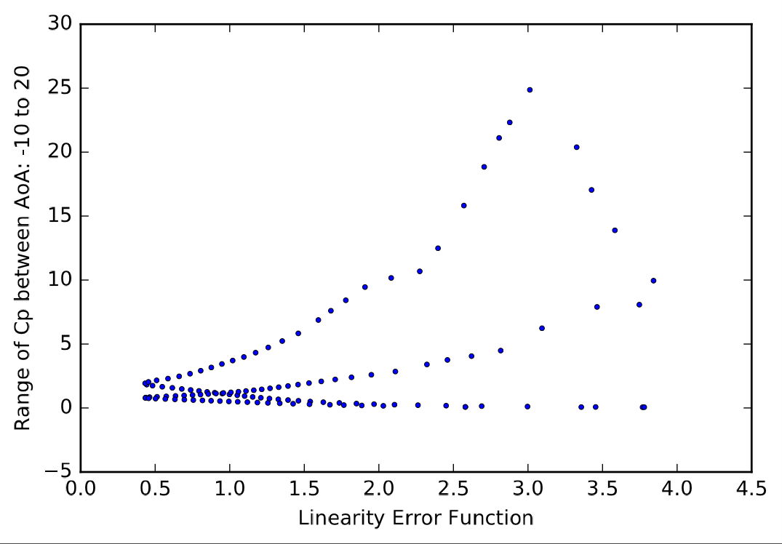
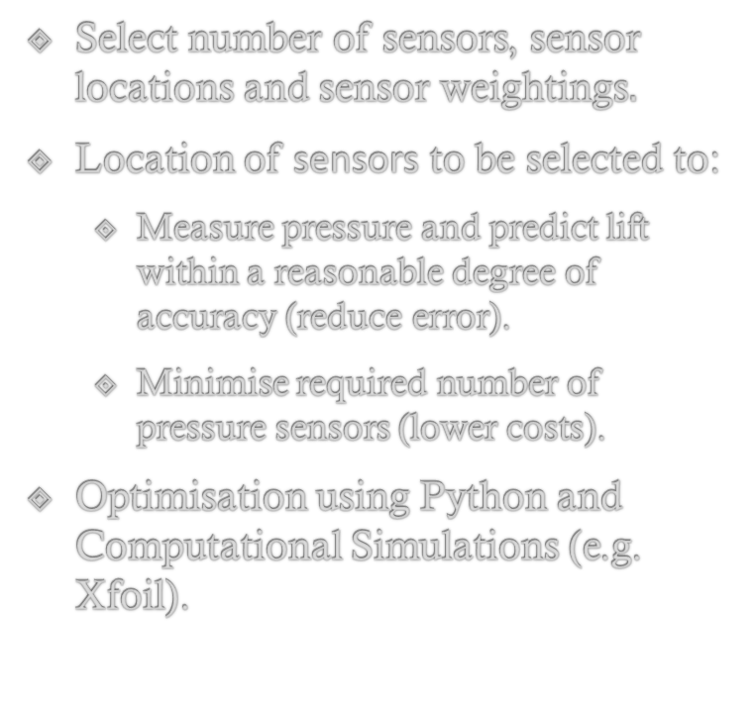
Measuring Pressure – Sensor Locations
Select number of sensors, sensor locations and sensor weightings$.$
Location of sensors to be selected to:
Measure pressure and predict lift within a reasonable degree of accuracy (reduce error).
Minimise required number of pressure sensors (lower costs).
Optimisation using Python and Computational Simulations (e.g. Xfoil).
“Linearity function for change in pressure” and “Range of pressure” for varying x/y coordinates on a Clark Y Aerofoil
Notes:
Clark Y Aerofoil

Slide 12
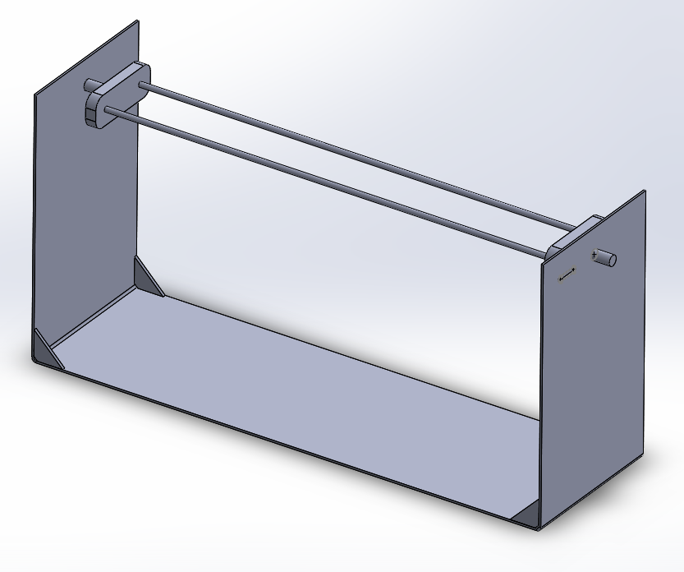
Test Rig
Holds wing section in middle of air flow
Changing wing sections easy - allowing for quick turnover
Sensor wires are easy to manage and place
Easy to make: sheet steel and 3D-printed parts
Dimensions 500x250x150m
Notes:
Clark Y Aerofoil

Slide 13
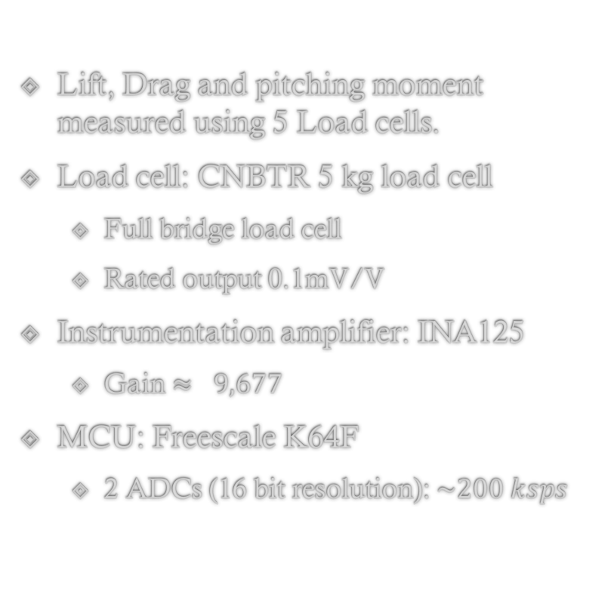
Test Rig (Continued)
Lift, Drag and pitching moment measured using 5 Load cells.
Load cell: CNBTR 5 kg load cell
Full bridge load cell
Rated output 0.1mV/V
Instrumentation amplifier: INA125
Gain $≈ 9,677$
MCU: Freescale K64F
2 ADCs (16 bit resolution): $\sim 200 ksps$
Notes:
Clark Y Aerofoil

Slide 14
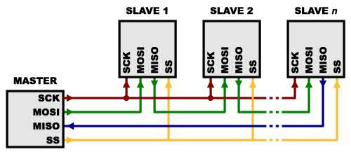
Sending and Receiving Data
Using the fast communication speed (up to MHz) of SPI – able to connect multiple sensors in an array using a “Daisy-Chain” configuration.
All slaves represent a BMP280 sensor, which share MOSI and MISO data lines.
By using a Daisy-Chain configuration the number of chip select (SS) pins in the master can be minimised.
By A shift register will be connected between the master SS pin and the slaves in order to multiply the SS outputs.

Slide 15
Pressure sensor to measure pressure distribution
Bosch BMP280 pressure sensor
Parameter | BMP280
Footprint | 2.0 x 2.25 mm
Minimum Supply Voltage | 1.71 V
Current Consumption @ 3Pa RMS Noise | 2.7 µA
RMS Noise | 1.3 Pa
Interfaces | I²C & SPI
Measurement Rate | Up to 157 Hz
Relative Pressure Accuracy @3.3V | ±0.12 hPa

Slide 16
Processing and Control
An Arduino Uno will serve as the SPI master for the sensors and for controlling the wing flaps to adjust lift.
A PID controller will be implemented on an onboard Raspberry Pi.
Measured variable => pressure over wing surface
Setpoint => Desired Lift
Data transfer between the Raspberry Pi and Arduino will be carried out via I²C.

Slide 17
UAV Implementation
After completion of testing in the wind tunnel we will attach the wing onto a premanufactured fuselage and tail plane.
This will allow more time to be spent developing and testing the wing technology.

Slide 18
Work to date: Sectional Design Idea
Using sensor array that controls one flap, where the system can be replicated to include multiple flaps along the wing

Slide 19
Manufacturing
Buy pre-built fuselage and tailplane and replace standard wings with “smart wings”, allowing more time to be spent on development and testing of wing technology
Likely to foam cut wings and embed pressure sensors in desired locations

