Slide 1
IMAGE CAPTION GENERATOR
Project based on the learning in the internship.
Roshan Upadhyay | B. Tech. Artificial Intelligence | RA2011047010015

Slide 2
Modules
Data Preprocessing and Model Architecture
Training and Testing Model and Finetuning hyperparameters
Output / Result

Slide 3
Data Preprocessing and Model Architecture
Notes:
This is the question that your experiment answers

Slide 4
“Flickr 8k dataset” is used
A .ipynb file is created in jupyter notebook.
All the necessary libraries are imported.
The dataset is imported in the python .ipynb file.
Extract image features
Load the Caption Data
Preprocessing Text Data
Model Architecture

Slide 5
Training and Testing Model and Finetuning hyperparameters
Notes:
This is the question that your experiment answers

Slide 6
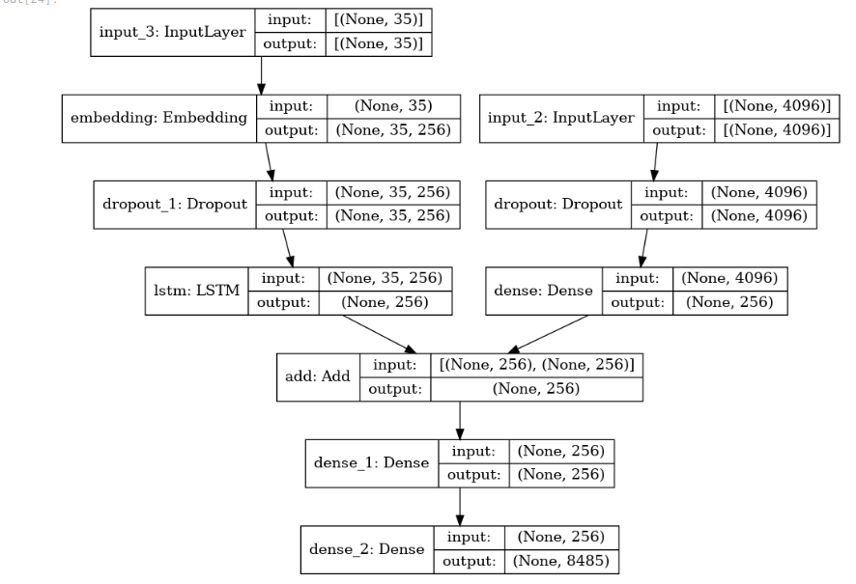
Train Test Split
Model Creation
Generate Captions for the Image
Hyperparameter tuning

Slide 7
Output / Result
Notes:
This is the question that your experiment answers

Slide 8
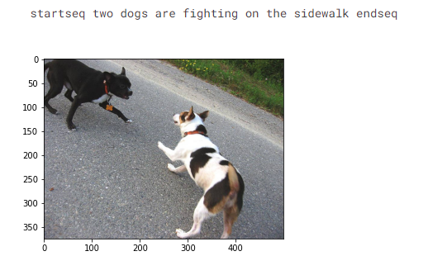
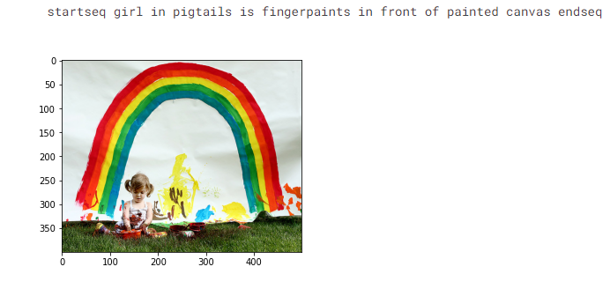
Visualize the Results

Slide 9
Modules Completed and Result

Slide 10
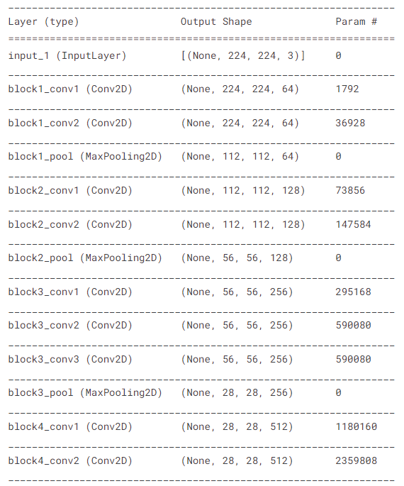
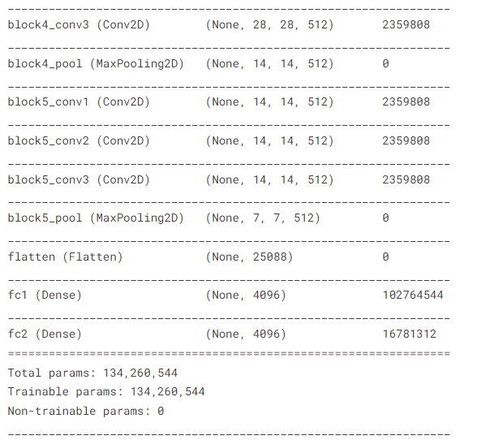
Model Architecture
Data Preprocessing and Model Architecture

Slide 11
Current Module Status
Notes:
Establish hypothesis before you begin the experiment. This should be your best educated guess based on your research.

Slide 12
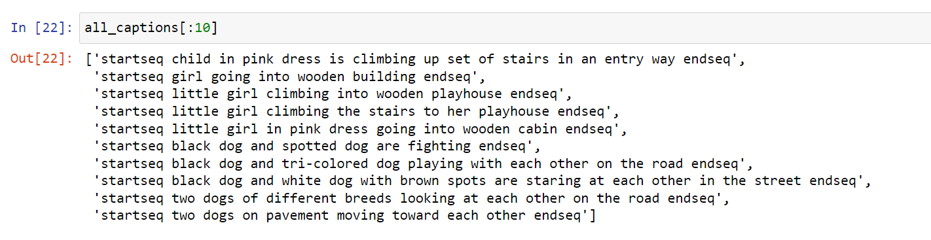
Completed
Data Preprocessing Result

Slide 13
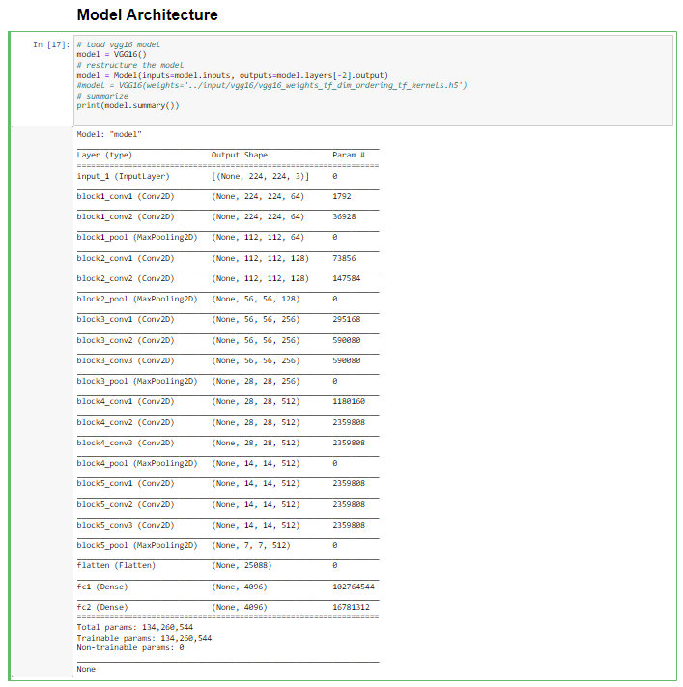
Model Architecture
CNN (VGG16)
+
LSTM

Slide 14
Thank You

