Slide 1
Industrial Training Review - 3
Roshan Upadhyay | B. Tech. Artificial Intelligence | RA2011047010015

Slide 2
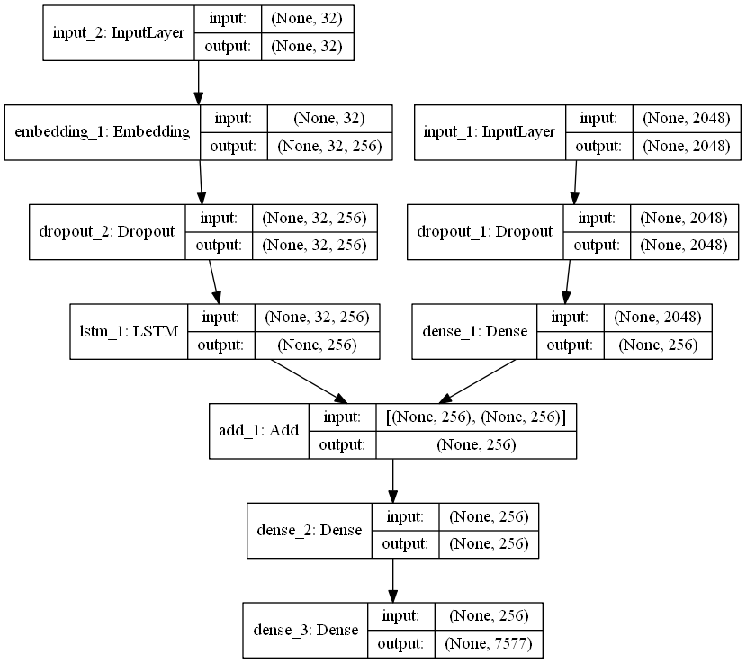
Project analysis slide 6
Data Preprocessing
and
Model Architecture
“Flickr 8k dataset” is used
A .ipynb file is created in jupyter notebook.
All the necessary libraries are imported.
The dataset is imported in the python .ipynb file.
Extract image features
Load the Caption Data
Preprocessing Text Data
Model Architecture

Slide 3
Project analysis slide 6
Training and
Testing Model
and
Finetuning
hyperparameters
Train Test Split
Model Creation
Generate Captions for the Image
Hyperparameter tuning

Slide 4
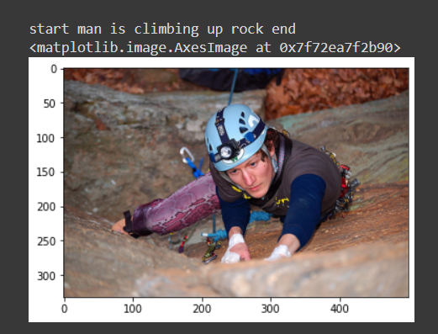
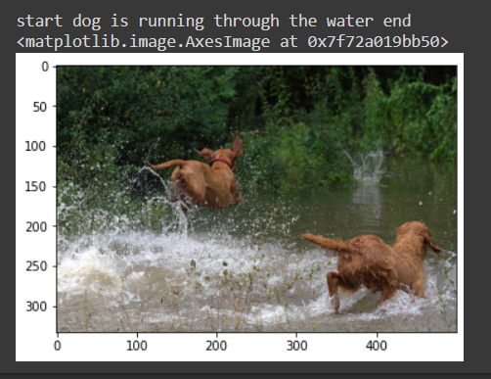
Project analysis slide 6
Output / Result
https://drive.google.com/file/d/1qD9VHRLYwAky6dIVJFZAxwVzDUW8KJm5/view?usp=share_link

Slide 5



Project analysis slide 6
Language or
Software used
Python
Jupyter Notebook
Google Colab

Slide 6
Thank You

