Slide 1

Stock Market analysis with DL
Roshanak Behrouz
2026

Slide 2

Project Goal
The objective is to predict the next day's closing price of a stock based on a window of previous 60 days.

Slide 3



Dataset
Ticker | Sector | Market Behavior
NVDA | Tech / AI | Hyper-Growth & Momentum. Explosive trends, huge volatility, "fat tails" (extreme outliers).
KO | Staples | Defensive & Stable. Low volatility, mean-reverting, slow steady growth.
JPM | Financials | Cyclical & Macro. Moves with the economy. Highly sensitive to interest rates.

Slide 4
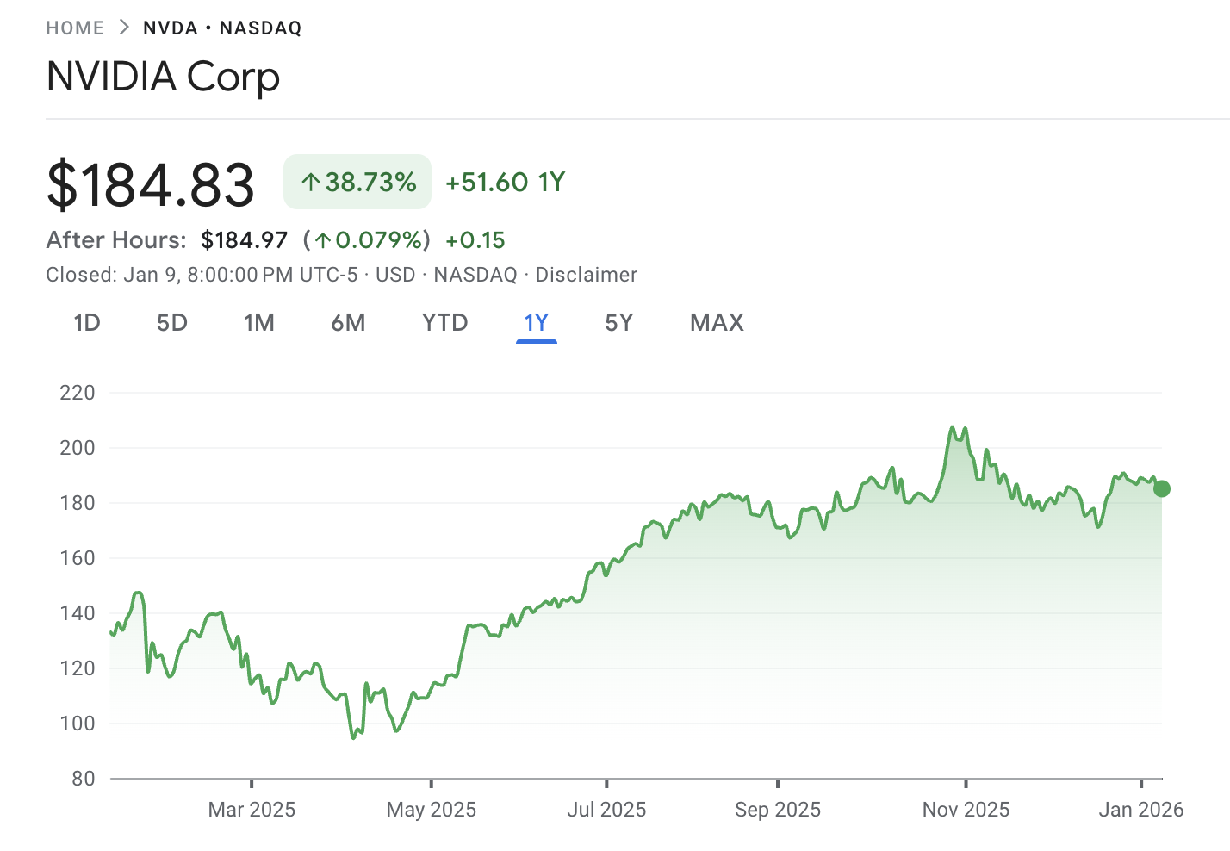
Data Acquisition
Source: Historical stock market data is downloaded directly using the yfinance API.
Date Range: 2015-2024
Raw Features: The initial dataset includes standard market data
Open
High
Low
Close
Volume
Notes:
Data Source: Uses the yfinance library to download daily stock history

Slide 5
Feature Engineering :
Feature | Type | Role in Prediction
RSI | Momentum | Detects Reversals: Tells the AI if the stock is "overheated" or "undervalued."
MACD | Trend | Identifies Direction: Helps the AI recognize the start of new trends vs. random noise.
SMA_20 | Smoothing | Provides Context: Gives a stable baseline to filter out daily market volatility.

Slide 6
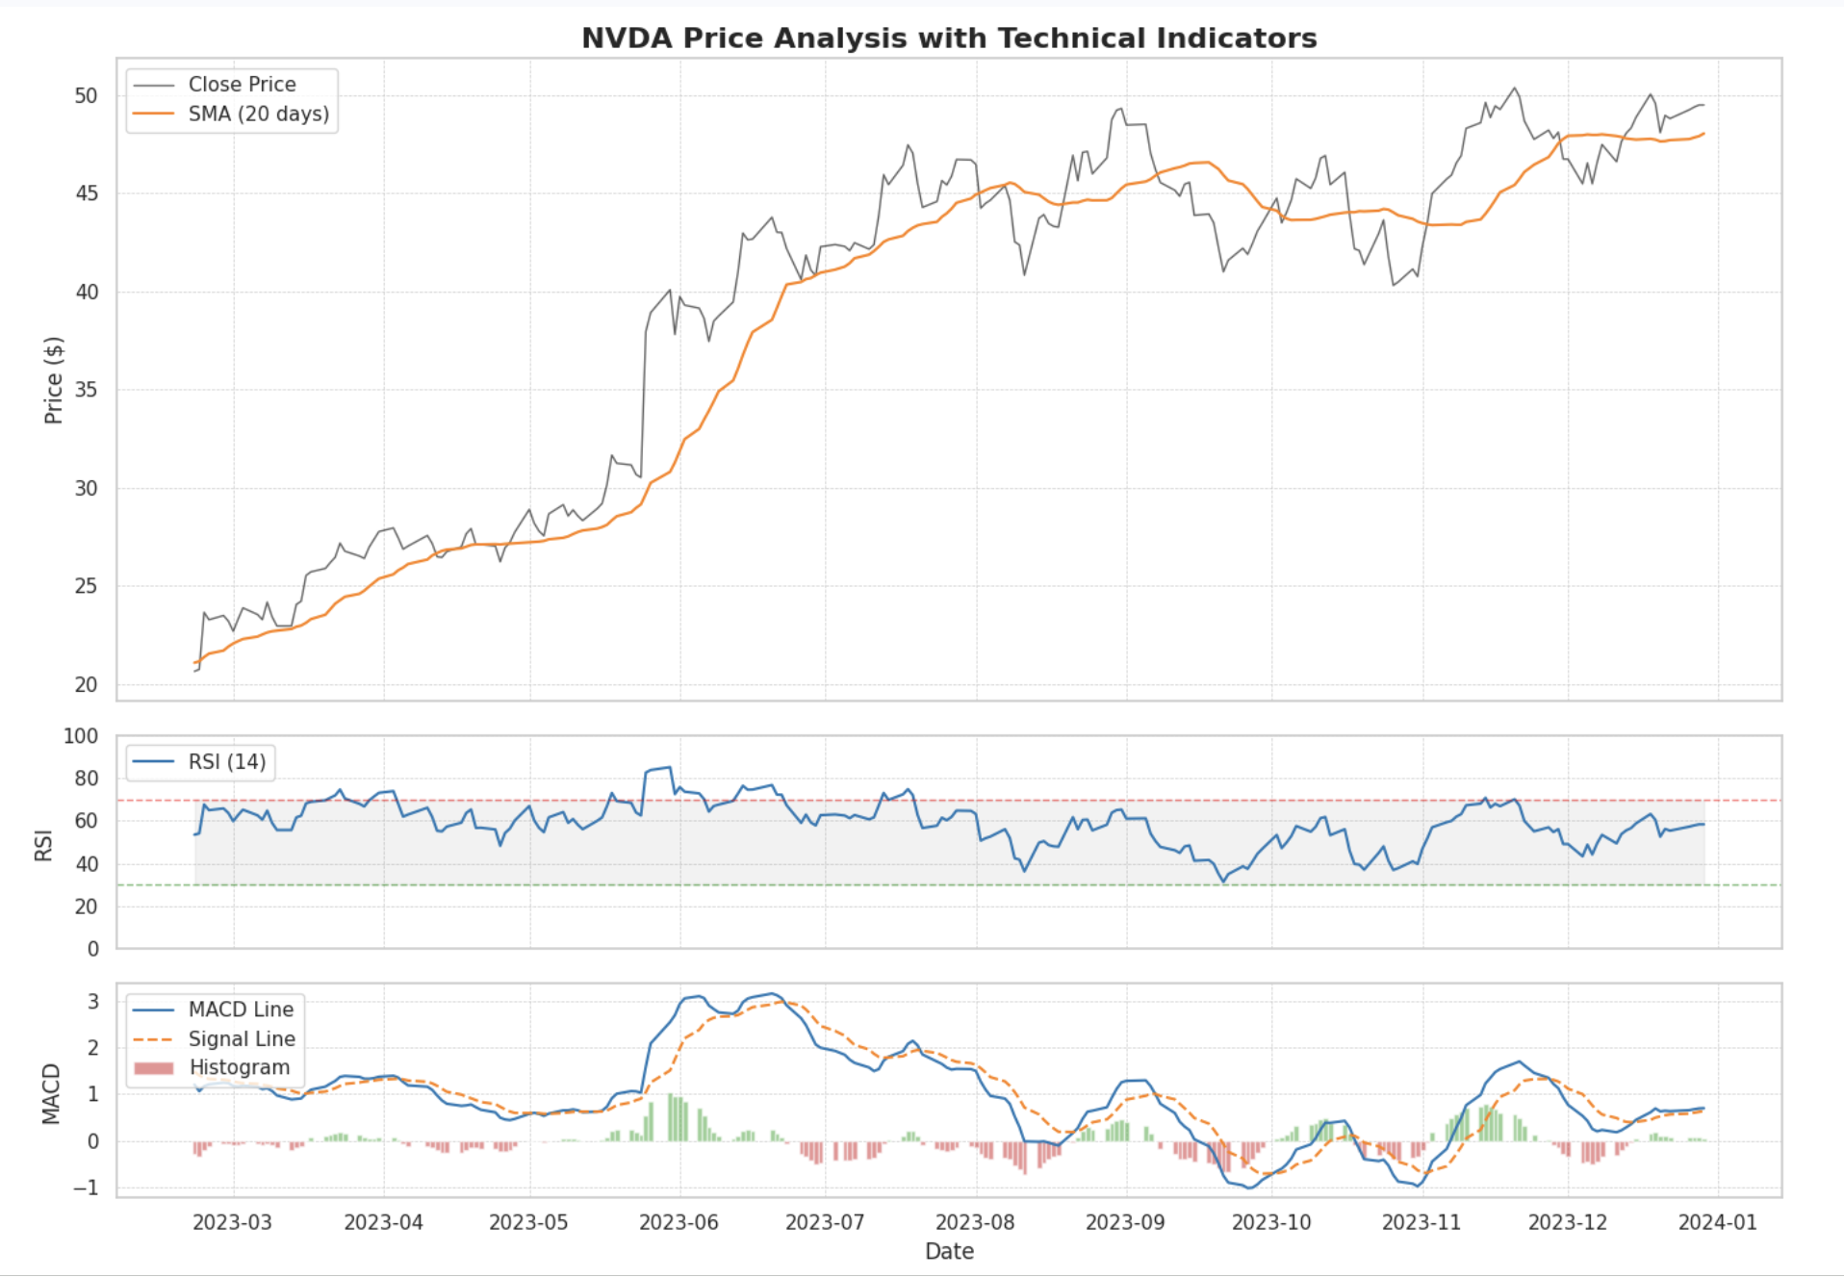
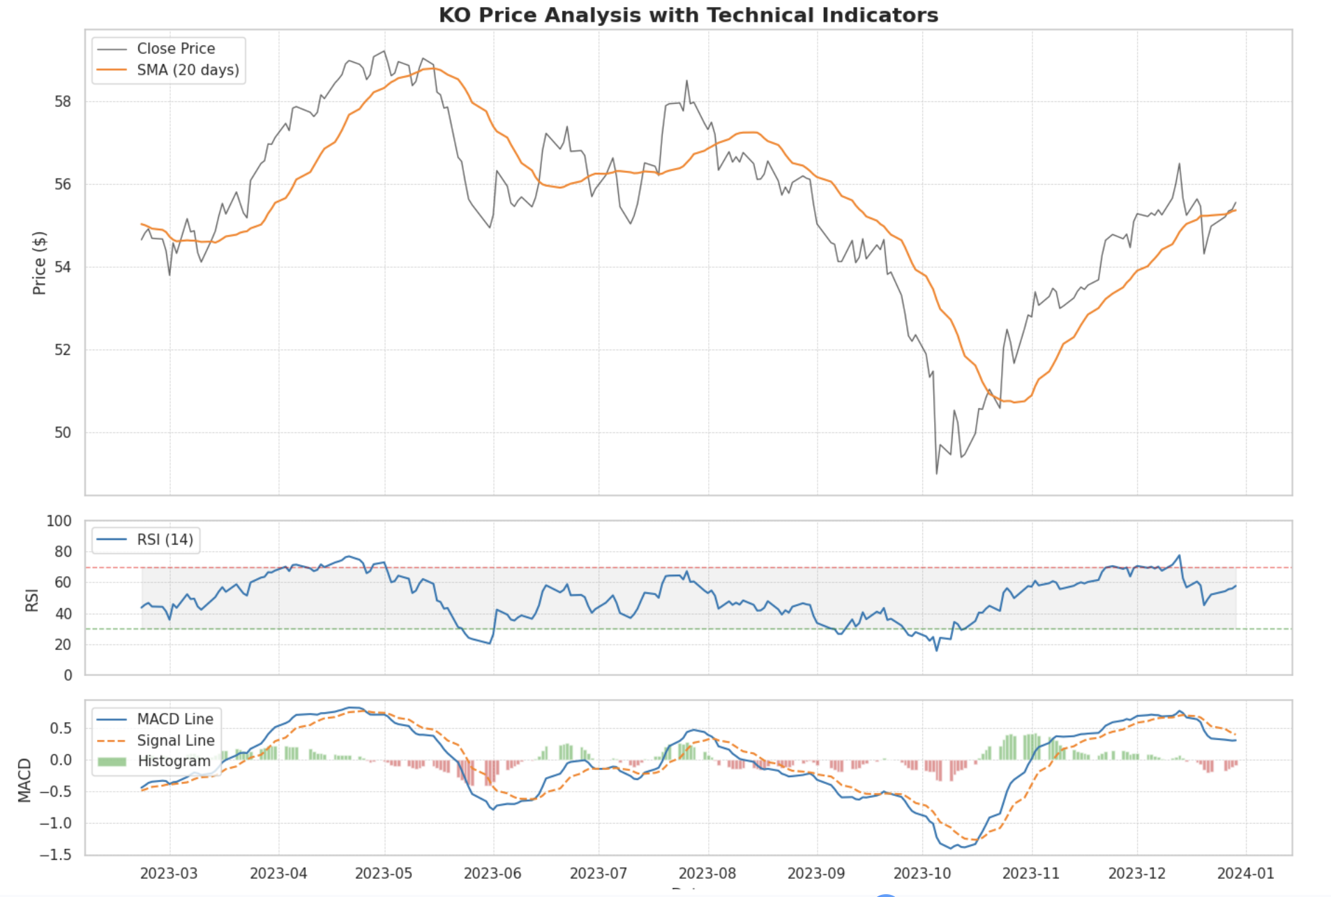
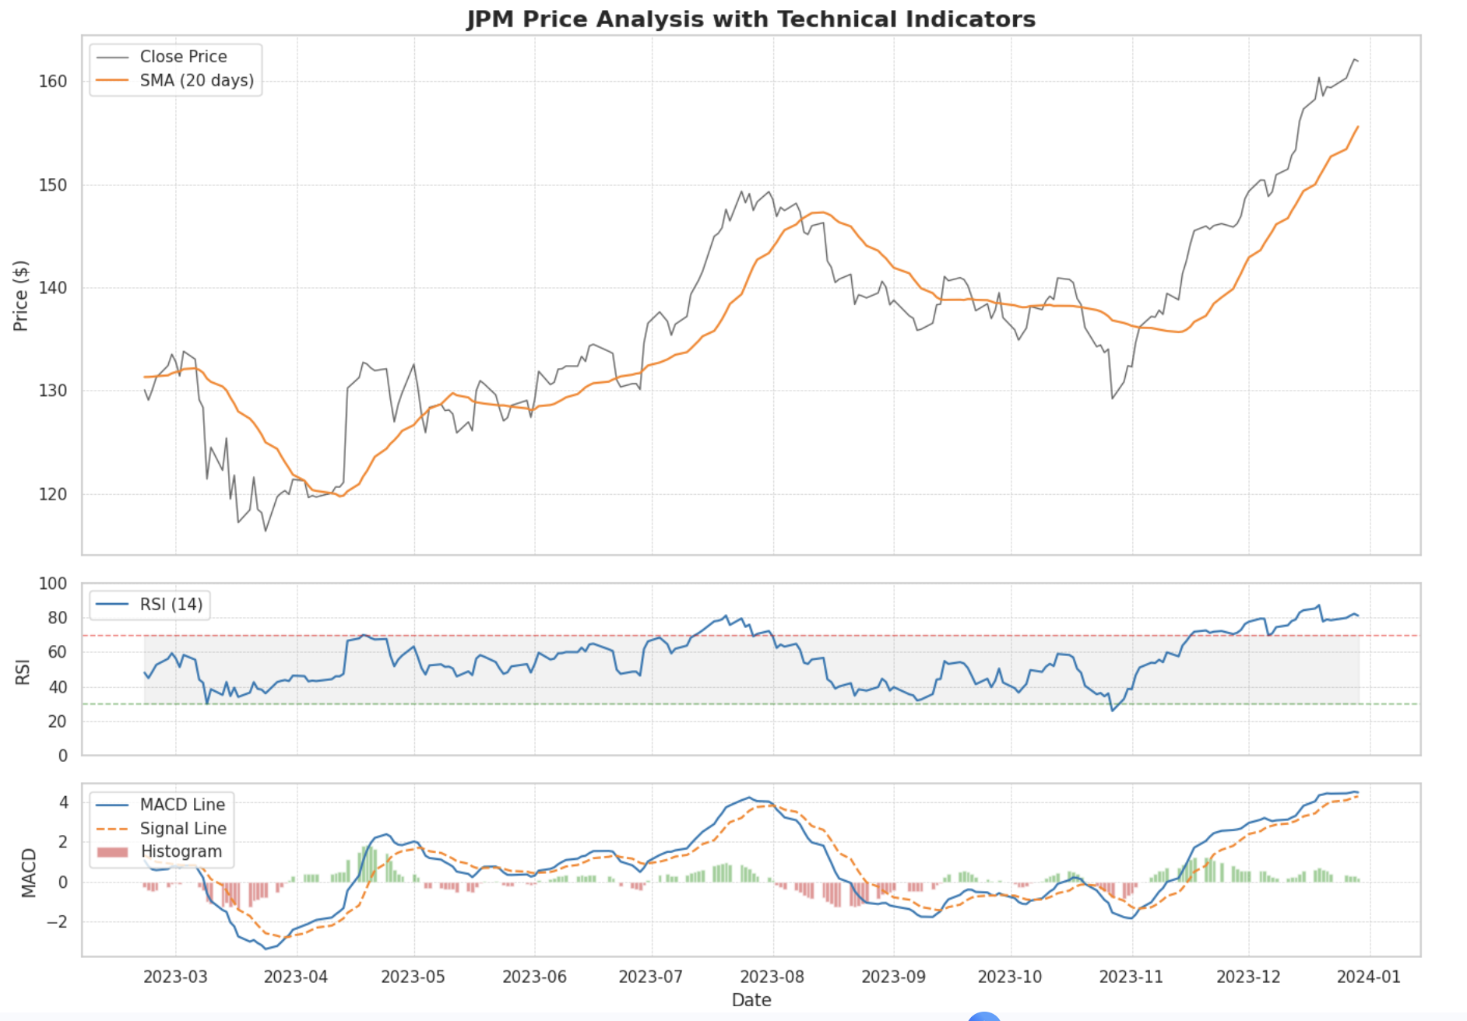
Technical Indicators Overview

Slide 7
Normalization
Sliding Window
Uses MinMaxScaler to scale data between 0 and 1. This is crucial for neural networks to converge faster.
It fits the scaler only on the training set (first 80%) to prevent "data leakage" (peeking into the future).
Input (X): A sequence of 60 days of features (Open, High, Low, Close, Volume, RSI, MACD, SMA).
Target (y): The Close price of the 61st day.

Slide 8
The models
Recurrent Models
Transformers

Slide 9
The Recurrent Baselines
RNN : The simplest form. It suffers from "short-term memory" issues where it forgets data from the beginning of long sequences.
LSTM : Adds a "forget gate" and a "cell state" to handle long-term dependencies, fixing the RNN's memory loss.
GRU : A simplified version of LSTM with fewer parameters, often faster to train but equally effective.

Slide 10
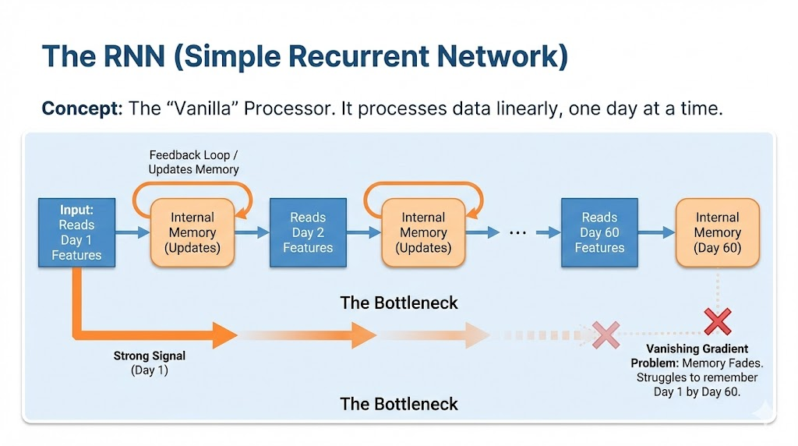
The RNN (Simple Recurrent Network)

Slide 11
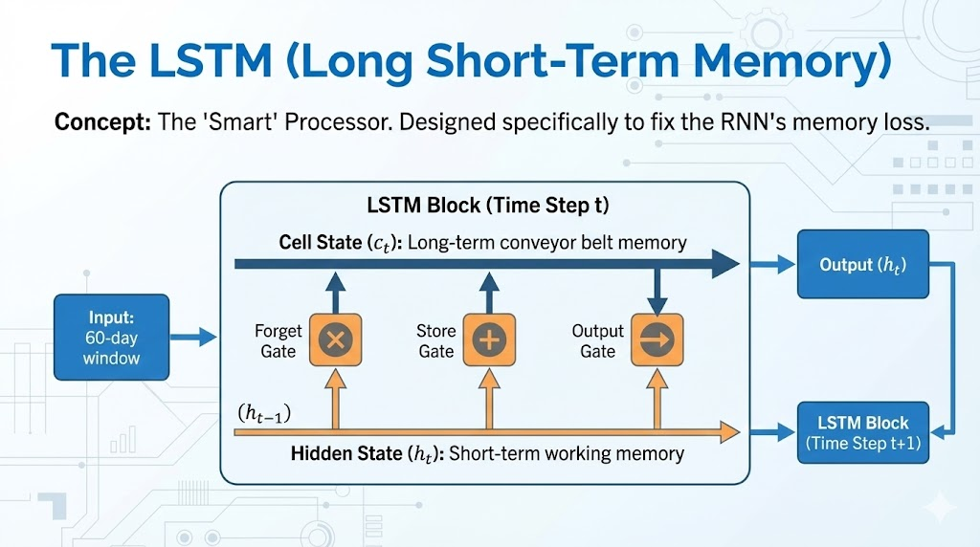
The LSTM (Long Short-Term Memory)

Slide 12
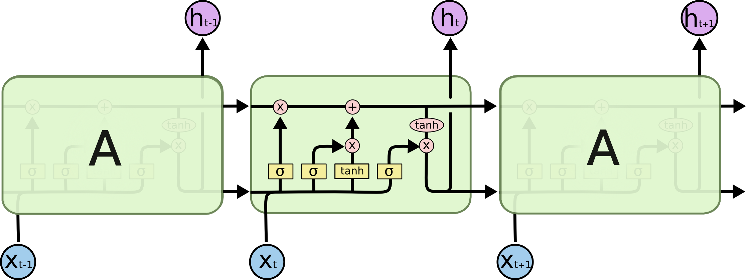
The LSTM (Long Short-Term Memory)

Slide 13
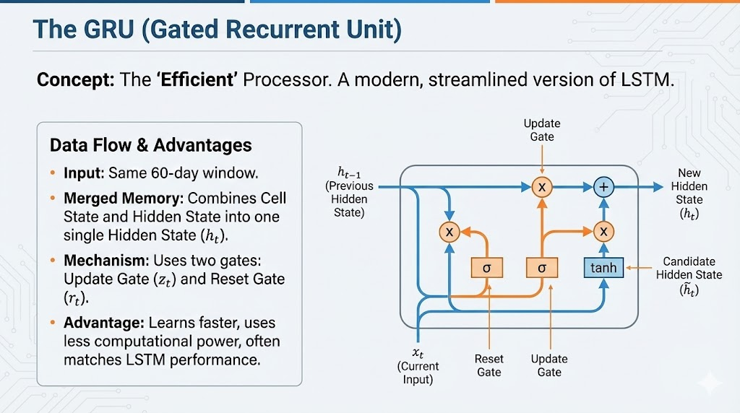
The GRU (Gated Recurrent Unit)

Slide 14
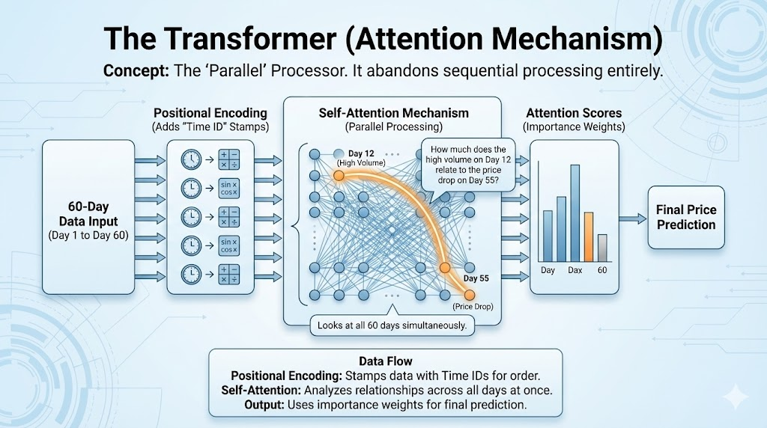
The Transformer

Slide 15
Order
[Input (60 days, 8 raw features)] ⬇
[Linear (Expands to 64 features)] ⬇
[Positional Encoding (Adds Time info)] ⬇
[Transformer Block (Self-Attention mixes history into Day 60)] ⬇
[Slice (Throw away Days 0-58, Keep Day 60)] ⬇
[Decoder (Linear map 64 features to 1 Price)] ⬇
[Output (Price Prediction)]

Slide 16
Feature Embedding
The Linear Layer mixes the 8 raw features to create 64 new, smarter features. It uses a mathematical weighted sum.
By expanding from 8 to 64:
Input: You give the model 8 raw facts.
Linear Layer: The model mathematically combines those facts to create 64 derived insights (abstract features).
Result: The Transformer now processes these 64 rich insights instead of just the 8 raw numbers, allowing it to "think" much deeper about the data.

Slide 17
Positional Encoding
Transformers process all 60 days simultaneously to be faster.
Without Positional Encoding, the model has no way of knowing that a "Price Crash" happened yesterday versus a month ago.
We need to attach a unique "Timestamp" to every single day's vector so the model can distinguish them.
For long sequences, the numbers get huge (e.g., Day 5000). Neural networks struggle with large, unbounded numbers (exploding gradients).
The "distance" between Day 1 and Day 2 changes depending on the total length. If you have 10 days, the step is 0.1. If you have 100 days, the step is 0.01. The model can't learn a consistent rule for "tomorrow."

Slide 18
Multihead attention
Split: The 64 features are split into 4 heads of 16 features each.
Q, K, V Generation: For each head, the data is multiplied by weights to create Query, Key, and Value matrices.
Attention Score (The Matrix):
The model calculates a [60, 60] grid for every example.
This grid represents relationships. Row 60, Column 30 tells us: "How much should Day 60 focus on Day 30?"
Weighted Sum:
If Day 60 has a high score for Day 30, it adds a large chunk of Day 30's Value vector to Day 60's current vector.
Concatenation: The 4 heads (16 features each) are glued back together to form 64 features.

Slide 19
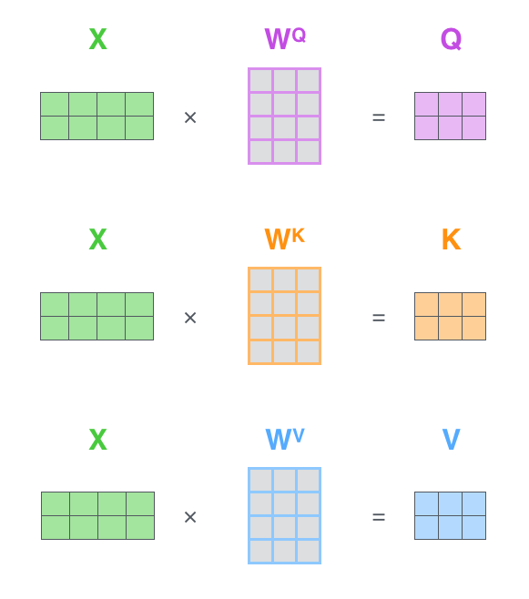
Q-K-V
Query (Q), Key (K), and Value (V) are three distinct representations of stock data created by the Transformer to understand relationships between days.
Even though they all come from the same input (your 60-day window of Inputs), the model mathematically transforms them to play three different "roles" in the attention mechanism.

Slide 20
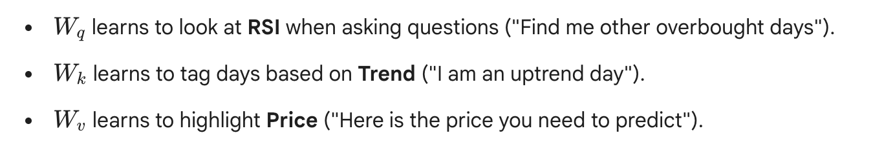
How They Learn (Backpropagation)
When initialized ➔ random garbage numbers

Slide 21
Training Loop
The script creates a dictionary models containing one instance of each architecture. It then iterates through them in a loop:
Forward Pass: The model predicts prices based on the input batch.
Loss Calculation: It compares the prediction to the real price using MSE (Mean Squared Error).
Backpropagation: It calculates gradients and updates the model weights to minimize the error.
Tracking: It records the loss history to compare later.

Slide 22
Results
Key Takeaway: There is no "one size fits all" model.
Transformers often win on complex patterns but require more data and are prone to overfitting.
GRUs are excellent for smaller datasets or less complex patterns because they have fewer gates (parameters) than LSTMs.
LSTMs generally perform well but lagged slightly behind GRU in this specific experiment.

Slide 23
Final Results
Ticker | Model | RMSE | MAE
JPM | Transformer | 1.977350 | 1.454659
JPM | RNN | 2.214401 | 1.695726
JPM | GRU | 2.444722 | 1.886917
JPM | LSTM | 2.896708 | 2.261623
KO | GRU | 0.528123 | 0.407034
KO | Transformer | 0.543257 | 0.421012
KO | LSTM | 0.580345 | 0.443668
KO | RNN | 0.603500 | 0.470974
NVDA | GRU | 3.689560 | 3.062855
NVDA | LSTM | 4.247264 | 3.489799
NVDA | Transformer | 4.382634 | 3.612529
NVDA | RNN | 4.805298 | 4.077263

Slide 24
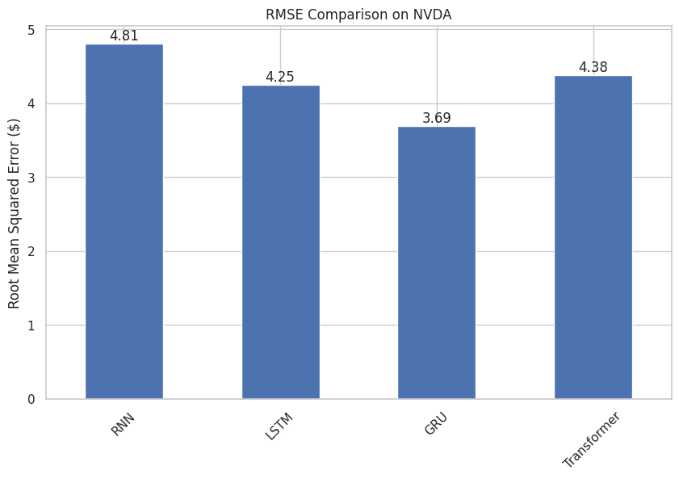
RMSE on NVDA

Slide 25
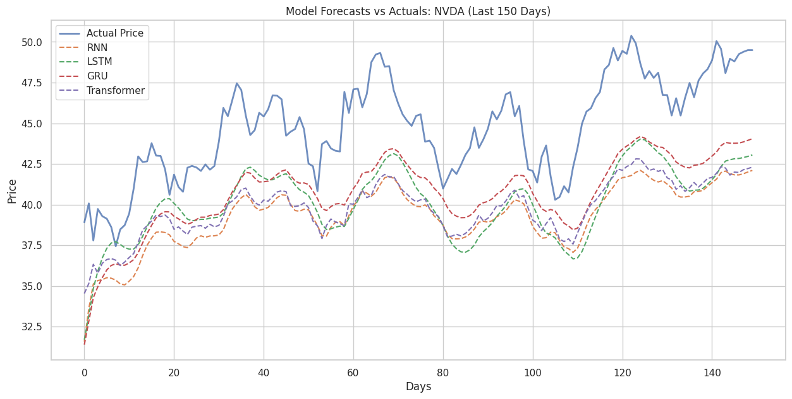
Model Forecasts vs Actuals on NVDA

Slide 26
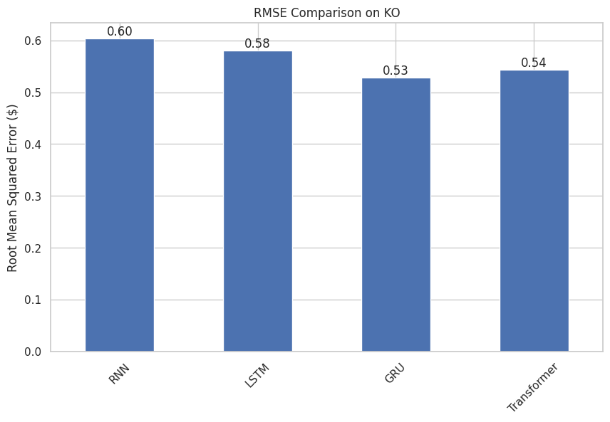
RMSE on KO

Slide 27
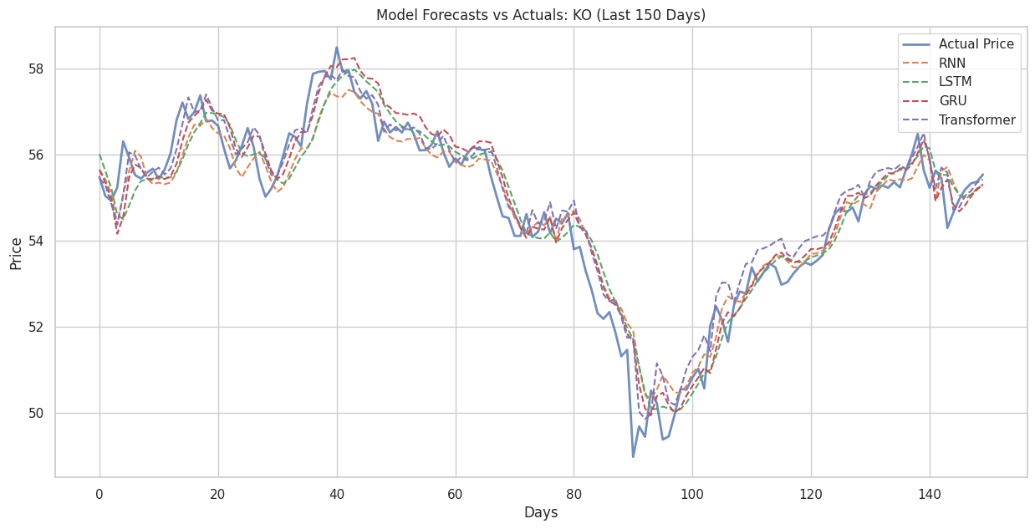
Model Forecasts vs Actuals on KO

Slide 28
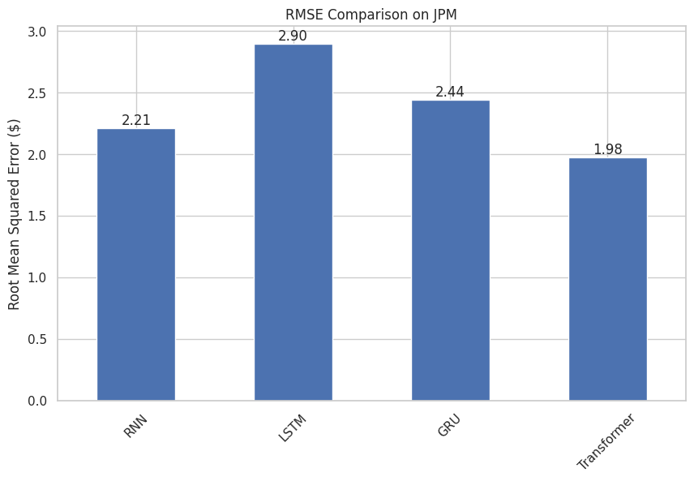
RMSE on JPM

Slide 29
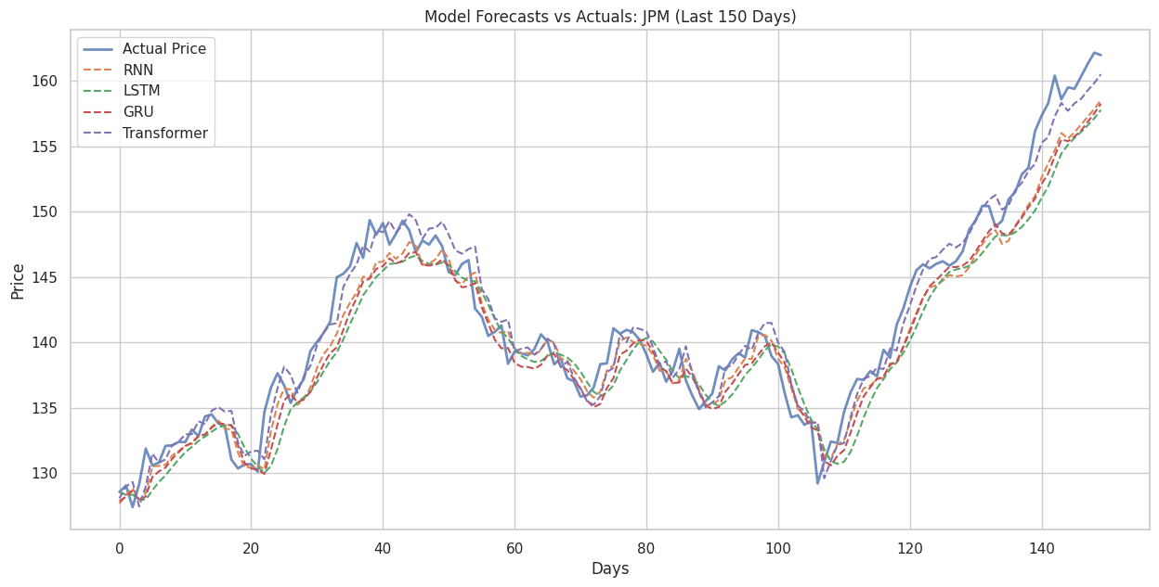
Model Forecasts vs Actuals on JPM

Slide 30

Q&A

