Slide 1
Secure data hiding in image using steganography
CAPSTONE PROJECT
Presented By:
Student Name : SHAIK ROSHANBI
College Name & Department :
LOYOLA INSTITUTE OF TECHNOLOGY AND MANAGEMENT
&
COMPUTER SCIENCE AND ENGINEERING

Slide 2
OUTLINE
Problem Statement
Technology used
Wow factor
End users
Result
Conclusion
Git-hub Link
Future scope

Slide 3

Problem Statement
To develop a robust and secure system that effectively hides sensitive data within seemingly normal images using steganography techniques, ensuring the confidentiality of the embedded information while maintaining minimal visual distortion in the carrier image, thereby preventing unauthorized access to the hidden data even if the image is intercepted.

Slide 4

Technology used
IDLE (python 3.12 32-bit):
IDLE (Integrated Development and Learning Environment) is Python's built-in IDE, providing a user-friendly interface for writing and executing Python code. It features a Python shell window with syntax highlighting and a multi-window text editor equipped with features like multiple undo, smart indent, and code completion. IDLE is cross-platform, functioning similarly on Windows, Unix, and macOS..

Slide 5
LIBRARIES USED IN PROJECT:
CV2:In Python, cv2 is a library that allows you to use OpenCV to solve computer vision problems. In Python, "cv2" stands for "OpenCV version 2", which refers to the OpenCV library used for computer vision tasks, with "cv" representing "Computer Vision" and the "2" indicating the current version of the library being accessed through Python bindings.
COMMAND:PIP INSTALL OPENCV-PYTHON
OS:The os module in Python is a built-in module that allows users to interact with the operating system. It provides functions for tasks like creating and deleting files and directories, managing files and directories, and more.
COMMAND: PIP INSTALL OS-SYS

Slide 6
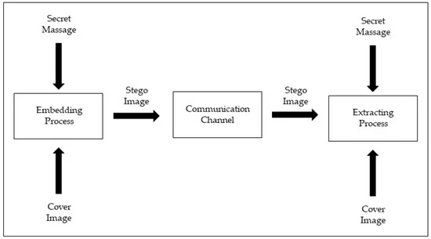
Wow factors
Stegno Image:A "stego image" is a digital image that contains hidden data embedded within its pixel values, essentially acting as a carrier for secret information without visibly altering the image itself; this practice is called "image steganography," where the image with the hidden data is referred to as the "stego image" while the original image used to embed the data is called the "cover image”.

Slide 7
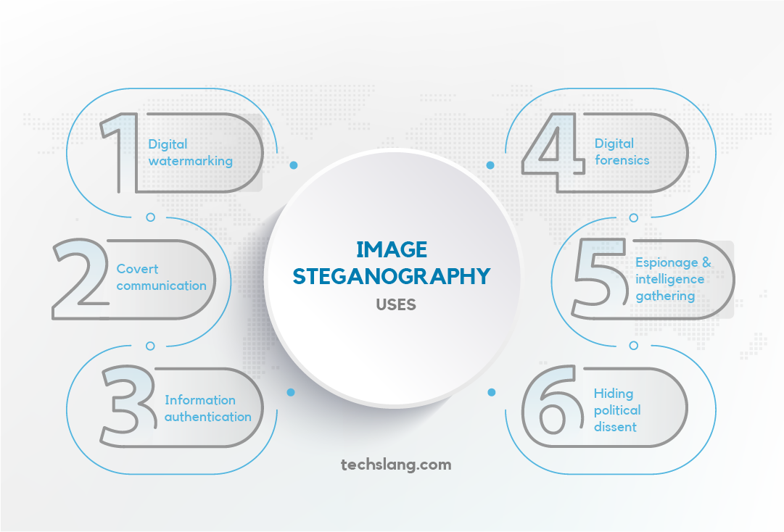
End users
Government and military
Cybersecurity Professionals
Law Enforcement
Researchers and Cryptographers
Journalists and Activists
Digital Forensics Experts
Companies and Enterprises
Privacy-Conscious Individuals
Corporate and Legal Entities
Hackers and Cybercriminals

Slide 8
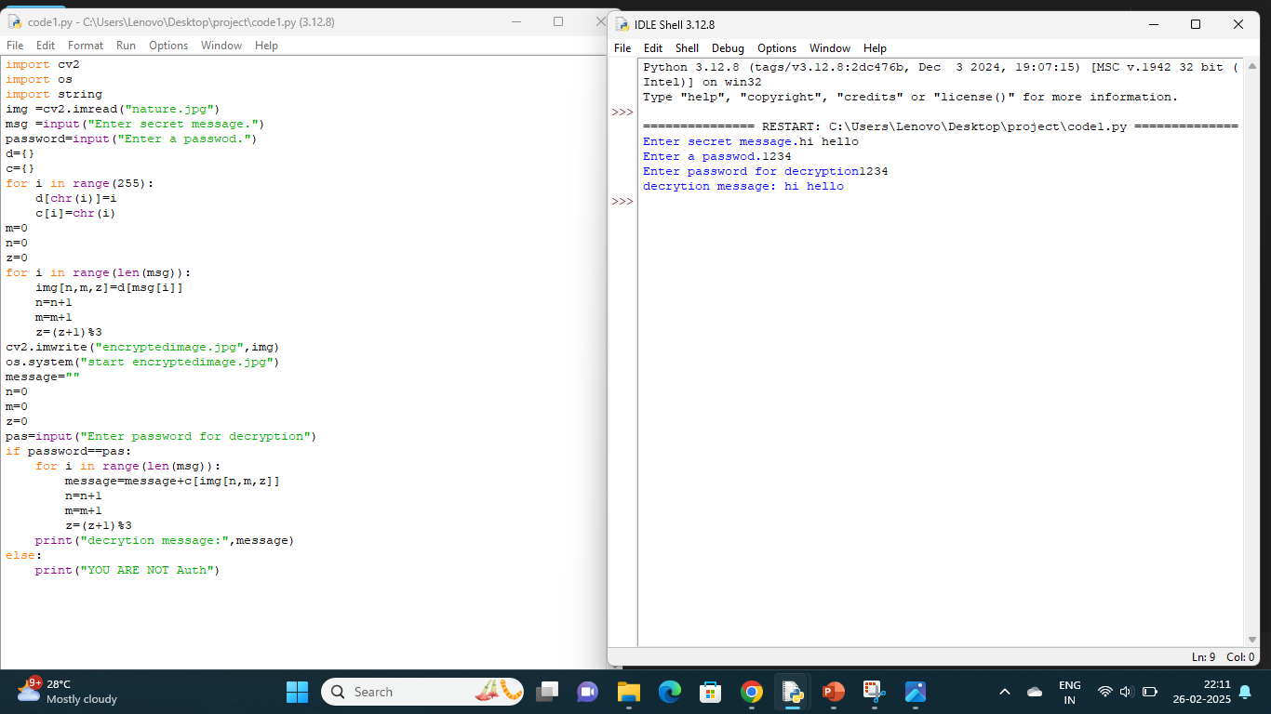

Results

Slide 9
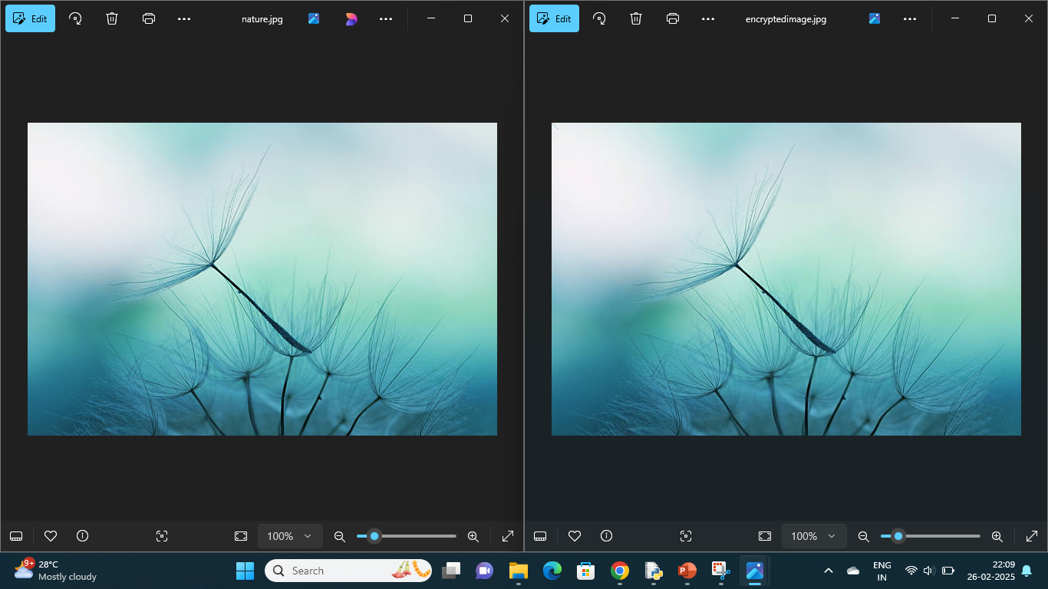
RESULT

Slide 10
Conclusion
Steganography is useful for hiding messages for transmission. One of the major discoveries of this investigation was that each steganographic implementation carries with it significant trade-off decisions, and it is up to the stegnographer to decide which implementation suits him/her best.
Image steganography is a powerful and evolving technique that plays a crucial role in secure communication and data protection. By embedding secret information within the pixels of an image, steganography provides a covert channel for transmitting sensitive data without arousing suspicion.
When properly implemented, steganography can be difficult to detect, but not impossible.
Steganography detection can be used to prevent communication of malicious data.

Slide 11
GitHub Link
https://github.com/Roshanbi1231/code.git

Slide 12
Future scope(optional)
Image steganography, the practice of concealing information within digital images, has a promising future in several areas. With the rise of advanced technologies, new applications, and increasing concerns over privacy and security, the future of image steganography looks expansive. Here are some key areas where it could evolve:
ADVANCE SECURITY AND PRIVACY : In the domain of security and privacy, image steganography can enhance the protection of sensitive information by integrating with blockchain technology.
ARTIFICIAL INTELLIGENT AND MACHINE LEARNING : With the rise of Generative Adversarial Networks (GANs), AI could be used to develop techniques that can dynamically create realistic-looking images with hidden data.
AUGMENTED AND VIRTUAL REALITY(AR/VR) : In AR and VR, steganography could be used to embed hidden data within the virtual world.

Slide 13
THANK YOU

