Slide 1
ApexPlanet Sales Data:
From Raw Data to Business Insights
A Data Analytics Internship Journey — Tasks 1 to 4
Roshani Jaiswal | ApexPlanet Software Pvt. Ltd.

Slide 2
Objective
To transform a raw, unstructured sales dataset into clean, actionable business intelligence — uncovering patterns, validating assumptions statistically, and recommending concrete next steps.
1,000
15
4
Sales transactions analyzed
Fields, including 3 engineered features
Sequential analysis phases
ApexPlanet Data Analytics Internship | 2

Slide 3
Where We Started: A Messy Dataset
• 20 missing Age values, 13 missing City values
• 8 Order_IDs mistakenly reused across 9 separate real transactions
• Inconsistent text formatting and date types
✓ Action taken
Cleaned, deduplicated, and standardized the full dataset — zero data quality issues remaining, ready for analysis.
ApexPlanet Data Analytics Internship | 3

Slide 4
How We Got Here: Methodology
1
2
3
4
Data Wrangling
Exploratory Analysis
Deep-Dive & Dashboard
Validation & Storytelling
Python + pandas — cleaning, deduplication, feature engineering
Descriptive stats, SQL queries, correlation & multivariate analysis
Customer segmentation + interactive Power BI dashboard
Hypothesis testing (T-test) + this final business narrative
ApexPlanet Data Analytics Internship | 4

Slide 5
Key Finding 1: Electronics Dominates by Volume
• 354 orders — more than double any other category
• Leads every single quarter of the year
• But does it also lead in order value...?
ApexPlanet Data Analytics Internship | 5

Slide 6
Key Finding 2: Category Doesn't Predict Order Value
Hypothesis Tested
“Electronics has a significantly higher average order value than Grocery”
ELECTRONICS AVG
GROCERY AVG
P-VALUE
₹1,43,442
₹1,45,305
0.868
Result: Fail to reject H0 — no statistically significant difference (p ≫ 0.05)
Business takeaway: Category choice should drive volume strategy, not value-based assumptions. Electronics and Grocery customers spend statistically the same amount per order.
ApexPlanet Data Analytics Internship | 6

Slide 7
Key Finding 3: Customer Value Beats Customer Volume
• High Value (316 customers): ₹92.4M revenue
• Medium Value (315 customers): ₹36.7M revenue
• Low Value (316 customers): ₹10.4M revenue
• High Value customers generate 9x more revenue than Low Value — despite placing only slightly more orders.
ApexPlanet Data Analytics Internship | 7

Slide 8
Key Finding 4: Where and When Revenue Concentrates
• Mumbai leads all cities in total revenue (₹18.7M)
• Revenue peaks in March and June
• Notable dip in August–September
ApexPlanet Data Analytics Internship | 8

Slide 9
What This Means for the Business
1
Protect High Value customers
2
Don't assume category drives value
A loyalty/account program here protects a disproportionate share of revenue.
Target Electronics for volume campaigns, not premium pricing assumptions.
3
Plan for the Aug–Sep dip
4
Prioritize top cities
Time promotions to smooth the seasonal revenue dip.
Focus regional marketing investment on Mumbai and other leading cities.
ApexPlanet Data Analytics Internship | 9

Slide 10
Call to Action: Next 30 Days
1
Launch a High-Value customer loyalty pilot targeting the top spending segment
2
A/B test a promotional campaign timed for the August–September revenue dip
3
Reallocate a portion of marketing budget toward Mumbai and top 3 performing cities
4
Track the 5 core KPIs (Revenue, AOV, Category Share, City Revenue, Age Group Orders) on the live Power BI dashboard monthly

Slide 11
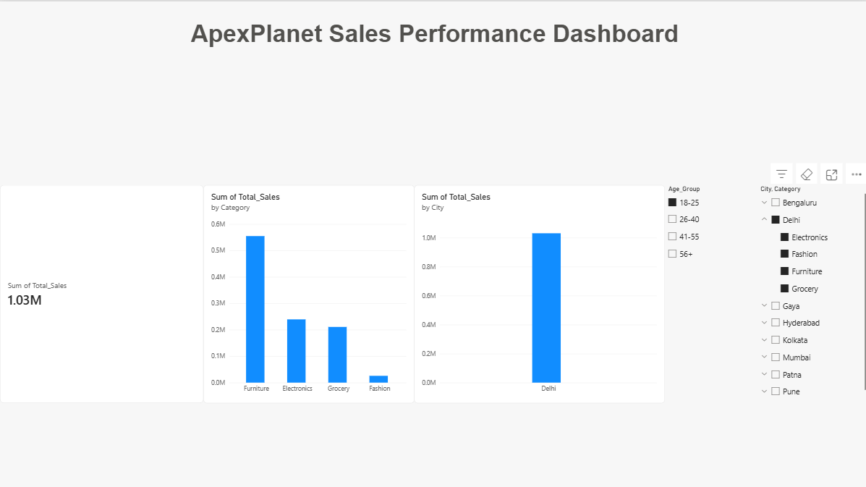
Bringing It to Life: Interactive Dashboard
An interactive Power BI dashboard tracks the core KPIs in real time, with live filters for Age Group and City so stakeholders can explore the data themselves.
Live dashboard link: https://app.powerbi.com/groups/me/reports/18286ada-9bda-44a0-ad66-0b683906c637/0f63c2e9f205bb1f7dce?experience=power-bi
ApexPlanet Data Analytics Internship | 11

Slide 12
Thank You
[Roshani Jaiswal] | [https://www.linkedin.com/in/roshani-jaiswal-553b01428] | [https://github.com/Roshani42]

