Slide 1
EC 871 Project Work
NBA File Locker System
Group Number:10
Project phase ॥- Final Review
Presented By:
Challa AbhinayaSree-2260609
Polamarasetty Vineela- 2260626
Roshani S- 2260636
Nandhakishore K- 2260668
Guided By:
Dr. Jesuwanth Sugesh R G

Slide 2
Topic
NBA File Locker System

Slide 3
Abstract
The NBA File Locker System is a smart security solution designed for the safe storage and monitoring of important documents. The system uses RFID technology to authenticate users and control locker access, ensuring that only authorized individuals can operate it. A Node MCU microcontroller works together with an Arduino Nano to manage system operations and process inputs from dual RFID readers, where one reader verifies users and the other detects the presence of files inside the locker. A servo motor is used to automatically lock and unlock the locker based on authentication results, while green and red LEDs provide visual feedback indicating access approval or denial. The system also includes a web dashboard that displays locker status, file presence, and access records in real time, enabling effective monitoring. Overall, the project provides a low-cost, secure, and efficient solution for document management by integrating essential hardware and software components.
3

Slide 4
Objectives
`
To design a smart locker system for secure storage of certificates and important documents.
To develop the locker system using Node MCU ESP8266, Arduino Nano, and RFID technology for user authentication and file detection.
To implement an automatic locking mechanism using a servo motor controlled through RFID-based authorization.
To create a web dashboard for monitoring locker status, file presence, and user access records.
To test and validate the system performance in a real-time environment to ensure reliability and security.
4

Slide 5
LITERATURE REVIEW
SI. No | Authors | Title | Journal / Conference | Year | Technique | Gap/ Scope for improvement
1. | C.Bharatiraja, P.K.Chittoor, Y.V.Bhargava | An IoT based centralized smart locker using RFID technology | AIP Conference Proceedings | 2023 | RFID-based authentication combined with centralized IoT control for locker access | Cloud dashboard, real-time monitoring, and scalable cloud storage are not addressed
5

Slide 6
SI. No | Authors | Title | Journal / Conference | Year | Technique | Gap/ Scope for improvement
2. | K. R. Umadi, A. Aishwarya, J.E. Narendramath, I. S. M. Inchara | Smart E-Locker System using IoT | International Conference on Intelligent Data Communication & IoT (IDCIoT) | 2023 | IoT-based automation with remote access control and sensor-based locker operation | Limited integration with cloud platforms and lack of detailed event logging
6

Slide 7
SI. No | Authors | Title | Journal / Conference | Year | Technique | Gap/ Scope for improvement
2. | R. Sinha, P. Iyer | Secure cloud-based smart locker using Azure IoT Hub | International Journal of Engineering Research & Technology | 2023 | Cloud-based security using Azure IoT Hub for device communication and data logging | Hardware-level implementation and real-time hardware validation are not detailed
7

Slide 8
SI. No | Authors | Title | Journal / Conference | Year | Technique | Gap/ Scope for improvement
4. | M. Fazero, A. Rahman, R. Fauzi | A library locker security system with integrated RFID, dual camera monitoring, and Telegram notification | Journal Sistem Cerdas | 2024 | RFID-based access control integrated with monitoring systems and alert notifications | System complexity is high and scalability for large campus deployment is limited
8

Slide 9
SI. No | Authors | Title | Journal / Conference | Year | Technique | Gap/ Scope for improvement
5. | Nair, B. S. Ramesh | ESP32-CAM smart locker with cloud logging | Sensors & IoT Conference | 2024 | ESP32-based communication with cloud logging and remote monitoring of locker events | Advanced access control methods and user-friendly dashboard features are limited
9

Slide 10
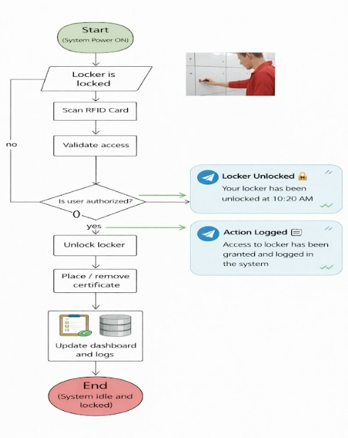
Block Diagram
The flowchart explains the step-by-step working of the RFID-based locker system. Only authorized users can open the locker to place or remove the certificate, after which the locker is securely locked again.
10

Slide 11
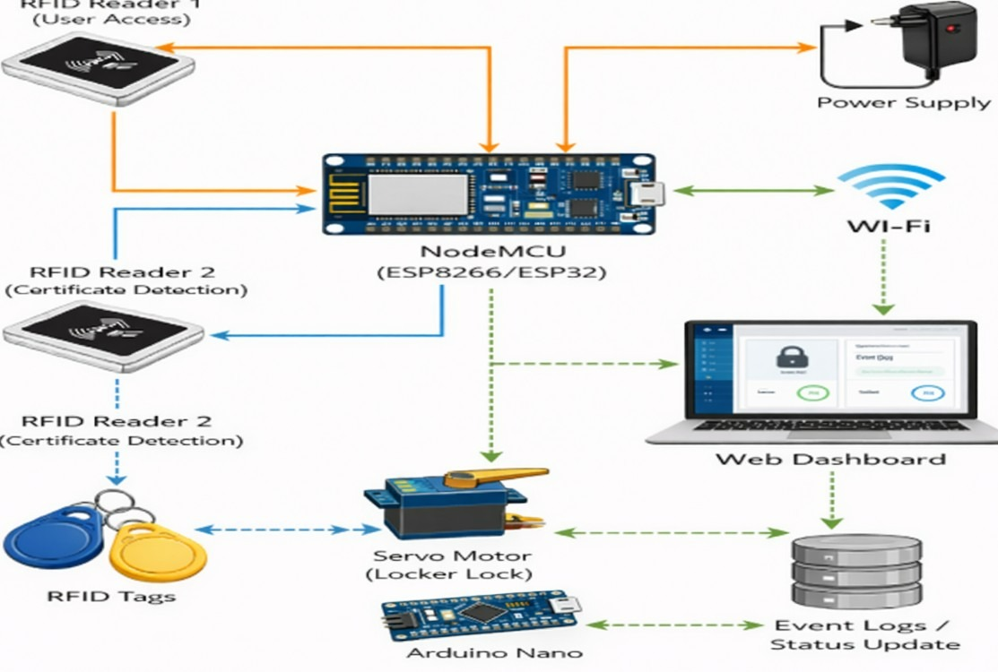
Figure 1.1:RFID-Based Access Control Hardware Architecture Using NodeMCU (ESP8266)
11

Slide 12
Hardware and Software to be used
Hardware components :
Node MCU ESP8266 – Main controller used for processing and Wi-Fi communication.
Arduino Nano – Supports sensor interfacing and control operations.
RFID Readers (2) – One reader authenticates users and the other detects file presence.
RFID Tags – Used as identification cards for authorized users and file tracking.
Servo Motor – Controls automatic locking and unlocking of the locker.
Green LED – Indicates authorized access.
Red LED – Indicates unauthorized access.
Power Supply – Provides electrical power to the system.
Connecting Wires – Used to connect all hardware components.
12

Slide 13
Software Components:
Arduino IDE – Used to write and upload program code.
Embedded C – Programming language used to control system logic.
Web Dashboard (HTML) – Displays Locker status and activity.
ESP8266 Web Server – Enables real-time monitoring through Wi-Fi.
Telegram Bot API – Sends notifications about locker access and file activity.
13

Slide 14
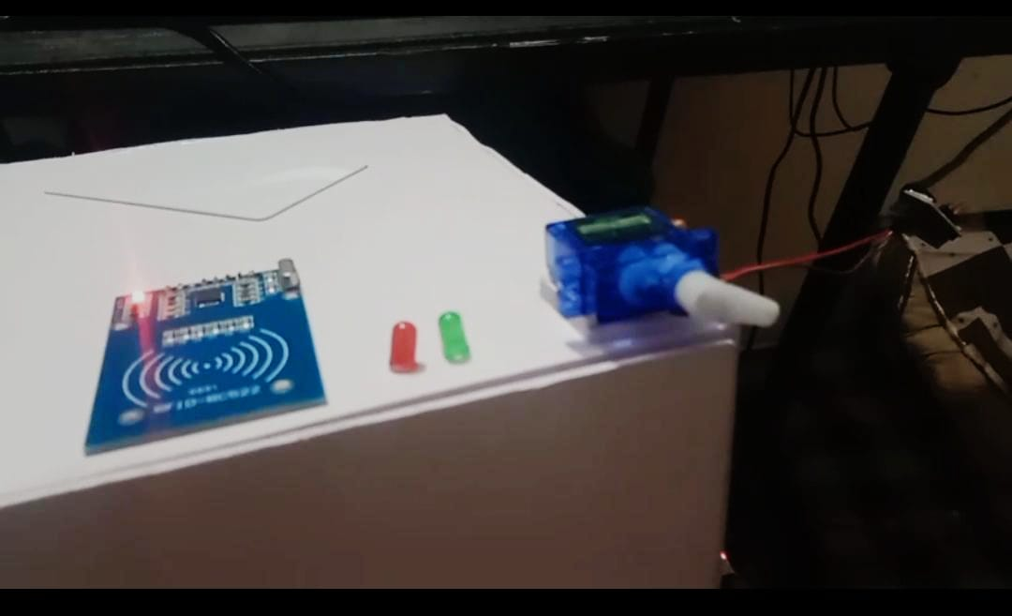
`
Fig 1.2 RFID Reader and Servo Motor Hardware Setup
14

Slide 15
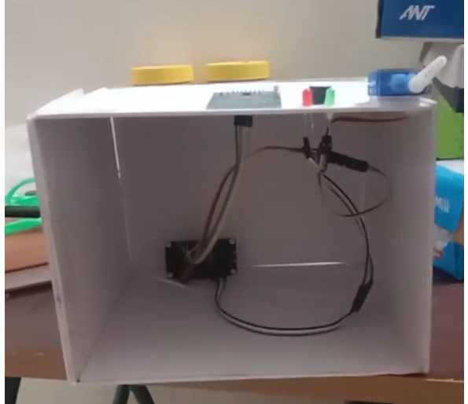
Fig 1.3 Internal Hardware Arrangement of File Locker System
15

Slide 16
https://drive.google.com/file/d/1DSJNradp6lKSVmRidummjNSDSU00mG3J/view?usp=drivesdk
Fig 1.4 Hardware–Software Implementation Demo of NBA Locker System
16

Slide 17
Analysis
The system was evaluated for security, performance, and reliability.
RFID authentication correctly allows authorized users and blocks unauthorized access.
Dual RFID readers successfully detect both user entry and file presence.
The Node MCU controller manages all components smoothly.
The servo motor locks and unlocks the locker automatically.
The dashboard updates locker status and access data in real time.
Testing confirmed stable and consistent system operation.
17

Slide 18
Results
The system successfully demonstrated secure locker access using RFID.
Authorized users accessed the locker while unauthorized users were denied.
File placement and removal were detected accurately.
Automatic locking worked correctly after each operation.
The dashboard displayed correct status and logs.
The system performed reliably during repeated testing.
18

Slide 19
References
C. Bharatiraja, P. K. Chittoor, and Y. V. Bhargava, “An IoT based centralized smart locker using RFID technology,” AIP Conference Proceedings, vol. 2427, p. 020098, Feb. 2023. DOI: 10.1063/5.0101139
K. R. Umadi, A. Aishwarya, J. E. Narendramath, and I. S. M. Inchara, “Smart E‑Locker System using IoT,” 2023 Int. Conf. on Intelligent Data Communication & IoT (IDCIoT), DOI: 10.1109/IDCIoT56793.2023.10053507
M. Fazero, A. Rahman, and R. Fauzi, “A library locker security system with integrated RFID, dual camera monitoring, and Telegram notification,” J. Sistem Cerdas, vol. 7, pp. 75–86, Apr. 2024. DOI: 10.37396/jsc.v7i1.390
V. Krishna, A. S. Mehta, and D. Joshi, “Gesture‑based sign interpretation system using hand glove,” Int. Res. J. Eng. Technol., vol. 10, no. 4, pp. 98–104, 2025.DOI: 10.37396/jsc.v7i1.390
A. Nair and S. Ramesh, “ESP32‑CAM smart locker with cloud logging,” Sensors & IoT Conf. (2024), pp. 66–72. DOI: 10.37396/jsc.v7i1.390
S. Chandrappa, P. K. Bhargava, and P. A. H., “Smart Locker 2.0: Leveraging IoT and ML for secure, user‑friendly public storage,” 2025 Int. Conf. on AI & Data Engineering (AIDE2025), DOI: 10.1109/AIDE64228.2025.10987522
19

Slide 20
THANK YOU

